Slide 1
Leadership Vision for 2022 Application Leaders August 2021
Notes:
Enterprise operations applications — spanning ERP, finance, and procurement and sourcing applications — are essential to the business functions of most corporations. As such, application leaders supporting enterprise operations favor stable applications over innovation.
However, the recent global economic disruption has caused businesses to seek opportunities to invest in new systems that will support agile business operations, particularly for business planning, cost management and digital business models.
Most organizations today are limited in their ability to adapt. This is primarily due to the state of their application portfolio, which is often bloated, difficult to change and aligned to the strategy of the past. To deliver on the future strategy of the organization, application leaders need to modernize the application portfolio. The application portfolio must operate at the pace of business change.
In response, Gartner has witnessed the evolution of composable applications for these essential commercial and operational processes.

Slide 2
Application Leaders and Software Engineering Leaders Deliver Composable Applications
Technology Innovation
Business Innovation
Intelligent Composable Applications
Application Leader
Custom Applications
Packaged Applications
Software Engineering Leader
Source: Gartner
Notes:
This model depicts the range of options for application delivery for two complementary roles:
Software engineering leaders (SWEL)
Application leaders.
Application and software engineering leaders have a range of options when supporting an organization’s digital transformation objectives.
Gartner views application delivery as a continuum. Processes can be automated with custom-built applications, or they can be automated with custom application development.
Application leaders are responsible for identifying, deploying and managing applications —provided by software vendors — that automate business processes. Gartner uses the term commercial applications to describe these applications — particularly those packaged into application suites. For example, Workday is a well-known suite for HR processes, SAP is well-known for enterprise operations, and Zendesk is well-known for customer service processes.
Within these suites, the most modern commercial applications are built for modularity, where discrete bundled functions for process automation can be used as a self-contained capability. Gartner uses the term packaged business capabilities (PBCs) when talking about this componentization. Each PBC is a self-contained system that automates discrete processes or functions.
Custom applications are typically the domain of software engineering leaders. Custom applications can be commercial, revenue-generating systems (such as a consumer website), but in the context of an application leader, custom applications also automate internal processes. Some can be enterprisewide systems, built to deliver functions not easily obtained from PBC vendors, and others can be discrete systems that are used for minor processes or just within a given department.

Slide 3

Application Leaders Use Composable Applications to Modernize Employee Experience, Customer Experience and Enterprise Operations
Domain of Composable Applications
Triggering Events
Improve Employee Experience Maximize Customer Experience Optimize Enterprise Operations
Custom applications
svc
svc
svc
svc
svc
Internal data and metadata
svc
svc
Enterprise Operations
svc
svc
Employee Experience
Internal data and metadata
svc
svc
Internal data and metadata
svc
svc
svc
Internal data and metadata
svc
svc
svc
Internal data and metadata
Customer Experience
Source: Gartner
Notes:
Applications are not purchased and implemented in a vacuum. They exist to automate the processes that drive business outcomes.
Gartner believes that composable applications — composed of PBCs with open-APIs, containerized architectures, and custom applications, and built using modern assembly languages — are the “what’s next” trend in application delivery. Rather than implementing monolithic technology stacks that automate a full range of all possible interrelated functions (for example, ERP systems), organizations will take a modular approach — using discrete components that can be assembled, reassembled and extended.
PBCs fit into three big categories:
Employee experience: Digital workplace applications and human capital management (HCM) suites
Customer experience: CRM sales, CRM digital commerce, CRM customer service, CRM voice of customer (VoC), CRM marketing, CRM field service solutions and digital experience platforms (DXPs)
Enterprise operations: ERP, finance, and strategic sourcing and procurement applications
PBCs are foundational as well as tactical, but the application leader must also rely on custom-developed applications to meet the business objectives. Application leaders may own the development, deployment and maintenance of these apps, or they may be managed by their colleagues in software engineering.
Gartner’s research for application leaders helps them to understand which PBCs are important, and a good fit for their needs, and to identify how to deploy custom applications to fill out the technology stack. To deliver on digital transformation, your organization needs applications that can be assembled, reassembled and extended. This will allow you to innovate and adapt to the changing needs of your business. You need to begin to enable the composable enterprise, and you need to start now.
Your organization must not be content to just keep pace — it must set the pace.
Evidence and Related Research
For more information on the concepts of composable applications, see Future of Applications: Delivering the Composable Enterprise — G00465932

Slide 4
Key Issues for Application Leaders
How do application leaders responsible for employee experience improve employee experience with composable applications for digital workplace and HCM?
How are customer experience programs changing with modern CRM and CX applications and how should application leaders responsible for CRM and customer experience respond?
How do application leaders responsible for enterprise operations modernize and optimize enterprise operations applications?
Notes:
Applications for employee experience include human capital management (HCM) and digital workplace suites

Slide 5
Employee Experience Is Now a Business Imperative
83%
of employees want to work in a remote or hybrid arrangement
40%
of workers are “at risk” of quitting if companies force a full return to the office
17%
of employees prefer to go back on-site full time
Source: Gartner
Notes:
The pandemic demonstrated that many of our work assumptions are archaic, unnecessarily limiting and now begging for reinvention.
When we work: The linear workday was established before the invention of electricity, to maximize hours of natural daylight. The common nine-to-five work schedule was formalized in the 1920s for manufacturers. We now have electricity, and many of us prefer to work outside the hours of natural daylight, so why does this workday schedule persist?
Where we work: Traditionally, the office, factory or hospital has also been viewed as the headquarters of work — even the term “remote working” suggests employees are away from the site where work gets done. The pandemic proved that many can get work done off-site, so why is daily physical colocation still the norm?
How we work: Many leaders believe that working together at the same time is key to innovation. This mindset arose in the 1950s, when the best way to get work done was to gather in a conference room. We now have all the asynchronous tools we need, so why do we maintain a culture of synchronous meetings?
Evidence and Related Research
The 2021 Gartner Hybrid Work Employee Survey included 4,264 employees from across the world, representing various industries and organizational sizes.
Future of Work Reinvented Resource Center Primer for 2021 — G00752889
Future of Work Reinvented: Seizing This Golden Opportunity Requires 3 Actions — G00752002

Slide 6
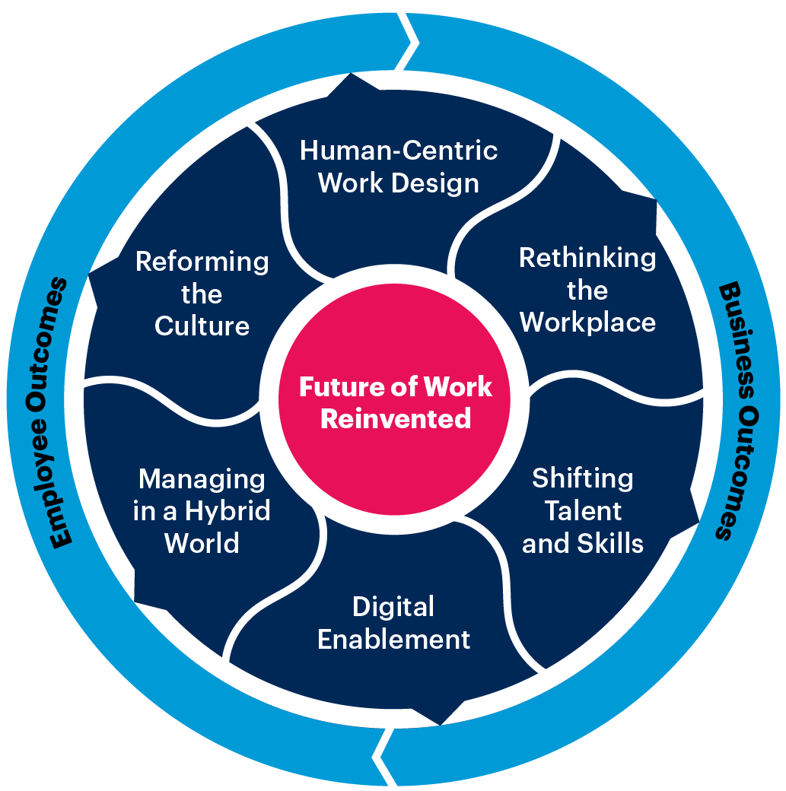
Composable Digital Workplace and HCM Applications Deliver Better Employee Experience
Future of Work Reinvented Resource Center
Composable Applications for Better Employee Experience
New Work Hub Applications Unified Communications Content Service Platforms Enterprise Video Content Management Resource Scheduling Apps Collaborative Work Management Workforce Management
Source: Gartner
Notes:
Gartner has a significant body of research about how work has changed and will change due to the postpandemic transformation.
To retain employees, organizations will have to embrace concepts associated with of employee experience.
Employee experience (EX) describes how employees internalize and interpret the interactions they have with and within their organization, and the contexts that influence those interactions.
The image on the left represents our latest transformational thinking about employee experience — a suite of research we term “Future of Work Reinvented.”
The tech that delivers it is outlined on the right.
Evidence and Related Research
Future of Work Reinvented Resource Center Primer for 2021 — G00752889

Slide 7
Key Issues for Application Leaders
How do application leaders responsible for employee experience improve employee experience with composable applications for digital workplace and HCM?
How are customer experience programs changing with modern CRM and CX applications and how should application leaders responsible for CRM and customer experience respond?
How do application leaders responsible for enterprise operations modernize and optimize enterprise operations applications?
Notes:
CRM applications include digital commerce, sales, marketing, and customer service functions.
Evidence and Related Research
For an overview, see CRM Application Functionality Taxonomy Propeller — G00740615

Slide 8
CRM and CX Investments Are Business-Critical, but Few Have Optimized Both
68%
estimated percentage of CX programs making use of information technology
<5%
estimated percentage of CX programs that have fully optimized processes and tech
190
number of discrete CRM and CX technologies that Gartner tracks
Source: Gartner
Notes:
CRM applications — comprising digital commerce, marketing, customer service, and sales systems — are a very mature category of technology. It is common for organizations to have over 100 CRM systems — many purchased from vendors and many custom-built. This makes for a complex, unwieldy technology stack. The problem is compounded by the need to deliver improved customer satisfaction, loyalty and advocacy.
Customer experience (CX) programs employ CRM technology to deliver better customer experience, but few companies have realized the payoff from their investments. Gartner estimates that less than 5% of organizations have fully embedded mature processes and technology in their customer experience programs. There are two important takeaways:
The percentage of customer experience (CX) projects making use of information technology on average has increased from 58% in 2019 to an estimated 68% in 2021.
There are over 190 sub-categories of CRM and CX application, which means that legacy technology investments collide with modern technologies.
Evidence and Related Research
Gartner’s 2020 Customer Experience Innovation Survey was conducted online from 17 January through 24 February 2020. There were 238 respondents from seven countries in North America, Western Europe and Asia/Pacific: the U.K. (24%), Australia (24%), the U.S. (22%), India (13%), Singapore (13%), Canada (3%) and New Zealand (0.5%).
For more information, see Survey Analysis: Customer Experience Maturity and Investment Priorities, 2020 — G00729974

Slide 9
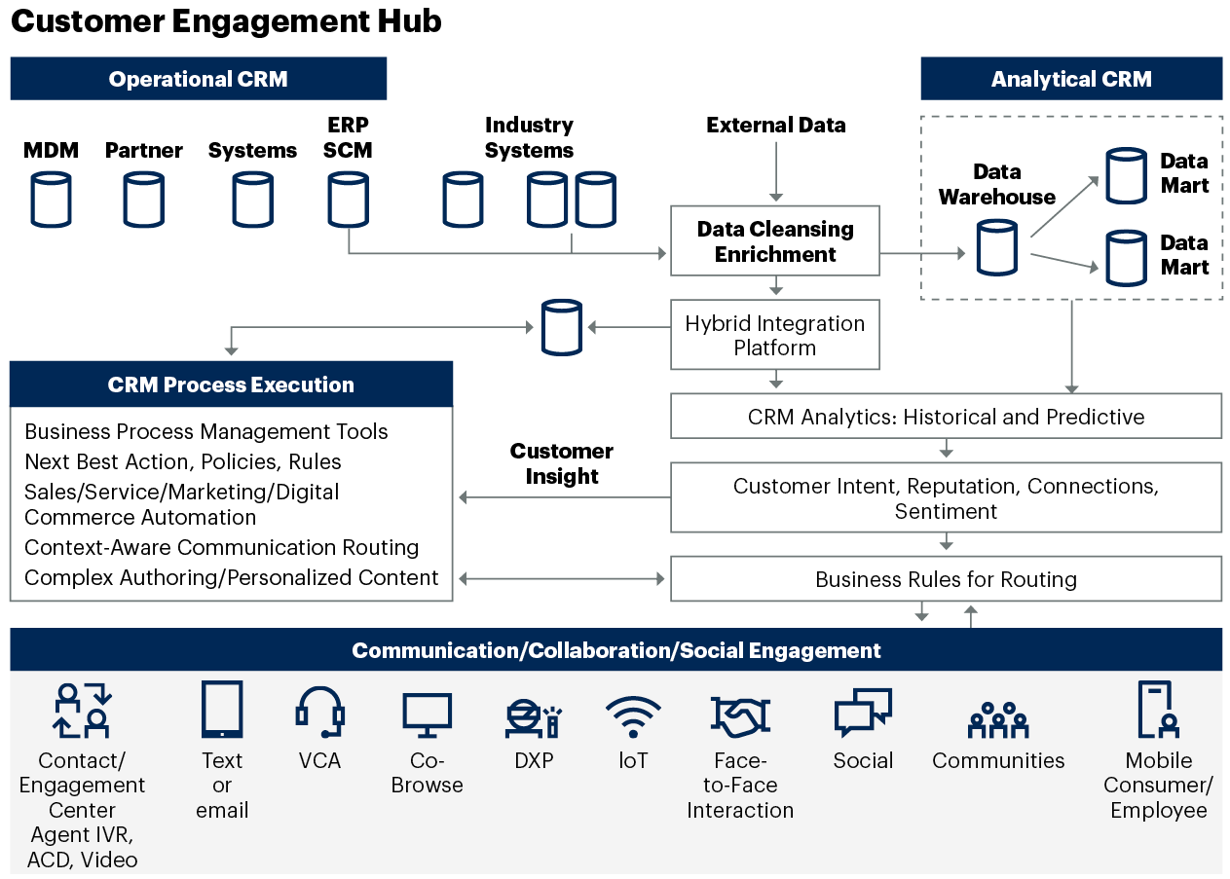
Composable Applications in the CRM Tech Stack
A customer engagement hub enables a personalized, contextualized customer engagement.
PBCs and API-based integrations at each CRM application and engagement layer are used to personalize customer journey experiences.
Source: Gartner
ACD = automatic call distribution; CRM = customer relationship management; DXP = digital experience platform; ERP = enterprise resource planning; loT = Internet of Things; IVR = interactive voice response; MDM = master data management; SCM = supply chain management; VCA = virtual customer assistant
Notes:
A customer engagement hub (CEH) has four component architectures or subsystems, rather than simply being a single system:
Operational CRM — This is composed of the supply chain, financial, logistics, e-commerce, master data management (MDM) and account management systems that contain information about customers and formal business conducted with them.
Analytical CRM — This is a series of subsystems, some of which analyze historical data about customers offline. These results are fed into a system that looks, in real time, for any clues that were not included in the back-end analysis. This result is then matched with a business rule. The business rule could be about marketing, selling or providing correct customer care. Basically, this architecture spans historical, descriptive, predictive and prescriptive analytics.
CRM process execution. This comprises systems that deliver the rules that determine the specific actions to be taken with customers. Currently, many systems still launch processes that cannot reconcile other application processes — such as those involved in campaign management, business process management and the making of online offers to customers. In future, however, enterprises will want to reconcile and integrate one or more of the following activities:
Selection of the next best action or policy, based on the findings of analytical systems.
Use of personalization engines to deliver the best responses and content to customers in context.
Selection of the correct knowledge artifacts.
Initiation of campaign activities.
Communication, collaboration or social engagement — This enables seamless escalation of customer conversations from mobile app to website to phone and over to social media. It remains unclear how the Internet of Things will impact communications and other functions.
One of the most significant changes in relation to applications will be a shift from large monolithic applications that lack APIs to the creation and use of PBCs. This will be driven by organizations’ desire to reduce the difficulty of adapting applications to meet changing business requirements. Of respondents to Gartner’s 2020 Future of Applications Survey, 58% found it either “somewhat difficult” or “difficult” to adapt applications’ business processes and experiences to respond to changes in business practices.
As a result of the use of composable applications and the creation of PBCs by technology suppliers and developers, organizations will increasingly create and use PBCs to enable application leaders to deliver more integrated, personalized and effortless customer experiences.
Evidence and Related Research
Gartner’s 2020 Future of Applications Survey was conducted online from 26 May to 9 June 2020 with 101 members of Gartner’s Research Circle — a Gartner-managed panel. Respondents were leaders within their organizations. This information is provided to enable deeper understanding of views about integration when choosing a SaaS provider and to help understand organizations’ views about adapting applications.
3 Direct Impacts of Composable Applications on the Customer Engagement Hub — G00720501

Slide 10
Key Issues for Application Leaders
How do application leaders responsible for employee experience improve employee experience with composable applications for digital workplace and HCM?
How are customer experience programs changing with modern CRM and CX applications and how should application leaders responsible for CRM and customer experience respond?
How do application leaders responsible for enterprise operations modernize and optimize enterprise operations applications?
Notes:
Enterprise operations includes systems for ERP, finance and procurement.

Slide 11





Enterprise Operations Are in a New Era
First Era:
Hardware-Centric
Second Era:
OS-Centric
Third Era:
DBMS-Centric
Fourth Era:
Application-Centric
Emerging Era:
Composable Ecosystems
“We are an X mainframe shop”
“We are an X desktop shop”
“We are an X DBMS shop”
“We are an X ERP or finance shop”
“We use the XXX ecosystem”
By 2025, more than 70% of large enterprises will move from a single-vendor monolithic ERP strategy to a more inclusive composable strategy
Source: Gartner
DBMS = database management system; OS = operating system
Notes:
Composable ERP is an adaptive technology strategy that enables foundational, administrative and operational digital capabilities through which an enterprise can keep up with the fast pace of business change.
To enable such speed and resilience, global enterprises need to support business environments that are becoming more complex and heterogeneous. These enterprises need to leverage disruption to create opportunities to build more efficient and outcome-driven enterprises.
Evidence and Related Research
Predicts 2021: Time to Compose an ERP Strategy to Outpace Disruption — G00735892

Slide 12
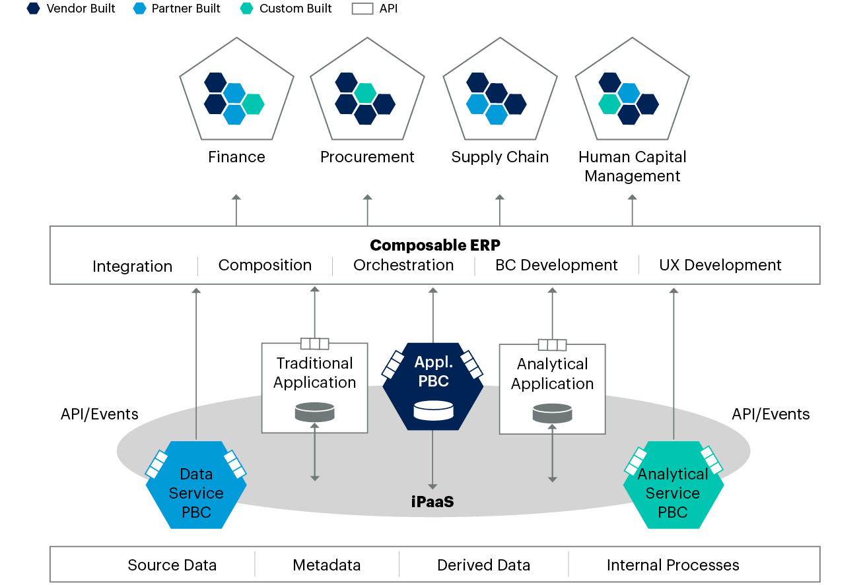
Modern Enterprise Operations Applications Are Composable, Not Monolithic
Source: Gartner
Notes:
For application leaders delivering enterprise operations, composable services and modern application architectures bring a tremendous opportunity to deliver value in a way that a heavily customized monolithic suite cannot. The organization is free to deploy any combination of suites, point solutions and services to meet its unique needs.
The purpose of this future is to compose applications that fulfill the specific capability requirements of the business. Some capabilities can be accomplished by a suite of applications provided by a single vendor. Other complex capabilities require integrated sets of applications to best provide value to the business. The ERP application leader becomes the maestro that weaves the data and applications together to fulfill the needs of the business. As the business changes and new models are required, the applications are recomposed to deliver the new capabilities.
The monolithic approach to ERP applications allowed vendors to dictate integration and data strategies because they owned the data model. ERP support teams did not keep up with the proprietary technology platforms, and often resorted to a flat file in tandem with FTP integration strategy, because that’s how it always worked. The underlying challenges is that “when all you have is a hammer, all issues look like a nail.”
The strategic decomposition of ERP brings the opportunity to build flexible integrations. Sophisticated business capabilities that rely on multiple data sources can be integrated to validate against up-to-date master data, with applications integrated for frictionless handoffs and cohesive use experiences (UXs). Application leaders should:
Reduce reliance on customizations by architecting the application portfolio to seamlessly span a variety of applications, suites and clouds.
Enable a flexible and vendor-agnostic composable ERP strategy by supporting the creation of a hybrid integration strategy that accommodates evolving and diverse technology needs.
Position your composable ERP strategy for growth by investing in a reliable data management strategy that focuses on business needs rather than “single-vision-of-the-truth” ERP architectures.

Slide 13
Recommended Actions for Digital Workplace and HCM
Retain employees by delivering modern PBCs that support a hybrid workforce.
Revise video teleconferencing, content development, and collaboration strategies to anticipate the virtual components that will be present in all meetings in future — due to the presence of the hybrid worker.
Improve employee experience with composable applications that support task-oriented work, enable new skills development, and plug into worker journeys.
Prioritize composable HCM capabilities because of their relevance to Future of Work Reinvented initiatives.

Slide 14
Recommended Actions for CRM and Customer Experience
Use PBCs to enable the composition of integrated, personalized and effortless customer experiences.
Use a product-based delivery model and PBCs to quickly compose — and recompose — integrated, personalized and effortless customer experiences.
Evaluate how easily a vendor’s applications can be composed with other applications within a customer engagement hub (CEH) architecture by checking for APIs and identifying whether the vendor uses a PBC architecture to build its applications.

Slide 15
Recommended Actions for Enterprise Operations
Reduce reliance on customizations and proprietary vendor technology by adopting a composable enterprise operations strategy that includes cloud- based, configuration-only business processes delivered via PBCs.
Continuously deliver incremental business value along the roadmap by demanding that enterprise operations vendors provide business capabilities, and then composing and recomposing as needed in a modular mode.
Enable a flexible and vendor-agnostic composable enterprise operations strategy by supporting the creation of a hybrid integration architecture to accommodate evolving and diverse technology needs.

Slide 16

Recommended Gartner Research
Future of Work Reinvented Resource Center Primer for 2021 Future of Work Reinvented Resource Center (G00752889)
Adopt a Composable DXP Strategy to Future-Proof Your Tech Stack Irina Guseva, Yefim Natis and Others (G00719666)
Revamp Your HCM Technology Strategy to Support Continuous HR for Composable Business Ron Hanscome, Sam Grinter (G00750153)
Quick Answer: 5 Things Digital Workplace Leaders Must Do to Support the Hybrid Workplace Lane Severson, Tori Paulman and Others (G00754018)
3 Direct Impacts of Composable Applications on the Customer Engagement Hub Gene Alvarez (G00720501)
Top Strategic Technology Trends for 2021: Total Experience Jason Wong, Michael Chiu and Others (G00740648)
Three Bold Strategies for Customer Experience Victory Ed Thompson (G00751993)
Composable Commerce Must Be Adopted for the Future of Applications Mike Lowndes and Sandy Shen (G00721518)
The Future of ERP Is Composable Tim Faith, Denis Torii, Paul Schenck (G0072361)
Two-Tier ERP: A Useful, Composable ERP Strategy for Complex Organizations Denis Torii, Dixie John (G00746463)
Shift to a Composable Architecture to Transform Your Financial Management Systems Robert Anderson, John Van Decker (G00739745)
For information, please contact your Gartner representative.

