Slide 1
Software Market View, 2020-2021
Varsha Mehta, Neha Gupta, Fabrizio Biscotti, Balaji Abbabatulla, Sharat Menon, James Richardson, Jessica Ekholm, Michael Warrilow, Cathy Tornbohm, Vanitha Dsilva, Craig Roth, John-David Lovelock, Naveen Mishra

Slide 2
The Gartner Software Market View, 2020-2021
Software providers can gain share and grow revenue by examining and taking action on their competitive position, market trends and relevant forecast assumptions.
This document provides examples of Gartner’s research on the future of the software marketplace. The content is presented in five sections:
Market Share and Forecast: Coverage, Taxonomy and Schedule
Forecast Analysis
Market Share Analysis
Competitive Landscape
Market Trends

Slide 3
Market Share and Forecast: Coverage, Taxonomy and Schedule

Slide 4








Software Market Coverage
Market Share (Published Annually)
Forecast (Published Quarterly)
2 Years of Data
7 Years of Data
2 Historical, 5 Forecast
2 Deliverables
19 Markets
82 Subsegments
EAS: 8 Markets, 21 Subsegments
EIS: 10 Markets, 51 Subsegments
394 Software Providers
1. Enterprise Application Software (EAS)
43 Country Markets
2. Enterprise Infrastructure Software (EIS)
43 Country Markets
U.S. Dollars, Constant and Local Currency
U.S. Dollars, Constant and Local Currency

Slide 5
Software Market Top-Level Taxonomy*
Software Markets
Enterprise Application Software
Enterprise Infrastructure Software
Analytics and Business Intelligence (ABI)
Application Development
Content Services
Application Infrastructure and Middleware (AIM)
Customer Experience and Relationship Management (CRM)
Data Management Software (excluding DBMS)
Enterprise Resource Planning (ERP)
Database Management Systems (DBMS)
Email and Authoring
IT Operations Management (ITOM)
Project and Portfolio Management (PPM)
Operating Systems
Supply Chain Management (SCM)
Security
Other Application Software
Storage Management
Virtualization Infrastructure Software
* For the full taxonomy, see Market Definitions and Methodology: Software
Other Infrastructure Software

Slide 6
List of Software Market Share and Forecast Publications From 3Q20 Through 2Q21
Frequency | Document Name
Annual | Market Share: All Software Markets, Worldwide
Annual | Market Share: Enterprise Application Software, Worldwide
Annual | Market Share: Enterprise Infrastructure Software, Worldwide
Annual | Market Share: Analytics and Business Intelligence, Worldwide
Annual | Market Share: Application Infrastructure and Middleware, Worldwide
Annual | Market Share: Application Development, Worldwide
Annual | Market Share: Content Services, Worldwide
Annual | Market Share: Customer Experience and Relationship Management, Worldwide
Annual | Market Share: Data Quality Software, Worldwide
Annual | Market Share: Data Integration Software, Worldwide
Annual | Market Share: Database Management Systems, Worldwide
Annual | Market Share: Enterprise Resource Planning, Worldwide
Annual | Market Share: IT Operations, Worldwide
Frequency | Document Name
Annual | Market Share: Integration Software Technologies, Worldwide
Annual | Market Share: Master Data Management Software, Worldwide
Annual | Market Share: Metadata Management Software, Worldwide
Annual | Market Share: Data Management Software (Excluding DBMS), Worldwide
Annual | Market Share: Operating Systems, Worldwide
Annual | Market Share: Security Software, Worldwide
Annual | Market Share: Supply Chain Management Software, Worldwide
Annual | Market Share: Storage Management Software, Worldwide
Annual | Market Share: Enterprise Application Software as a Service, Worldwide
Annual | Market Share: Enterprise Platform as a Service, Worldwide
Quarterly | Forecast: Enterprise Application Software, Worldwide
Quarterly | Forecast: Enterprise Infrastructure Software, Worldwide
Quarterly | Forecast: Information Security, Worldwide
Quarterly | Forecast: Public Cloud Services, Worldwide

Slide 7
Forecast Analysis

Slide 8
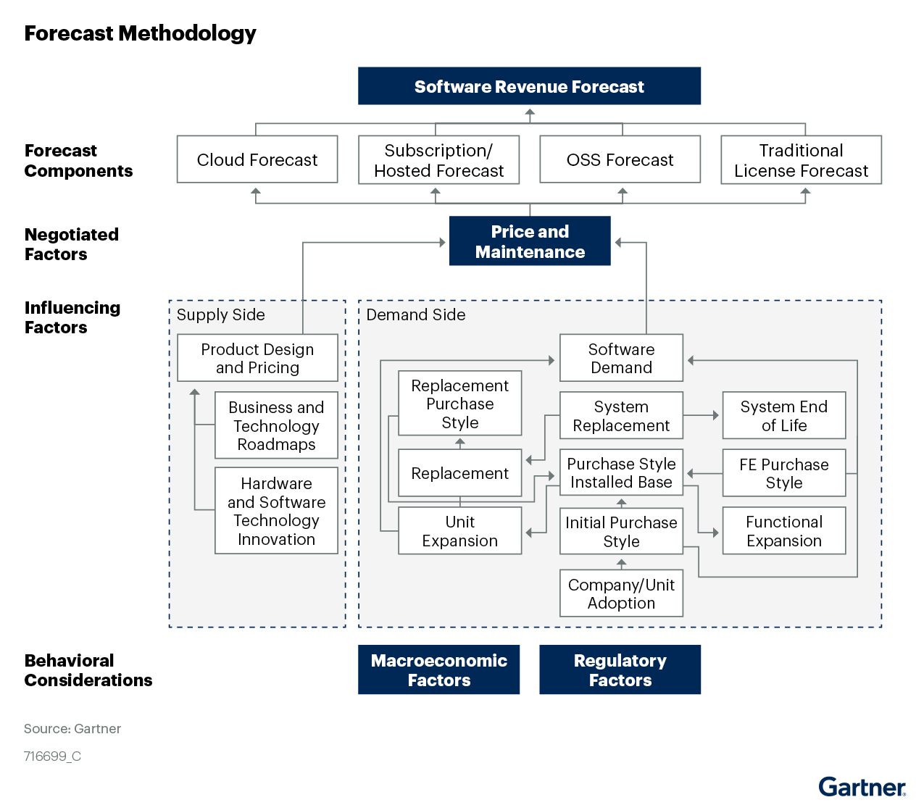
Software Market Model, Forecast Assumptions and Market Impact
Supply Chain Management Software
Forecast Assumptions
Investments in orchestrated, digital supply chain solutions will enable business leaders to deliver a consistent customer experience, despite unanticipated economic disruptions, through 2025.
Packaged SCM capabilities that support multienterprise supply chain networks will replace at least 10% of traditional SCM functional modules by 2025.
By 2023, spend on SCM SaaS will exceed spend on non-SaaS SCM software applications across all SCM market segments.
Market Impact
Spend on SCM software will increase to $31.8 billion by 2025, twice the $15.8 billion spent in 2020. The compound annual growth rate (CAGR) for the SCM market will be 14.3% in constant currency terms (base 2020).
SCM SaaS spend will increase to $19.6 billion by 2025, more than three times the $6.3 billion spent in 2020. The CAGR for the SCM SaaS market will be 24.8% in constant currency terms (base 2020).
Sources: "Forecast Analysis: Supply Chain Management Software" (G00755650) and Market Definitions and Methodology: Software

Slide 9
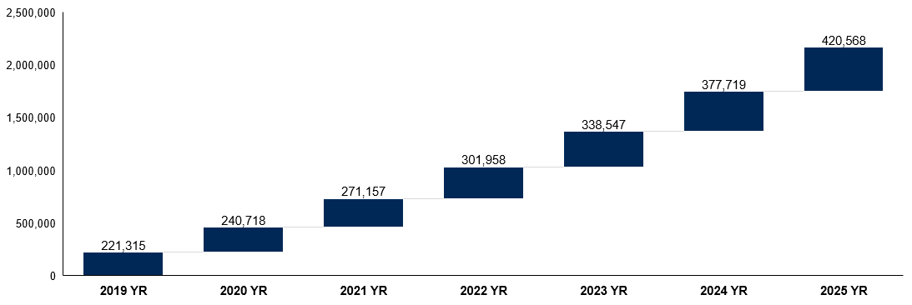
Worldwide Enterprise Application Software Market Will Reach $421 Billion by 2025
Forecast Summary: The worldwide enterprise application software market will grow to $271 billion in 2021 (annual growth of 10.3% in constant currency) and will continue to grow through 2025 to reach $421 billion with a CAGR of 11.8% for the five-year period 2021 through 2025.
Forecast: Enterprise Application Software, Worldwide, 2019-2025 (USD M)
11.8% CAGR
Source: Forecast: Enterprise Application Software, Worldwide, 2019-2025, 2Q21 Update

Slide 10
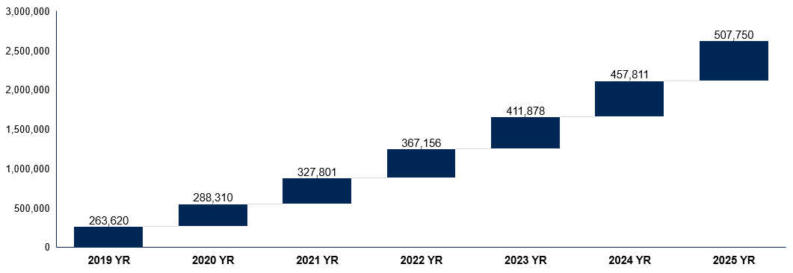
Worldwide Enterprise Infrastructure Software Market Will Reach $508 Billion by 2025
Forecast Summary: Enterprise infrastructure software spending is expected to grow by 11.5% in constant currency in 2021 to reach $508 billion by 2025 in current currency. This corresponds to a five-year CAGR of 11.98%.
Forecast: Enterprise Infrastructure Software, Worldwide, 2019-2025 (USD M)
11.98% CAGR
Source: Forecast: Enterprise Infrastructure Software, Worldwide, 2019-2025, 2Q21 Update

Slide 11
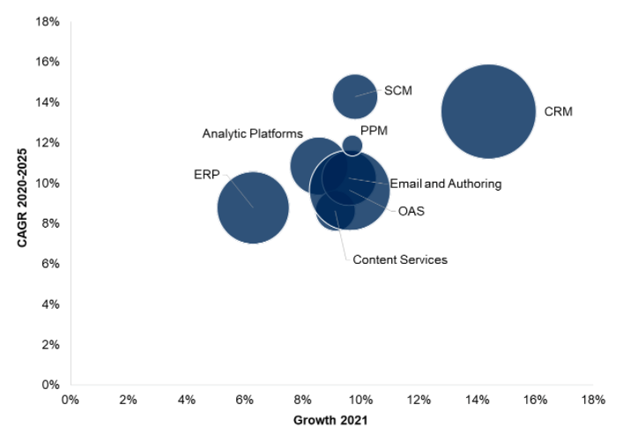
Spending on Enterprise Application Software Is Expected to Increase to $271 Billion in 2021
Summary: Overall spend on enterprise application software will grow 10% in 2021 in constant currency and 13% in current U.S. dollars. Enterprise spend on CRM and SCM solutions will register high growth of 14% and 10%, respectively, in 2021 (in constant currency).
Market Size of Enterprise Application Software Markets
Forecast Assumptions
More than 30% of organizations will bring their long-term initiatives in digital transformation, modernization and user experience forward to 2022, due to the disruption COVID-19 caused to “ways of business.”
By 2022, at least an additional 10% of enterprises will increase their spending in software applications, largely in digital transformation activities that will help enhance customer experience and improve business processes, to sustain business and remain competitive.
More than 50% of incremental spend in 2021 will be driven by increased enterprise demand for software, analytic platforms, and customer experience and relationship management (CRM) software products. More than 50% of this demand will be met by cloud solutions.
Note: The size of each bubble represents 2020 market size for the EAS market in constant currency.
Source: Forecast Analysis: Enterprise Application Software, Worldwide, 2Q21 Update

Slide 12
Market Share Analysis

Slide 13
Top 10 Worldwide Software Providers by 2020 Vendor Revenue in USD Billions
10.2%
SAP gained one place, capturing third place in 2020 compared to fourth place in 2019, with below-average revenue growth of 3%. This gain in rank is primarily attributed to IBM’s revenue decline of 11%, which led IBM to slip from third place to fourth position in 2020.
Amazon Web Services (AWS) continues to be the strong driving force behind Amazon’s second-highest revenue growth of 33% among the top 10 vendors.
Microsoft continues to be the top software vendor and accounted for $94 billion revenue in the global enterprise software market in 2020.
Among the top 10 vendors, Google achieved the highest revenue growth rate of 48%, fueled by the growing adoption of cloud during the pandemic.
0.6%
3.0%
-11.1%
25.7%
32.9%
48.1%
16.2%
18.2%
7.2%
Global Enterprise Software Market, 2020
$536 Billion
53% Share
47% Share
Other Vendors, $282.4 Billion
Top 10 Vendors, $253.5 Billion
% = annual growth rate
Source: Market Share: All Software Markets, Worldwide, 2020

Slide 14
Market Coverage of Top Five Enterprise Application and Infrastructure Software Providers by 2020 Revenue in USD Millions
Enterprise Application Software Providers, Worldwide
Enterprise Infrastructure Software Providers, Worldwide
Microsoft
$21,829
SAP
$20,061
Salesforce
$15,364
Oracle
$11,549
Adobe
$2,809
Microsoft
$62,062
Oracle
$20,655
IBM
$19,503
Amazon
$16,549
VMware
$8,789
Top five providers account for 37.4% share in the overall EAS market.
Top five providers account for 43.2% share in the overall EIS market.
Note: The size of the bubble and value equals 2020 revenue (in millions of U.S. dollars) and the color coding equals positive or negative year-over-year change. A green bubble represents positive change, and an orange bubble represents negative change. See Slides 4 to 6 for software market names.
Sources: Market Share: Enterprise Application Software, Worldwide, 2020 and Market Share: Enterprise Infrastructure Software, Worldwide, 2020

Slide 15
DBMS Emerged as the Fastest-Growing Software Market, With a 17% Growth Rate
The worldwide DBMS software market grew by 17% in 2020, reaching $64.8 billion. Growth is sustained by the need for solving multicloud and hybrid data integration challenges of customers, along with the sustained need for supporting specific data integration styles needed by customers.
Top 5 DBMS Vendors by Revenue, 2020 (USD B)
Top DBMS Vendors Are Losing Ground
Consolidated Market Share of Top 5 Vendors vs. Other Vendors, 2019 and 2020
Global Database Management System Market, 2020 = $64.8 Billion
Top 5 DBMS Vendors by Revenue, 2020 = $53.1B
Others DBMS Vendors = $11.7B
Source: Market Share: Database Management Systems, Worldwide, 2020

Slide 16

Top Five SCM Vendors by Subsegment by 2020 Revenue
The global supply chain management software market grew 5.2% in 2020, reaching $15.8 billion. SAP, Oracle and Blue Yonder (JDA) retained the SCM top three market share positions in 2020.
Top 5 Procurement Vendors by Revenue, 2020 (USD B)
Top 5 Supply Chain Planning Vendors by Revenue, 2020 (USD B)
Top 5 Supply Chain Execution Vendors by Revenue, 2020 (USD B)
SAP continues to be the top SCM vendor, holding leading positions in each of the three SCM submarkets. The vendor holds 27.8% share in the overall SCM market, with its revenue growing by 5.3% in 2020.
Share of top 5 Procurement, SCP and SCE Vendors, 55%
Share of top 5 Procurement, SCP and SCE Vendors, 55%
Global SCM Market = $15.8 Billion
Top 5 SCE Vendors, 13%
Top 5 SCE Vendors, 13%
Top 5 SCP Vendors, 20%
Top 5 SCE Vendors, 13%
SCM Market Composition
Top 5 Procurement Vendors, 22%
Top 5 SCP Vendors, 20%
Share of Top 5 Procurement, SCP and SCE Vendors, 55%
Share of Other SCM Vendors, 45%
Top 5 Procurement Vendors, 22%
Top 5 SCP Vendors, 20%
Top 5 SCE Vendors, 13%
Source: Market Share: Supply Chain Management Software, Worldwide, 2020

Slide 17
Competitive Landscape

Slide 18
The Enterprise Software Market: Who Are the Incumbents*?
The competitive landscape is being revitalized and reinvented as digital innovations emerge and expand. More providers will be drawn to the expanding opportunity, resulting in a higher degree of fragmentation.
> $15 Billion
Microsoft, Oracle, IBM, SAP, Salesforce, Amazon
$2 Billion to < $15 Billion
Adobe, Google, VMware, Apple, Dell EMC, Broadcom, ServiceNow, Micro Focus, SAS, OpenText, Workday, Red Hat (IBM), McAfee, Infor, Cisco, Sage, Citrix, Veritas, Splunk, NortonLifeLock, Experian, BMC
Fujitsu, Hitachi, NetApp, Epsilon, Atlassian, Genesys, HERE Technologies, Trend Micro, Informatica, Esri, Ultimate Software, Quest, Twilio, Visma, Alibaba, Kronos, MathWorks, Dropbox, FICO, TIBCO Software, SolarWinds, Veeam, Verint, Teradata, Proofpoint, Palantir, Blue Yonder (JDA), Blackbaud, Yonyou, Avast, Zendesk, Software AG, SS&C Technologies, Qlik, Zoho, NEC, Zucchetti, NICE, Hyland, Infobip, Pegasystems, HPE, Mailchimp, Box, Cloudera, Kaspersky, Commvault, RSA, HubSpot, Shopify, Sophos, Avaya, Deltek, Tableau, ESET, New Relic, Tencent, Cornerstone OnDemand, Okta, Ceridian, InterSystems, Epicor, Ivanti, Forcepoint, Huawei, Dynatrace, TOTVS, VIAVI, NETSCOUT SYSTEMS, Pivotal, Unit4, IFS, Cegid, ABB, CrowdStrike, Endurance, Alteryx, Progress, MicroStrategy
$400 Million to < $1.9 Billion
Mimecast, Kingdee, MongoDB, ManageEngine, GitHub, Flexera, Datadog, Inspur Genersoft, Zscaler, HCL, UiPath, Coupa, Qualys, LinkedIn, Aurea Software, Rocket Software, Perforce, Rapid7, Sitecore, JetBrains, Anaplan, Axway, Apttus, E2open, Syncsort, Boomi, Descartes, EnterpriseDB, Riverbed, Aptean, WiseTech Global, JAGGAER, Idaptive, SailPoint, Compuware, Automation Anywhere, Manhattan Associates, Ping Identity, QAD, MarkLogic, Saba Software, Tricentis, Bitdefender, Cheetah Digital, Hootsuite, Exact, [24]7.ai, iCIMS, Webroot, Talend, Sprinklr, Freshworks, Zuora, PROS, Intel, Quadient, Acquia, DataBricks, F-Secure, Sovos, Digital River, Barracuda, Sailthru, LogRhythm, Puppet, Inspur Electronics, Arcserve, Information Builders, Domo, GoodData, Khoros, Panda Security, Synopsys, Acronis, Centrify, Carbon Black, TechnologyOne, HashiCorp, Appian, DataRobot, Canonical, Kinaxis, Pitney Bowes, DataStax, GEP, Face++, OBIC, Zellis, OutSystems, Episerver, BluJay, Cylance, Quick Base, Basware, Malwarebytes, Darktrace, Check Point Software Technologies, SumTotal Systems, ForgeRock, Sumo Logic, Blue Prism, Actian, Cherwell, Zerto, Alfresco, Science Logic, Emarsys, … and counting
< $400 Million
Pyramid represents 2020 software license, maintenance and subscription revenue (including SaaS/PaaS).
Source: Market Share: All Software Markets, Worldwide, 2020
* Vendors are listed by ranking order as per published market share. Red denotes companies coming from other IT segments, green denotes vendors born in the cloud, black denotes commercial OSS.

Slide 19





Number of People Using ABI Platforms Is Accelerating Massively Into the Millions
Gartner Magic Quadrant Framework
Vendors in the ABI market range from startups backed by venture capital funds to large technology firms. The vast majority of new spending in this market is on cloud deployments, and major cloud platform players are present in the market.
Example Vendor Considered for ABI Platforms Magic Quadrant
Looker is opening up LookML-governed data to other ABI platforms, having added a Tableau-specific connector in 2020.
Following its acquisition of Looker, Google has made progress integrating Looker into GCP go-to-market activities.
The influence of Power BI has drastically reduced the price of tools in the ABI platform market since its launch.
Microsoft continues to invest in a broad set of visionary capabilities and to integrate them with Power BI.
Quadrant Description Summary
Leaders: Demonstrate a solid understanding of the product capabilities and commitment to customer success that buyers in this market demand.
Challengers: Well-positioned to succeed in this market. However, may be limited to specific use cases, technical environments or application domains.
Visionaries: Have a strong and unique vision for delivering a modern analytics and BI platform.
Niche Players: Do well in a specific segment.
Amazon QuickSight provides core data connectivity and data visualization functionality.
AWS is the largest cloud service provider in the world by revenue and has an international presence and a global client base.
Oracle implemented augmented analytics capabilities across its platform earlier than most vendors.
Oracle invests aggressively in augmented analytics capabilities and consumerlike, conversational user experiences.
Source: Magic Quadrant for Analytics and Business Intelligence Platforms

Slide 20

Customer Analytics: Competition in Next Three to Five Years Will Come From Vendors That Focus on ML and Deep Learning Capabilities
The CA landscape consists of line-of-business and enterprise application providers that offer data and analytics solutions to understand customer needs, values and satisfaction. These include vendors that focus on marketing to acquire new customers, sales to grow the customer base, service to retain customers, and cross-channels such as customer journeys to track and engage with customers across channels of engagement.
Two Main Competitive Vendor Approaches
Customer Analytics
Emerging CA Solution Providers
Intelligent Enterprise App Providers
Providers that specialize in offering emerging and complex CA solution capabilities
Established enterprise-grade platform providers that approach the market by deploying emerging and innovative technologies
Example vendors: Balto, Glassbox, Quantum Metric, ThoughtSpot and Yellowfin
Example vendors: Adobe, IBM, Microsoft, Redpoint, Salesforce and SAS
Source: Competitive Landscape: Customer Analytics

Slide 21
HCI Software: Five Vendors Measuring Up Against Competitive Trends
The HCI software-only market accounted for more than $1.5 billion in 2020. Nutanix led the market with 49.2% revenue share, followed by VMware with 43.6%, while other smaller vendors accounted for 7.2% share. Enterprises are increasingly evaluating HCI software providers based on their automation capabilities, integration with public cloud providers, simplified software maintenance and upgrade coupled with Kubernetes support.
Five HCI Software Vendors Measuring Up Against Competitive Trends
Trends |  | Vendors
 |  | Microsoft | Nutanix | Pivot3 | StorMagic | VMware
Hypervisor Support
 | Hyper-V | X | X | X | X
 | vSphere |  | X | X | X | X
 | KVM |  |  | X | X
 | Xen |  |  | X
HCI Features
 | Hybrid Cloud | X | X | X |  | X
 | Networking |  | X | X |  | X
 | Kubernetes | X | X | X |  | X
 | File |  | X |  |  | X
 | S3 Object |  | X |  |  | X
 | Security | X | X | X | X | X
Purchase Options
 | Perpetual |  | X | X | X | X
 | Subscription | X | X | X | X | X
Source: Competitive Landscape: Hyperconverged Infrastructure Software and Market Share: Data Center Hardware Integrated Systems, Worldwide, 1Q21 Update

Slide 22
Market Trends

Slide 23
Proportion of IT Spending "Shifting to Cloud" Will Accelerate in Aftermath of COVID-19 Crisis
The proportion of enterprise IT spending on public cloud computing continues to increase. Technology and service providers must ensure they remain attuned to changing market dynamics as enterprise IT spending continues the shift to cloud from 2020 through 2024 in the wake of COVID-19. Over 45% of IT spending in the segments included as part of the cloud shift will have shifted to cloud by 2024, up from 33% in 2020.
Sizing Cloud Shift, Worldwide, 2018-2024
Total Revenue
Growth in Revenue
Increasing Cloud Revenue
Source: Market Trends: Cloud Shift — 2020 Through 2024

Slide 24
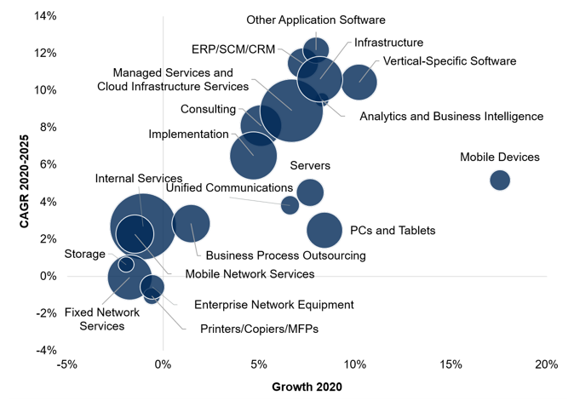
Global IT Spending Will Reach $4.1 Trillion in 2021, Surpassing 2019 Spending Levels
The rise of enterprise application software, infrastructure software, and managed services and cloud infrastructure services in the near and long term demonstrates that the trend toward digital business is not a one- or two-year trend. Rather, it is systemic and long-term.
Global IT Spending by Market Segment
Market Impact
Digital business initiatives will push spending on enterprise applications, infrastructure software, and managed services and cloud infrastructure services into double-digit growth in 2021.
Cloud spending is expected to grow at 18.4% in 2021. 2020 was the year of a cloud proof point. Cloud had always promised the ability to scale up and scale down as required, and the shifting needs of enterprises throughout the pandemic validated the claims around its scalability and flexibility. CIOs with more IT to do, and less time to do it, will increasingly use cloud alternatives to gain the quickest time to value in 2021 spending.
Note: The size of each bubble represents 2021 end-user spending by IT market segment in constant currency.
Source: Forecast Analysis: IT Spending, Worldwide

Slide 25
Pandemic Bent the Long-Term Curve of the Social and Collaboration Software Market Upward
Forecast Assumption: By 2025, nearly 65% of enterprise application software providers will have included some form of social and collaboration software functionalities in their software product portfolios.
Forecast Social Software Spending, Worldwide Revenue, 2019-2024
Five-Year Market Growth = $3 Billion (CAGR 13%)
$6.5 Billion
The course of the social and collaboration software market was altered by the COVID-19 pandemic, which decreased short-term spending but increased market maturity. The net effect is expected growth from an estimated $3.5 billion in 2019 to $6.5 billion by 2024.
$3.5 Billion
2019
2020
2021
2022
2023
2024
Source: Forecast Analysis: Social Software and Collaboration in the Workplace, Worldwide

Slide 26
Convergence of iBPMS, RPA, Low Code and Enterprise Software With AI Styles of Tools Is Disrupting Multiple Markets
RPA Morphing Into Hyperautomation
RPA Vendor Marketplace
Process Insight and Management Tools
Process-Ready Digital Worker On Demand Process-aaS
Process Mining
Process Discovery
Real-Time Monitoring
Micro Process View
Macro Process View
Digital Twin
Business Insight Tools
Artificial Intelligence
Analyze Process Data in Systems
Analytics
Algorithmic ML
iBPMS Alliances
Knowledge Management
Work/Process Orchestration Tools for Case Management Between Bots and People
Consulting Products and Services
Strategic ROA Initiatives
COE Advice
Workforce Planning
Digital Operations
Change Management
Business Case Creation/Monitoring
Open-Source Developers
RPA Training Providers
Process Template Marketplace
Process Template Marketplace
Robot Instructions Marketplace
Robot Instructions Marketplace
Bot Routines
RPA Runtime on Server
RPA Orchestrator
University Partnerships
Artificial Intelligence to Get Data Into Systems: Paper, Voice, Written, Unstructured
OCR + MI
NLP/NLG
Computer Vision
Chatbots
Virtual Assistants
Intelligent Voice Recognition
Credentials Vault
RPA Runtime on Desktop
Cloud Runtime Bots on Demand
Cloud Infrastructure
Business Applications: ERPs, CRM, iBPMS
Flavors of RPaaS Providers
RPA as a Managed Cloud Platform
RPA + AI Managed Services/Processes
Testing Tools
APIs
IoT
Security
Typical Software Integrations
Source: Market Trends: RPA Morphing Into Hyperautomation

Slide 27
Recommended Gartner Research
Market Share: All Software Markets, Worldwide, 2020
Market Share: Enterprise Application Software, Worldwide, 2020
Market Share: Enterprise Infrastructure Software, Worldwide, 2020
Market Share Analysis: Database Management Systems, Worldwide, 2020
Market Share Analysis: Customer Experience and Relationship Management Software, Worldwide, 2020
Market Share Analysis: ITOM, Performance Analysis Software, Worldwide, 2020
Market Share Analysis: ERP Software, Worldwide, 2020
Market Share Analysis: Digital Experience Platforms, Worldwide, 2020
Market Share Analysis: Data Integration Software, Worldwide, 2020
Forecast: Enterprise Application Software, Worldwide, 2019-2025, 2Q21 Update
Forecast: Enterprise Infrastructure Software, Worldwide, 2019-2025, 2Q21 Update
Forecast Analysis: Enterprise Application Software, Worldwide

