Slide 1
How to Assess Windows Autopilot for Device Provisioning
Downloadable Figures
Eric Grenier
Notes:
Presenter's Name
Presenter's Name

Slide 2
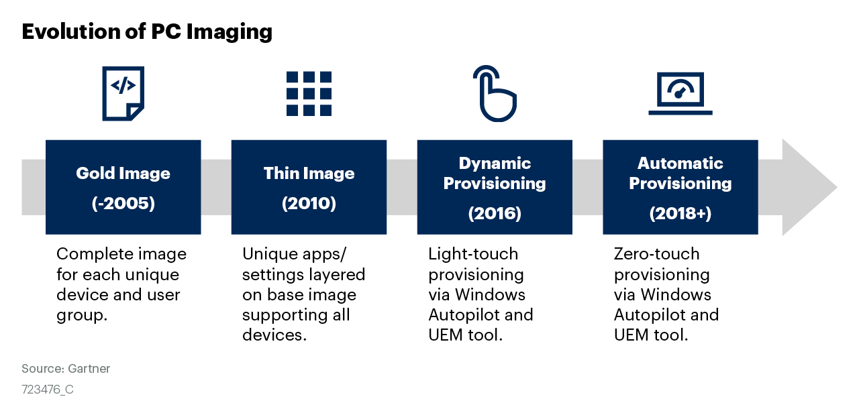
Figure 1

Slide 3
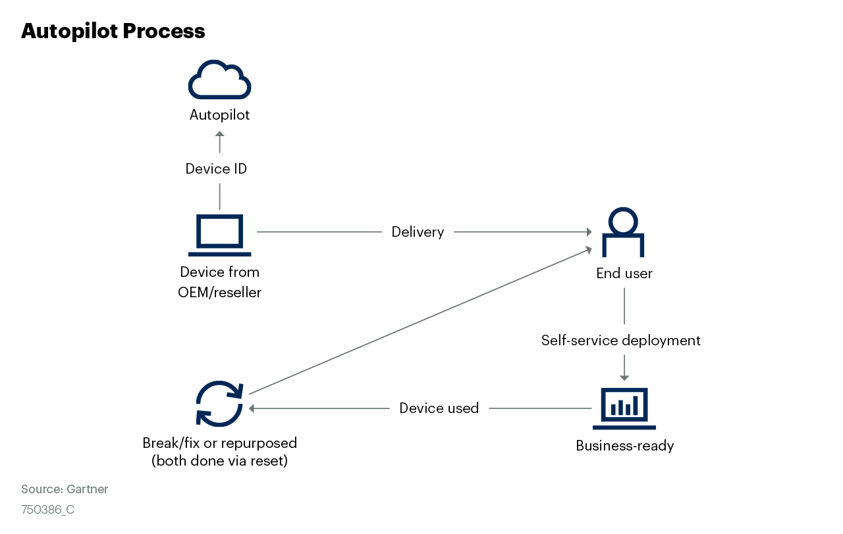
Figure 2

Slide 4
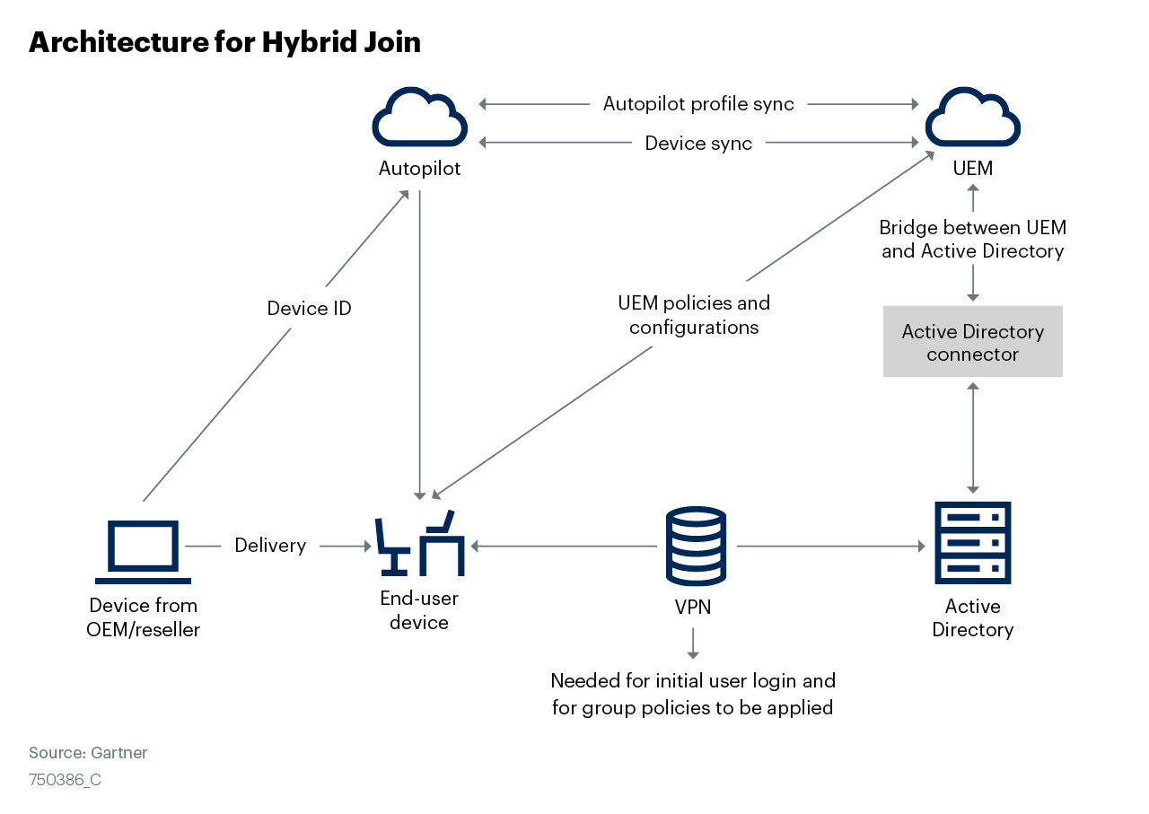
Figure 3

