Slide 1
ChatGPT and GPT: A Board Reference Presentation
Bern Elliot, Jim Hare, Anthony Mullen, Van Baker
10 March 2023
Notes:
Whit Andrews
1 © 2022 Gartner, Inc. and/or its affiliates. All rights reserved. Gartner is a registered trademark of Gartner, Inc. and its affiliates.

Slide 2
Why Is ChatGPT Generating Such a Buzz?
It represents a “perfect storm” of “hot” technologies by using:
A chatbot that enables natural-sounding conversational interactions.
A large language model (Generative Pre-trained Transformer [GPT]) that performs advanced language-related functions, including language generation, summarization and question answering.
It can hold seemingly intelligent conversations with humans by appearing to understand what they say:
Interactions with ChatGPT can be humorous and insightful, even profound. But they can also be factually incorrect or biased, despite OpenAI’s improvement efforts so far.
There is a danger that ChatGPT content that is factually incorrect may be assumed to be correct because it is presented eloquently.
The terms “understand” and “intelligent” are implicitly human terms; their application to a machine algorithm like that of ChatGPT is highly misleading.
It has massive market implications:
It offers significant potential opportunities, but also entails disruption and risk.

Slide 3
Key Issues
What are ChatGPT and GPT?
ChatGPT examples
How to develop an enterprise ChatGPT strategy
Industry and enterprise use cases

Slide 4
Key Issue No. 1 What Are ChatGPT and GPT?

Slide 5
What Are ChatGPT and GPT?
ChatGPT is a chat application that uses a specially trained version of GPT (GPT-3.5).
ChatGPT is designed to interact with users conversationally and to use GPT-3.5’s specially trained large training set.
GPT (Generative Pre-trained Transformer) is a type of foundation model.
Foundation models (also known as large language models [LLMs]) are a type of machine learning that uses very large pretraining sets.
There are many uses and types of foundation models.
OpenAI (founded in 2015) develops leading generative artificial intelligence (AI) technology.
OpenAI Inc. is a nonprofit organization.
OpenAI LP is a for-profit subsidiary.
OpenAI developed ChatGPT.
Microsoft invested $1 billion in 2019 and $10 billion in 2023. It has exclusive rights until it has recouped its investment.

Slide 6
Two Versions of ChatGPT in the Market
There are two versions of ChatGPT in the market:
Version 1: OpenAI LLC’s OpenAI ChatGPT, which is available today.
Version 2: Azure OpenAI Service’s ChatGPT, which Microsoft has announced.
Azure OpenAI Service’s ChatGPT is available in preview as of 9 March 2023.
ChatGPT’s GPT-3.5 model has been customized and uniquely trained for over a year.
The stand-alone GPT-3.5 model is available for use. But the customized version is not, and not with ChatGPT.
Microsoft‘s Azure OpenAI Service is expected to offer enterprise levels of security, compliance and confidentiality:
OpenAI LLC’s version gives no privacy or confidentiality assurances.
Gartner does not recommend using OpenAI LLC’s ChatGPT version for any business use.
See the addendum slide for privacy, security, compliance and confidentiality details.
Both ChatGPT services operate on closed, specially trained versions of GPT-3.5:
Many projects will not use ChatGPT, but instead use their own variations of transformer models.
APIs are available for GPT models, but not currently for ChatGPT.
Longer-term Microsoft strategy:
ChatGPT will be integral to future versions of Microsoft applications, such as Microsoft 365, Power BI and Bing, and will be expected to challenge Google's search technology.
Confusing Point Here

Slide 7
Ethical Concerns Regarding Foundation Models Like GPT
“Hallucinations” and false answers: Use of model to predict next words. No true understanding of content.
Ensure human supervision and review of output: Eloquence does not equal truth.
Training data issues: Inaccurate, biased, prohibited, wrong data. Lack of real-time data.
Consider risk exposure: ethical, reputational, legal, financial issues.
IP and copyright infringements: Use of proprietary training data.
Consult legal department about risks of foundation models.
"Deep fakes”: Foundation models can generate fake content in the requested style.
Review for abuse: fake news, misinformation, personalized impersonation, manipulation, false attributions.
Fraud and abuse: False reviews, false papers, spam, phishing.
Lack of transparency and explainability: Cannot check why a model reached a conclusion.
Ensure your use cases do not require this transparency.
Concentration of power: Foundation models can be developed only by hyperscalers.
Exposure of information: Confidential and personal identifiable Information.
Take care with what data is used: Work with vendors that offer strong data usage policies.

Slide 8
Key Issue No. 2 ChatGPT Examples

Slide 9
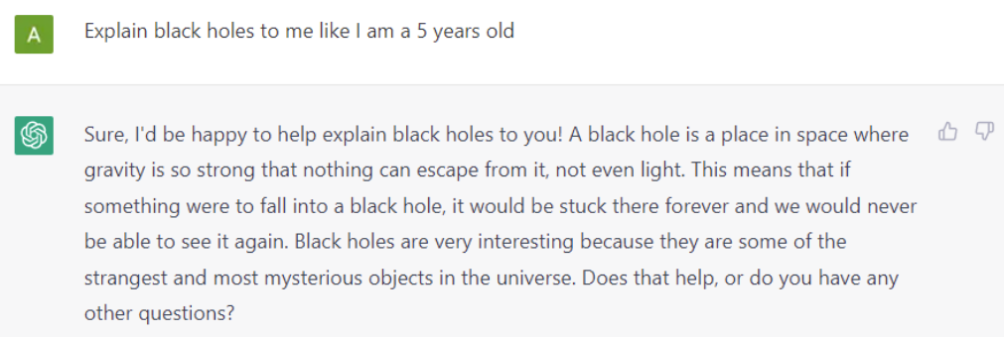
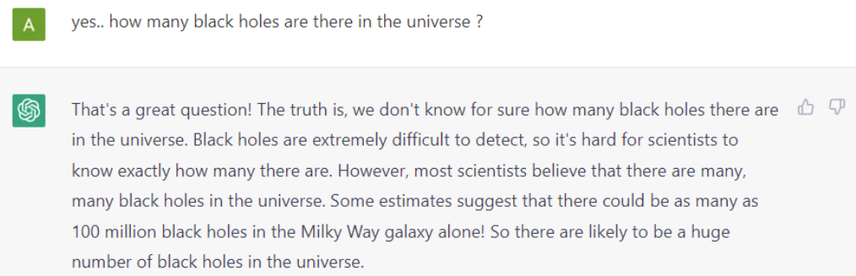
Example ChatGPT Use Case: Explain Black Holes Amazing depth and subtlety on complex topic
Source: https://machinelearningknowledge.ai/chatgpt-demos-and-examples/

Slide 10
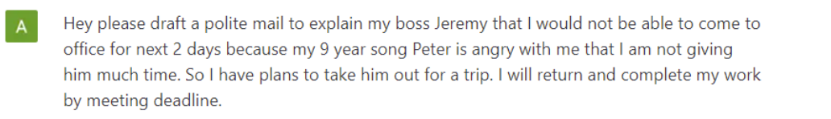
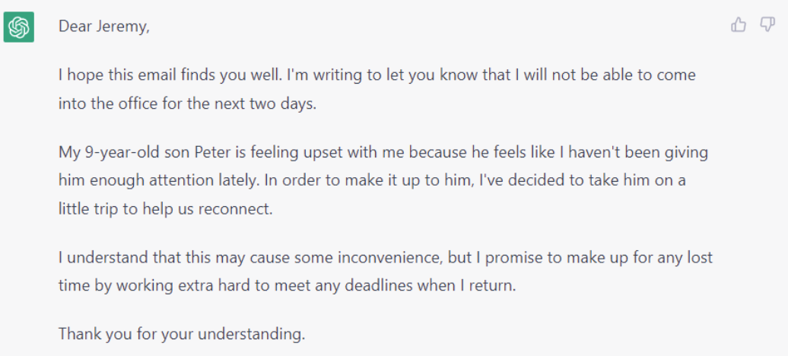
Example ChatGPT Use Case: Draft an Email to Boss for PTO Blends personal information and formatting
Source: https://machinelearningknowledge.ai/chatgpt-demos-and-examples/

Slide 11
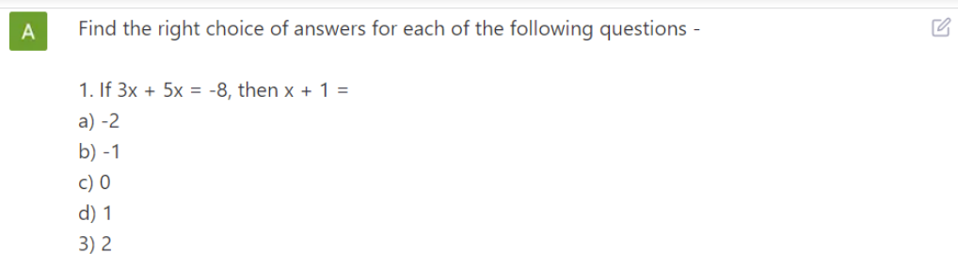

Example ChatGPT Use Case: Error on Simple Math Question
Commentary: ChatGPT chose the right approach to solve the math question, but instead of finding the value of x+1, it calculated the value of x, and hence arrived at the wrong answer, which should have been (c) 0. GPT does not “understand” — it predicts word sequences.
Note: On 30 January 2023 ChatGPT received an update with improved math capabilities. It was then able to solve this question. Other problems with ChatGPT have been found, however. Expect continuous improvement, but also continuous discovery of false information and “hallucinated” information.
Source: https://machinelearningknowledge.ai/chatgpt-demos-and-examples/

Slide 12
Conceptual Flow of ChatGPT Service
Enterprise controls can only be applied here:
Text input/output
Input filtering and prompt preparation (and conversation)
Output acceptability filtering and conversation preparation
Session context
Closed GPT3 model
Reinforcement learning and human feedback training
Closed version of GPT3 training data and process
RLHF

Slide 13
Key Issue No. 3 How to Develop an Enterprise ChatGPT Strategy

Slide 14
Enterprise ChatGPT/GPT Usage Areas: Pros and Cons
Out-of-the-Box Model Usage
Uses ChatGPT service “as is,” no direct access to GPT-3.5 model.
Pro: Fast to market; limited investments; gain experience.
Con: Limited differentiation; control range is limited.
ChatGPT
Prompt Engineering
Uses tools to create, tune, and evaluate prompt inputs and outputs.
Pro: Better targeted ChatGPT and GPT3 results; low startup costs.
Con: Must integrate with business systems to introduce data.
GPT3 Model
Use of Custom Models
Uses (builds/licenses) GPT or other language models directly.
Pro: Customized or optimized models, data, parameters and tuning.
Con: Requires added funding and skills. This is not ChatGPT.

Slide 15
Out-of-the-Box Model Usage
This form of usage is by far the most accessible and common today.
Text-based webchat interface (chat.openai.com). API recently available.
Currently (10 March 2023), this is available only from OpenAI LP, not Microsoft.
For most use cases, output must be reviewed by a human, as it may contain inaccuracies or unacceptable content.
Enterprises may achieve useful results with limited investments and skills. But because many users are inexperienced, they risk overlooking data, security and analytics risks.
A limitation is that the model cannot include real-time, current or custom data. Nor does it cover recent historical events (those after December 2021). However, new data can be added via a prompt at the time of interaction.

Slide 16
Prompt Engineering
Prompt engineering can be applied to both ChatGPT and GPT use cases. It involves developing a systematic approach to creating, tuning, and evaluating results in terms of inputs and outputs to and from ChatGPT.
In ChatGPT, the prompt is the critical element driving results. Small changes to a prompt’s choice of words and word order can result in significant changes in output. A prompt can also contain data that should be incorporated or considered when generating a response.
Leaders should anticipate that prompt engineering is a new technical skill that will need to be developed, along with related tools.
In some cases, this requirement will extend to building a separate learning model to optimize prompts.

Slide 17
Use of Custom Models
This is the likely long-term approach for sophisticated solutions.
This approach is not possible with ChatGPT, as it does not provide users with access to customize its underlying model.
Besides GPT, other foundation models exist. Some are specialized.
Customizing foundation models is a complex task that requires significant skills, data curation and funding.
Enterprises should anticipate a robust market for third-party models customized for different use cases.
Planners should anticipate the emergence of third-party, fit-for-purpose, specialized models. Buying one of these may prove a better approach for many enterprises than customizing a model themselves.
Applications may also have prebuilt models for their users.

Slide 18
Key Issue No. 4 Industry and Enterprise Use Cases

Slide 19
Use Cases: General
These can be applied to many different industries and business areas:
Written content augmentation and creation: There are many ways in which ChatGPT can produce a “draft” output of text, which is then reviewed by the user. ChatGPT can produce the length and style of text desired.
Question answering and discovery: Enables users to locate answers to input, based on data and prompt information.
Tone: Text manipulation — to soften language or professionalize text, for example.
Summarization: Offers shortened summaries of conversations, articles, emails and web pages (the length of summary can be specified); conversion to and from bullet points.
Simplification: Titles, outlines, extraction of key content.
Classification of content for specific use cases: By, for example, sentiment or topic.
Chatbot performance improvement: Multiple methods can be improved, such as entity extraction, whole-conversation sentiment classification, and generation of journey flows from general descriptions. These methods can also be used to improve the performance of other applications involving user interaction.
Software code generation, translation, explanation and verification.

Slide 20
Use Cases: Industry and Business Areas
These examples draw on use cases outlined earlier:
Customer service: Improve chatbot intent identification; summarize conversations; answer customer questions; direct customers to resources.
Sales and marketing: Engage with potential customers on a website or in a chatbot; supply recommendations; provide product descriptions.
Personal assistant: Manage schedules; summarize emails; compose emails (and chains), replies and summaries; draft common documents.
Education: Create personal learning experiences, like tutors.
Healthcare: Provide simple-language descriptions of medical information and treatment recommendations.
Software programming: Write code from prose; convert code from one programming language to another; correct erroneous code; explain code.

Slide 21
Recommended Actions
Avoid being seduced by the intense hype about ChatGPT, a service that is still at a very early stage of development:
Learn about the risks associated with the use of large language models, which include the introduction of erroneous information.
Investigate this technology’s significant potential, but avoid committing too much to it.
Explore other emerging use cases for generative artificial intelligence (AI), beyond GPT’s language-focused ones.
Encourage exploration of potential use cases and changes to work processes:
Define usage guidelines — ensure that all users understand the risks, issues and practices.
Do not use versions of ChatGPT with any private data if the service does not offer assurances of privacy or confidentiality. It is likely, however, that Microsoft’s Azure OpenAI Service version of ChatGPT will have enterprise-level confidentiality, privacy and compliance capabilities.
Form a task force, which should report to your CIO and CEO, charged with:
Detailing existential threats and major opportunities.
Documenting what management needs to know in order to plan and set direction.
Developing a plan to explore opportunities as they arise.
Monitoring this fast-evolving market.

Slide 22
Recommended Gartner Research
Quick Answer: What Is ChatGPT?
Innovation Insight for Artificial Intelligence Foundation Models
Innovation Insight for Generative AI
Use Generative AI to Enhance Content and Customer Experience
Predicts 2022: Generative AI Is Poised to Revolutionize Digital Product Development
Hype Cycle for Natural Language Technologies, 2022

Slide 23
Addendum: Service Data, Privacy and Security Links
OpenAI LLC’s ChatGPT privacy policy clearly indicates that it is not an enterprise-grade privacy policy.
Microsoft’s initial Azure OpenAI Service announcement came on 16 January 2023.
Microsoft’s Azure OpenAI Service webpage includes information on features, security and pricing.
Microsoft’s blog post announcing ChatGPT’s availability in preview in Azure OpenAI Service, 9 March 2023.
According to Microsoft’s Data, Privacy, and Security for Azure OpenAI Service (30 January 2023): "Text prompts, queries and responses. The requests & response data may be temporarily stored by the Azure OpenAI Service for up to 30 days. This data is encrypted and is only accessible to authorized engineers for (1) debugging purposes in the event of a failure, (2) investigating patterns of abuse and misuse or (3) improving the content filtering system through using the prompts and completions flagged for abuse or misuse."
For clarification of Microsoft’s compliance offerings, which will apply to the Azure OpenAI Service as well as to Azure, Dynamics 365 and Microsoft 365, see Microsoft Compliance Offerings.

