Slide 1
Generative AI: The Basics
Gartner Futures Lab, ft. Sam Berndt, Erick Brethenoux, Frank Buytendijk, Pieter den Hamer, Frances Karamouzis, Malcolm Murray, Daryl Plummer, Christian Stephan, Sarah Watt
Notes:
AI is one of the most important technological trends of our time. The future of AI is fundamentally uncertain, but will be deeply impactful for most organizations.
Presenter's Name
Presenter's Name

Slide 2
Introduction to Generative AI

Slide 3
What Is Generative AI?
An OpenAI service that incorporates a conversational chatbot with an LLM to create content. It was trained on a foundational model of billions of words from multiple sources and was then fine-tuned by reinforcement learning from human feedback.
ChatGPT
Large Language Models (LLM)
AI that is trained on vast amounts of text allowing it to to interpret and generate humanlike textual output.
Large machine learning models. They are trained on a broad set of ​unlabeled data, fine-tuned and adapted to a wide range of applications.
Foundation Models
AI techniques that learn from a representation of artifacts in a model & generate new artifacts with similar characteristics.
Generative AI (GenAI)
Source: Gartner
Notes:
There are many definitions of AI, and many AI technologies with differing capabilities and uses. Generative AI is composed of multiple technologies as well. This slide provides some short definitions, mostly to distinguish ChatGPT as a product from overall large language models, foundational models and the umbrella term of generative AI.
For more information, contact Penny Gillespie and Anthony Mullen.

Slide 4



Why Was ChatGPT So Impactful?
Technology
Economics
Social Acceptance
Technology
Technology
Technology
GPT-4 has an estimated one trillion parameters. Accuracy is still limited to 70% to 80% but has substantially improved from previous models.
It is estimated that running ChatGPT costs $3 million per month, but it is available for the masses.
ChatGPT offers immediate benefit, with little effort. It helps professionals write speeches, students write essays, and executives write strategies.
Source:GPT-4 has a trillion parameters — Report, The Decoder; The secret history of Elon Musk, Sam Altman, and OpenAI, Semafor; GPT-4 Technical Report, OpenAI; OpenAI’s ChatGPT Reportedly Costs $100,000 a Day to Run, CIOCoverage.
Notes:
We’ve had breakthroughs in AI in the last few years, but ChatGPT and other forms of generative AI seem to be different. In 2016, Google’s AlphaGo beat Lee Sedol, world Go champion (while the 2022 defeat of KataGo by a high-ranking amateur showed some of the limitations that AI is currently facing). MuZero learns games quickly without being taught the rules. AI now beats humans in complex video games. Progress has been breathtaking.
Still, ChatGTP set the record for fastest growing application. AlphaGo was impressive, but it didn’t change the world in the way that ChatGPT did. Why? Because ChatGPT scales, and people can use it for useful things. Changes usually happen gradually across many different places, markets and technologies. ChatGPT immediately hit an ignition point.
For more information, contact Frank Buytendijk.

Slide 5
“We shape our tools, and thereafter our tools shape us.”
John Culkin (1928-1993) Professor of Communication, Fordham University
Notes:
The quote, “We shape our tools, and thereafter our tools shape us” is often used to explain that people are technological beings. Creating technologies is our evolutionary advantage and has helped us to survive. The impact of agricultural tools shaped society. The steam engine and printing press reshaped and industrialized society. The internet and now AI are reshaping society and humanity again.
For more information, contact Frank Buytendijk.

Slide 6
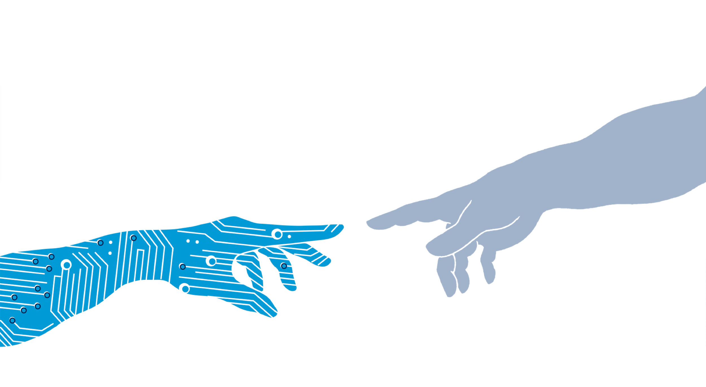
We should not treat AI as just a technology, or a business case. AI is shaping our society and changing what it means to be human.
Notes:
Some experts argue that AI is just a technology, but that misses the bigger picture. It is attractive to frame generative AI in terms of business benefits, but that also misses part of the picture.
Generative AI is moving us closer to what is called a “sociotechnical society,” in which people and machines are more integrated.
How AI behaves can teach us something about ourselves. How do we learn as human beings? What do we learn about human intelligence through developing artificial intelligence?
For more information, contact Frank Buytendijk.

Slide 7
The Benefits of AI Outweigh the Risks
Percentage of Respondents Who Agree
27%
Don’t Know
68%
Yes
5%
No
n = 1,079
Source: Beyond the Hype: Enterprise Impact of ChatGPT and Generative AI Webinar Polls, 21 April 2023
Q: “Do you believe the benefits of generative AI outweigh the risks?”
For more information, see Executive Pulse: AI Investment Gets a Boost From ChatGPT Hype
Notes:
Sixty-eight percent of executives queried at a Gartner webinar said they see more benefits than risks from generative AI
Only 5% of respondents to the Beyond the Hype Webinar Poll said there will be increased risk from generative AI. However, this data comes with a note of caution that initial enthusiasm for a new technology can give way to disillusionment once implementation begins. It’s likely that organizations will encounter a host of trust, risk, security, privacy and ethical questions as they start to develop generative AI.
The webinar cited was held in 2023 on 30 March and 21 April with 1,465 and 1,079 respondents to the polling respectively, for a total of 2,554. Results of these polls should not be taken to represent all executives as the survey responses come from a population that had expressed interest in AI by attending a Gartner webinar on the subject.
For more information, contact Fran Karamouzis.

Slide 8
Generative AI and Productivity

Slide 9


Generative AI Is Changing: Product Development
Absci — a drug creation pharma company — has launched a generative AI tool to assist with the identification and testing of antibodies typically not found in existing databases. It anticipates this advancement could cut the time to clinical testing by more than 50%.
Autodesk — a software firm specializing in design — uses its Dreamcatcher platform to generate CAD designs based on user goals and constraints. The software can incorporate elements such as local regulations and sustainability into its various proposals.
Source: Absci First to Create and Validate De Novo Antibodies With Zero-Shot Generative AI, Absci (10 January 2023); Project Dreamcatcher: Generative Design Solutions in CAD, Autodesk
Notes:
Most of the recent public conversation and media attention has focused on chatbots and their accuracy, hallucinations and potential for societal impact. Generative AI also represents a new frontier when it comes to business operations and productivity. While we anticipate use cases are going to expand and proliferate quickly, we believe that the short-term use cases will primarily be around product development, customer experience and interaction, and employee productivity.
This slide highlights how generative AI is changing product development beyond the most obvious examples where the product is easily replicated.
For more information, contact Sam Berndt.

Slide 10



Generative AI Is Changing: Customer Experience
IBM and the Masters — a U.S. golf tournament — recently used generative AI to provide spoken commentary to highlight clips for the 2023 tournament. This will result in more than 20,000 highlight reels having audio narration.
SKT — a South Korean telecom provider — has dramatically expanded its AI capabilities and services. During the pandemic, it created Nugu Care Call, an AI-powered check-in call service to assess for symptoms of COVID-19 and assist healthcare workers.
Source: What the Masters App Can Teach Us About Large Language Models, IBM (4 April 2023); Korea Telecom Giant SKT Doubles Down on AI, Computer Weekly (28 February 2023)
Notes:
We believe generative AI represents a much greater opportunity for customers than just improving chatbots. IBM and SK Telecom both used the technology to improve and expand the customer experience.
For more information, contact Sam Berndt.

Slide 11



Generative AI Is Changing: Employee Productivity
Stitch Fix — a clothing recommendation service — has incorporated AI to assist in writing its advertising headlines and product descriptions. For copywriters, this means significant time savings.
Accenture’s velocity team has been using Amazon CodeWhisperer to help complete code based on natural language prompts. As a result of this partnership, they’ve seen a 30% reduction in development efforts.
Source: A New Era of Creativity: Expert-in-the-loop Generative AI at Stitch Fix, Stitch Fix (6 March 2023);
How Accenture Is Using Amazon CodeWhisperer to Improve Developer Productivity, Amazon Web Services (AWS) (13 April 2023)
Notes:
We believe that generative AI is going to fundamentally improve both the labor market and the number of jobs that require human workers. However, we also expect generative AI to fundamentally change (and improve) the nature of what it means to work. To illustrate, this slides contains two examples where humans and AI can collaborate to ease rote work and allow people to focus on more productive activities.
For more information, contact Sam Berndt.

Slide 12
Generative AI Is Changing: Innovation Productivity
Human only |  | Human+AI
Early pruning for an achievable solution |  | Exploiting the complete solution space for optimal solution
Based on individual experience and training |  | Relying on the whole extracted knowledge of many
Aiming for a minimum viable product (MVP) |  | Enabled with a minimum marketable product (MMP)
Few iterations and samples |  | Maximized “What-ifs per hour“
Redesign for industrialization of innovation is needed |  | Trained models and designs can often be used directly
For more information, see Use Generative AI in Applied Innovation to Drive Business Value
Notes:
Developing novel ideas is not about eureka moments. It’s about continuously combining possible options, identifying the most promising and refining them until a proof of concept, technology or value is achieved. Even the best human teams can only explore a small part of the total solution space for a given problem. They innovate by eliminating less likely solutions and focusing on the most immediately promising ones.
Generative AI enables developers, engineers and designers to use more variables and to explore a far greater solution space in less time:
Algorithmic engineering allows for bionic designs that otherwise can’t be processed.
Generative AI in pharma is able to find novel structures for medical applications that would take human researchers years to come up with.
Software developers can focus on the function they want to build, and an AI copilot takes care that the code is energy efficient.
Innovating products and services with AI is often limited, due to a lack of proper labeled data for prototypes. Generative AI is also a cure for this problem as it can generate synthetic datasets.
Generative AI is giving human innovators superpowers by maximizing the “What-ifs per hour” and increasing the rate and number of iterations. Organizations are able to move from the classic MVP toward a MMP, the minimum marketable product.
For more information, contact Christian Stephan.

Slide 13
By 2025: Generative AI will support authors, marketers and others in 50% of new content generation.
For more information, see The Future of AI: Reshaping Society
Notes:
For more information, contact Pieter den Hamer.

Slide 14


Gartner recently reviewed an IT strategy, created with assistance from ChatGPT. It looked relevant to the industry and organizational priorities.
Gartner scored it a 4 out of 5
Eyad Tachwali, Senior Director, Gartner Research and Advisory
Notes:
Why did the strategy get four stars? Because it “looked” good. That is:
It followed our best practice structure.
It included relevant information, such as context and actions.
It had a focus on technology, people, ecosystems and other key areas.
Although the strategy earned four stars, we doubt it would be effective as it was without ensuring its content was truly in resonance with the specific enterprise’s business strategy. The strategy would still need to be iteratively communicated to people throughout the company in ways that resonate with each audience group.
The process of generating the strategy is as important as the strategy document itself — if not more important. After all, until strategy can be executed without the involvement of people throughout the company, people throughout the company must be involved in the creation and communication of strategy.
For more information, contact Brandon Germer and Eyad Tachwali.

Slide 15
Regulation, Risk & Ethics

Slide 16
Digital Technologies Go Through Phases of Responsible Use
Smart Phones
Big Data Privacy
Societal Impact
Social Media
Block-chain
Auton. Vehicles
GenAI
Phase 1 Learn by making mistakes
Phase 2 Learn by resolving conflict
Phase 3 Learn by applying best practices
Source: Gartner
Notes:
All digital technologies go through different phases as we learn to use them responsibly. Generative AI will be no exception.
First, a technology comes to the market, like the current wave of generative AI. There is limited experience with it, so we learn by making mistakes.
Then, regulation is introduced. Regulation always trails technology innovation. We learn how to use technology better through interpreting the new regulations in real life and resolving conflict with regulators. A good example is the regulation around data privacy (for example, GDPR).
After that, technology providers start building best practices into their technologies, and we learn about responsible use through these best practices.
For more information, contact Frank Buytendijk.

Slide 17

Four Approaches to Regulation of Generative AI
Many voices are calling for a global approach to AI — as opposed to patchwork regional regulations
Example: Open Letter from AI Leaders (Global) calling for a pause and new policy bodies to regulate AI
More Globally Comprehensive
Broader Policy Scope
Regulations are looking at technology beyond the typical issues of data, privacy and security
Example: EU AIA (Europe) broadly considers AI use and creates a category of unacceptable uses, such as social scoring
Greater AI capabilities and convincing generative speech means greater political impacts
Example: CAC Draft Rules (China) cover a wide range of implications, such as political speech, bias and content moderation
Greater Economic and Political Complications
Faster Speed of Implementation
Regulatory bodies have been empowered to move quickly on this new technology
Example: U.S. Comment Period on Trust (U.S.) is currently open to discuss how these models should be audited, implying more regulation
Source: Gartner
Notes:
While Phase 1 of digital adoption may be “learning by mistakes” from a regulatory perspective, governments and regulatory bodies seem less interested in sitting on the sidelines and seeing where this goes. We see four shifts happening in global technology regulation that are being driven by the potential upside (and downsides) or generative AI.
First, we see it as likely that regulation will become more globally comprehensive. Many AI leaders have spoken publicly about the need for global regulation. In the recent Open Letter from the Future of Life Institute, leaders in the tech and AI space not only called for a pause on AI training, but also to “dramatically accelerate development of robust AI governments systems, [including] new and capable regulatory authorities dedicated to AI.”
Second, the scope of policy and regulation will become broader. While most technology regulations — even ones as expansive as GDPR — are still mostly focused on the issues of data, privacy, and security, we’ll see new regulations focus on a broader range of policy impacts. The recent AI regulations for the EU have created categories of unacceptable use based on new advances in generative AI. Unacceptable uses include “social scoring” or using the technology to rank and assess people based on their trustworthiness or value to society.
We’ve also seen AI policies linked to more social programs, such as universal basic income. Even OpenAI, the creator of ChatGPT, has been funding universal basic income pilots with the understanding that generative AI is going to have policy impacts beyond just the technology itself.
Third, the technology will generate new complications when it comes to economies and politics. Already, the Cyberspace Administration of China has released draft rules on generative AI that make it broadly subject to political speech laws. They mandate the veracity of the underlying data, and — most critically — they hold creators of the central models responsible for the content generated, even if they have no influence on the choices a downstream developer chooses to make. It is anticipated that generative AI, while likely increasing overall wealth and abundance, may impact wealth distribution — accelerating a lingering economic and political challenge governments will need to wrestle with.
And fourth, we anticipate faster speed of implementation. Already, most regions of the world have put in place major regulations or are exploring them. The U.S. is currently wrapping up an open comment period on how these technologies should be audited, implying more regulations are soon coming.
While technology regulations in many places have lagged behind their implementation and adoption, that’s unlikely to be the case here. For example, we can take social media, which has been in existence for decades — and during that time there has been a lot of public discussion about its impact on youth. Still, it wasn’t until 2023 that some U.S. states started banning or putting in place restrictions on youth access. This isn’t to say the approach is right or wrong, but that the issue lingered before regulation caught up. While this “wait and see” approach has been tolerated until now, Generative AI will not receive the same laissez-faire attitude.
For more information, contact Sam Berndt.

Slide 18

Generative AI Creates Many Kinds of Risks
Intended
Designated use
New, smaller competitors, enabled by GenAI, entering and disrupting industries
Misuse
Mass production of misinformation and deepfakes
Accidents from use
AI hallucinations leading to incorrect decision making
GenAI
Structural effects on society
Mass unemployment of creators of content and code
Misaligned, power-seeking AIs
Power-seeking AI model with goals not aligned with humanity
Unintended
Source: Gartner
Notes:
GenAI risk is not just one single risk that should be added to an organization’s risk register like cyber risk or data privacy risk.
Since GenAI amplifies the human type of intelligence that underlies every human activity, providing superhuman capabilities in a range of activities, it also creates brand new risks and it amplifies many existing risks. And this is only complicated further by the output of GenAI often being unpredictable and unexplainable.
Organizations should therefore create their own risk taxonomy specifically for GenAI.
Since GenAI risk will be so all-encompassing, it is key that organizations set risk tolerance levels for the various types of GenAI risk. Some risks will be very hard for organizations to meaningfully mitigate.
This slide suggests one high-level GenAI risk taxonomy, with five categories. For each one, an example risk is provided.
This is not meant to be a comprehensive list, but it can be used as a starting point for an organization looking to think through all the ways in which GenAI will impact its ability to execute its strategies.
The first category is use of GenAI along intended, designated lines. Even if GenAI is “only” used as intended, it will disrupt multiple industries. For instance, the educational services industry is suffering because of students turning to ChatGPT. And Hollywood writers have been on strike, fearing that Generative AI will take their jobs. Generative AI fuels new types of competition with smaller companies getting superpowers and being able to take on bigger competitors. It will also lead to increased ease of entry for new disruptive startups in many industries.
Second, there will naturally be great misuse. People will use GenAI to mass produce highly tailored and personalized misinformation, including deepfakes. This will lead to an increase in fraud and extortion scams. Powerful technology that is easy to use will most certainly be used this way. Another example in this category is creation of code for malware, leading to an increase in cyberattacks.
Third, since GenAI leads to such productivity improvements, it will be adopted widely — soon perhaps in every Microsoft office product. However, since at least the current generations of GenAI tend to “hallucinate,” make up incorrect information and present it in a convincing way, there is great risk of inaccurate, incorrect AI-informed decision making.
A fourth category could be structural effects on society. Some suggest that many jobs could be replaced by GenAI, and we may see large effects on unemployment. This is a risk where there is less that each individual organization can do to manage and mitigate, but it is essential that these scenarios are included in an organization’s scenario planning.
Finally, there is a fifth category, which has the most speculative risks. There has, for example, been speculation over the past decade that AIs that operate as agents, like the recent AutoGPT, if given goals that are misaligned with humanity, can end up causing massive harm to humanity. This is a set of risks that the individual organization cannot do much about, but it is an important set of risks to include in the discussion.
For more information, contact Malcolm Murray.

Slide 19




Build Trustworthy Generative AI
Transparency
Bias and Accuracy
Make sure the output is always recognizable as machine-generated.
Notifications in text, watermarks in images or identification through voice
Make use of reinforcement learning through human feedback.
Allow human intervention, be aware of trolling, and build “AI therapy” skills
Privacy and Security
Governance
Be careful with intellectual property and private data.
Synthetic data, third-party learning and copyrights
Promote tolerance.
Keep in beta, educate and embrace regulation
For more information, see How to Responsibly Use ChatGPT (and Other LLM Applications) in Your Business Interactions
Notes:
If GenAI is to last, the trustworthiness issue must be resolved. Currently, generative AI tools creating images often make mistakes — for example, these tools are typically incapable of creating images that include words or coherent text of any kind. And tools like ChatGPT often “hallucinate,” and come up with incorrect responses. To make their output more trustworthy, these tools will need to make improvements in a few key areas.
First, focus on transparency. It will be hard for the machine learning to be transparent. Even the engineers creating generative AI models don’t fully know how the results work. But you can be transparent about the origin of the output. Make sure the output is always recognizable as machine generated. This could be done by adding a notification in textual output, a watermark in images and a form of vocal identification in generated voice output.
Second, mind bias and accuracy. This is increasingly hard as generative AI training algorithms may not be very transparent and explainable. Bias and accuracy can be improved in a different way though — through the use of generative AI tools in the real world. This is called “reinforcement learning from human feedback.” The model improves itself through real-world interaction. However, be very aware of active trolling taking place. Bad actors will try to mess up your generative AI tools. Another way to counteract bias is through feeding the model corrective data. This will be a new skill to develop in the years to come. You could see this as “behavioral therapy” for AI.
Privacy and security is the third area to address. Be very careful in feeding your intellectual property or other types of private data to a public LLM. Third parties may learn and use the data that belongs to you. The interesting thing is that generative AI itself may even be part of the solution. Generative AI is often used to create synthetic data.
Lastly, and most importantly, in everything you do with generative AI, promote tolerance for imperfection. It will improve, but it will make mistakes. Educate people on how to responsibly use generative AI tools. Embrace regulation that will help people use generative AI in appropriate ways. One best practice that has emerged is to keep generative AI systems in beta for a very long term — a clear indication that one should expect imperfection.
Note that regulations will be different, and sometimes contradictory, across the world. For instance, Germany requires that all mail come through, otherwise it’s seen as censorship. The U.S. on the other hand, expects “offensive” emails to be filtered or this can be seen as harassment.
For more information, contact Frank Buytendijk.

Slide 20
AI and Sustainability

Slide 21


Balancing AI Energy and Emissions Impacts
By 2030, AI has the potential to reduce global CO₂e emissions by 5% to 15%.
Positive Impacts
Negative Impacts
By 2030, AI may consume up to 3.5% of the world’s electricity.
CO₂e = carbon dioxide equivalent
Source: Gartner
Notes:
AI’s contribution to society, communities and economies will come under increasing scrutiny. Executive leaders must be prepared to explain how AI will both positively and negatively impact sustainability performance. Benefits created through AI use cases must outweigh the impacts from training and development.
Through the lens of greenhouse gas emissions. AI can be seen as part of the solution. Gartner estimates that AI can contribute to a 5% to 15% reduction of carbon dioxide equivalent (Co2e) emissions. But AI also consumes a significant amount of energy, not only through use, but also the embodied energy in IT assets. Increased energy consumption may become a license to operate issue, with investment in new energy generation taking time to deploy, while AI energy needs grow rapidly through iterative development and increased uptake.
Executive leaders must have a sense of AI’s break-even points, where positive impacts exceed negative. Governance processes should be put in place to surface unintended consequences from decision making.
For more information, contact Sarah Watt.

Slide 22



















Example Applications of AI for Sustainability
Outcomes
Positives
Negatives
Access to banking for all
Built-in bias in decision making; Citizen Score
People
Tailor-made education enabling increased access and participation
Deepfakes & misinformation
Enhanced climate modeling & targeted action
AI-enabled conflict for climate “stable” areas
Planet
Forecast rainfall & equality of access to water
AI cyberattacks on critical services
Accelerated circular economy of resources
Privacy concerns over customer product use data; targeted advertising
AI-enabled smart cities & agriculture
Denial of land for small holder farmers and people who are not digital-natives
Prosperity
Smart grids
Increased resource use for low-carbon digitally enabled energy generation
Assess how AI can have a positive impact across multiple areas
Source: Gartner
Notes:
AI’s use cases determine its impact. Across the UN Sustainable Development goals, positive and negative use cases can be identified. Sound governance is critical to identifying and managing unintended consequences from an application of AI. Executive leaders must put in place sound communications strategies around AI impacts — being mindful of greenwashing risks.
However, addressing the macro sustainability challenges and the ambitious goals set will require digital enablement.
For more information, contact Sarah Watt.

Slide 23

90% of business leaders state that technology is increasing sustainability maturity
Source: 2022 Gartner Sustainability Opportunities, Risks and Technologies Survey
Notes:
Our research shows that 90% of business leaders state that technology is increasing sustainability maturity. From an enterprise-strategy-enablement point of view, digital solutions are needed. But this is about selecting the right type of solution to solve the right type of challenge and finding the right tool for the job. AI has a role to play when applied to complex systemic sustainability challenges.
For more information, contact Sarah Watt.

Slide 24
How Generative AI Affects Your AI Strategy

Slide 25
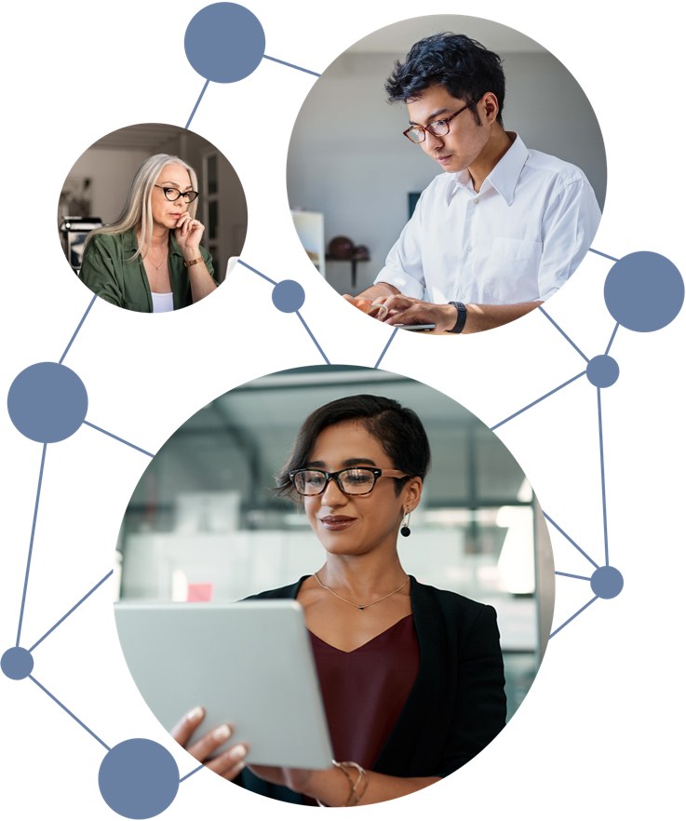
Now customers and employees expect the same sophistication from you …
170+ million people have used ChatGPT.*
* In the first two months after its release
Notes:
Businesses are often slow to allow new technology in the workplace. This happened with internet access and smartphone use, to name two examples. And in both cases executives were criticized for not being in touch with the rest of the world. Generative AI is following the same path. Customers and employees are using GenAI technologies at home, and expect the same sophistication and ease of use from the organizations they buy from (as customers), or work at (as employees). You can’t stop it.
For more information, contact Frank Buytendijk.

Slide 26





How Does GenAI Change a Typical AI Strategy?
 | Current AI Strategy |  | Updated AI Strategy
Vision | AI automating tasks |  | Generative AI augmenting people in their work
Roadmap | Three-year outlook, business innovation |  | One-year outlook, business criticality
Use Cases | Predictive analytics, automating tasks |  | Generating artifacts (text, video, audio, code & data) and simulating decisions
Governance | Fragmented or part of data and analytics |  | Clear business responsibility, AI ethics committee
Talent | AI center of excellence |  | Educating everyone on responsible use of GenAI
Source: Gartner
Notes:
The sudden popularity of generative AI changes the ways in which organizations should strategize for AI. Key aspects that will need attention include:
Vision: Many organizations have been looking at AI as a means to automate tasks, and ultimately jobs. We believe that the effects of generative AI will be different — much more geared toward augmenting people in their jobs and activities.
Roadmap: Many AI strategies have a three-year roadmap, with priorities lined out. AI so far has been seen as a business innovation. Every strategy should now be sped up, with results maximally one year out. And AI’s impact has changed as well. It is now business-critical.
Use cases: These have changed too. Although AI is a wide-ranging set of technologies, one prominent category was predictive analytics. Generative AI shifts the focus of use cases toward generating artifacts, such as text, video, audio and computer code.
Governance: The governance structure options around AI have been fragmented. Some organized it in IT, others in data and analytics or other places. Now is the time to change that. There needs to be clear delineation of business responsibility. It was already a best practice to establish AI ethics committees, but now, they have become a necessity.
Talent: Most organizations organized their AI specialists in an AI center of excellence. But with generative AI, everyone will be using AI tools, and the focus should shift to educating every employee on how to responsibly use GenAI tools.
For more information, contact Erick Brethenoux.

Slide 27
By 2025: 35% of large organizations will have named a Chief AI Officer reporting to a CEO or COO.
Notes:
For more information, contact Erick Brethenoux.

Slide 28
How GenAI Affects Jobs

Slide 29





Through 2026
Despite all the advancements in AI, the global jobs impact will be neutral — there will not be net decrease or increase.
By 2026
More than 100 million people will engage robocolleagues (synthetic virtual colleagues) to contribute to enterprise work.
By 2036
AI solutions introduced to augment or autonomously deliver tasks, activities or jobs will result in over a half billion net new human jobs.
Notes:
Through 2026, despite all the advancements in AI, the global jobs impact will be neutral —meaning there will not be a net decrease or increase. That’s because, despite all the hype, it will take a while before there will be significant job impact. Some jobs will disappear and some will be created, but this will be a slow process overall, taking years. There is a process of budgeting, full-time equivalent (FTE) calculations, and other tasks. If job losses occur after the hype dies down, generative AI will hit the “Trough of Disillusionment” in the Hype Cycle. Moreover, in the coming years, Gartner estimates that only 15% of organizations will be able to get the most out of advances in generative AI.
By 2026, more than 100 million humans will engage robocolleagues (synthetic virtual colleagues) to contribute to enterprise work. Rather than framing our conversation about jobs being displaced, we should think of generative AI as a way to augment jobs. There will be millions of people that will be able to assign certain tasks to robocolleagues.
By 2036, AI solutions introduced to augment or autonomously deliver tasks, activities or jobs will result in more than 500 million net new human jobs. Although in the short term, the job impact will be minimal, the long-term impact will be significant. Our calculations show that there is reason to be optimistic. This increase of 500 million new human jobs will be largely due to a democratization of skills and roles, making previously highly specialized jobs, such as those in healthcare or the legal industry, much more accessible for others. This will lead to massive growth of the jobs market.
For more information, contact Fran Karamouzis.

Slide 30
AI Outperforms People in Some Tasks, but Not All
Example Tasks
2023
2033
Weather prediction
AI Outperforms Human counterpart
Competing in video games
AI + Human Coexistence
Breadth of translation
Human outperforms AI counterpart
Voice/Facial recognition
Driving a car
Medical scan diagnosis
Software programming
Creating financial analysis
Creating music
Writing best-selling books
Moral and ethical reasoning
Build new scientific theories
Personal care & therapy
Notes:
Weather prediction: Weather prediction involves complex models, workflows, and real-time interpretation. These are tasks that AI tools already master.
Competing in video games: AI systems will continuously increase their usage of player behavioral prediction, adversarial strategy and spatial awareness to outperform human players.
Language translation: AI is already much better at translation in certain dimensions like speed and consistency. However, humans can bring unique cultural awareness for more complex or creative translation. The combination, with AI supporting human translators is currently the best option. However, this might quickly change with the rapid improvement of large language models, which can translate large documents in sophisticated ways, even for rare languages. For more information, see Maverick* Research: Machine Translation Can Save the World’s Languages From Extinction (G00773251).
Voice/facial recognition: AI already assists in recognizing human voice and facial features, but humans are still much better at these tasks. This will change as facial- and voice-recognition models improve.
Driving a car: Drivers will be increasingly assisted by AI in control of the vehicle, navigation and avoidance of collisions. We are expecting full autonomy to be allowed by the end of the 2020s. For more information, see Emerging Tech: The Future of Autonomous Vehicles (G00759769).
Medical diagnosis: AI can uncover complex patterns in patient data and clinical images that humans cannot. However, medical diagnosis requires causal reasoning, which current AI struggles with, making human and AI teams the best current option. Rapid advances in causal AI could tip the balance toward AI taking over as the more accurate option.
Software programming: Software programming is a creative endeavor. Humans can be greatly assisted by GenAI proposing solutions to problems and generating the associated code, but it will not replace humans because it lacks context, judgment and contextual knowledge. For more information, see The Ai Weekly article, Will ChatGPT Replace Developers?
Creating financial analysis: AI and machine learning is helping humans automate and run large and complex financial models, but it is unlikely to outperform people in identifying investment opportunities and making new recommendations.
Creating music: AI can help generate ideas, helping humans to create music. It can combine preexisting musical works, but it lacks the creativity needed to generate original art.
Writing best-selling book: AI can help humans gain additional context on a new topic, but writing new stories and creating engaging and compelling plots are aspects not present in current AI. Machine learning algorithms can help in analyzing vast amount of text to create plot structures, but they may not be novel.
Moral and ethical reasoning: Ethical reasoning requires subjective judgments based on the unique human life experience. AI, even very advanced AI, is unlikely to properly consider the complexities and contradictions of human values and preferences. AI can still be useful in implementing ethical principles, but ethical reflection and deliberation will remain a uniquely human activity for the next 10 years.
Building new scientific theories: AI already greatly contributes to science. However, creating fundamentally new scientific theories requires not only domain knowledge, but an ability to reason abstractly and creatively, connecting ideas from different domains. AI is currently incapable of doing any of these things.
Personal care and therapy: Although ChatGPT scored better on “empathy” than doctors (for more information, see the Axios article, ChatGPT Might Show More Empathy Than Docs, Study Finds), there is a physical aspect to care and therapy as well. These are not capabilities and traits that AI systems have or will have in the next 10 years. For more information, see The Washington Post article, AI Isn’t Yet Going to Take Your Job — But You May Have to Work With It.
For more information, contact Gunjan Gupta.

Slide 31



Democratization of Work and Redistribution of Workload
Gartner predicts that every knowledge job will be scrutinized and separated into individual activities and tasks.
Human
Combination of Both​
AI
Source: Gartner
Notes:
A 2023 Goldman Sachs report estimated 300 million jobs could be lost or degraded by AI (for more information, see the Forbes article, Goldman Sachs Predicts 300 Million Jobs Will Be Lost Or Degraded By Artificial Intelligence). We do not share that pessimism. Per our analysis, Gartner expects to see a net surplus of jobs globally. But you can expect to recalibrate your vocabulary — the word “job” will no longer be exclusively used to refer to human employment. AI solutions (robocolleagues in the form of synthetic virtual workers) will boost productivity or even execute many job tasks.
Gartner expects that in the next decade AI will lead to a worldwide net growth in total human jobs — in fact, AI will lead to many newly created occupations.
We agree that many job tasks or activities, performed by people, will change radically, with roles and job titles being restructured and renamed in many cases (hence, some may refer to them as disappearing jobs). We consider this value enhancement. However, Gartner predicts that changes of this magnitude will occur in less than 20% of total occupations worldwide.
In the end, Gartner predicts that a majority of jobs (over 60%) will have some form of (virtual) robocolleagues that will either highly augment the human role or perform certain activities or tasks autonomously.
For more information, contact Fran Karamouzis.

Slide 32
Democratization of Work and Redistribution of Workload
The most common impact for the next decade will not be the replacement of workers. It will be the augmentation of jobs with AI.
Source: Gartner
Notes:
Most jobs will be recalibrated by the augmentation of the overall evaluation process. Like manual labor was optimized in the days of “scientific management,” every knowledge job will be reviewed under an intense spotlight. Each job will be separated into individual activities and tasks, and these will be scrutinized. Choices must be made as to whether tasks should be executed by an AI, a human being, or a combination of both. ​
Initially the most common impact for the next decade will not be to replace people, but to augment jobs.
Augmentation will occur in two forms:
Expanding or complementing existing jobs: People will be supported by AI. They will use AI applications to increase speed, boost quality and lower error rates.
Creating new jobs: People will augment AI, leading to a democratization of jobs, making them accessible to a group larger than only specialists. In healthcare, caretakers will coach people through AI-driven examinations and procedures. The legal profession will create new jobs to allow people to interpret the output of legal AI (including contracts or even preliminary rulings) and explain next steps..
For more information, contact Fran Karamouzis.

