Slide 1

























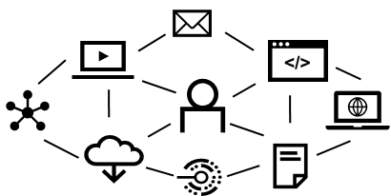




























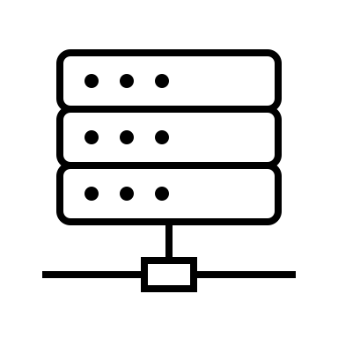

































Cybersecurity Mesh Architecture (CSMA) V2.1
External Threat Intelligence
Point Products
CSMA Aligned * (Subscriber/Contributor)
Entity/Assets
Identity Fabric
Operations
Policy, Posture, & Playbook Management
Predictive Sentiment Monitoring
External
Feeds
Users
Policy Management
CSV / Vulns
Finance / Fraud
Attack Chains
SIEM
Physical
Work Bench
Dark Web
News
XDR
Authentication
100
Brand Reputation
MITRE
Intel Feeds
PACS
Supply Chain
1234
Overall Risk
HR
Anonymized CSMA
Security Policy Standards
Ie. Zero Trust, ISO, CIS,
CSA, NIST, etc
Policy Settings Management
Travel
SCRM
Devices with Proximity
Posture Management
Social Media
PKI / Secrets / HSM / KMS
Cryptography
Activism
Help Desk
Security Threat Feeds
LI
Mesh Visualization
of Entities Risks
WAAP
Location
Location
Security Intelligence
SAST/DAST
Realtime Entity &
Risk Scoring / Dynamic Context
100
ZTNA
Applications / API
Date & Time
Posture Standards
Config/Policy Drift Management
Generative AI Interface
Playbook Management
Overall Risk
SWG / EFW
Analytics Aggregation
DDOS
Normalization / Standards / API Integration
Predictions of Attack
Machine Learning
& AI
NDR
Network
Other Contextual Attributes and Signals
DLP
Playbook Creation
Playbook Registration
Action Repository
Business Logic Rules
Automated Response
Data Class
BYO
Protection Product Analytics / Information Sharing
DSP
Data
Situational Awareness
SEG / MTD
Email Security
Messaging
Identity Storage
Centralized Operations
Dashboard
CPSPP
IOT / OT
Identity Onboarding
Business Logic Rules
Business Boundaries
Business Risk Acceptance
Thresholds Requiring Action
Models to map security to business
UEM / UES
Policy Enforcement
Centralized
Alerting
Security Product
Performance Reliability
Infrastructure
Version
Control
What if scenario modeling (Probability)
EPP
Encryption & Trust
Behavioral
Patterns
EDR
Server/VM/Container/ Serverless
Centralized Investigation
Behavior
MTD
Operating Systems
Identity Governance and Lifecyle
Automated Response
Pen tests, AST, DAST, SAST
Realtime scanning
Honey pots
Deception tools
Security Awareness Training
Cyber Resiliency Service
Software Updates
Security Tool Replacement
Scripts
Configuration Changes
Infrastructure Configuration Resets based upon version
Exposure Management Toolbox
Attack Surface Measurement
Attack Chain Mapping
Asset Inventory
Vulnerability Measurement Modeling
Red vs Blue Team
War Gaming
Breach and Attack Simulation
Control / Monitor/ Response Validation
Anomalies
IOCs, Incidents
Incidents
EAM
PC/Laptop
Discovery & Ownership
Centralized Reporting
Historical Records
PAM / AM
Continuous Session Management
IGA
Mobile/Tablet
Businesss, Executive and Board Context
Product
Register
Registration
UEBA
Directory Services
ITDR
Users / Entities
Real Time Adaptive Access
Discovery, Orchestration & Automation
CASB / SSPM / SSE
CWPP / CSPM
Entitlements Management
* Note: Products included in the diagram are not all of the products that can be included but an example list of possible tools that protect assets
CNAPP
Cloud
Notes:
1 = Threat intelligence exchange
Probablisitc threat model\
With premptive response get away from cvss
PAM
User Directory
Access Management
IGA
SASE
XDR

