Slide 1

Use-Case Prism: AI for IT Service Desk
Chris Matchett

Slide 2
Overview
Artificial intelligence (AI) is an enabler of specific use cases in IT service management (ITSM). These include generative AI-enabled opportunities that have recently emerged and are of heightened interest to I&O leaders. The Use-Case Prism ranks each of the 16 use cases for IT service desk outlined in this report against its business value and feasibility. The pipeline shows how those use cases are distributed across the context, advice and action stages of applying AI in ITSM.
The AI use cases for IT service desk identified in this research are categorized by broader AI use-case families (as defined in AI Zodiac: Mapping AI Use Cases to Techniques), which are shown in the scoring breakdown and pipeline. These use case families can be cross-referenced with other Gartner research about AI. Use-case families not used in this Prism are intelligent automation, decision intelligence and autonomous systems. Generative AI use cases are mainly found within the content generation use-case family, but also knowledge discovery.
This Use-Case Prism plots these use cases against business value and feasibility axes, inviting strategic conversations and driving investment decisions related to specific vendor solutions.

Slide 3
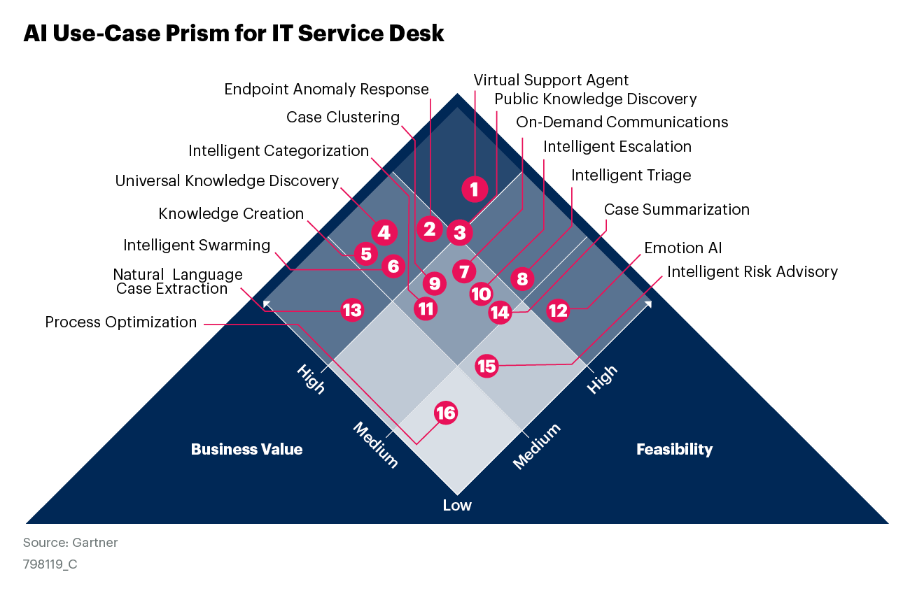
AI Use-Case Prism for IT Service Desk

Slide 4

How to Use
AI is an enabler of specific use cases for IT service desk. This Use-Case Prism plots these use cases against business value and feasibility axes, inviting strategic conversations and driving investment decisions.
Review the AI use cases plotted on the Prism, comparing them with the maturity and requirements of your own ITSM organization.
Likely Wins offer a great combination of high feasibility and high business value.
Marginal Gains are highly feasible but offer low business value.
Calculated Risks offer high business value but low feasibility.
Selective Exceptions offer low business value and low feasibility.

Slide 5
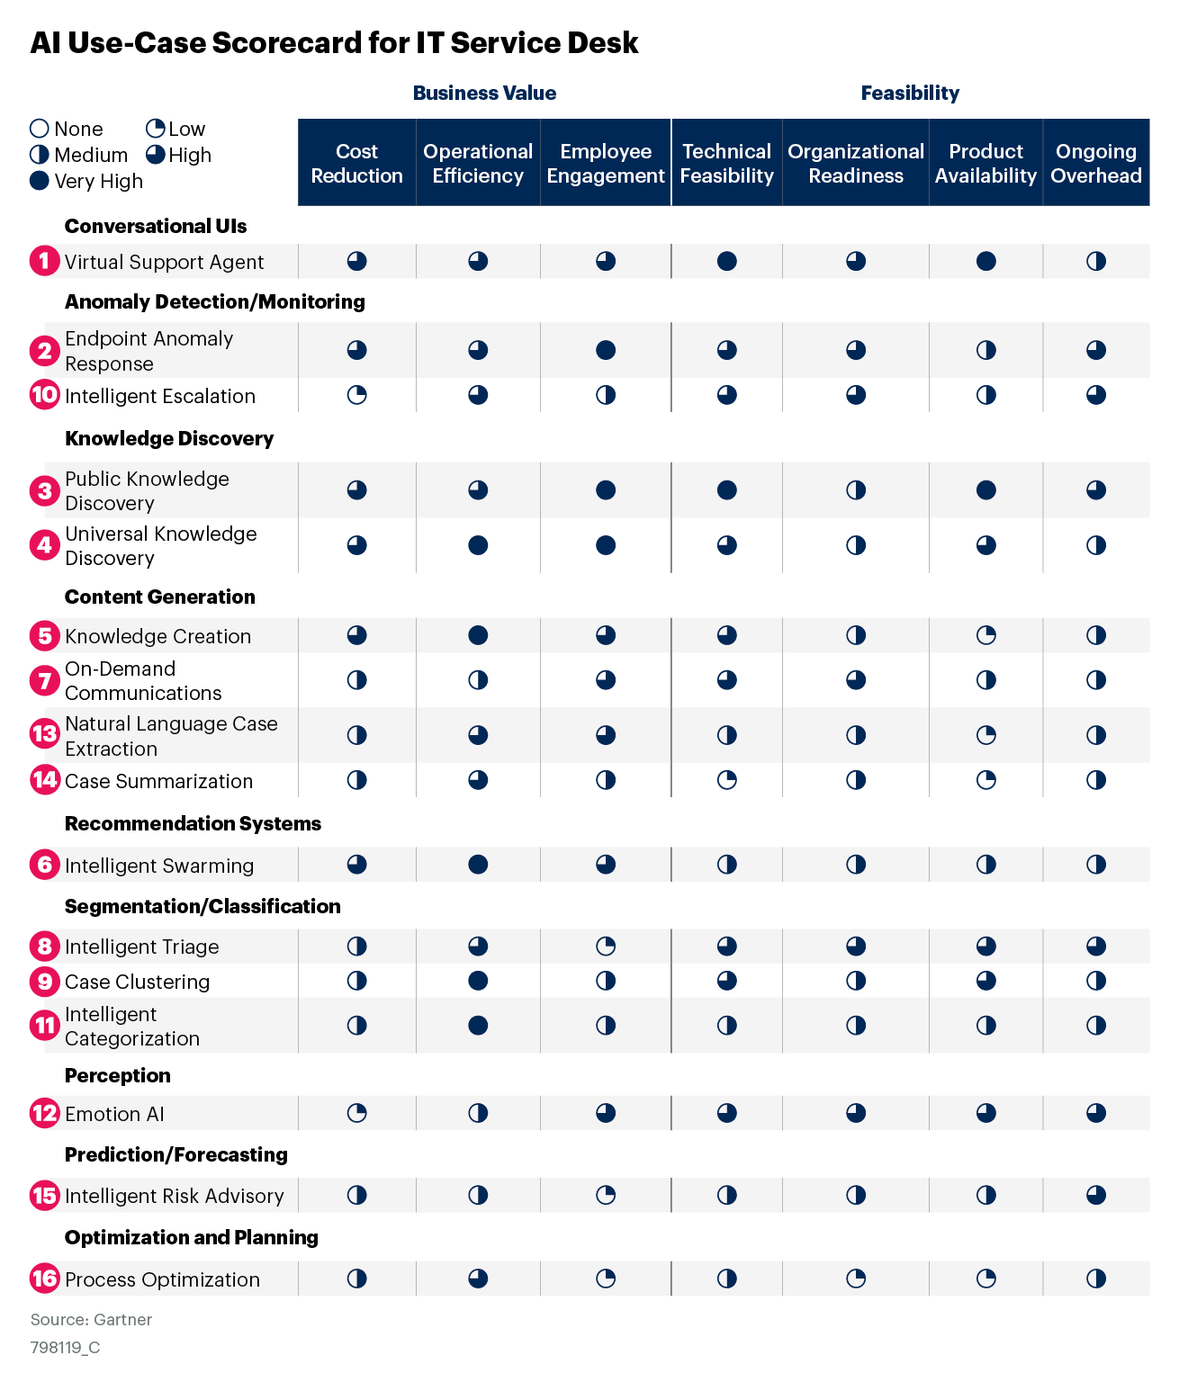
AI Use-Case Scorecard for IT Service Desk

Slide 6
Use-Case Dimension Explanations
Dimension | Explanation
Cost Reduction | Includes process, user experience and product improvements that enable tangible reduction in costs, such as labor savings, logistical improvements, faster execution and improved accuracy.
Operational Efficiency | Includes process, user experience and product improvements that enable I&O teams to optimize processes through insight and automation.
Employee Engagement | Includes employee-facing user experience and workflow improvements that enhance IT’s relationship with the business consumer.

Slide 7
Use-Case Dimension Explanations
Dimension | Explanation
Technical Feasibility | Includes whether necessary underlying technologies are mature enough to be successfully deployed.
Product Availability | Includes whether necessary underlying technologies are available and in the market.
Organizational Readiness | Includes the ability of the organization to make the necessary policy, procedural and change management activities to adopt the solution.
Ongoing Overhead | Includes the effort and finance costs on the organization to continue to use and maintain the solution after implementation.

Slide 8
Use-Case Pipeline
The pipeline shows how these 16 use cases are distributed across three stages of application of AI in ITSM (see Leverage 4 Domains of AITSM to Evolve ITSM Tools and Practices). It allows prioritization, as you can easily see which use cases have a chance of improving context, advice and action, which are described as:
Context: This refers to structured and unstructured data that can help both humans and “robots” better understand a situation and make informed decisions on how to respond.
Advice: This includes analysis of the context and further information to provide recommendations that speed up the response of the human operating the process.
Action: This domain refers to automation of part of the ITSM process in the ITSM platform or virtual support agent. Generative AI use cases will typically include this domain.

Slide 9
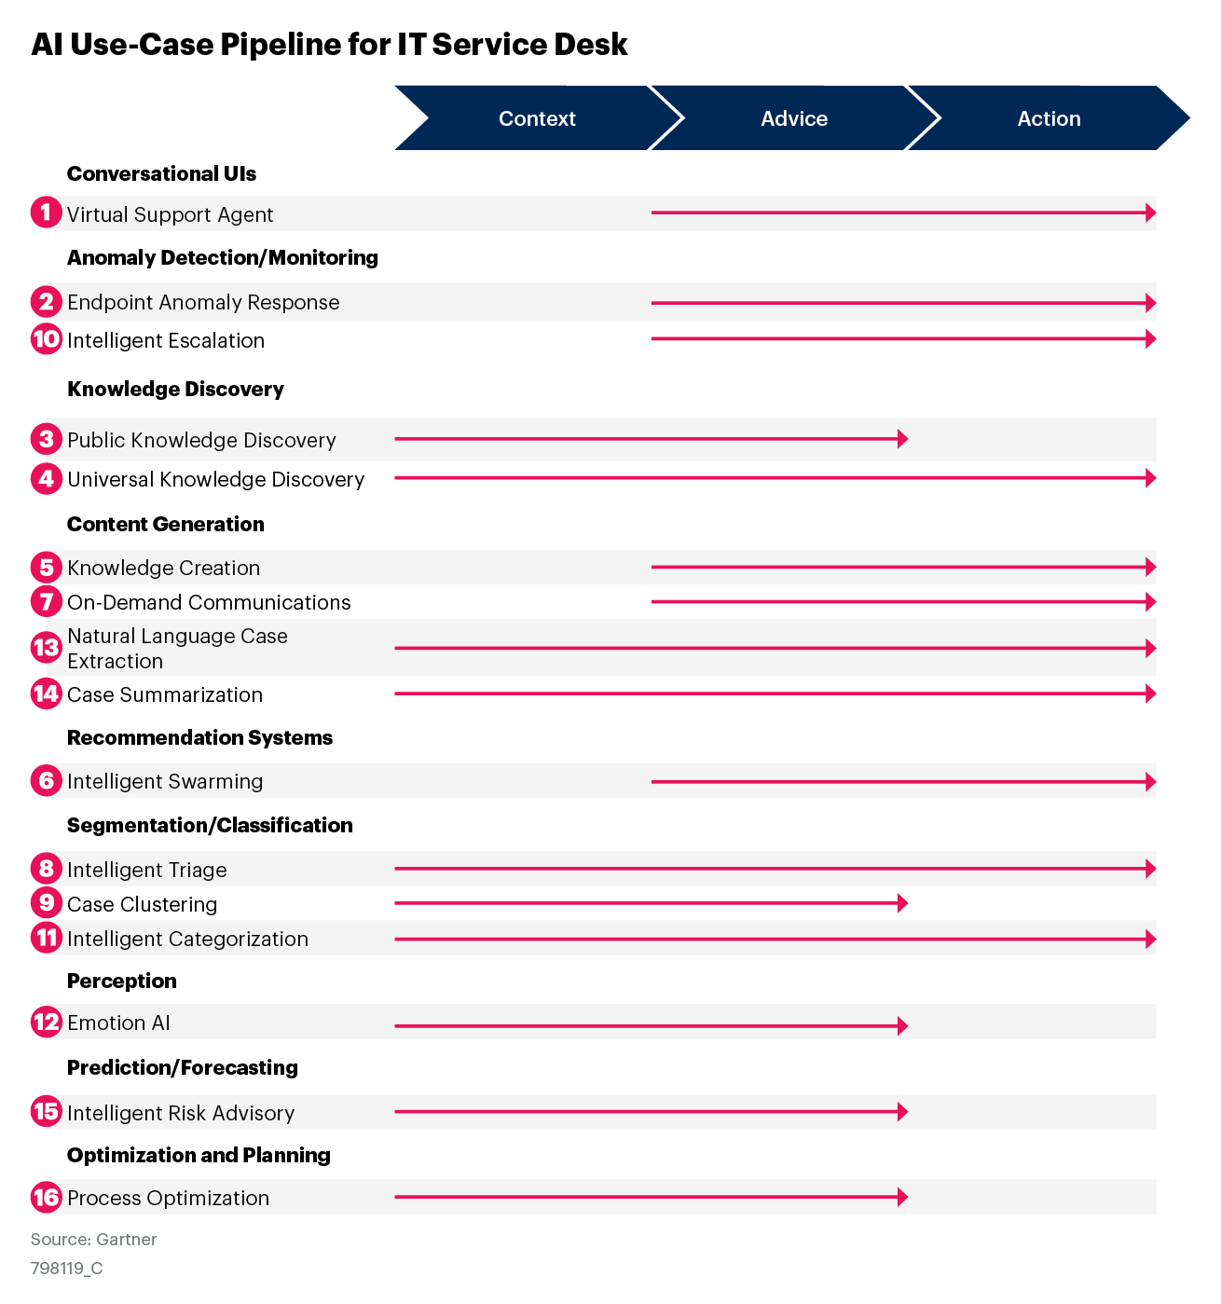
AI Use-Case Pipeline for IT Service Desk

Slide 10
About This Research
These use cases have been selected and positioned based on an assessment by Gartner analysts and customer feedback. Their applicability may vary across organizations and industries.
For detailed customization, use Gartner’s Prism Toolkit:
Toolkit: Discover and Prioritize Your Best AI Use Cases With a Gartner Prism (732696)

