Slide 1
AI Design Patterns for Generative AI and Augmented Analytics & BI
David Pidsley, Rita Sallam, Leinar Ramos
Notes:
Presenter's Name
Presenter's Name

Slide 2
What are design patterns?
Why are we applying them to generative AI?
Design patterns:
Represent general solutions to common AI and software design problems
Provide repeatable approaches, principles and architectural blueprints
Are not specific to a particular use case, but rather provide a set of proven solutions that can be applied in a variety of use cases
Consist of extensible reference patterns that are stable to underlying technology changes
GenAI is an evolving technology with a broad set of use cases that can be applied in the Analytics & BI (ABI) space. As a result, it opens up a number of design patterns
Design patterns can integrate GenAI with the existing ABI architecture, broadening their use
There is high demand for knowledge on how to design and implement GenAI use cases
This deck will help readers recognize not just what is possible but how it is broadly achieved

Slide 3
Gartner Generative AI Landscape Layers
Generative AI Use Cases
Design patterns are only one part of the broader Gartner Generative AI framework
Design patterns do not represent mutually exclusive architectural choices, but reusable elements that can be combined for different use cases and architectures
Generative AI Design Patterns
Generative AI Framework
Generative AI Framework Architectures
Reference Architectures

Slide 4


Gartner AI Design Patterns: Icons
Data
ML
Model
Process/ Application
Input/ Output
Decision
Interface/ API
Agent (Human)
Memory
Symbolic
Model
Training
Environment
Flow
Composite AI Model
Inference
Agent (AI)
Compositional Icons
Design Pattern
Application
Serves both as a bounding box and as a representation of the full design pattern logic in patterns with a higher abstraction
Serves as a bounding box for applications
The design patterns in this deck are built from these icons. You can use these to create your own additional or modified patterns as well.

Slide 5
Gartner AI Design Patterns: Description
Field | Explanation
Name and Description | A concise and descriptive name for the pattern
Motivation | A description of the challenge the pattern addresses, including the context in which it arises and any constraints that must be considered
Solution | A description of the elements that make up the pattern, including their relationships and collaborations, and how they solve the problem
Implementation | A description of the steps required to implement the pattern
Benefits | A list of the benefits the pattern provides, such as increased flexibility or reduced complexity
Drawbacks | A list of any drawbacks or trade-offs associated with using the pattern
Use cases | Illustrations of how the pattern can be used (use case); an example that illustrates how the pattern is used in a real-world scenario

Slide 6
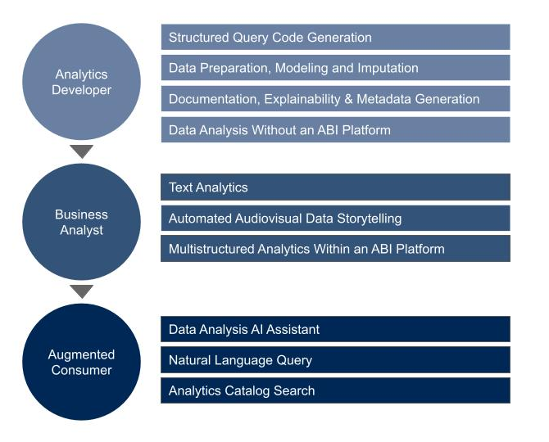

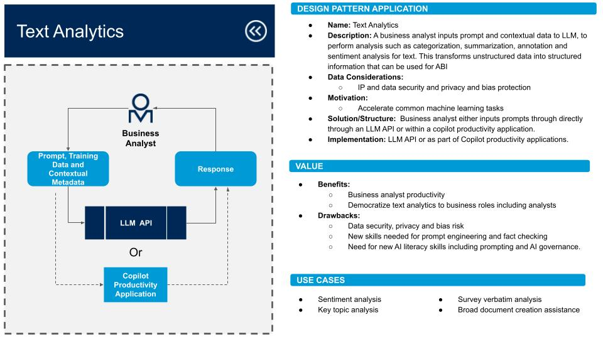
How to Use This Presentation
1
Go ‘Full Screen’ for the best experience
In the following slides, we present 10 design patterns, divided into three groups
3
At any point you can click the “back icon” to return to the main screen
2
You can click on each pattern to see a design illustration, description, implementation, benefits, drawbacks and use cases

Slide 7
Generative AI and Augmented Analytics & BI
Design Patterns

Slide 8
Analytics Developer
Structured Query Code Generation
Data Preparation, Modeling and Imputation
Documentation, Explainability & Metadata Generation
Data Analysis Without an ABI Platform
Business Analyst
Text Analytics
Automated Audiovisual Data Storytelling
Multistructured Analytics Within an ABI Platform
Augmented Consumer
Data Analysis AI Assistant
Natural Language Query
Analytics Catalog Search

Slide 9

AI Design Patterns for Analytics Developers

Slide 10
Structured Query Code Generation
DESIGN PATTERN APPLICATION
Name: Structured Query Code Generation
Description: User enters a prompt with a natural language description of a query that can be answered by facts and metrics stored in a database. The large language model (LLM) response is code, in a format of choice, that is executed in the database to extract the relevant data.
Data Considerations:
Managing intellectual property (IP) and privacy
Motivation:
Provide analytics developers an easier access to databases
Improvement in analytics development speed
Speed up learning old or new platforms, languages and frameworks
Solution/Structure: Query in natural language along with the desired query language (e.g., SQL). The database schema/ontology needs to be provided
Implementation: Web chatbot, IDE chatbot, multiline code suggestions
Prompt (Query and Table Schema)
Analytics Developer
LLM
API
VALUE
Benefits:
Accelerates the process of querying a database against known entities and relationships
Faster than a search engine or documentation, less context switching
Drawbacks:
Context given in prompt may not be enough to produce accurate results
Consider any limitation on size of content that can be sent in prompt
Loss of skills by relying on the model (syntax / methods)
Code quality (including security and performance)
Cognitive bias, managing effort of prompting and validating outputs
Query Language Code
Extracted
Data
Database
USE CASES
Database population
Metadata management
Debugging and refactoring structured queries.
Notes:
Gartner Research:
Innovation Insight for ML-Powered Coding Assistants
Quick Answer: Should Software Engineering Teams Use ChatGPT to Generate Code?
Quick Answer: Will Machine-Learning-Generated Code Replace Developers?
Emerging Tech: Generative AI Code Assistants Are Becoming Essential to Developer Experience

Slide 11
Data Preparation, Modeling and Imputation
DESIGN PATTERN APPLICATION
Name: Data Preparation, Modeling and Imputation
Description: User wants to connect to data sources, improve data quality and create synthetic data for a data model with the LLM while protecting PII.
Data Considerations:
PII data protection
Data source connectivity that has been made available to the LLM.
Motivation:
Improve data quality
Creation of tabular synthetic data as ML training set
Accelerate work
Solution/Structure: Analytics developer promops LLM API and provide query embedding such as datasets and metadata and is returned a (improve) data model and synthetic data (imputation).
Implementation: Within or without an ABI platform, LLM connects to data sources and returns semantic data model and synthetic data
Analytics Developer
Prompt
Response
VALUE
Benefits:
Improves data quality with tabular synthetic data
Creates well modelled semantic data model for business users
Speeds up data preparation
Drawbacks:
Disconnection from data integration or data quality platforms/tools
Lack of transparency or trust (explanation) about data imputations
May impact query performance (e.g., bidirectional table joins)
LLM API
Query Embeddings
Datasets and Metadata
Data Model & Synthetic Data
USE CASES
Data preparation
Data quality improvements
Self-service analytics
ML training set creation
Notes:
Gartner Research:
Emerging Tech: Generative AI Is Core to the “Big Six” Methods of Creating Tabular Synthetic Data

Slide 12
Documentation, Explainability & Metadata Generation
DESIGN PATTERN APPLICATION
Name: Documentation, Explainability & Metadata Generation
Description: Using LLMs to generate metadata and documentation for data, code, and explanations of analytical content and lineage
Data Considerations:
Availability of analytics documentation/analytics content to prompt LLM API
Existence of catalog, high quality data pipelines and samples
Motivation: Use LLM capabilities to improve discoverability and understanding of data model and analytical artefacts and lineage in an automated way without manual effort to create metadata and documentation
Solution/Structure: Analytics developer prompts question (and format) with docs and analytics content. Entities are extracted and explanations are returned by the LLM. Persisted in metadata repository for post processing
Implementation: LLM API, metadata repository, document store, vector DB
Prompt (Question, Format, Documentation, Analytics Content)
Analytics Developer
LLM
API
Documentation, Explanation and Metadata
VALUE
Benefits:
Reduced manual effort in metadata and documentation generation
Increased explainability of code, data sources, metrics and analytics
Build and maintain trust in the quality of data and automated insights
Drawbacks:
Most LLMs cannot process visual data (e.g., charts, data viz, etc.)
Ambiguity in human vs. machine-generated documentation impacts trust
Metadata Repository
Postprocessing
USE CASES
Discover & design data models
Explain ML/automated insights to augmented consumers
Reconcile physical to logical models
Developers documenting data models
Entity metadata for discoverability
Notes:
Gartner Research:
Assessing How Generative AI Can Improve Developer Experience
Case Study: An Active Metadata Augmented Data Classification System to Boost Analytics Efficiency)

Slide 13
Data Analysis Without an ABI Platform
DESIGN PATTERN APPLICATION
Name: Data Analysis Without an ABI Platform
Description: Users guide the application through prompt engineering to create analytics content. By providing details like desired metrics, database name, schema (table and column descriptions), and data location, the LLM can translate this into structured queries (SQL, Python). The results are then presented either in natural language, as per the prompt, or visualized through an API-linked chart engine
Data Considerations:
Enterprise data being provided to third parties
Data security
Motivation:
Reduce ABI platform licensing costs (this solution still generates LLM API consumption-based costs)
Solution/Structure: Analytics developer inputs prompts directly through an LLM API that then generates structured query to a database, which then calls out to a charting engine then back to the LLM for natural language response and analysis.
Implementation: LLM API, database API, charting engine API
Analytics Developer
Prompt, Training Data and Contextual Metadata
NLG, Charts, Table & Analysis Suggestions
LLM API
LLM API
VALUE
Benefits:
Reduces the need for analytics and BI platform licenses
Used within existing business workflow, not a separate application
Drawbacks:
Higher skill levels than querying through an analytics & BI platform
Exchange the cost of an analytics and BI platform for the consumption costs of building analytics content via an LLM API (may not be cheaper)
Assumes database includes high-quality data and is structured for analysis
Charting Engine API/ Plugin
Extracted Data
Structured Query
Database
USE CASES
Data story development
Ad hoc analysis
Data wrangling
Summarizing trends
Notes:
Gartner Research:
Quick Answer: What Are the Short-Term and Midterm Implications of ChatGPT for Data and Analytics?

Slide 14
AI Design Patterns for Business Analysts

Slide 15
Text Analytics
DESIGN PATTERN APPLICATION
Name: Text Analytics
Description: A business analyst inputs prompt and contextual data to LLM, to perform analysis such as categorization, summarization, annotation and sentiment analysis for text. This transforms unstructured data into structured information that can be used for ABI
Data Considerations:
IP and data security
Privacy and bias protection
Motivation:
Accelerate common machine learning tasks
Solution/Structure: Business analyst either inputs prompts directly through an LLM API or within a Copilot productivity application
Implementation: LLM API or as part of Copilot productivity applications
Business Analyst
Prompt, Training Data and Contextual Metadata
Response (Structured Data)
VALUE
Benefits:
Business analyst productivity
Democratize text analytics to business roles including analysts
Drawbacks:
Data security, privacy and bias risk
New skills needed for prompt engineering and fact checking
Need for new AI literacy skills including prompting and AI governance
LLM API
Or
Copilot Productivity Application
USE CASES
Sentiment analysis
Key topic analysis
Survey verbatim analysis
Broad document creation assistance
Notes:
Gartner Research:
Best Practices for the Responsible Use of Natural Language Technologies
Market Guide for Text Analytics

Slide 16
Automated Audiovisual Data Storytelling
DESIGN PATTERN APPLICATION
Name: Automated Audiovisual Data Storytelling
Description: Analysts feed prompts to the LLM API, which channels the query to the ABI platform. The platform adds context from the knowledge graph, conducts varied analyses (like trends, forecasts), and produces insights with visuals. These insights are rendered in user-friendly language by the LLM API and translated into video or voice narratives via AI.
Data Considerations:
Enterprise data being provided to third parties
Data security
Motivation:
Accelerate audiovisual (multimedia) analytics content creation
Expand consumable insights to a broader audience
Solution/Structure: ABI platform generates insights to be output as a GenAI video with avatar to read insights or to a narrated podcast with insights
Implementation: ABI platform with integration to LLM API, GenAI video API, podcast application API (text-to-speech)
Business Analyst
Audio Podcast
Video With Avatar
Augmented Consumer (Human)
Prompt, Training Data and Contextual Metadata
Voice Synthesis (TTS)
User-Friendly Explanations
VALUE
Benefits:
Expand adoption and insights to underserved audiences
Accessibility for mobile and/or handsfree business analysts
Faster more engaging delivery of insights promotes sharing
Drawbacks:
Human in the loop to check the accuracy of responses
Data privacy and security
Need for new AI literacy skills, including prompting & AI governance
LLM API
LLM API
SQL Query
Prompt (Query Result)
Gen AI Video API
Insights and Visualization
USE CASES
ABI
Platform
Enterprise reporting and analysis
Domain reporting
Customer-facing reporting
Notes:
Gartner Research:
Data Storytelling: Analytics Beyond Data Visualizations and Slideshows

Slide 17
Multistructured Analytics Within an ABI Platform
DESIGN PATTERN APPLICATION
Name: Multistructured Analytics Within an ABI Platform
Description: Use an LLM orchestration application to bring together multiple LLM-API workflows to answer a single query, spanning multiple data repositories. For example, a call center agent searching for a customized customer response based on transaction data and call transcripts
Data Considerations:
Knowledge graph/database and/or vector database may be required
Motivation:
Perform multistructured analytics queries over wide data sources, formats and structures of data and content
Solution/Structure: LLMs, LLM orchestration and LLMOps, AI agents, and data repositories
Implementation: LLM orchestration application handles the data and application workflow to and from the LLMs, with a model to link different data sources such as via insight engines
Prompt and Metadata for Multistructured Query
Business Analyst
Response
LLM Orchestration Application
LLM API
LLM API
LLM API
VALUE
Benefits:
Support for complex multi-step queries against wide data sources
A diverse variety of data sources can be supported
Drawbacks:
Multiagent systems introduces latency and cost
Query
Query
Query
Data Source 1
Data Source 2
Data Source 3
USE CASES
Extracted Data
Extracted Data
Extracted Data
Customer service and support
Digital workplace search
Website search
Legal and financial queries
Sales and marketing personalization
Customized insight applications
Notes:
Gartner Research:
Use Multistructured Analytics for Complex Business Decisions

Slide 18
AI Design Patterns for Augmented Consumers

Slide 19
Data Analysis AI Assistant
DESIGN PATTERN APPLICATION
Name: Data Analysis AI Assistant
Description: User inputs prompt to LLM API which interprets and translates into a query for the ABI platform. The platform adds enterprise data and context from the semantic model/knowledge graph. It generates analytics content, which can then be passed to LLM API for natural language explanations and suggestions
Data Considerations:
Enterprise data being provided to third parties
Data security
Motivation:
Improve user experience and reduce skill requirements for augmented analytics consumers of content by knowledge workers
Speed of data analysis for analytics developers in the business moment
Solution/Structure: Integration with LLM APIs as part of ABI platforms
Implementation: Optimize semantic model / knowledge graph and data security and access for LLMs
Augmented Consumer
Prompt (Business Question)
Natural Language Generation Explanations and Suggestions
VALUE
LLM API
LLM API
Benefits:
Improved multiexperience user interface for analytics consumers
Broader adoption of ABI platforms and data-driven decisions
Higher productivity for analytics developers
Drawbacks:
Human-in-the-loop needs to check the accuracy of responses
Poor quality analytics outputs due to unskilled users
Need for new AI data literacy skills (prompting and AI governance)
Structured Query Code
Analytics Content
ABI
Platform
USE CASES
Analytics and BI content creation (analytics developer)
Augmented analytics consumers
Self-service analytics (business analysts)

Slide 20
Natural Language Query
DESIGN PATTERN APPLICATION
Name: Natural Language Query (NLQ)
Description: NLQ allows ABI augmented consumers to input or speak business prompts. The LLM provides suggestions and type-ahead autocompletions. The refined question is sent to a chatbot that uses LLM APIs to structure queries. Additional LLM APIs can process the extracted data to produce natural- language responses; the visualization engine outputs visual dashboards.
Data Considerations: Requires business language naming of fields, values, dimensions, etc
Motivation: LLMs-enhanced NLQ turns business questions into structured queries so users don’t need to know the underlying data model when asking questions.
Solution/Structure: ABI platform with out-of-the-box integration to (multiple) LLMs
Implementation: LLM deployment options: consume SaaS app or API, embed (SaaS or PaaS), extend (retrieval augmented generation or fine-tuning) or build
Start of Question
LLM API
Suggestions & Type Ahead
Augmented
Consumer
Refined Question
VALUE
Traditional Chatbot
Answer
Visual Report
Benefits:
Flattens the learning curve for analytics consumer
Accelerates time to insight in asking follow-up question from alerts
Explains data visualizations as insights without complex analysis
Drawbacks:
The “cold-start problem”: not knowing which questions to ask the NLQ
Limited complexity of reasoning in ABI platforms compared to ChatGPT
Poor support of spoken language except English or specialist taxonomies
LLM API
LLM API
Data Viz Engine
SQL Query
Extracted Data
USE CASES
Dataset
Executive boardrooms
Embedded in LOB applications
Integrates in chatbot workflows
Business analyst/analytics consumers
Mobile (hands-free/voice) user interfaces
Geospatial and temporal reasoning

Slide 21
Analytics Catalog Search
DESIGN PATTERN APPLICATION
Name: Analytics Catalog Search
Description: A search or retrieval model finds the most relevant data (dashboards, reports, data stories) for an augmented-consumer question, incorporating these documents into the context of the LLM prompt to generate a natural language response, adding a conversational layer to the analytics search experience
Data Considerations:
Content lives across multiple ABI platforms and elsewhere
Access and authentication requirement for metadata of content
Motivation:
Faster discovery and increased discoverability
Make analytics search more conversational and user-friendly
Reduce duplication of content from self-service analytics
Solution/Structure: LLM handles prompt, matches index, returns results
Implementation: LLM integrated into an ABI platform’s own analytics catalog (search engine) or standalone analytics catalog (multiple platforms)
Augmented Consumer
NLG Search Results
Prompt
LLM API
Retrieval/ Search Model
Prompt + Top Docs
VALUE
Search Index
Benefits:
Unifies the search and NLQ experiences into conversational interface
Provides summarization of search results and data quality explanations
LLM provides true natural language processing of search queries
Drawbacks:
Disconnected from other elements of the multiexperience UI
Users may not want NLG summarization, just a list based on relevance
Heterogeneous types of content in a search results can confuse users
Search Query
ABI Platforms
DSML Platforms
Data Catalogs
Dashboards & Reports
Data Stories
NLQs
Datasets
USE CASES
Analytics catalog of reports
Data catalog finding dataset
Self-service analytics governance
Augments consumer experience
Notes:
Gartner Research:
Quick Answer: How Can Metrics Stores and Analytics Catalogs Help Govern ABI Platforms?
How Large Language Models and Knowledge Graphs Can Transform Enterprise Search

