Slide 1
Top Strategic Technology Trends for 2023: Metaverse
Marty Resnick
Alfonso Velosa
Adrian Leow
Tuong Nguyen
Michelle DeClue-Duerst
October 2022

Slide 2
By 2027, over 40% of large organizations worldwide will be using a combination of Web3, Spatial Computing and digital twins in metaverse-based projects aimed at increasing revenue.
Metaverse
Gartner Strategic Planning Assumption

Slide 3
Metaverse is the next level of interaction in the virtual and physical worlds, providing innovative new opportunities and business models, by allowing businesses to extend digital business to be persistent, decentralized, collaborative and interoperable. Emerging metaverses are fragmented. Be careful when investing in metaverse-specific technologies (e.g., spatial computing, digital humans and virtual spaces) because it’s too early to determine which investments, in which metaverses have long-term viability. Furthermore, the next one to three years will be a time of learning, exploring and preparing for a metaverse with limited implementation. The financial and reputational risks of early investments aren’t fully known, and we advise caution.
Gartner, October 2022

Slide 4
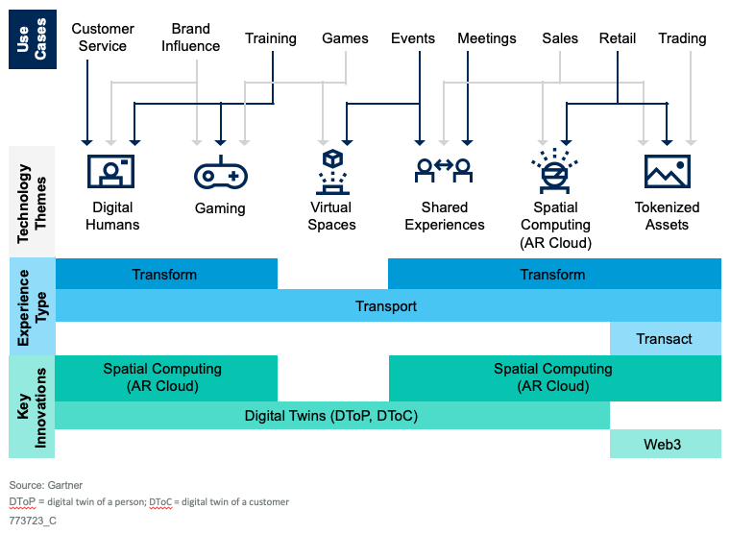
Metaverse: Impact and Opportunities

Slide 5
Why Is This A Trend Now?
Metaverse is a combinatorial innovation made up of multiple technology themes and trends. Individually, these trends are projected to provide new opportunities, and challenges, to organizations across a wide spectrum of industries and use cases.
The four key innovations that make metaverse a strategic technology trend include:
Web 3
Spatial Computing
Digital Twin of a Person
Digital Twin of a Customer

Slide 6

Example Case Study: OneRare
“The world’s first food metaverse.”
Creating a unique gaming layer that allows users to claim NFTs, play food-themed games, and discover new products along the way.
OneRare is gamifying the food industry using metaverse technologies, web 3, gaming and tokenized assets.
OneRare
Metaverse Web3 Gaming
Photo by Ernest Brillo on Unsplash
Notes:
source: https://www.forbesindia.com/article/sports-tech-special/onerare-meet-the-worlds-first-food-metaverse/77043/1

Slide 7
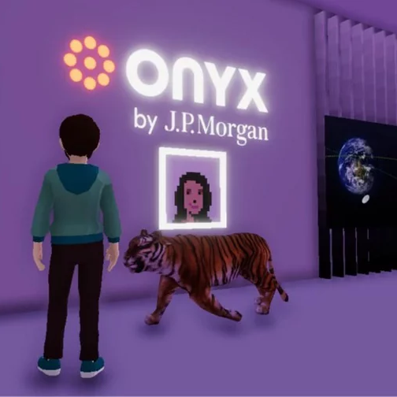
Example Case Study: JP Morgan
JP Morgan has become the first bank to establish a presence in the metaverse.
Predicts a market opportunity of $1 trillion and eyes virtual real estate.
The bank’s Onyx lounge, the name of which references the bank’s suite of permissioned Ethereum-based services, offers institutions and businesses an opportunity to enter the metaverse.
OneRare
Metaverse Banking
Photo by Ernest Brillo on Unsplash
Notes:
Source: https://fintechmagazine.com/banking/jp-morgan-becomes-the-first-bank-to-launch-in-the-metaverse

Slide 8
Actions
Explore opportunities where metaverse technologies could optimize digital business, or create new products and services.
Build metaverse products and solutions through a pipeline of combinatorial innovation rather than trying to find a “killer app.”
Identify metaverse-inspired opportunities by evaluating current high-value use cases.
Develop technology strategies that leverage the built-in infrastructure and participants of the metaverse.
Invest in specific emergent metaverses cautiously, as it is still too early to determine which investments will be viable in the long term.
Protect your reputation by proactively establishing a data governance, security, and privacy policy to protect customer and employee data.

Slide 9
Recommended Gartner Research
Infographic: Impact Map of the Metaverse Marty Resnick and Andrew Gianni (G00775451)
Building a Digital Future: The Metaverse Marty Resnick, Tuong Nguyen and Others (G00761111)
Quick Answer: What Is a Metaverse? Marty Resnick, Tuong Nguyen and Others (G00762274)
Quick Answer: How Will the Metaverse Shape the Digital Employee Experience? Matt Cain and Christopher Trueman (G00761512)
Predicts 2022: 4 Technology Bets for Building the Digital Future Marc Kerremans and Others (G00726304)

Slide 10
Gartner Experts

Slide 11








Gartner Analysts Covering Metaverse
Marty Resnick
VP Analyst 7 years at Gartner / 24 years industry experience
Michelle DeClue-Duerst
VP Analyst 6 years at Gartner / 28 years industry experience
Tuong Nguyen
Sr Principal Analyst 23 years at Gartner / 23 years industry experience
Matt Cain
Distinguished VP Analyst 32 years at Gartner / 36 years industry experience
Adrian Leow
VP Analyst 9 years at Gartner / 23 years industry experience
Christophe Uzureau
VP Analyst 22 years at Gartner / 24 years industry experience
Alfonso Velosa
VP Analyst 22 years at Gartner / 31 years industry experience
Christopher Trueman
Sr Principal Analyst 5 years at Gartner / 10 years industry experience

