Slide 1
AI Design Patterns for Large Language Models
Leinar Ramos, Anthony Mullen, Ben Yan, Van
Baker, Erick Brethenoux, Arun Chandrasekaran
Notes:
Presenter's Name
Presenter's Name

Slide 2
What are design patterns?
Why are we applying them to large language models (LLMs)?
Design patterns:
Represent general solutions to common AI and software design problems
Provide repeatable approaches, principles and architectural blueprints
Are not specific to a particular use case, but rather provide a set of proven solutions that can be applied in a variety of use cases
Consist of extensible reference patterns that are stable to underlying technology changes
LLM is an evolving AI technology with a broad set of use cases it can apply to. As a result, it opens up a number of design patterns — from simple to complex.
Design patterns can integrate LLMs with the existing architecture, broadening their use.
There is high demand for knowledge on how to design and implement LLM use cases.
This deck will help readers recognize \what is possible — and how it is broadly achieved.

Slide 3
Gartner Generative AI Landscape Layers
Generative AI Use Cases
Design patterns are only one part of the broader Gartner Generative AI framework.
Design patterns do not represent mutually exclusive architectural choices, but reusable elements that can be combined for different use cases.
Generative AI Design Patterns
Generative AI Framework
Generative AI Framework Architectures
Reference Architectures

Slide 4


Gartner AI Design Patterns: Icons
Data
ML
Model
Process/ Application
Input/ Output
Decision
Interface/API
Agent (Human)
Memory
Symbolic
Model
Training
Environment
Flow
Composite AI Model
Inference
Agent (AI)
Compositional Icons
Design Pattern
Application
Serves both as a bounding box and as a representation of the full design pattern logic in patterns with a higher abstraction
Serves as a bounding box for applications
The design patterns in this deck are built from these icons. You can use these to create your own additional or modified patterns as well.

Slide 5
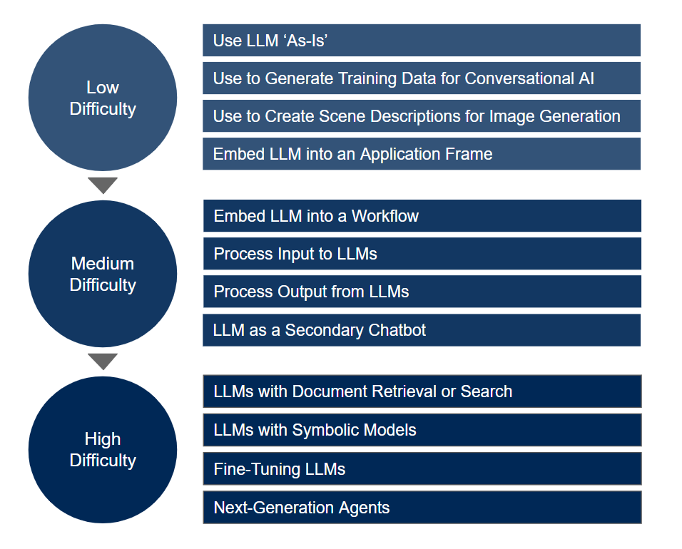

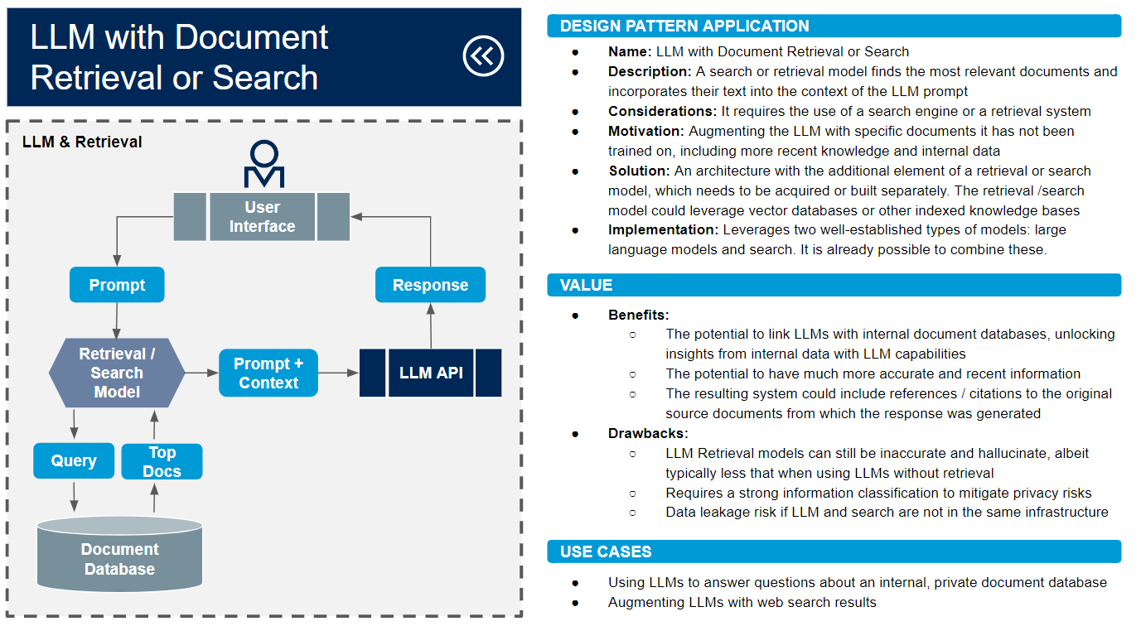
How to Use This Presentation
1
Go full screen for the best experience!
In the following slides, we present 12 different design patterns, divided into three groups.
3
At any point, you can click the “back icon” to return to the main screen.
2
You can click on each pattern to see a design illustration, description, implementation, benefits, drawbacks and use cases.

Slide 6
Large Language Model (LLM) Design Patterns

Slide 7
Use LLM “As-Is”
Low
Difficulty
Use to Generate Training Data for Conversational AI
Use to Create Scene Descriptions for Image Generation
Embed LLM Into an Application Frame
Embed LLM Into a Workflow
Medium
Difficulty
Process Input Into LLM
Process Output From LLM
LLM as a Secondary Chatbot
LLM With Document Retrieval or Search
High
Difficulty
LLM With Symbolic Models
Fine-Tuning LLM
Next-Generation Agents

Slide 8

Low-Difficulty LLM Design Patterns

Slide 9
Use LLMs “As-Is”
DESIGN PATTERN APPLICATION
Name: Using LLM models directly
Description: Users interacting directly with LLMs to increase their productivity via prompts, which could include additional content (for example, text, code snippets, examples, etc.)
Data Considerations:
IP or sensitive information being provided to third parties
Recency of the data LLM is trained on
Motivation:
To quickly generate and transform language artefacts (code, prose) with no IT investment
To empower informal bottom-up content production efficiency
Solution: Simple input and response of text via end-user applications. API use should be prioritized for privacy and security in most use cases (see Embed LLM ‘As-Is’ into an Application Frame).
Implementation: Can be delivered in LLM providers’ applications
Simple Prompt
User
Prompt
Response
LLM
VALUE
Prompt With Content
Benefits:
The simplicity and versatility of this design pattern — a general purpose natural language generation tool — makes it high value in complementing workflows of language and software production.
Drawbacks:
Risk of incorrect or biased outputs, requiring human quality control of generated response.
Potential privacy risks when sharing IP or confidential information.
User
Prompt + Content
Response
USE CASES
LLM
Code generation
Idea generation/brainstorming
Copywriting/content creation
General knowledge discovery/search
Basic translation/NLP tasks

Slide 10
Use LLM to Generate
Training Data for a Conversational System
DESIGN PATTERN APPLICATION
Name: Using LLMs “as-is” to generate conversational data for third party conversation platform
Description: Users with an existing LLM system want to develop synthetic data and conversational assets using a LLM as a generative engine
Motivation: To generate conversational AI assets quickly such as intents, conversational utterances or responses to questions. The synthetic data generated can better cover “edge” cases that are not in the regular dataset.
Solution: Two approaches are used:
User asks for assets relating to input prompts (for example, intents, utterances, questions)
Use develops question-and-answer pairs as conversational assets
Implementation: Workflow can be either human-driven with as-is interfaces or more automated by calling LLM APIs.
Data Generation for Chatbot Training
Prompt (e.g., “Give me other ways of saying this”)
User
LLM
API
VALUE
Benefits:
Low technical skills required
Support training and improvement of chatbot implementations
Drawbacks:
This pattern might breach the terms of use of the LLMs depending on the use case (this requires careful evaluation of the terms of service).
If the target content and topic is not well-represented in the LLM training data, then then breadth and depth of results will be low.
Requires checking whether LLM outputs are suitable for AI training.
Alternates, Synonyms, Intents and Utterances
Conversational Assets Store
USE CASES
Chatbot development
Knowledge management
Semantic asset development (e.g., taxonomies, ontologies)

Slide 11
Use LLM to Create Scene Descriptions for a
Generative Visual Model
DESIGN PATTERN APPLICATION
Name: Use LLMs to generate scene descriptions for image generation
Description: Use the output of an LLM as the input to an image-generation model
Motivation:
To cheaply specify and create customized images at scale
To create multimodal experiences
Solution: LLM is prompted by the user to augment the user’s initial textual description of a scene. That “image specification” text is fed into a visual generative model.
Implementation: This is possible by prompting the LLM to obtain a text for a scene description that can be used in an image-generation model. Alternatively, an automated model-chaining workflow can be built between an LLM API and other image-generation models.
LLM for Image Prompting
Scene Description Prompt
User
LLM
API
VALUE
Benefits:
Quick customized creation of image artifacts
Drawbacks:
Unclear copyright context of generated images (this is a risk inherent to image generation and not specific to the use of LLMs)
The data that the LLM was trained might not include enough information on generating good image-generation prompts
Scene Description
Image Generation Model
USE CASES
Personalized marketing experience
Image generation for e-commerce
AI-Generated Image

Slide 12
Embed LLM “As-Is” Into
an Application Frame
DESIGN PATTERN APPLICATION
Name: Embed LLM “as-is” into an application frame
Description: Exposing LLM capabilities via an application frame that makes API calls to the LLM on the back end
Motivation: To better control and secure adoption of LLM capabilities
Solution: Service called via API and results presented in UI frame inside host application
Implementation: Implemented as an on-demand discovery or content generation tool (in essence, a new tool in a frame awaiting a prompt from user)
LLM Exposed Within an Application Frame
User
VALUE
Request
Response
Benefits:
Takes advantage of the better privacy and security protections included in API offerings (as compared to the end-user applications).
Easier to monitor compliance by recording usage via the proprietary user interface.
APIs give more flexibility for creating complex workflows (for example, adding automated controls before sending data to the API).
Drawbacks:
Volume of use and pricing: API costs need to be monitored.
Private instances of LLMs could be eventually be offered directly by vendors, changing the cost-benefit of building a private user interface.
App Frame
Non-LLM prompt UI
App User Interface
API Call
Prompt
Response
USE CASES
Enabling employee access to LLMs in a controlled environment
All the use cases in the Using LLMs As-Is apply here: code generation, Idea generation/brainstorming, copywriting/content creation, general knowledge discovery, basic NLP tasks
LLM
API

Slide 13
Medium-Difficulty LLM Design Patterns

Slide 14
Embed LLM Into an Application Workflow
DESIGN PATTERN APPLICATION
Name: LLM embedded in an application workflow
Description: Embedding as-is LLM as part of a broader application workflow. This differs from the Application Frame pattern in that this is not just a way to expose LLM APIs, but a way to integrate them as part of a complex application
Data Considerations: Potential inconsistency between the LLM and the host application context and data
Motivation: To expand the functionality of an application with LLM capabilities
Solution: LLM called via API by application and results processed by the application
Implementation: Can be implemented in two ways:
As a secondary source of content proactively queried by application and presented to the user
Where the LLM output drives another process in the application and may or may not present results in the UI
LLM in an Application Workflow
User
Application
A proprietary app augmented with LLMs
App User Interface
VALUE
Benefits:
Enhances the functionality of an application
Drawbacks:
Usage controls need to be implemented to keep API costs under control
Using the LLM as a component of an application might be too risky for some use cases, requiring careful guardrail design
App Workflow Trigger
Prompt
LLM
API
USE CASES
Process LLM
Response
Response
Embedding LLMs into productivity software or collaboration tools
Presenting LLM outputs alongside existing search results
Embedded into a content management system
Chatbot application expanding virtual assistant network with LLMs

Slide 15
Process Input Into LLM
DESIGN PATTERN APPLICATION
Name: Process input to LLMs
Description: Using an application or a model to control or rewrite the user prompt going into the LLM (also known as prompt engineering)
Motivation:
To rewrite prompts for more effective results and/or combine context/guidelines with user input
Complex processing like translating and summarizing the original prompt
To control security, ensuring no sensitive content sent to the LLM
Solution: An application or model is used to interpret and, if needed, rewrite the input prompt to the LLM. It may include “system” prompts invisible to the user, but visible to the API in order to better direct its responses.
Implementation: This typically requires the use of LLM APIs. There are a number of approaches:
Semantic tools like heuristic rules checking or rewriting prompts
Other neural network and ML tools to process or transform the input
Process Input to LLM
User Interface
Non-LLM prompt UI
Prompt
Application: Evaluate and/or Rewrite Prompts
VALUE
Benefits:
Adding domain expertise via the prompt to better inform responses
More versatile and easier to implement than a fine-tuning approach
Increased security controls, acting as a filter/firewall of LLM prompts
Drawbacks:
When moving beyond keyword processing, natural language understanding skills will be needed
Limited backward compatibility — engineering workflows may perform differently if the base model is retrained
Revised Prompt
LLM
API
Response
USE CASES
Prevent the use of PII going into LLMs
Rewriting prompts to better instruct the LLMs for many different use cases

Slide 16
Process Output From LLM
DESIGN PATTERN APPLICATION
Name: Process output from the LLM
Description: Using an application or a model to automatically control or rewrite the output coming from the LLM.
Motivation:
To control security — ensure that no content sent from the LLM service breaks laws, regulations, or internal policies
To rewrite the LLM outputs for improved consumption
Solution: An application or model is used to interpret and, if needed, rewrite the output of the LLM in an automated fashion.
Implementation: There are a number of approaches:
Semantic tools like heuristic rules checking and rewriting outputs
Other neural network and ML tools to process or transform the output
Process LLM Output
User Interface
Non-LLM
prompt UI
Prompt
VALUE
LLM
API
Benefits:
Increased results quality by post-processing the output.
Increased security controls by validating LLM outputs.
Could be used to decide between the outputs of different LLMs.
Drawbacks:
NLU skills will be needed when moving beyond keyword processing (e.g., term matching).
Limited backward compatibility — engineering workflows may perform differently if the base LLM model is retrained.
Response
Application: Evaluate and/or Rewrite Outputs
USE CASES
Revised Response
Compliance check of generative output (for example, an automated similarity check to copyrighted material)

Slide 17
LLM as a Secondary Chatbot
DESIGN PATTERN APPLICATION
Name: LLM as a secondary conversational agent
Description: A conversational system routes requests to an existing chatbot or the LLM API. This handover could also be done from the existing chatbot.
Motivation:
To add a broad general knowledge experience to a conversational UI
To enable open-ended conversations
Solution: There are two broad approaches:
Where a chatbot orchestration function routes a user query to either an existing chatbot or the LLM API
Where existing chatbot has low confidence and hands query over to the LLM
Implementation: The incumbent conversational system is responsible for invoking the LLM based on context or enabling the chatbots in its network to fall back/hand over to the LLM based on confidence levels (or some other factor).
LLM as Secondary Agent
User Interface
Non-LLM
prompt UI
Orchestration & Routing Logic
1
VALUE
Benefits:
Extend the conversational capabilities of an existing chatbot ecosystem
Drawbacks:
Low consistency in response between the LLM and the existing chatbot
Risk in low accuracy/hallucinations coming from the LLM responses
External chatbots may require sending customer data into the LLM API, potentially creating a privacy risk
Other Chatbot
LLM
API
2
Response Handling
Option 1. Route to appropriate bot
Option 2. Handover when chatbot confidence is low
USE CASES
Improving customer service chatbots
Augmenting nonplayable characters in video games
Response

Slide 18
High-Difficulty LLM Design Patterns

Slide 19
LLM With Document
Retrieval or Search
DESIGN PATTERN APPLICATION
Name: LLM with document retrieval or search
Description: A search or retrieval model finds the most relevant documents and incorporates their text into the context of the LLM prompt.
Considerations: It requires the use of a search engine or a retrieval system.
Motivation: Augmenting the LLM with specific documents it has not been trained on, including more recent knowledge and internal data.
Solution: An architecture with the additional element of a retrieval or search model, which needs to be acquired or built separately. The retrieval/search model could leverage vector databases or other indexed knowledge bases.
Implementation: Leverages two well-established types of models: large language models and search. It is already possible to combine these.
LLM and Retrieval
User Interface
Prompt
Response
VALUE
Benefits:
The potential to link LLMs with internal document databases, unlocking insights from internal data with LLM capabilities.
The potential to have much more accurate and recent information.
The resulting system could include references/citations to the original source documents from which the response was generated.
Drawbacks:
LLM retrieval models can still be inaccurate and hallucinate, albeit typically less than when using LLMs without retrieval.
Requires a strong information classification to mitigate privacy risks.
Data leakage risk if LLM and search are not in the same infrastructure.
Retrieval/ Search Model
Prompt + Context
LLM API
Query
Top Docs
Document Database
USE CASES
Using LLMs to answer questions about an internal, private document database
Augmenting LLMs with web search results

Slide 20
LLM With Symbolic Models (Example: LLM +
Mathematical Model)
DESIGN PATTERN APPLICATION
Name: LLM with symbolic models (such as mathematical models, tools, coding environments, etc.)
Description: LLMs being able to interface with symbolic models to process specific prompts and incorporate this back into its responses.
Motivation: LLMs struggle with problems where exact answers are required, such as logic and math questions. Creating interfaces where LLMs can query specialized symbolic models could increase its accuracy and broaden its use.
Solution: LLM queries external symbolic models (via plugins to APIs). Alternatively, a system can orchestrate calls to both LLMs and other APIs.
Implementation: An interface to symbolic models is possible through LLM plugins to different APIs. It can also be built through open-source tools to orchestrate workflows with external APIs.
LLMs With Symbolic Models
User Interface
Prompt
Response
VALUE
Benefits:
The potential to have much more accurate information and carry out much more advanced computations, while keeping the conversational capability of LLMs. This extends what LLMs can be realistically used for.
Drawbacks:
The integration between these two types of models (statistical and symbolic) is a hard technical challenge. It requires a natural language interface between them.
It creates a more complex system with new failure modes.
LLM
API
Plug-in/ API Calls
Plug-in/ API Data
Symbolic
Model(s)
Example: LLM is combined with a mathematical model
USE CASES
LLMs interfacing with a mathematical engine
LLMs interfacing with analytics and BI platforms, as well as knowledge graphs

Slide 21
Fine-Tuning LLM
DESIGN PATTERN APPLICATION
Name: Fine-tuning LLMs
Description: An LLM foundation model is fine tuned (using transfer learning) with your enterprise’s own documents or a particular training dataset. In contrast to prompt engineering, fine-tuning updates the underlying LLM parameters.
Considerations:
Fine-tuning is not currently possible for some of the most advanced proprietary LLM models.
Open-source LLMs can give much more flexibility for fine-tuning, since organizations can have full access to the model’s parameters.
It requires having enough training data for fine-tuning the LLM.
Motivation: Leverage LLM foundation models for specialized use cases, with your enterprise’s own data and context.
Solution: Two approaches:
Fine-tuning the foundation models with a customized training corpus
Fine-tuning the conversational layer via instruction training to obtain a bespoke ChatGPT-like model. This is not possible for ChatGPT at the moment, but it is possible with open-source models.
Foundation Model Fine-Tuning
Custom Training Data Corpus
LLM API (Fine-Tuning)
Customized LLM
Model
Conversational Layer Fine-Tuning
VALUE
Benefits: LLMs that are customized to your specific use cases. A private LLM would reduce security concerns on sending data to public cloud services.
Drawbacks:
Further fine-tuning steps are required to keep bespoke GPT models with up-to-date knowledge.
Potential higher privacy risk as it leverages internal data for fine-tuning.
Custom Conversational Dataset
Instruction Training/ RLHF
LLM Foundation Model
Bespoke Chat Model
USE CASES
Customized chatbots for customer services and help desk
Enterprise internal search engine

Slide 22
Next-Generation
LLM Agents
DESIGN PATTERN APPLICATION
Name: Next-generation LLM agents
Description: Agent iteratively and autonomously calls the LLM API, as well as other models and tools, to accomplish a user task.
Motivation: Some tasks require not just a fixed workflow, but a flexible approach to calling LLMs and different tools that depends on the user input. Agents that recursively access LLMs and other tools could accomplish this
Solution: The central piece in the pattern is a “task planning and model selection” model that can recursively call different APIs, save previous interactions in memory, and generate a response. This model could itself be an LLM, but could also have a different architecture.
Implementation: There are open-source models that can facilitate the construction of this kind of agents. LLM agents are starting to emerge, with different degrees of success.
LLM Agents
User Interface
User’s request is broken down into tasks, involving an iterative calling of the LLM and/or other tools until request is completed
User
Request
Task Planning & Model Selection
LLM
API
VALUE
Benefits:
The potential to execute actions on behalf of the user.
The potential to accomplish much more sophisticated user tasks.
The system could self-correct given its recurring nature.
Drawbacks:
Security risks, given the ability of the combined system to execute actions.
This is currently technically challenging and unfeasible for most use cases.
Memory
Other Models/ Tools
Response
Response Generation
USE CASES
Personal assistants based on LLM technologies
The creation of more sophisticated chatbots that incorporate LLMs
Task-specific enterprise assistants for business functions like CRM, procurement, HR, banking and others
User Response

