Slide 1
Neural Turing Machine
Norbert Jankowski
Nicolas Copernicus University
Department of Computer Methods
http://www.phys.uni.torun.pl/~norbert

Slide 2
Project Goals
What is Turing Machine?
Why to build Neural TM?
  NTM --> power of Universal Computer!!!
How to build Neural Turing Machine?

Slide 3
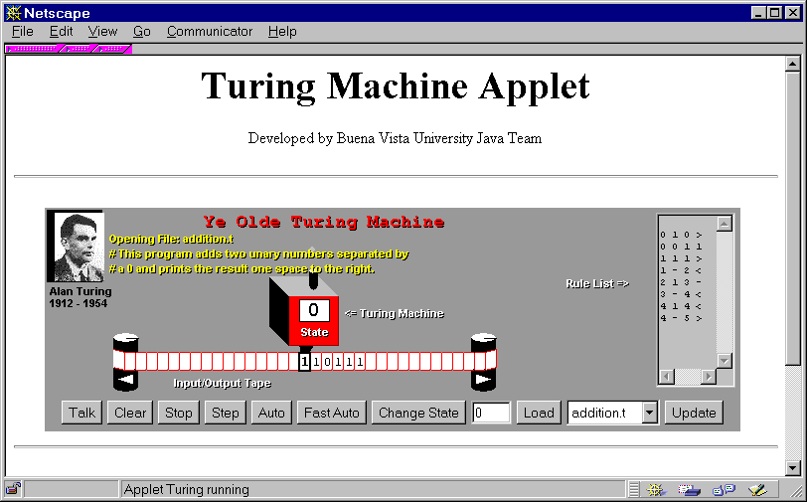
Example of Turing Machine
Java Applet

Slide 4
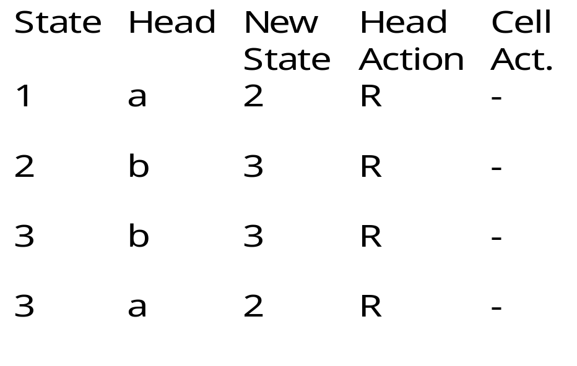
Example of simple program
Words of regular language:
a, aba , abba, abbba, ...
What is the program?
OK if last state = 2 or 4
a
1
2
b
a
3
b
4

Slide 5
Neural Turing Machine
Head
1-fixed !!!
Tape
1-fixed !!!
1-fixed !!!
Control Panel
Program

Slide 6
Control Panel & Program
Head
Tape
St
L/R/S
TA/L
Rec/Start
L

Slide 7
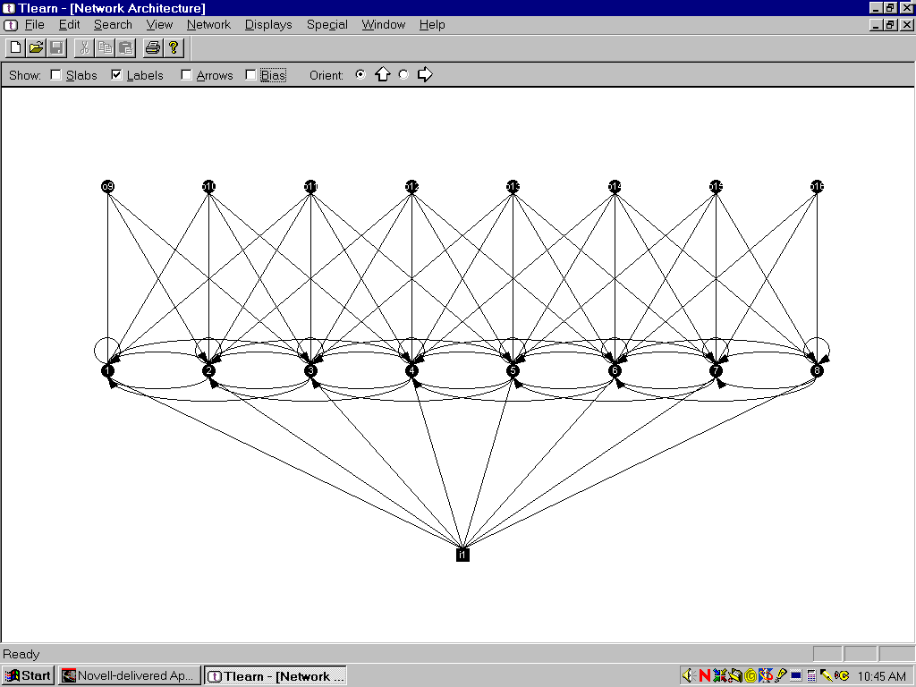
Head
Head = Straits!
Actions (input):
  Up 1
  Down -1
  Stay 0

Slide 8
Tape = Cluster of Beatles
Letter/Symbol
(Head see ...)
Only one
connection is
active!!!
Tape/Action
(from Control Panel)
HEAD

Slide 9

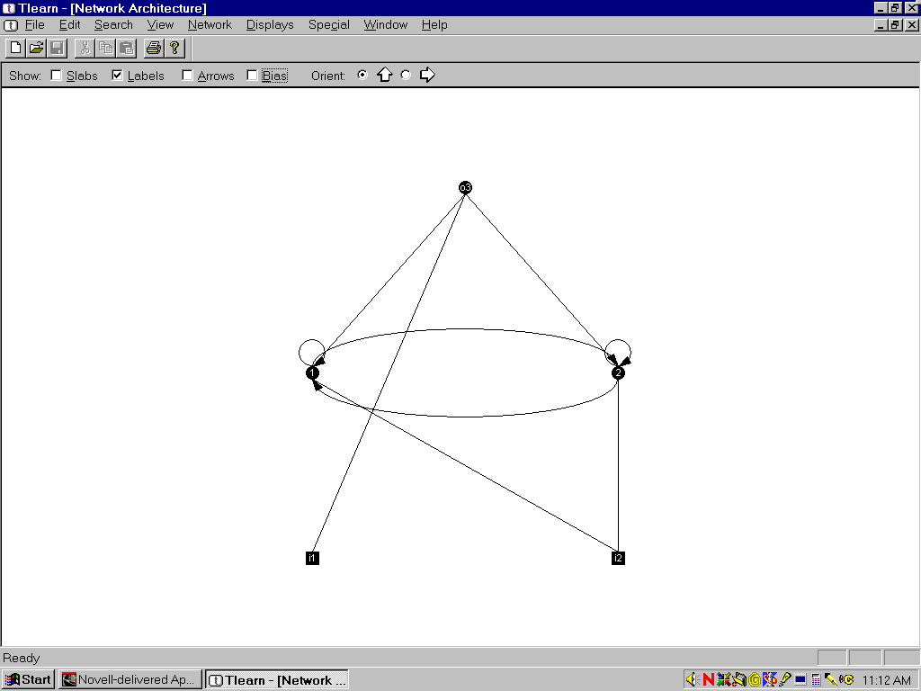
Beetle
Goals:
  keep state (letter or 0/1)
  hide/show
Actions:
  1 0 - show s.
  1 1/-1 - set s.
  0 ? - sleeeep

Slide 10
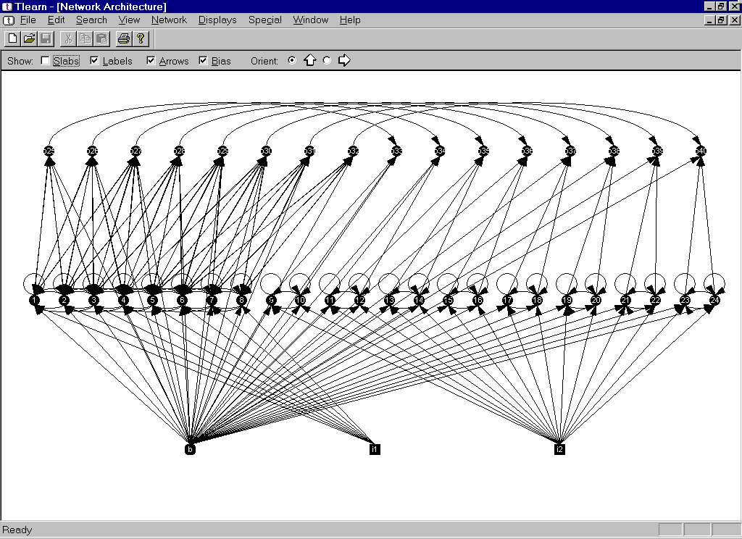
Head + Tape

Slide 11
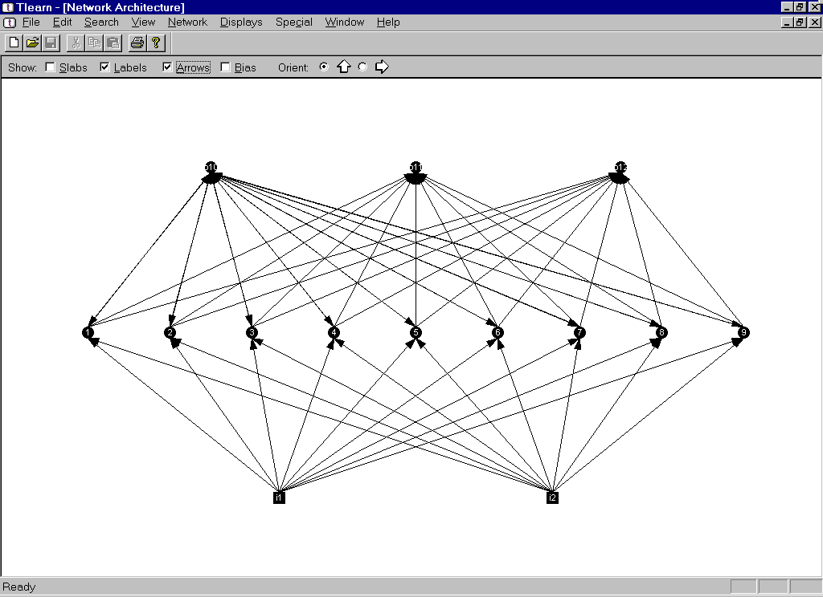
Control Panel / Program

