Slide 1
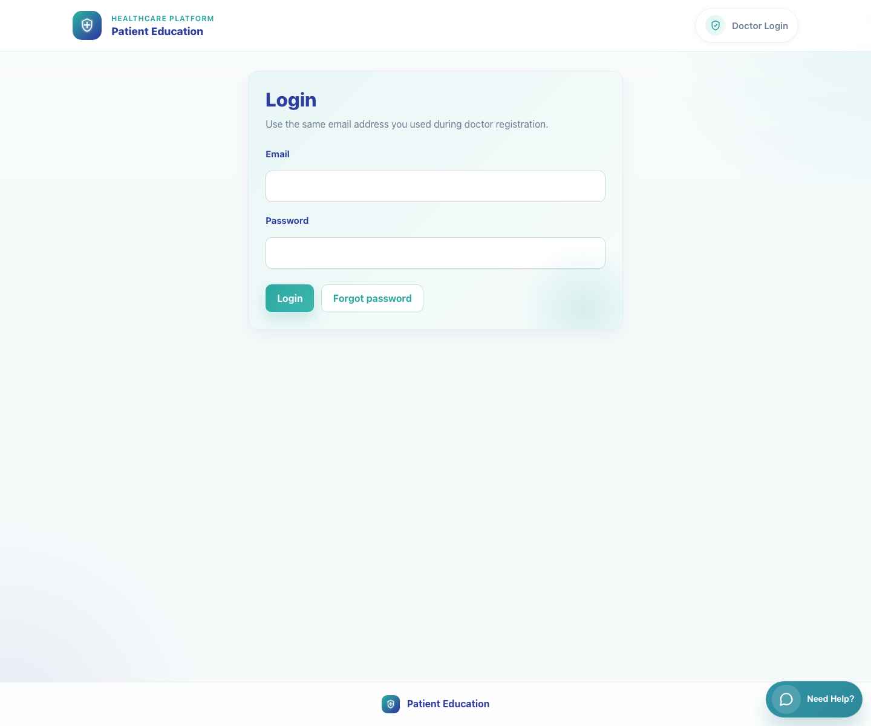
Master index
PedsEdu User Flow Training Pack
Live-verified workflow guides for trainers, onboarding teams, and client stakeholders
Keep this index deck in the same folder as the workflow decks. All links below are written as sibling-file links so the pack remains shareable.
Included
12 workflow decks plus this master index deck.
Open this deck first • Verified 2026-04-23

Slide 2
Workflow links
Platform and clinic workflows
Click a workflow title or filename to open the sibling deck.
Platform and Campaign Setup
01
02
Platform Overview
Explain what the product does, which roles participate in the end-to-end journey, where each operational workflow starts, and how internal oversight surfaces support rollout.
01-platform-overview-and-role-map.pptx
Publisher Campaign Setup
Show a publisher how to open a campaign from an SSO link, select campaign content, configure templates, and save the campaign record.
02-publisher-campaign-setup.pptx
03
Field Rep Recruitment
Show how a field rep uses the campaign link to recruit a clinic by checking a doctor's WhatsApp number and routing the clinic correctly.
03-field-rep-doctor-recruitment.pptx
Clinic Onboarding and Sharing
04
05
Doctor Registration
Show a new clinic how to complete doctor registration and understand the first-login handoff.
04-doctor-registration-and-first-access.pptx
Doctor Single Video Share
Show a doctor how to log in, search the catalog, select a single video, and share it to a caregiver through WhatsApp.
05-doctor-share-single-video.pptx
Index • Platform and clinic workflows
06
Clinic Staff Bundle Share
Show a clinic staff member how to log in to the same clinic workspace, choose a full bundle, and share it with a caregiver.
06-clinic-staff-share-bundle.pptx

Slide 3
Workflow links
Caregiver and internal workflows
Click a workflow title or filename to open the sibling deck.
Caregiver Experience
07
08
Caregiver Single Video View
Show what a caregiver sees after opening a shared single-video link from WhatsApp.
07-caregiver-single-video-view.pptx
Caregiver Bundle View
Show what a caregiver sees after receiving a bundle link that contains multiple educational videos.
08-caregiver-bundle-view.pptx
Internal Operations
09
10
Admin Content Management
Show internal staff how to enter the publishing dashboard, review the video catalog, and edit a video's metadata and language rows.
09-admin-content-management.pptx
Share Tracking Dashboard
Show internal superusers how to open the share tracking dashboard and review doctor shares, playback milestones, and banner engagement.
10-share-tracking-dashboard.pptx
11
12
PE Records Dashboard
Show internal superusers how to open the PE-only records dashboard and manage campaign, field-rep, and doctor records scoped to Patient Education campaigns.
11-pe-records-dashboard.pptx
System Records Hub
Show local superusers how to use the broader System Records Hub to review local campaign configurations and maintain master field-rep and doctor records.
12-system-records-hub.pptx
Index • Caregiver and internal workflows

