Slide 1
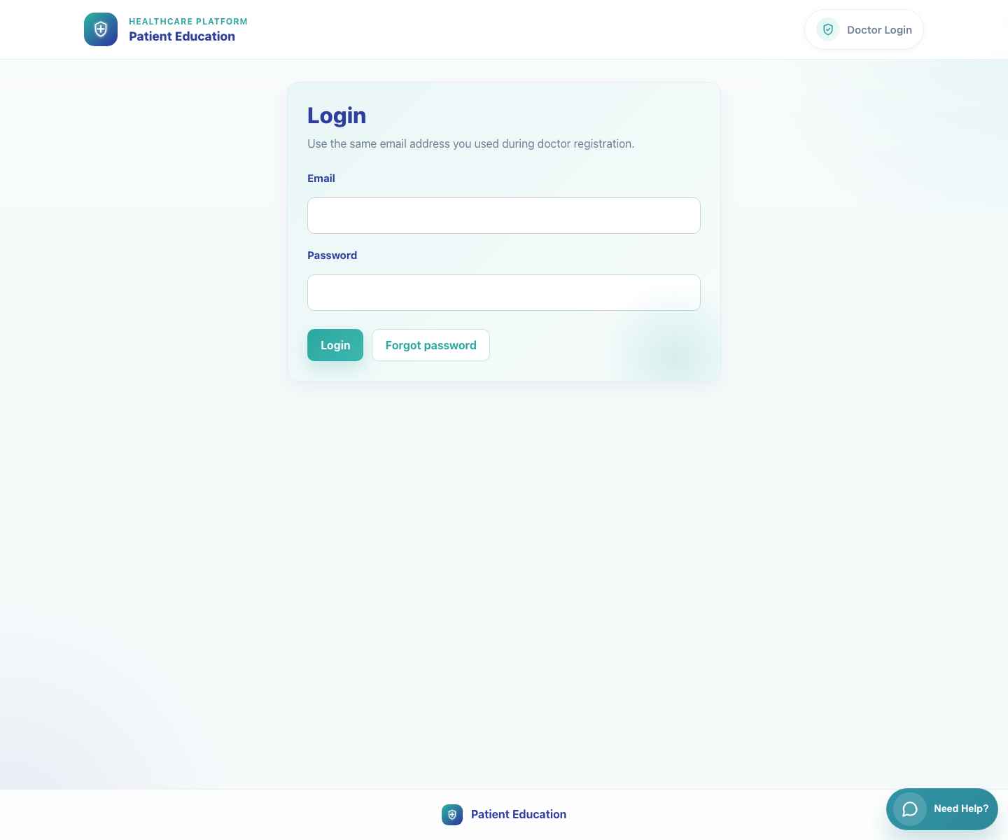
Platform and Campaign Setup
Platform Overview and Role Map
Explain what the product does, which roles participate in the end-to-end journey, where each operational workflow starts, and how internal oversight surfaces support rollout.
Primary user
Entry point
Trainers, implementation leads, client stakeholders, and internal onboarding teams
This overview spans the four main entry points: publisher SSO campaign links, field rep campaign links, clinic login at `/accounts/login/`, and the internal operations surfaces at `/publisher/`, `/publisher/pe-system/`, `/publisher/system-records/`, and `/tracking/`.
Use this deck first in training sessions, then move into the role-specific decks in the order shown in the master index.
Platform Overview and Role Map • Verified 2026-04-23

Slide 2
Workflow 01
Platform and Campaign Setup
Workflow At A Glance
Purpose, user, entry point, and the operational outcome of this workflow.
Purpose
Primary user
Entry point
Explain what the product does, which roles participate in the end-to-end journey, where each operational workflow starts, and how internal oversight surfaces support rollout.
Trainers, implementation leads, client stakeholders, and internal onboarding teams
This overview spans the four main entry points: publisher SSO campaign links, field rep campaign links, clinic login at `/accounts/login/`, and the internal operations surfaces at `/publisher/`, `/publisher/pe-system/`, `/publisher/system-records/`, and `/tracking/`.
Workflow summary
• Publishers configure campaign-specific bundles, outreach copy, and activation windows from an authenticated landing page.
• Field reps recruit clinics into a campaign by checking a doctor's WhatsApp number against the master database.
• Doctors and clinic staff use the same clinic workspace to share a single video or a full bundle with caregivers over WhatsApp.
• Caregivers open secure patient pages without logging in and can switch languages directly on the page.
• Internal admins maintain the reusable catalog of videos, bundles, triggers, and therapy areas that power all downstream sharing.
• Superusers also monitor share analytics and govern PE-only or system-wide records through separate internal dashboards.
Workflow summary • Platform Overview

Slide 3
Workflow 01
Platform and Campaign Setup
Role Map And Start Points
How the product hands off between roles across campaign setup, clinic onboarding, sharing, and caregiver playback.
Publisher
Field rep
Doctor or clinic staff
Caregiver
Campaign setup
→
Recruitment
→
Clinic sharing
→
Caregiver playback
Role map
Workflow start points
• Publisher: Creates campaign detail records, bundle selection, and outbound templates.
• Field rep: Registers clinics into the correct campaign and handles existing-versus-new clinic routing.
• Doctor: Selects a single video or bundle and shares it with caregivers.
• Clinic staff: Uses the same clinic workspace for bundle sharing and caregiver follow-up.
• Caregiver: Consumes multilingual content through secure patient links without logging in.
• Internal admin: Maintains the master catalog, monitors sharing activity, and governs PE or system records.
• Publisher campaign setup: `/publisher-landing-page/?campaign-id=...&token=...`
• Field rep recruitment: `/field-rep-landing-page/?campaign-id=...&field_rep_id=...`
• Doctor and clinic staff sharing: `/accounts/login/`
• Doctor self-registration: `/accounts/register/`
• Caregiver single-video playback: `/p/<doctor_id>/v/<video_code>/?lang=<code>&d=<signed-payload>`
• Caregiver bundle playback: `/p/<doctor_id>/c/<cluster_code>/?lang=<code>&d=<signed-payload>`
• Internal content management: `/admin/login/?next=/publisher/` then `/publisher/`
• Share tracking dashboard: `/tracking/login/` then `/tracking/`
• PE records dashboard: `/publisher/pe-system/login/` then `/publisher/pe-system/`
• System records hub: `/admin/login/?next=/publisher/system-records/` then `/publisher/system-records/`
Role map • Platform Overview

Slide 4
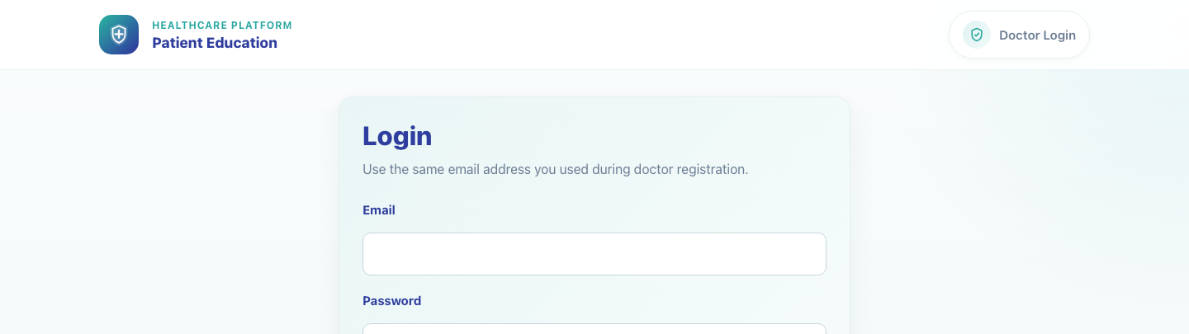
Workflow 01
Platform and Campaign Setup
Step 1: Identify the shared entry surfaces
Shared clinic login entry for registered doctors and clinic staff.
What the user does
What the user sees
Reviews the main product entry points for publishers, field reps, clinic users, caregivers, and internal admins.
Distinct role-specific URLs: external campaign links for publishers and field reps, a shared clinic login page, and staff-only publishing pages.
Why it matters
Expected result
Most support questions come from role confusion, so training starts by making each entry point explicit.
Trainees can say which URL each role uses and which workflows require authentication.
Trainer note
Doctors and clinic staff share the same login page. Caregivers do not log in at all.
Step 1 • Platform Overview

Slide 5
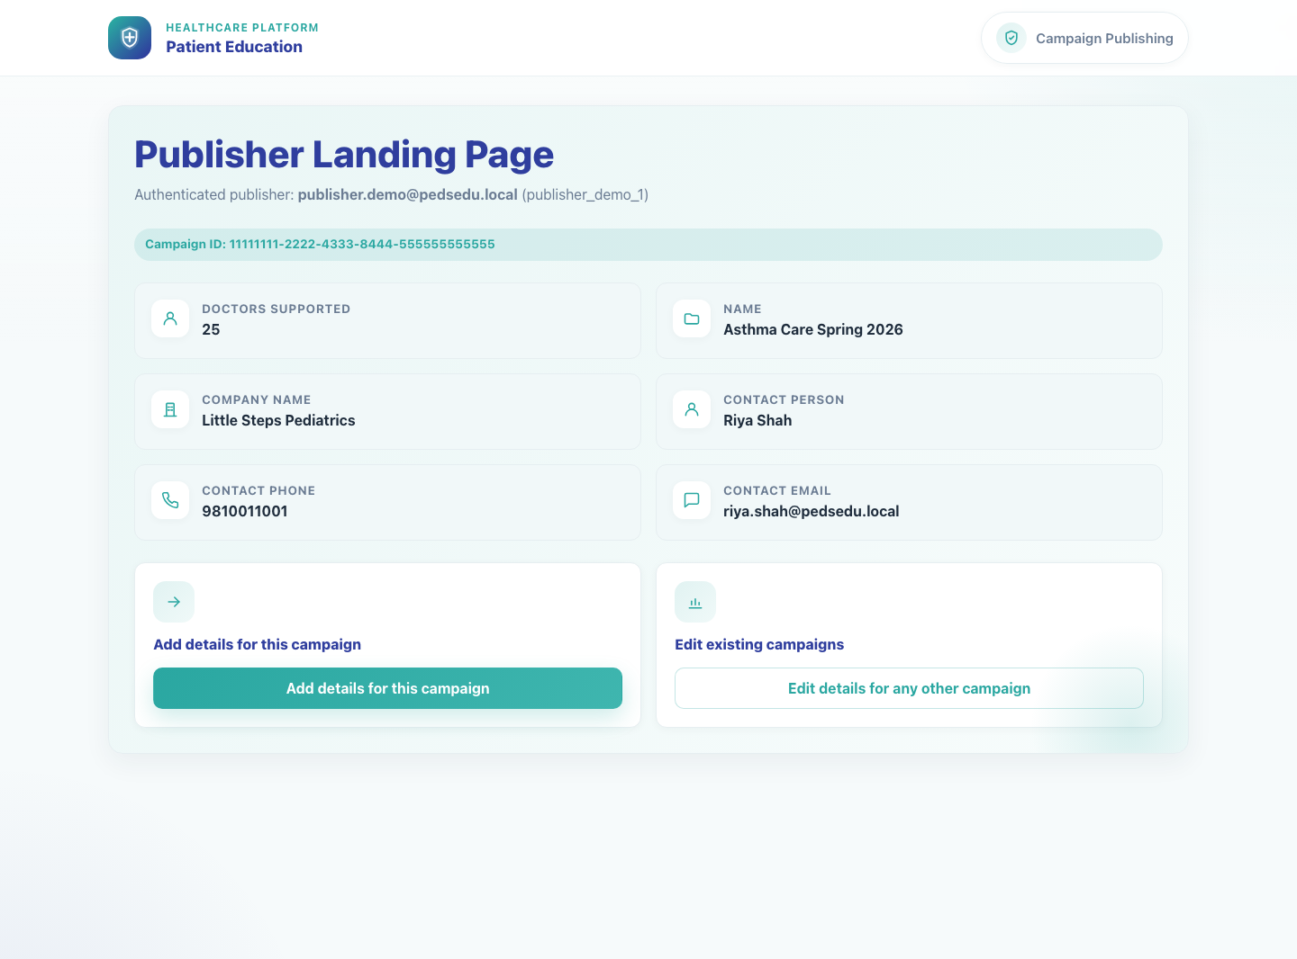
Workflow 01
Platform and Campaign Setup
Step 2: Map campaign setup to campaign activation
Publisher campaign landing page.
What the user does
Traces how a publisher receives an SSO-backed campaign link and adds campaign details before clinics can use that campaign.
What the user sees
A publisher landing page that exposes the campaign context and a launch action for Add details for this campaign.
Why it matters
Campaign setup controls which bundles are available downstream and what enrollment messaging is sent.
Expected result
Stakeholders understand that publisher work happens before field reps or clinics start sharing content.
Trainer note
If campaign details already exist, the product redirects publishers into the edit flow rather than duplicating the record.
Step 2 • Platform Overview

Slide 6
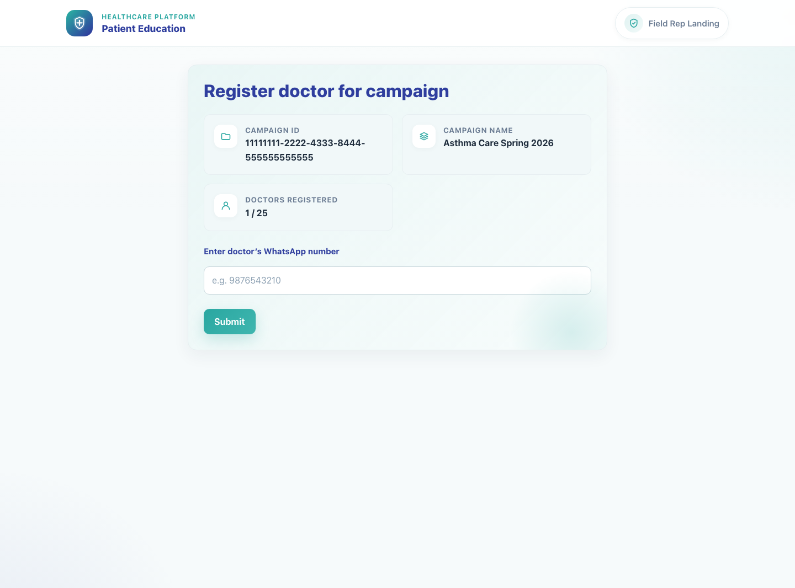
Workflow 01
Platform and Campaign Setup
Step 3: Trace clinic enrollment from the field rep workflow
Field rep campaign recruitment page.
What the user does
Follows the field rep handoff that checks a doctor's WhatsApp number and decides whether to enroll an existing clinic or redirect a new clinic to registration.
What the user sees
A campaign-aware field rep page with the campaign ID, enrollment counts, and a doctor WhatsApp input.
Why it matters
This is the operational bridge between campaign setup and clinic activation.
Expected result
Trainees understand the existing-versus-new doctor decision point and the downstream handoff.
Trainer note
Existing clinics are enrolled and sent a WhatsApp deeplink. New clinics are redirected to `/accounts/register/` with campaign context.
Step 3 • Platform Overview

Slide 7
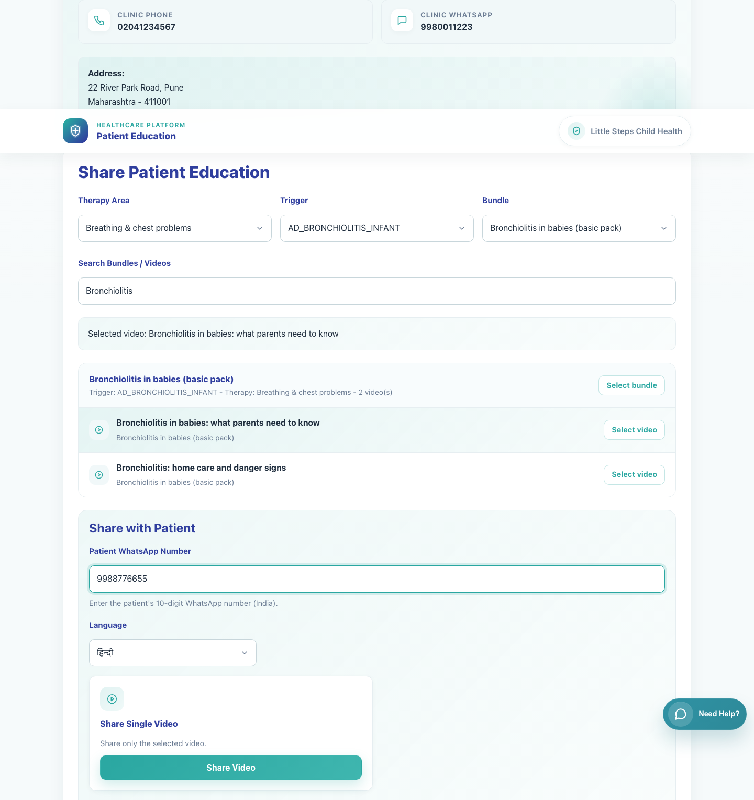
Workflow 01
Platform and Campaign Setup
Step 4: Connect clinic sharing to caregiver playback
Clinic sharing workspace for a registered doctor.
What the user does
What the user sees
Views how doctors or clinic staff search the library, choose a video or bundle, and generate a WhatsApp share to a caregiver.
The clinic sharing workspace with filter controls, bundle and video selection, and share actions.
Why it matters
Expected result
This is the core day-to-day workflow for clinic teams and the point where patient education becomes visible to caregivers.
Users understand that caregiver links are created inside the clinic workspace and are language-aware.
Trainer note
Selecting a video exposes Share Video. Selecting a bundle exposes Share Bundle.
Step 4 • Platform Overview

Slide 8
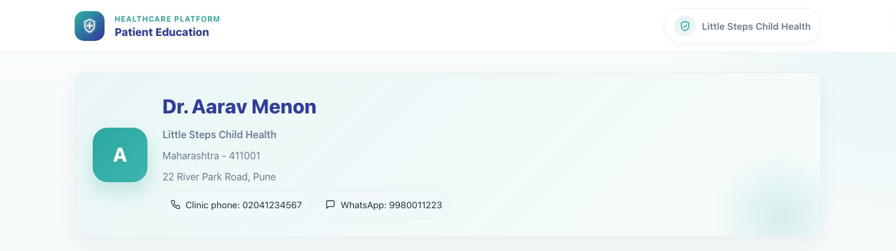
Workflow 01
Platform and Campaign Setup
Step 5: Show the caregiver-facing experience
Single-video caregiver page in English.
What the user does
What the user sees
Opens a secure patient link to see the branded clinic context, embedded content, and language selector.
A no-login patient page branded with the clinic identity and the selected educational content.
Why it matters
Expected result
Training is easier when caregivers know what to expect after a clinic shares content.
Stakeholders can explain the caregiver experience and confirm that language switching happens on the patient page.
Trainer note
Single-video links open one item. Bundle links open a multi-video collection.
Step 5 • Platform Overview

Slide 9
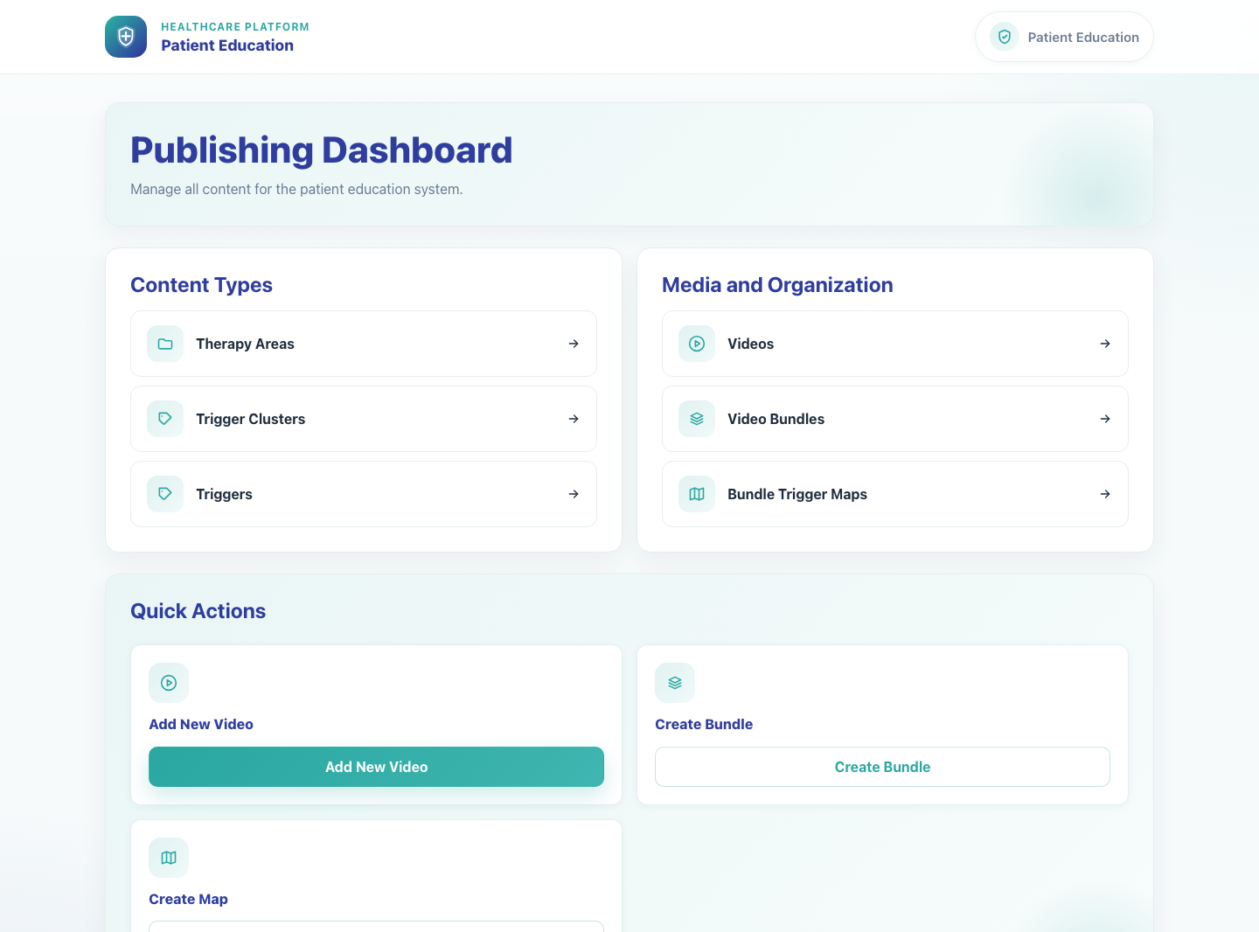
Workflow 01
Platform and Campaign Setup
Step 6: Position internal administration as the catalog source of truth
Internal Publishing Dashboard.
What the user does
Reviews the internal publishing dashboard that manages reusable videos, bundles, triggers, and therapy areas.
What the user sees
A staff-only Publishing Dashboard with links to content types, media management, and quick actions.
Why it matters
Campaign setup and clinic sharing depend on this internal catalog being correct and publish-ready.
Expected result
Trainees understand that catalog maintenance is a separate internal responsibility.
Trainer note
Catalog changes are global. Campaign-specific availability is handled later in the publisher campaign workflow.
Step 6 • Platform Overview

Slide 10
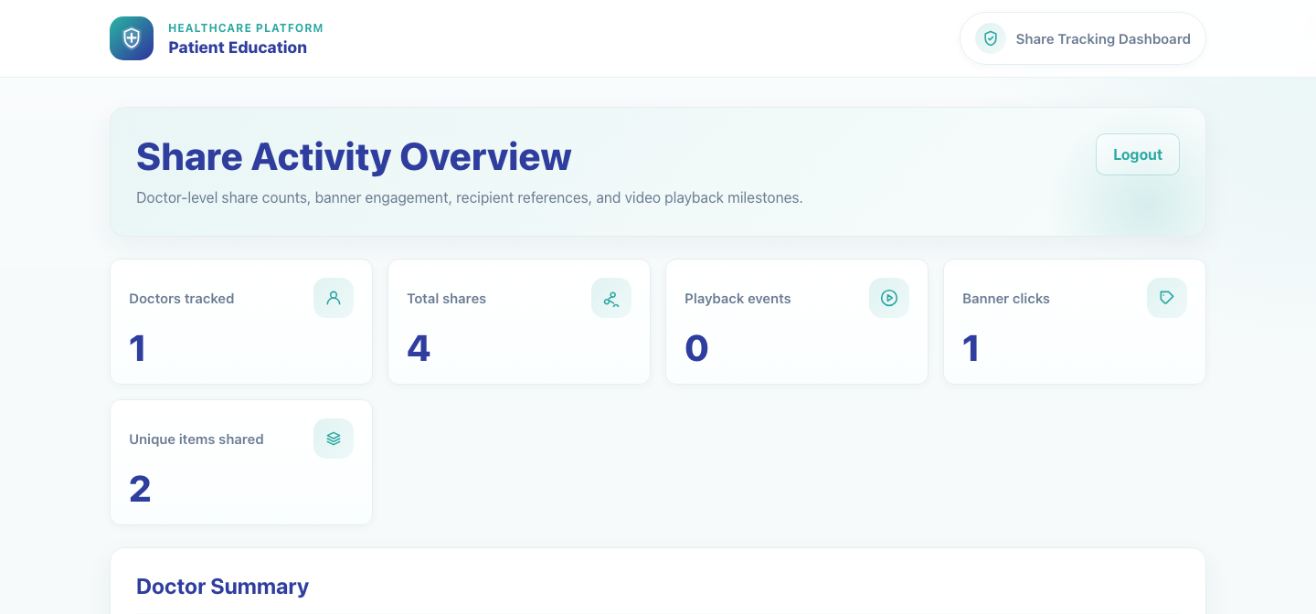
Workflow 01
Platform and Campaign Setup
Step 7: Show the internal oversight dashboards
Internal share tracking dashboard.
What the user does
What the user sees
Reviews the internal reporting and governance surfaces used after campaigns and sharing are live.
A Share Activity Overview for analytics plus separate PE Records and System Records dashboards for data maintenance.
Why it matters
Expected result
Operations teams need a clear split between tracking engagement, governing PE-only records, and maintaining broader system records.
Trainees know which internal dashboard to open for analytics, PE-only governance, or broader record cleanup.
Trainer note
The tracking dashboard uses `/tracking/login/`. The PE records dashboard uses a dedicated superuser session at `/publisher/pe-system/login/`. The System Records Hub is a local superuser route at `/publisher/system-records/`.
Step 7 • Platform Overview

Slide 11
Workflow 01
Platform and Campaign Setup
Trainer Tips And Common Issues
The highest-value coaching points to cover during rollout or onboarding sessions.
Wrong entry point
Documentation drift
A clinic user who opens a publisher or field rep link will not see the clinic sharing workspace. Start training by matching role to URL.
Older project notes do not always reflect current routes or environment behavior. Use live product behavior and current code as the source of truth.
Campaign expectations
Internal dashboard mix-ups
Clinic users only see campaign-supported bundles in the share workspace, so a missing bundle usually points back to campaign setup rather than a clinic-side issue.
The publishing dashboard, tracking dashboard, PE records dashboard, and System Records Hub are all different surfaces with different scopes and access rules.
Success markers
• Each stakeholder can identify their entry point and the handoff to the next role.
• Training teams can distinguish campaign setup work from clinic-sharing work and from internal content administration.
• Internal teams can separate catalog maintenance, analytics review, PE-only record governance, and broader system-record maintenance.
• Users understand that caregiver links are generated from the clinic sharing workspace and are campaign-aware.
Trainer tips • Platform Overview

Slide 12
Workflow complete
Platform Overview and Role Map
Related manuals
• PedsEdu_System_Documentation.md
• README.md
• 02-publisher-campaign-setup.md
• 03-field-rep-doctor-recruitment.md
• 05-doctor-share-single-video.md
Use this deck first in training sessions, then move into the role-specific decks in the order shown in the master index.
Success criteria
• Each stakeholder can identify their entry point and the handoff to the next role.
• Training teams can distinguish campaign setup work from clinic-sharing work and from internal content administration.
• Internal teams can separate catalog maintenance, analytics review, PE-only record governance, and broader system-record maintenance.
• Users understand that caregiver links are generated from the clinic sharing workspace and are campaign-aware.
Status
Live-verified against the local demo environment and refreshed with real screenshots on 2026-04-23.
Workflow complete • Platform Overview

