Slide 1
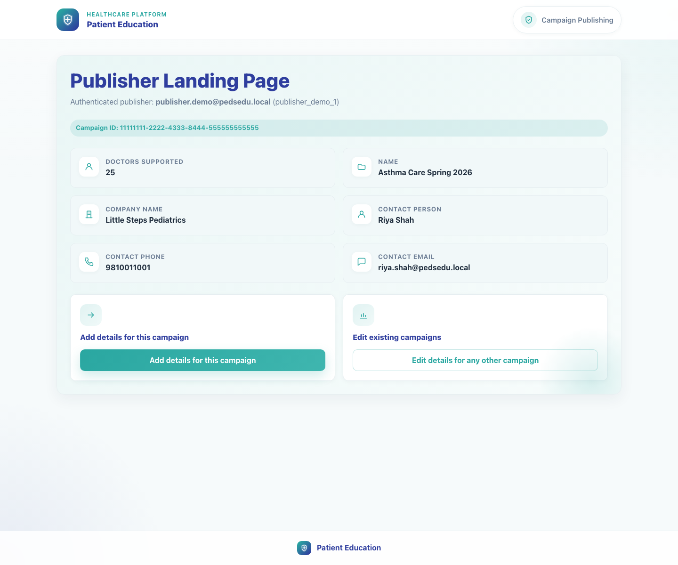
Platform and Campaign Setup
Publisher Campaign Setup
Show a publisher how to open a campaign from an SSO link, select campaign content, configure templates, and save the campaign record.
Primary user
Entry point
Publisher or brand manager using the campaign-specific SSO link
Publisher SSO entry link such as `/publisher-landing-page/?campaign-id=...&token=...`.
Once this workflow is complete, field reps can recruit clinics into the campaign and clinics will inherit the campaign-supported bundle selection.
Publisher Campaign Setup • Verified 2026-04-23

Slide 2
Workflow 02
Platform and Campaign Setup
Workflow At A Glance
Purpose, user, entry point, and the operational outcome of this workflow.
Purpose
Primary user
Entry point
Show a publisher how to open a campaign from an SSO link, select campaign content, configure templates, and save the campaign record.
Publisher or brand manager using the campaign-specific SSO link
Publisher SSO entry link such as `/publisher-landing-page/?campaign-id=...&token=...`.
Workflow summary
• The publisher lands on a campaign-aware page that carries campaign metadata from the upstream system.
• Add Campaign Details creates a local campaign record, a new campaign bundle, and the outbound registration templates used downstream.
• The campaign list is the operational place to confirm that a record exists and to re-open it for editing.
Workflow summary • Publisher Campaign Setup

Slide 3
Workflow 02
Platform and Campaign Setup
Decision Points
Key branches or usage choices that change what the user should do next.
New campaign detail set
Existing campaign detail set
Use Add details for this campaign when the campaign has not yet been configured in this app.
If the campaign already exists, the product redirects the publisher into the edit flow.
Outcome
Outcome
The app creates a new campaign record and bundle mapping.
The user updates the existing campaign instead of creating a duplicate.
Decision points • Publisher Campaign Setup

Slide 4
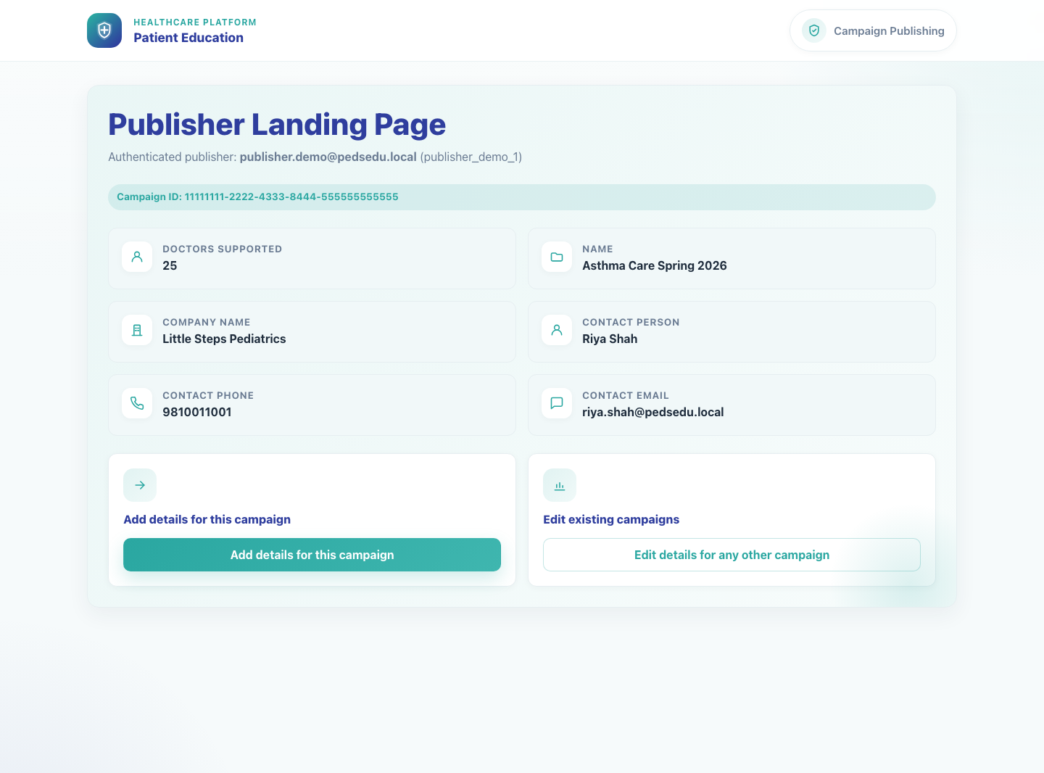
Workflow 02
Platform and Campaign Setup
Step 1: Open the publisher landing page from the campaign link
Publisher landing page with campaign metadata.
What the user does
Opens the authenticated campaign link supplied by the upstream system or brand workflow.
What the user sees
Publisher Landing Page with the authenticated publisher identity, campaign ID, and campaign metadata such as company name and doctors supported.
Why it matters
This page confirms the publisher is in the right campaign context before configuration begins.
Expected result
The publisher can verify the campaign context and proceed into Add details for this campaign.
Trainer note
If no campaign ID is supplied, the landing page still opens but the add-details action is disabled.
Step 1 • Publisher Campaign Setup

Slide 5
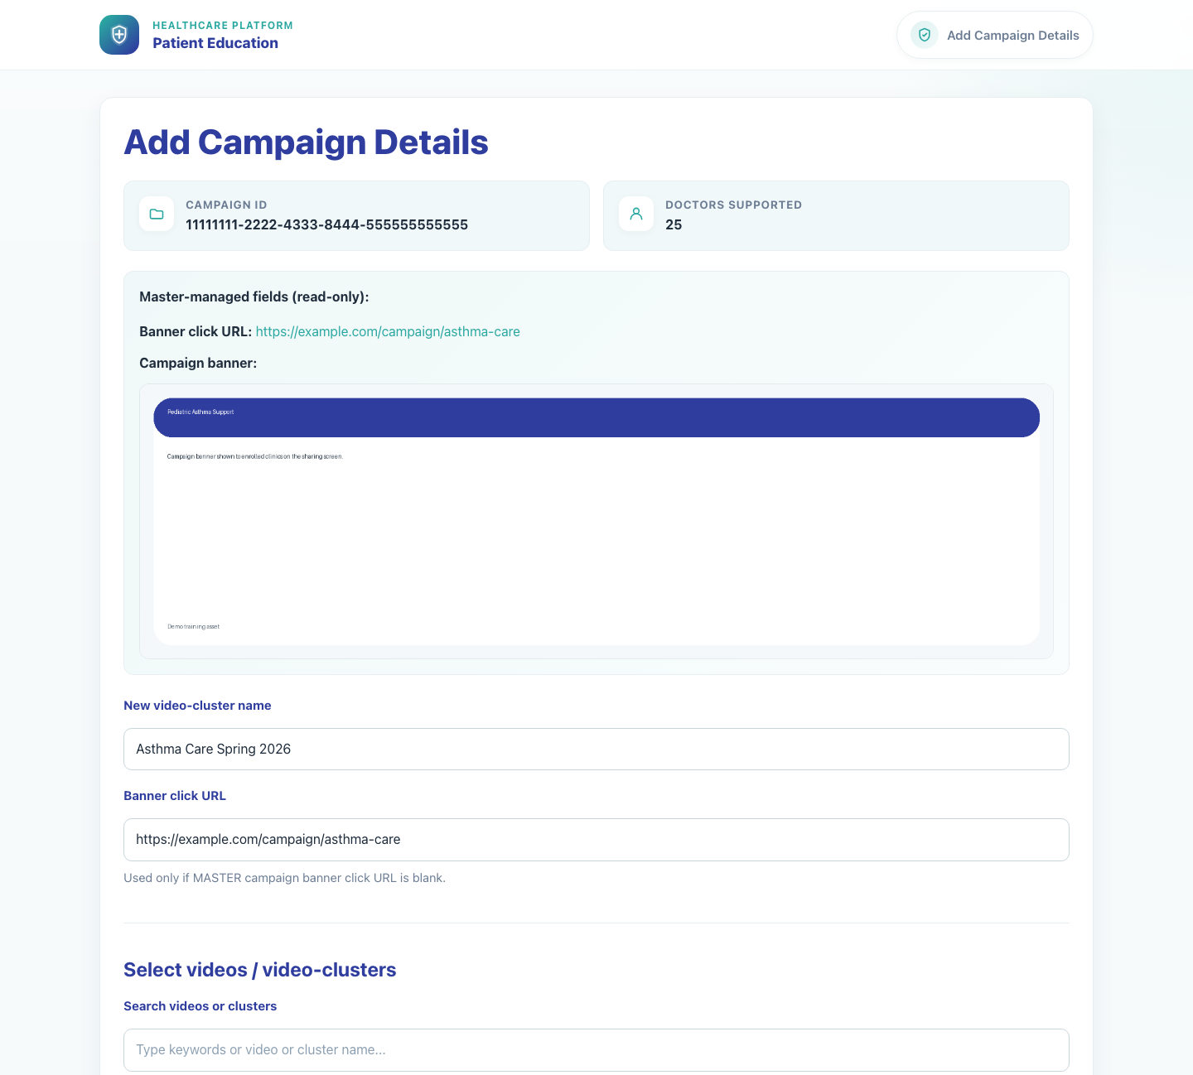
Workflow 02
Platform and Campaign Setup
Step 2: Launch Add Campaign Details
Blank Add Campaign Details form.
What the user does
What the user sees
Selects Add details for this campaign to open the campaign form.
Add Campaign Details with read-only campaign data from the master system, including the campaign ID, supported doctor count, and banner data.
Why it matters
Expected result
The page separates master-managed fields from the fields the publisher is allowed to configure locally.
The campaign form is open and ready for local configuration.
Trainer note
The master-managed banner click URL and campaign banner are informational unless the local fallback banner URL field is needed.
Step 2 • Publisher Campaign Setup

Slide 6
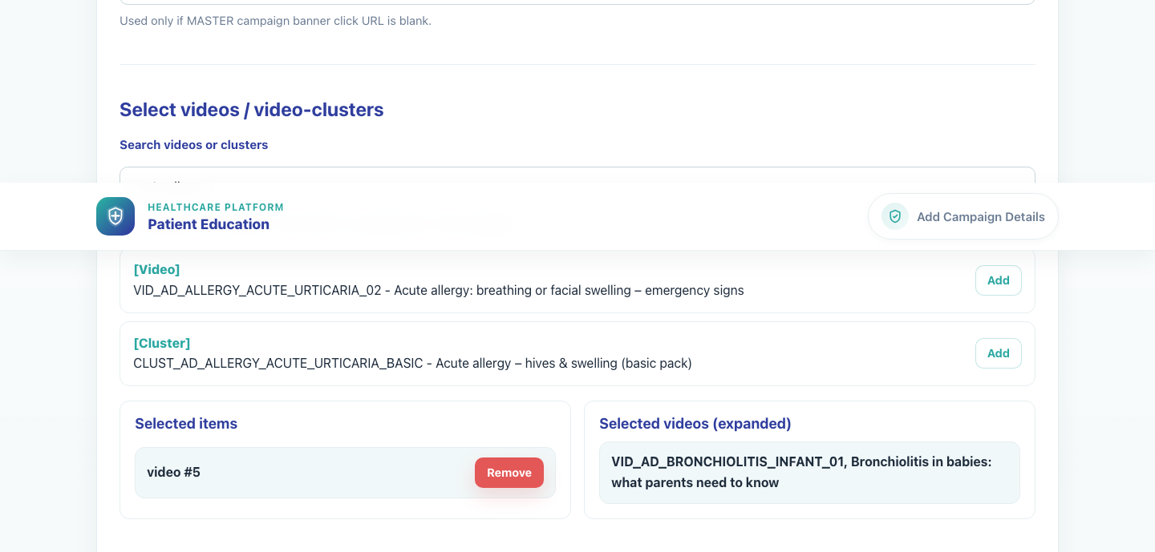
Workflow 02
Platform and Campaign Setup
Step 3: Select the campaign videos and bundle inputs
Campaign content selection completed.
What the user does
What the user sees
Names the campaign cluster, searches the catalog, and adds the required video or cluster items to the selected list.
Search results with Add actions, a Selected items panel, and an expanded Selected videos panel showing the final content set.
Why it matters
Expected result
Campaign visibility downstream depends on the content selected here.
The selected-items list is populated and the expanded-videos panel confirms the final campaign content.
Trainer note
The form will not save if no valid videos can be expanded from the selection.
Step 3 • Publisher Campaign Setup

Slide 7
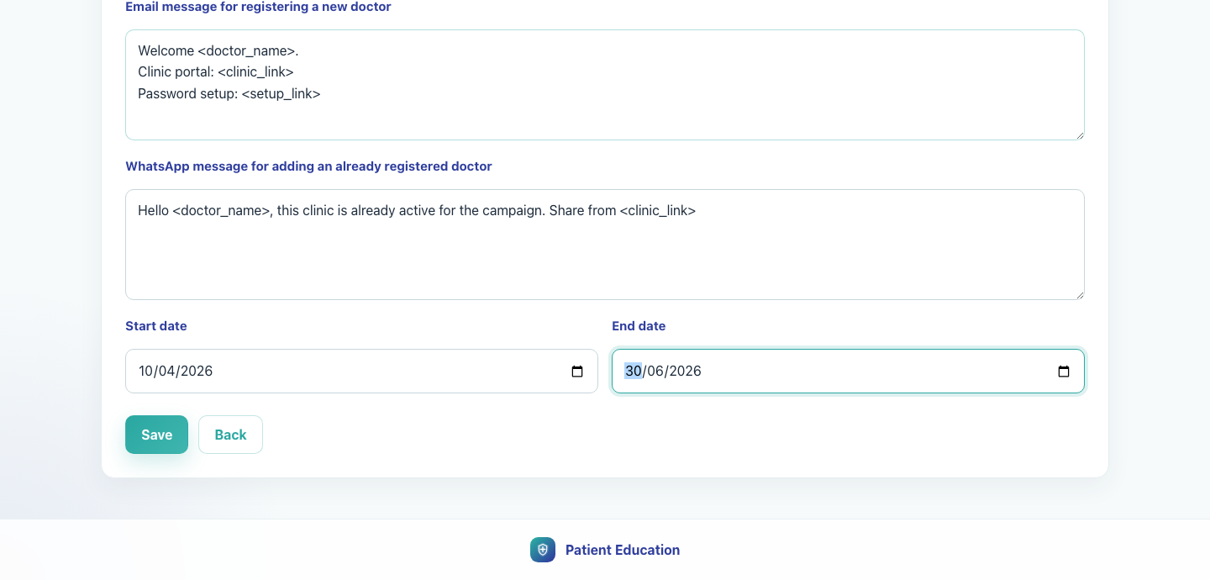
Workflow 02
Platform and Campaign Setup
Step 4: Configure registration messaging and campaign dates
Messaging and date configuration.
What the user does
What the user sees
Enters the registration email text, existing-doctor WhatsApp text, and campaign start and end dates.
Text areas with merge-token placeholders such as `<doctor_name>`, `<clinic_link>`, and `<setup_link>`, plus date pickers.
Why it matters
Expected result
These templates drive the onboarding experience for doctors recruited into the campaign.
All required campaign communication fields and dates are ready to save.
Trainer note
Local templates override missing master text and should be written in trainer-ready copy before launch.
Step 4 • Publisher Campaign Setup

Slide 8
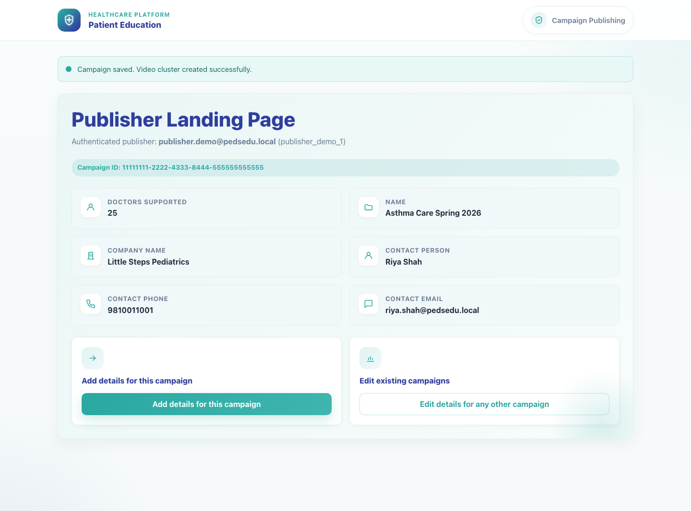
Workflow 02
Platform and Campaign Setup
Step 5: Save the campaign and return to the landing page
Publisher landing page after saving the campaign.
What the user does
Clicks Save after validating the selected content and templates.
What the user sees
The publisher landing page again, now with the campaign detail set created in the app.
Why it matters
Saving creates the local campaign record and associated bundle mapping used by later workflows.
Expected result
The app confirms the campaign was saved successfully.
Trainer note
A duplicate campaign ID is blocked and redirected to the edit flow.
Step 5 • Publisher Campaign Setup

Slide 9
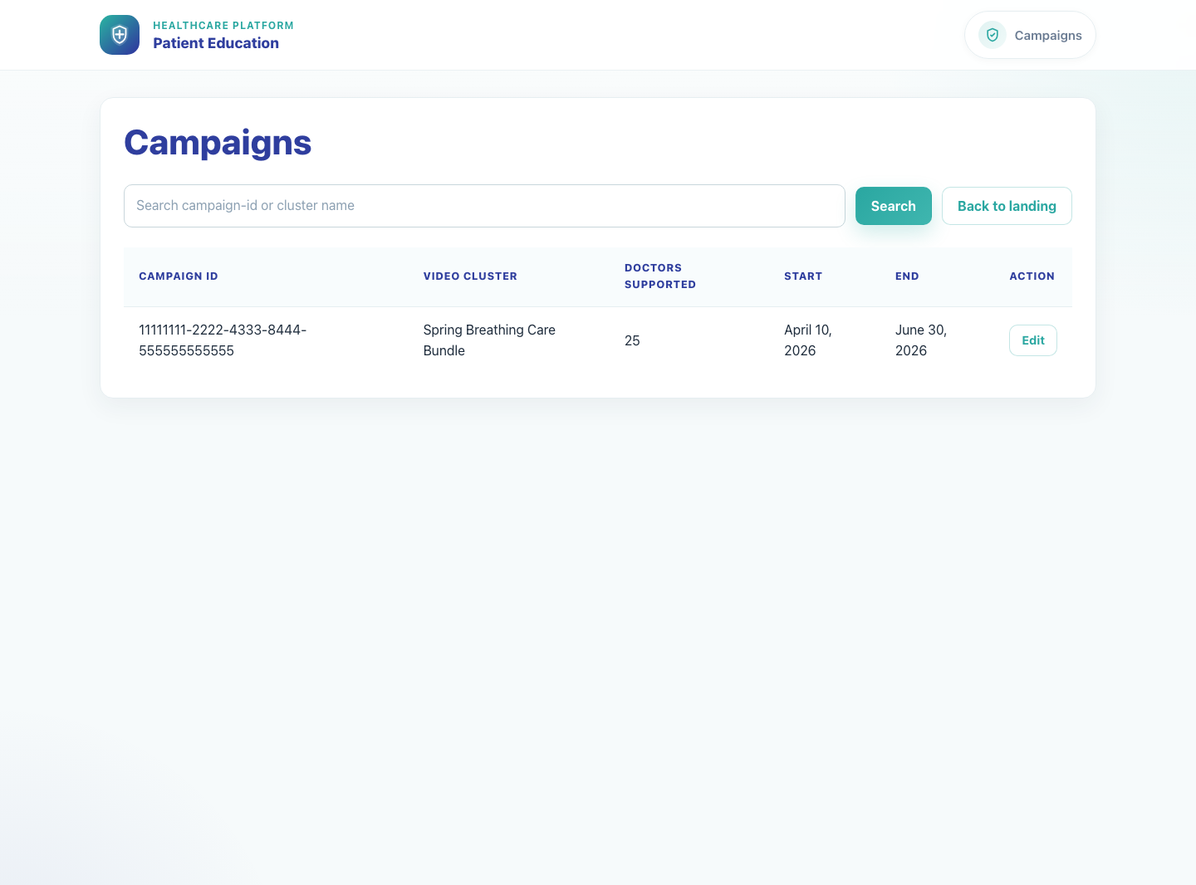
Workflow 02
Platform and Campaign Setup
Step 6: Review the campaign from the Campaigns list
Campaign list with edit actions.
What the user does
Opens the Campaigns list to confirm the record and use the Edit action when needed.
What the user sees
A searchable campaign table with campaign ID, cluster name, capacity, dates, and Edit.
Why it matters
This is the operational page for verifying the saved record and managing future updates.
Expected result
The campaign appears in the list and can be re-opened for edits.
Trainer note
Search supports campaign ID and cluster-name lookup.
Step 6 • Publisher Campaign Setup

Slide 10
Workflow 02
Platform and Campaign Setup
Trainer Tips And Common Issues
The highest-value coaching points to cover during rollout or onboarding sessions.
Expired or missing SSO context
No selected videos
Without a valid campaign ID and token, the landing page cannot create a campaign detail set.
The form saves only when the selected items expand into at least one valid video.
Duplicate cluster naming
If the proposed campaign cluster name already exists, the user must choose a different name.
Success markers
• The campaign record exists and appears on the Campaigns list.
• At least one valid video or cluster has been selected and expanded into campaign content.
• Registration email text, existing-doctor WhatsApp text, and campaign dates are saved.
Trainer tips • Publisher Campaign Setup

Slide 11
Workflow complete
Publisher Campaign Setup
Related manuals
• 01-platform-overview-and-role-map.md
• 03-field-rep-doctor-recruitment.md
Once this workflow is complete, field reps can recruit clinics into the campaign and clinics will inherit the campaign-supported bundle selection.
Success criteria
• The campaign record exists and appears on the Campaigns list.
• At least one valid video or cluster has been selected and expanded into campaign content.
• Registration email text, existing-doctor WhatsApp text, and campaign dates are saved.
Status
Live-verified against the local demo environment and refreshed with real screenshots on 2026-04-23.
Workflow complete • Publisher Campaign Setup

