Slide 1
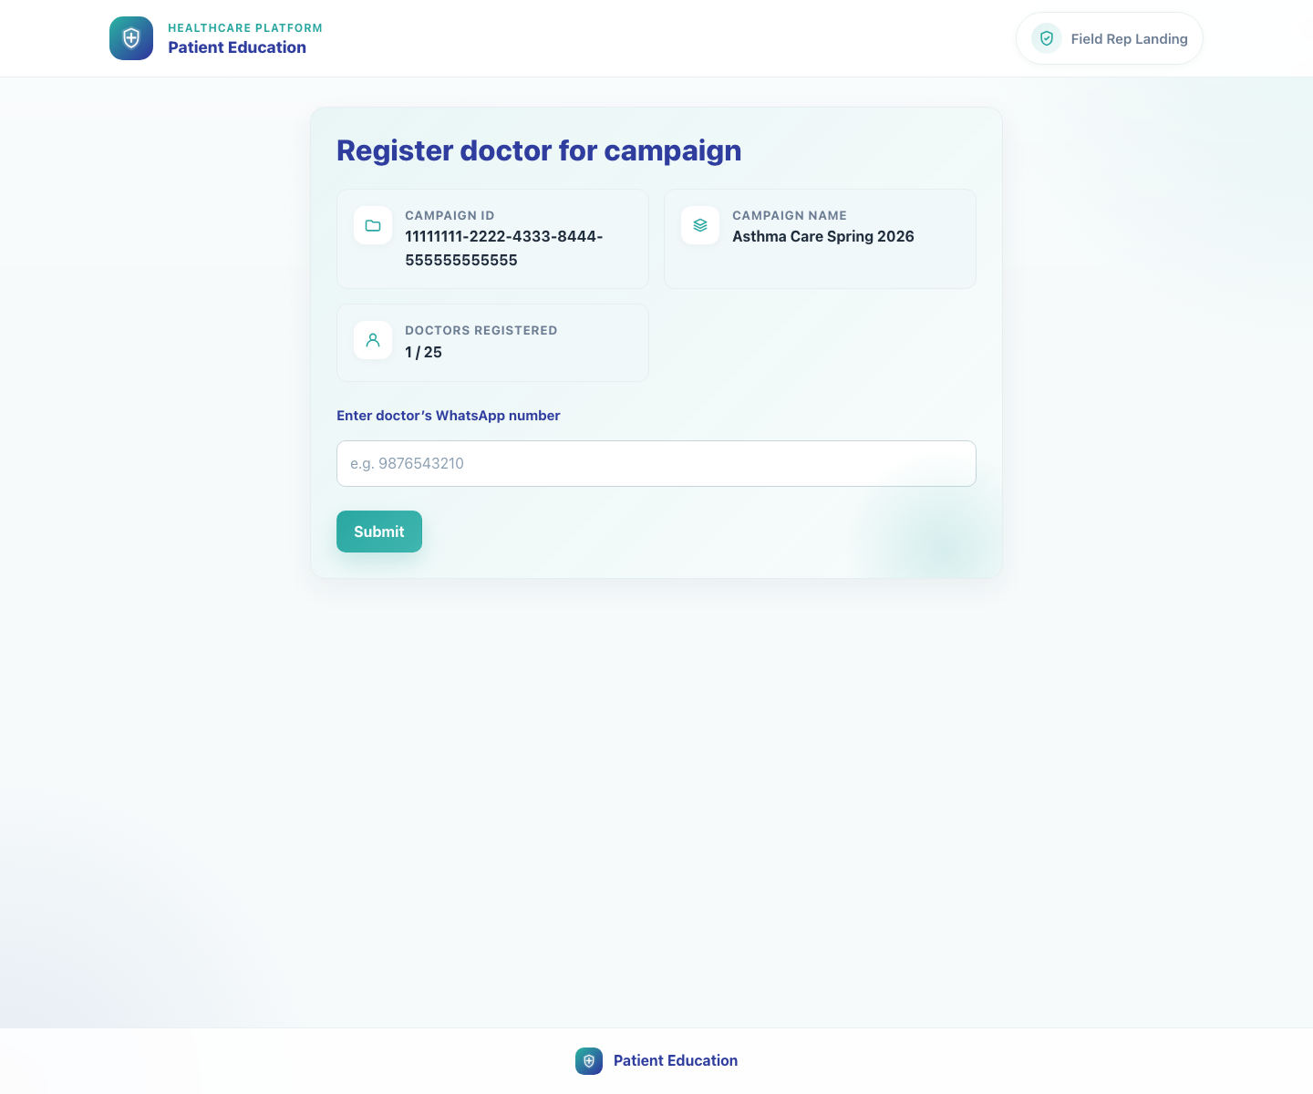
Platform and Campaign Setup
Field Rep Doctor Recruitment
Show how a field rep uses the campaign link to recruit a clinic by checking a doctor's WhatsApp number and routing the clinic correctly.
Primary user
Entry point
Field rep assigned to a campaign
Campaign recruitment link such as `/field-rep-landing-page/?campaign-id=...&field_rep_id=...`.
When the field rep flow ends on the registration page, the next operational deck is Doctor Registration and First Access.
Field Rep Doctor Recruitment • Verified 2026-04-23

Slide 2
Workflow 03
Platform and Campaign Setup
Workflow At A Glance
Purpose, user, entry point, and the operational outcome of this workflow.
Purpose
Primary user
Entry point
Show how a field rep uses the campaign link to recruit a clinic by checking a doctor's WhatsApp number and routing the clinic correctly.
Field rep assigned to a campaign
Campaign recruitment link such as `/field-rep-landing-page/?campaign-id=...&field_rep_id=...`.
Workflow summary
• The field rep page validates both the campaign and the field rep against the master database before allowing recruitment.
• Entering an existing doctor's WhatsApp number enrolls the clinic into the campaign and opens a WhatsApp deeplink with the clinic link.
• Entering a new doctor's WhatsApp number redirects into the doctor registration flow with campaign context preserved.
Workflow summary • Field Rep Recruitment

Slide 3
Workflow 03
Platform and Campaign Setup
Decision Points
Key branches or usage choices that change what the user should do next.
Existing doctor match
New doctor
The entered WhatsApp number matches an existing doctor in the master database.
No doctor record matches the WhatsApp number.
Outcome
Outcome
The system ensures campaign enrollment and opens a WhatsApp message containing the clinic share link.
The system redirects to `/accounts/register/` with campaign and field rep context preserved.
Decision points • Field Rep Recruitment

Slide 4
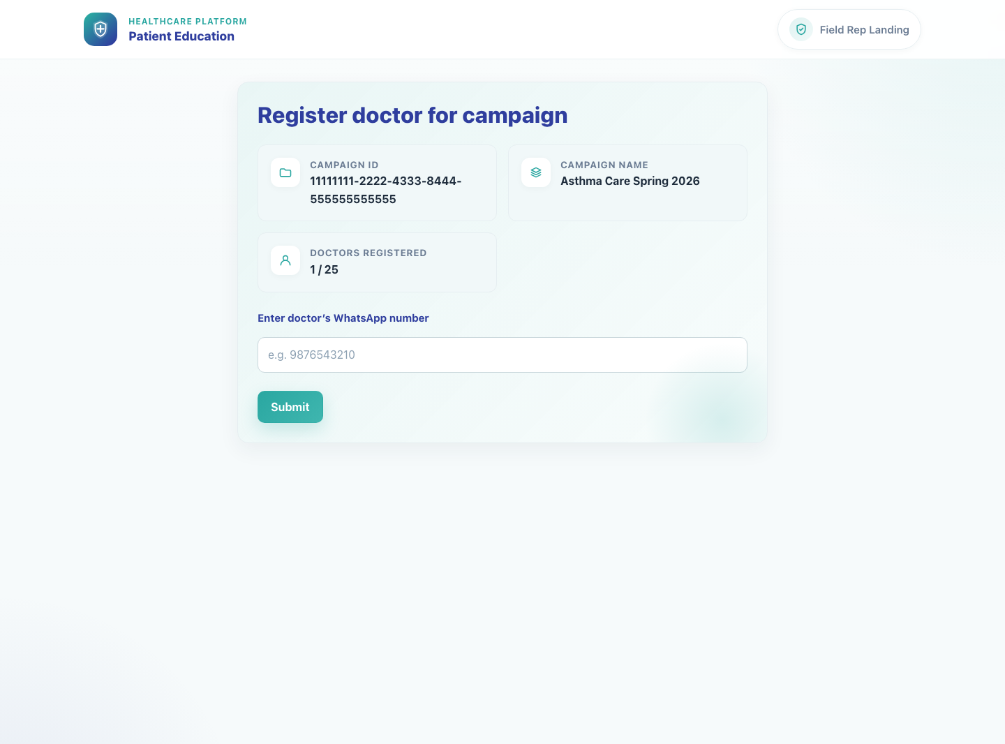
Workflow 03
Platform and Campaign Setup
Step 1: Open the field rep campaign page
Field rep campaign recruitment landing page.
What the user does
Launches the campaign recruitment link supplied for the field rep.
What the user sees
Register doctor for campaign with the campaign ID, campaign name, and doctors registered count.
Why it matters
This page confirms the field rep is working inside the correct campaign before recruitment begins.
Expected result
The field rep sees a valid campaign context and an input for doctor WhatsApp number.
Trainer note
If the campaign license cap has been reached or the link is invalid, the page surfaces a blocking message instead of the form.
Step 1 • Field Rep Recruitment

Slide 5

Workflow 03
Platform and Campaign Setup
Step 2: Enter the doctor's WhatsApp number
Field rep form with an existing doctor number entered.
What the user does
Types the doctor's 10-digit WhatsApp number and prepares to submit the campaign registration check.
What the user sees
The WhatsApp number inside the campaign-bound form with the Submit action.
Why it matters
The WhatsApp number is the matching key used to determine whether the clinic already exists.
Expected result
The form is ready to evaluate whether the clinic is already registered.
Trainer note
Use the clinic's actual doctor WhatsApp number rather than a generic clinic front-desk number when possible.
Step 2 • Field Rep Recruitment

Slide 6
Workflow 03
Platform and Campaign Setup
Step 3: Handle an existing doctor match
Existing doctor branch starts from the same recruitment form.
What the user does
Submits a WhatsApp number that already belongs to a doctor in the master database.
What the user sees
A backend-driven redirect into a WhatsApp deeplink rather than a visible intermediate success page.
Why it matters
This path avoids duplicate registration and immediately gives the clinic the correct share link.
Expected result
The doctor is enrolled into the campaign and a WhatsApp message opens with the clinic share URL.
Trainer note
The message uses the campaign's existing-doctor WhatsApp template when one is available.
Step 3 • Field Rep Recruitment

Slide 7
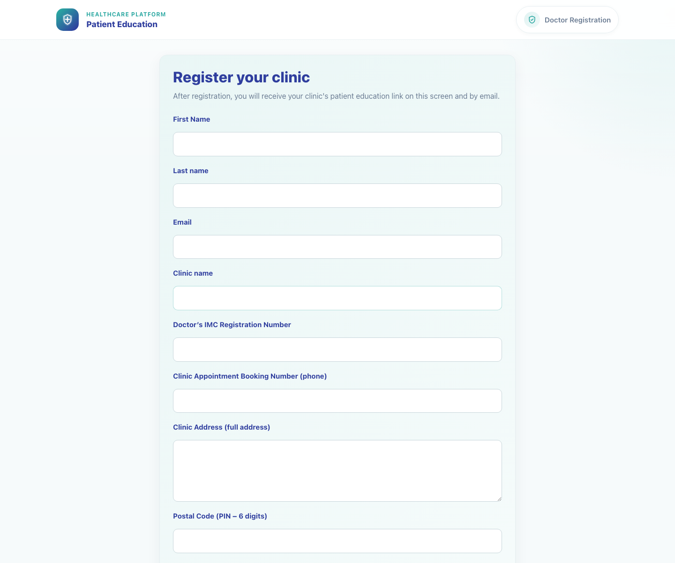
Workflow 03
Platform and Campaign Setup
Step 4: Route a new doctor into registration
New doctor redirected to registration.
What the user does
What the user sees
Submits a WhatsApp number that is not yet present in the master database.
The public doctor registration page with campaign and field rep parameters carried into the URL.
Why it matters
Expected result
This handoff preserves campaign attribution and keeps recruitment operational without manual intervention.
The doctor registration form opens with campaign context in place.
Trainer note
The doctor WhatsApp number can be prefilled from the field rep page to reduce re-entry.
Step 4 • Field Rep Recruitment

Slide 8
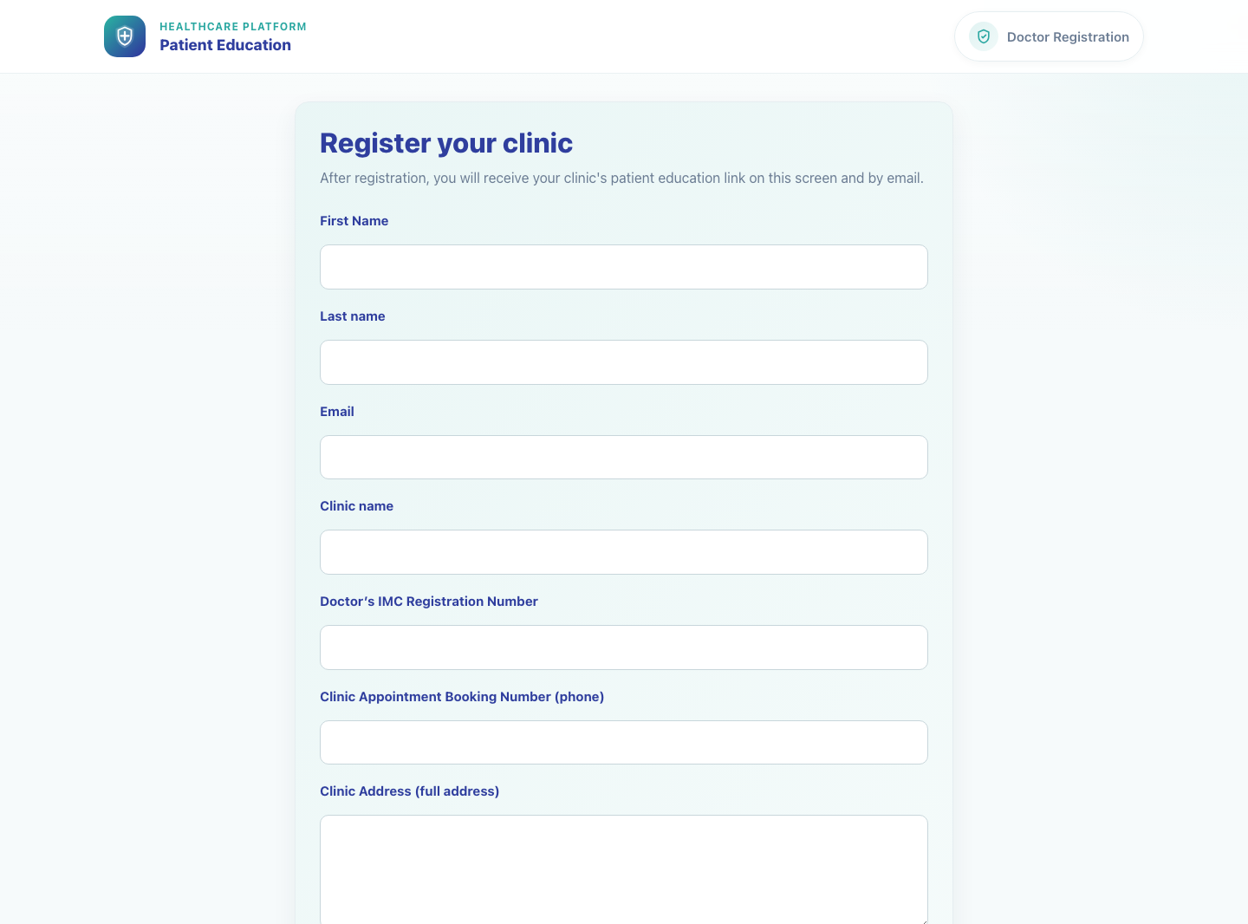
Workflow 03
Platform and Campaign Setup
Step 5: Hand off to clinic onboarding
Clinic onboarding handoff.
What the user does
Explains to the clinic that the next step is completing registration and then logging into the clinic workspace.
What the user sees
A seamless transition from field rep recruitment into clinic onboarding.
Why it matters
Successful recruitment is not complete until the clinic can actually log in and share content.
Expected result
The clinic understands the next step and moves into registration or login.
Trainer note
Use the Doctor Registration and First Access deck immediately after this one in training sessions.
Step 5 • Field Rep Recruitment

Slide 9
Workflow 03
Platform and Campaign Setup
Trainer Tips And Common Issues
The highest-value coaching points to cover during rollout or onboarding sessions.
Field rep not linked to the campaign
Campaign cap reached
The page blocks if the field rep identity is inactive or not authorized for the supplied campaign.
If doctors supported has been reached, recruitment is blocked until additional licenses are available.
Wrong WhatsApp number
Using the wrong number can route an existing clinic into the new-doctor path or vice versa, so confirm the number before submission.
Success markers
• Existing clinics are enrolled without manual database work.
• New clinics are redirected to the registration form with campaign context and prefilling.
• The field rep can explain which path happened and why.
Trainer tips • Field Rep Recruitment

Slide 10
Workflow complete
Field Rep Doctor Recruitment
Related manuals
• 01-platform-overview-and-role-map.md
• 04-doctor-registration-and-first-access.md
When the field rep flow ends on the registration page, the next operational deck is Doctor Registration and First Access.
Success criteria
• Existing clinics are enrolled without manual database work.
• New clinics are redirected to the registration form with campaign context and prefilling.
• The field rep can explain which path happened and why.
Status
Live-verified against the local demo environment and refreshed with real screenshots on 2026-04-23.
Workflow complete • Field Rep Recruitment

