Slide 1
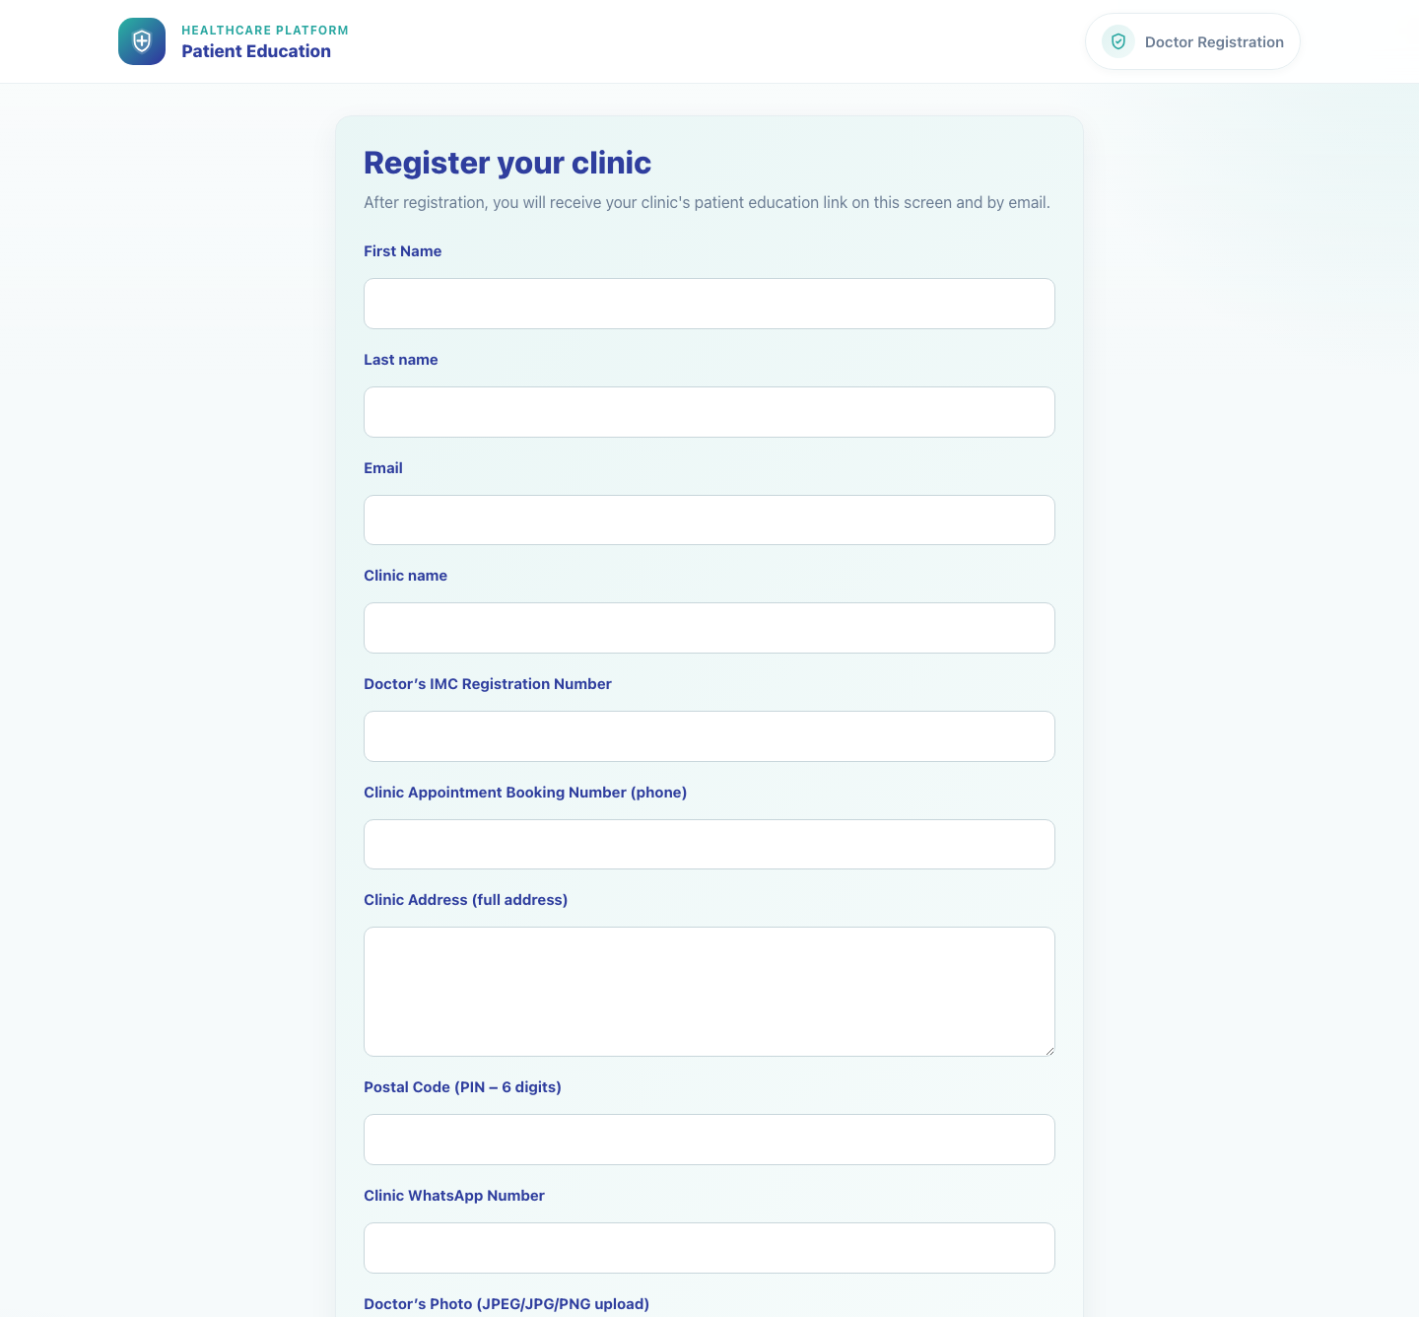
Clinic Onboarding and Sharing
Doctor Registration and First Access
Show a new clinic how to complete doctor registration and understand the first-login handoff.
Primary user
Entry point
New doctor or clinic representative completing the registration form
Public registration form at `/accounts/register/`.
After registration, move directly into the clinic login and sharing workflows.
Doctor Registration and First Access • Verified 2026-04-23

Slide 2
Workflow 04
Clinic Onboarding and Sharing
Workflow At A Glance
Purpose, user, entry point, and the operational outcome of this workflow.
Purpose
Primary user
Entry point
Show a new clinic how to complete doctor registration and understand the first-login handoff.
New doctor or clinic representative completing the registration form
Public registration form at `/accounts/register/`.
Workflow summary
• The registration form creates the doctor and clinic record and can carry campaign context from the field rep flow.
• The page collects doctor identity, clinic profile, address, WhatsApp, and a photo upload.
• After successful registration, the system instructs the clinic to log in or use Forgot password to set credentials if needed.
Workflow summary • Doctor Registration

Slide 3
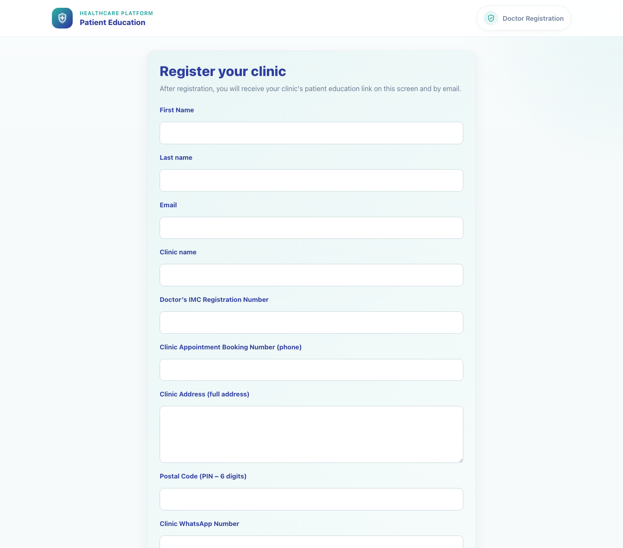
Workflow 04
Clinic Onboarding and Sharing
Step 1: Open the registration form
Blank doctor registration form.
What the user does
What the user sees
Starts from the public register page, either directly or from the field rep handoff.
Doctor Registration with the Register your clinic heading and a full onboarding form.
Why it matters
Expected result
This is the official entry point for clinics that do not already exist in the system.
The clinic can see all required onboarding fields before data entry begins.
Trainer note
If the clinic already exists, stop and use the login or password-reset route instead of registering again.
Step 1 • Doctor Registration

Slide 4
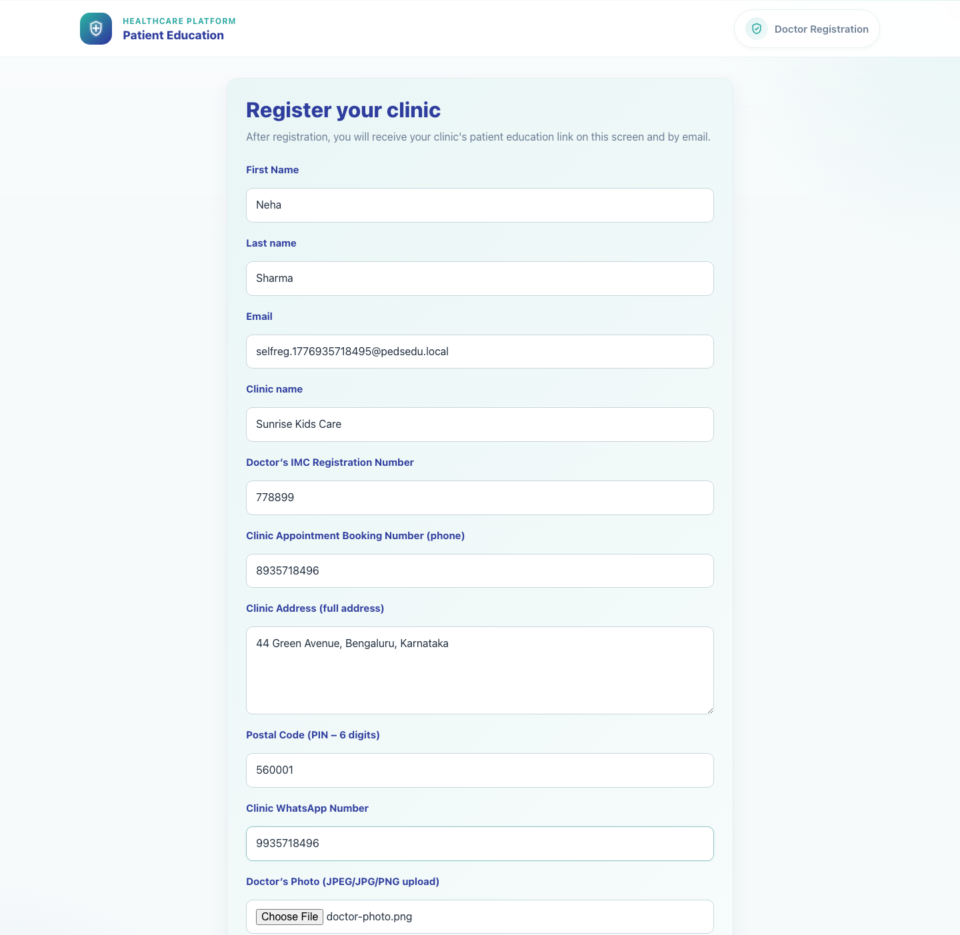
Workflow 04
Clinic Onboarding and Sharing
Step 2: Complete doctor and clinic details
Completed doctor registration form.
What the user does
What the user sees
Enters the doctor's name, email, clinic name, registration number, phone numbers, address, postal code, WhatsApp number, and doctor photo.
A fully populated registration form with all required onboarding fields visible.
Why it matters
Expected result
Accurate clinic identity and contact details are required for both login support and caregiver communication.
The form is complete and ready for submission.
Trainer note
The same clinic WhatsApp number is used later in caregiver-facing contact sections.
Step 2 • Doctor Registration

Slide 5
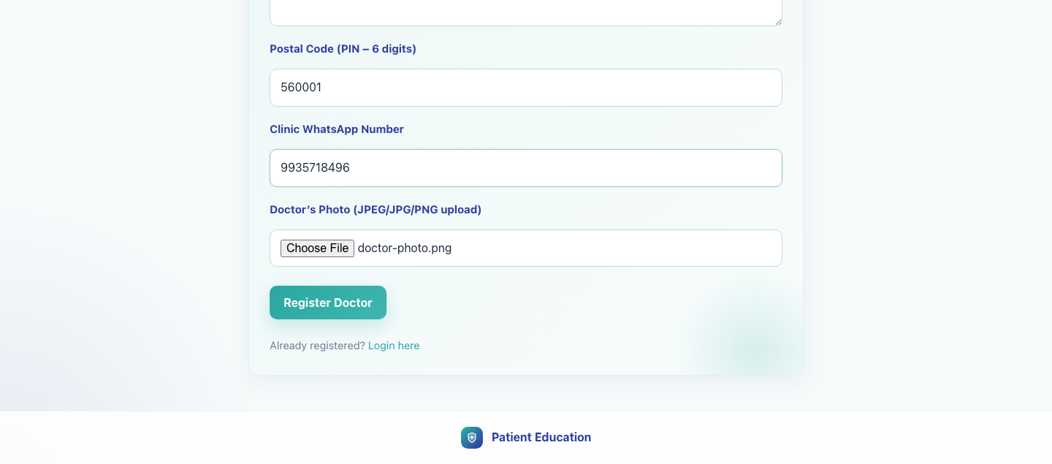
Workflow 04
Clinic Onboarding and Sharing
Step 3: Submit the registration
Registration ready for submission.
What the user does
What the user sees
Clicks Register Doctor once all fields are complete.
The same page validates the input and sends the data into the registration workflow.
Why it matters
Expected result
Submission creates the clinic identity used for future login and sharing.
The form submits successfully with no validation errors.
Trainer note
If validation fails, correct the highlighted field and resubmit instead of refreshing the page.
Step 3 • Doctor Registration

Slide 6
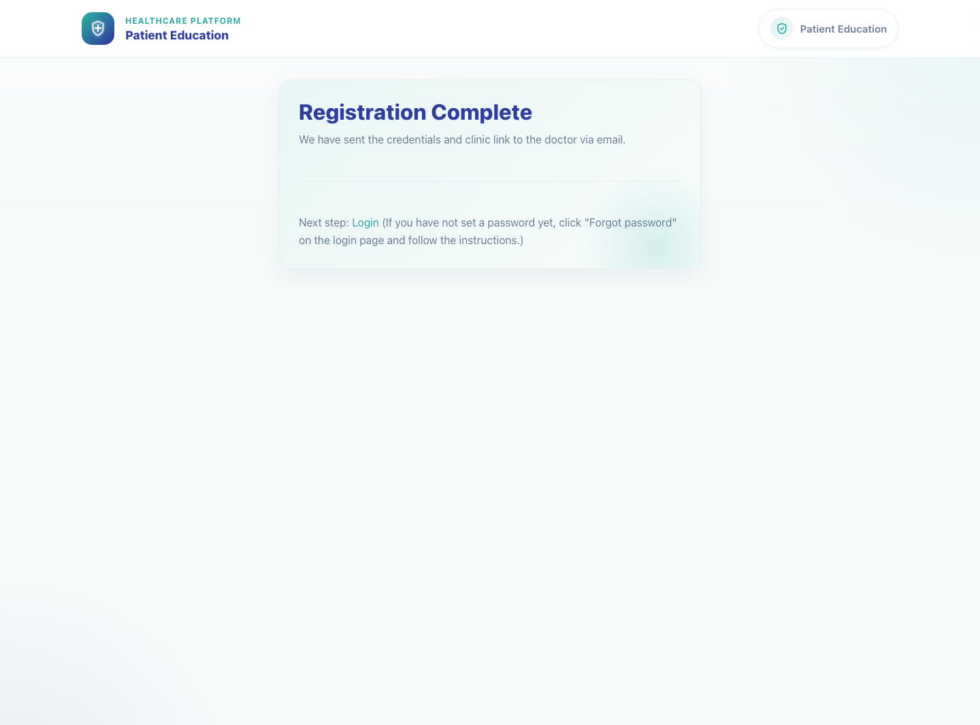
Workflow 04
Clinic Onboarding and Sharing
Step 4: Review the completion page and next-step instructions
Registration Complete confirmation screen.
What the user does
Reads the Registration Complete screen and follows the Login or Forgot password guidance.
What the user sees
A confirmation page stating that credentials and the clinic link were sent to the doctor by email.
Why it matters
This page closes the onboarding loop and points the clinic toward first access.
Expected result
The clinic understands that login is next and knows how to request a password setup link if needed.
Trainer note
Current product behavior uses the Forgot password action on the login page for first-time password setup when a password has not yet been set.
Step 4 • Doctor Registration

Slide 7
Workflow 04
Clinic Onboarding and Sharing
Trainer Tips And Common Issues
The highest-value coaching points to cover during rollout or onboarding sessions.
Already registered clinic
Missing required fields
If the clinic already exists, use login or password reset instead of creating a duplicate registration.
The form requires a complete clinic profile, so blank clinic contact or address fields will block submission.
Password expectations
The confirmation page points the user to login first and to Forgot password when a password setup link is needed.
Success markers
• The registration completes successfully and shows the confirmation page.
• The clinic receives login and clinic-link instructions by email.
• The clinic can proceed to login or password setup without manual admin help.
Trainer tips • Doctor Registration

Slide 8
Workflow complete
Doctor Registration and First Access
Related manuals
• 03-field-rep-doctor-recruitment.md
• 05-doctor-share-single-video.md
After registration, move directly into the clinic login and sharing workflows.
Success criteria
• The registration completes successfully and shows the confirmation page.
• The clinic receives login and clinic-link instructions by email.
• The clinic can proceed to login or password setup without manual admin help.
Status
Live-verified against the local demo environment and refreshed with real screenshots on 2026-04-23.
Workflow complete • Doctor Registration

