Slide 1
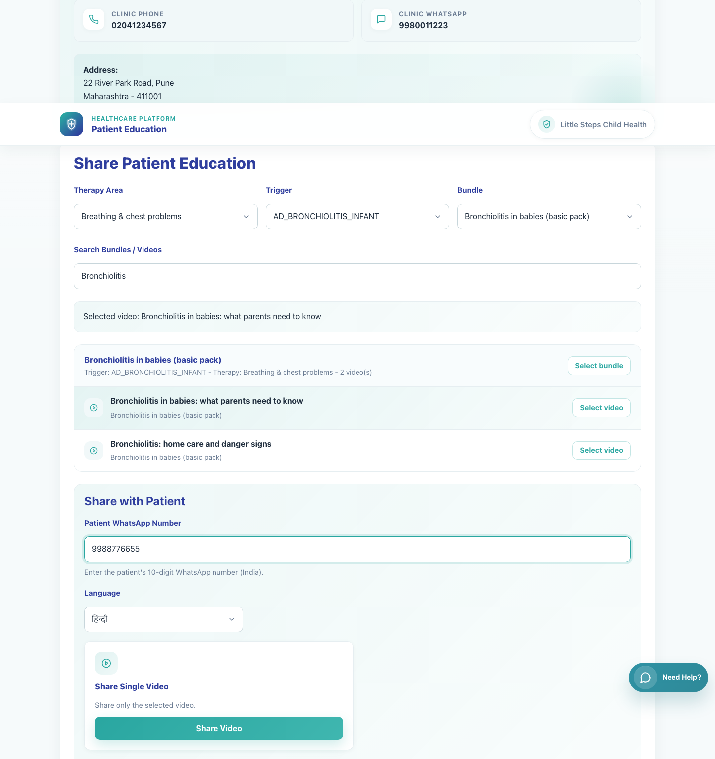
Clinic Onboarding and Sharing
Doctor Share Single Video
Show a doctor how to log in, search the catalog, select a single video, and share it to a caregiver through WhatsApp.
Primary user
Entry point
Registered doctor using the clinic sharing workspace
Doctor login at `/accounts/login/`.
Use the caregiver single-video deck after this one to show exactly what the recipient sees.
Doctor Share Single Video • Verified 2026-04-23

Slide 2
Workflow 05
Clinic Onboarding and Sharing
Workflow At A Glance
Purpose, user, entry point, and the operational outcome of this workflow.
Purpose
Primary user
Entry point
Show a doctor how to log in, search the catalog, select a single video, and share it to a caregiver through WhatsApp.
Registered doctor using the clinic sharing workspace
Doctor login at `/accounts/login/`.
Workflow summary
• The doctor logs into the clinic workspace and lands directly on the Share Patient Education page for the clinic.
• Selecting a video activates the Share Video action and generates a secure patient link in the chosen language.
• The caregiver receives a WhatsApp message containing the video title and the secure patient page link.
Workflow summary • Doctor Single Video Share

Slide 3
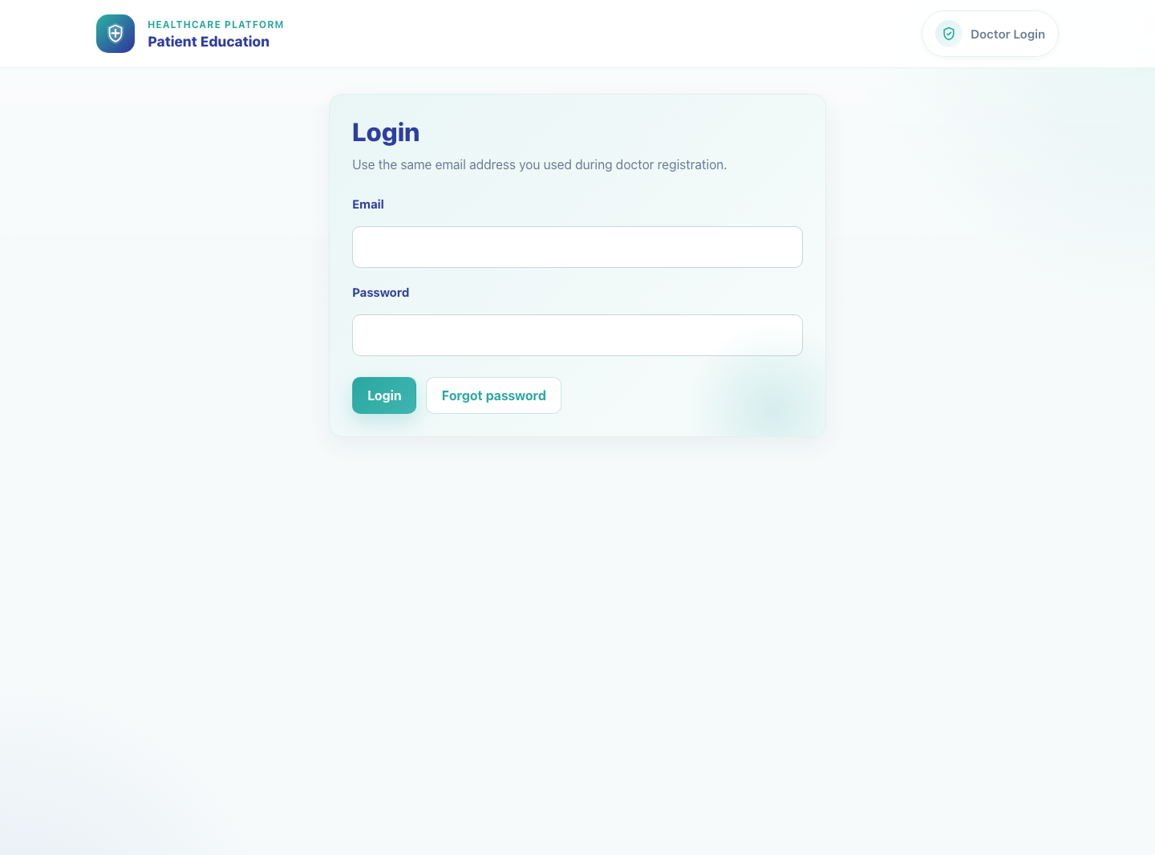
Workflow 05
Clinic Onboarding and Sharing
Step 1: Log into the clinic sharing workspace
Doctor login page.
What the user does
Signs in with the registered doctor email address and password.
What the user sees
The shared Doctor Login page and, after sign-in, the clinic's Share Patient Education workspace.
Why it matters
Clinic sharing is only available after a successful authenticated login.
Expected result
The doctor lands on the clinic share page for the correct doctor ID.
Trainer note
The same login page is also used by clinic staff accounts tied to the same clinic.
Step 1 • Doctor Single Video Share

Slide 4
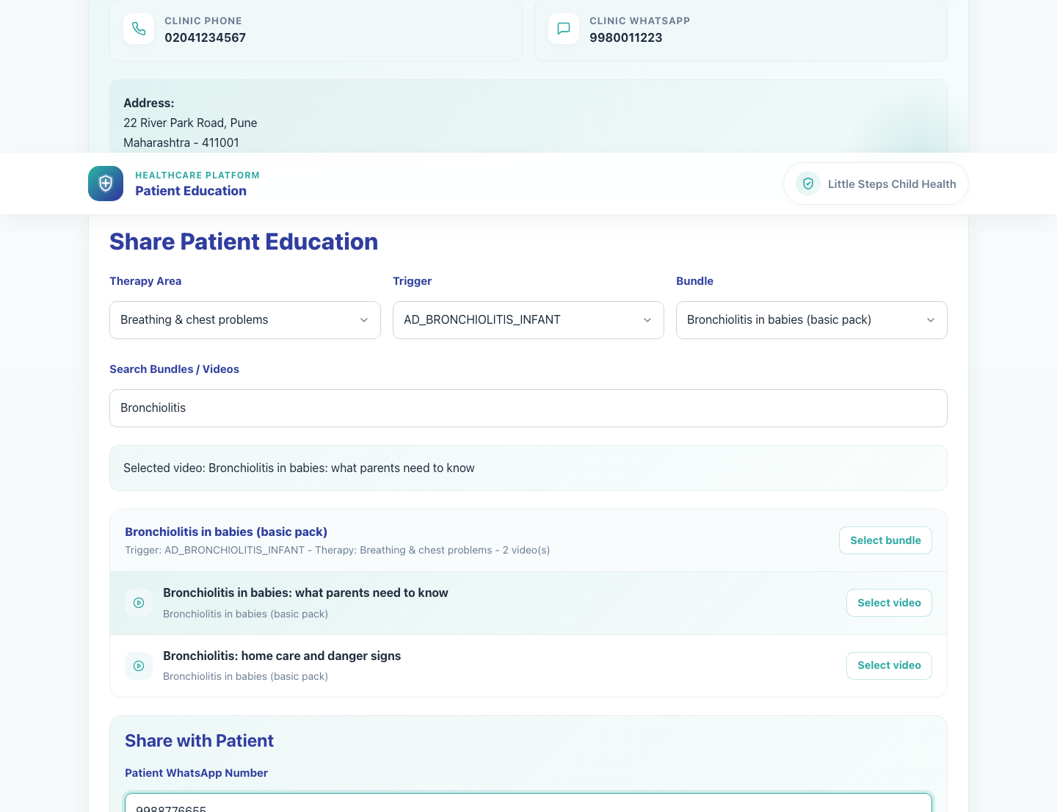
Workflow 05
Clinic Onboarding and Sharing
Step 2: Filter the catalog and select the target video
Doctor workspace with a selected video.
What the user does
What the user sees
Uses therapy, trigger, bundle, or search controls to narrow the catalog and then selects the required video.
A selected video state inside the clinic sharing page, with the active bundle and the matching video highlighted.
Why it matters
Expected result
Selecting the video is what enables the single-video share action.
The correct video is active and ready to share.
Trainer note
Clicking a bundle alone is not enough for this workflow; the doctor must click the specific video to activate Share Video.
Step 2 • Doctor Single Video Share

Slide 5
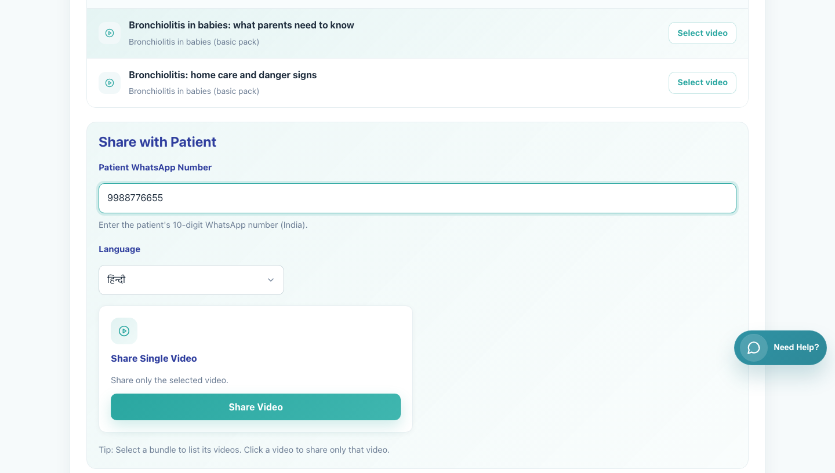
Workflow 05
Clinic Onboarding and Sharing
Step 3: Enter the caregiver WhatsApp number and choose language
Single-video share panel ready for use.
What the user does
What the user sees
Types the caregiver's 10-digit WhatsApp number and selects the content language.
The Share with Patient panel containing the patient WhatsApp field and language selector.
Why it matters
Expected result
The share message is personalized to the caregiver number and the selected language.
The share panel is complete and ready for action.
Trainer note
The clinic workspace expects a 10-digit India-format WhatsApp number.
Step 3 • Doctor Single Video Share

Slide 6
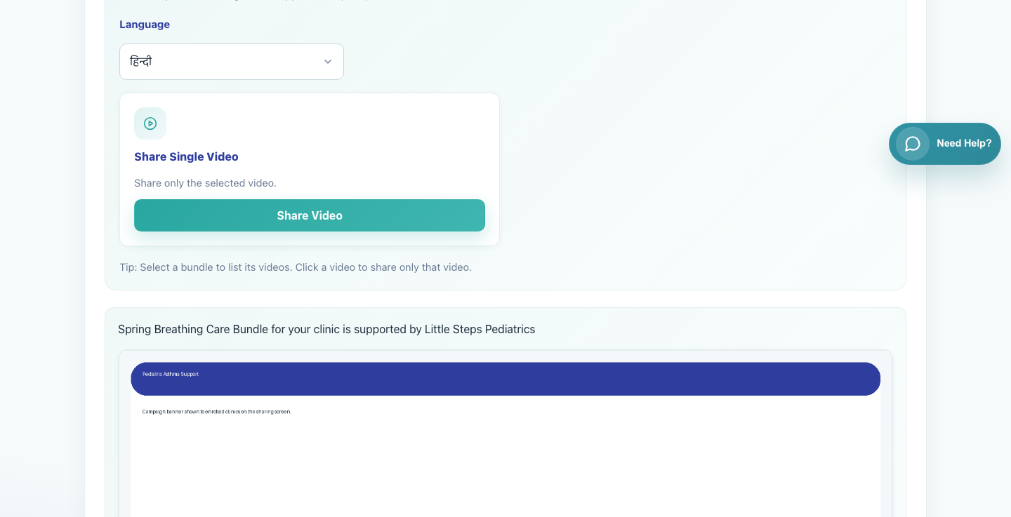
Workflow 05
Clinic Onboarding and Sharing
Step 4: Share the single video through WhatsApp
Share Video action tile.
What the user does
What the user sees
Clicks Share Video after the patient number, language, and selected video are all in place.
The Share Single Video action tile and a backend redirect into a WhatsApp deeplink.
Why it matters
Expected result
This is the moment the secure caregiver link is generated and delivered.
WhatsApp opens with a prefilled message containing the video title and the secure link.
Trainer note
If Share Video is not visible, confirm that a specific video rather than only a bundle is selected.
Step 4 • Doctor Single Video Share

Slide 7
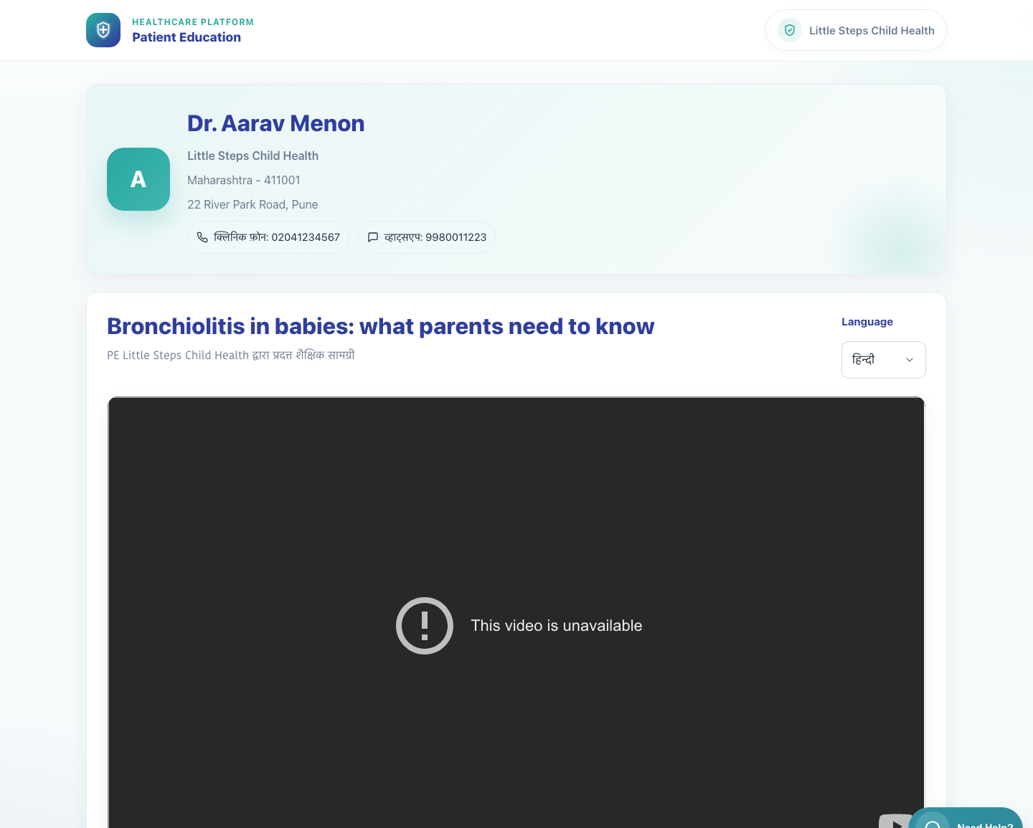
Workflow 05
Clinic Onboarding and Sharing
Step 5: Explain what the caregiver receives
Shared caregiver page for a single video.
What the user does
What the user sees
Reviews the caregiver-facing page to confirm the shared result.
A secure patient video page with clinic branding, contact details, the selected video, and a language chooser.
Why it matters
Expected result
Doctors are more confident sharing content when they know exactly what the caregiver will see.
The doctor can describe the caregiver experience and confirm the share worked.
Trainer note
The caregiver page does not require login. Language can be changed after the link is opened.
Step 5 • Doctor Single Video Share

Slide 8
Workflow 05
Clinic Onboarding and Sharing
Trainer Tips And Common Issues
The highest-value coaching points to cover during rollout or onboarding sessions.
Share button not available
Invalid WhatsApp number
Share Video appears only after a specific video is selected.
The share form expects a 10-digit number and will not work correctly with partial or formatted values.
Wrong content level
If the doctor wants the caregiver to receive a full collection rather than one item, switch to the bundle-sharing workflow instead.
Success markers
• The doctor can find the correct video in the clinic workspace.
• A valid patient WhatsApp number and language are selected before sharing.
• WhatsApp opens with a prefilled message containing the secure single-video link.
Trainer tips • Doctor Single Video Share

Slide 9
Workflow complete
Doctor Share Single Video
Related manuals
• 04-doctor-registration-and-first-access.md
• 07-caregiver-single-video-view.md
Use the caregiver single-video deck after this one to show exactly what the recipient sees.
Success criteria
• The doctor can find the correct video in the clinic workspace.
• A valid patient WhatsApp number and language are selected before sharing.
• WhatsApp opens with a prefilled message containing the secure single-video link.
Status
Live-verified against the local demo environment and refreshed with real screenshots on 2026-04-23.
Workflow complete • Doctor Single Video Share

