Slide 1
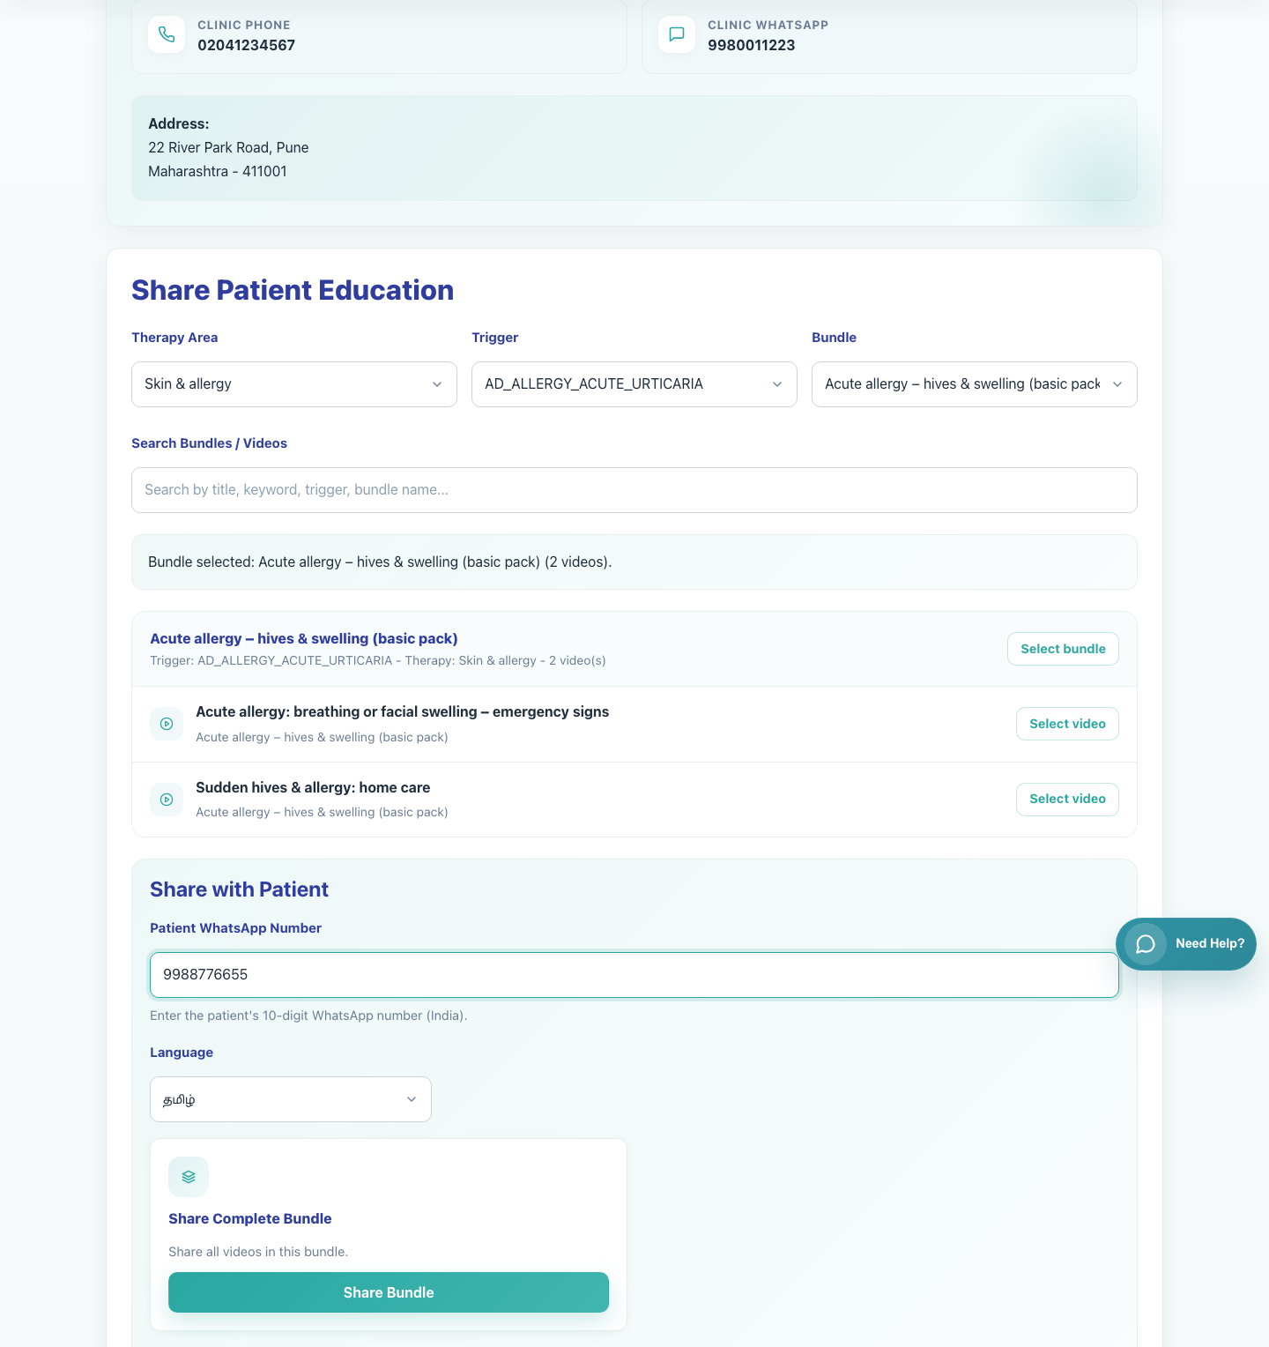
Clinic Onboarding and Sharing
Clinic Staff Share Bundle
Show a clinic staff member how to log in to the same clinic workspace, choose a full bundle, and share it with a caregiver.
Primary user
Entry point
Registered clinic staff user linked to an existing clinic
Clinic staff login at `/accounts/login/`.
Follow this deck with the caregiver bundle view deck whenever staff need to understand the recipient experience.
Clinic Staff Share Bundle • Verified 2026-04-23

Slide 2
Workflow 06
Clinic Onboarding and Sharing
Workflow At A Glance
Purpose, user, entry point, and the operational outcome of this workflow.
Purpose
Primary user
Entry point
Show a clinic staff member how to log in to the same clinic workspace, choose a full bundle, and share it with a caregiver.
Registered clinic staff user linked to an existing clinic
Clinic staff login at `/accounts/login/`.
Workflow summary
• Clinic staff use the same clinic share workspace as doctors, but they often share complete bundles for repeated counseling.
• Selecting a bundle activates Share Bundle and produces a secure multi-video patient link.
• The caregiver receives a WhatsApp deeplink to a page that contains the full bundle in the chosen language.
Workflow summary • Clinic Staff Bundle Share

Slide 3
Workflow 06
Clinic Onboarding and Sharing
Decision Points
Key branches or usage choices that change what the user should do next.
Share a single video
Share a complete bundle
Use when the caregiver needs one targeted item only.
Use when the caregiver should receive the full condition-specific sequence.
Outcome
Outcome
Select the video and use Share Video.
Select the bundle and use Share Bundle.
Decision points • Clinic Staff Bundle Share

Slide 4
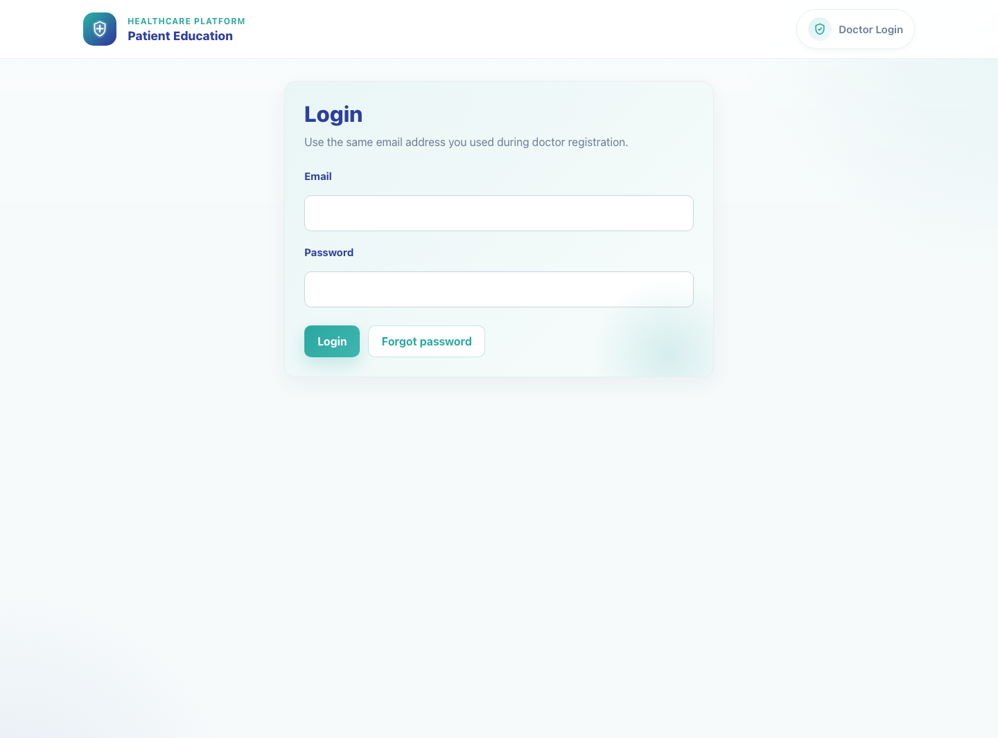
Workflow 06
Clinic Onboarding and Sharing
Step 1: Log in with clinic staff credentials
Shared clinic login page for staff and doctors.
What the user does
Signs in through the shared clinic login page with the clinic staff email and password.
What the user sees
The same clinic-sharing workspace used by doctors.
Why it matters
Clinic staff do not need a separate app; they work inside the same operational share page.
Expected result
The clinic share workspace opens for the correct clinic.
Trainer note
The page layout is role-aware only for access control and banners; the main sharing controls remain the same.
Step 1 • Clinic Staff Bundle Share

Slide 5
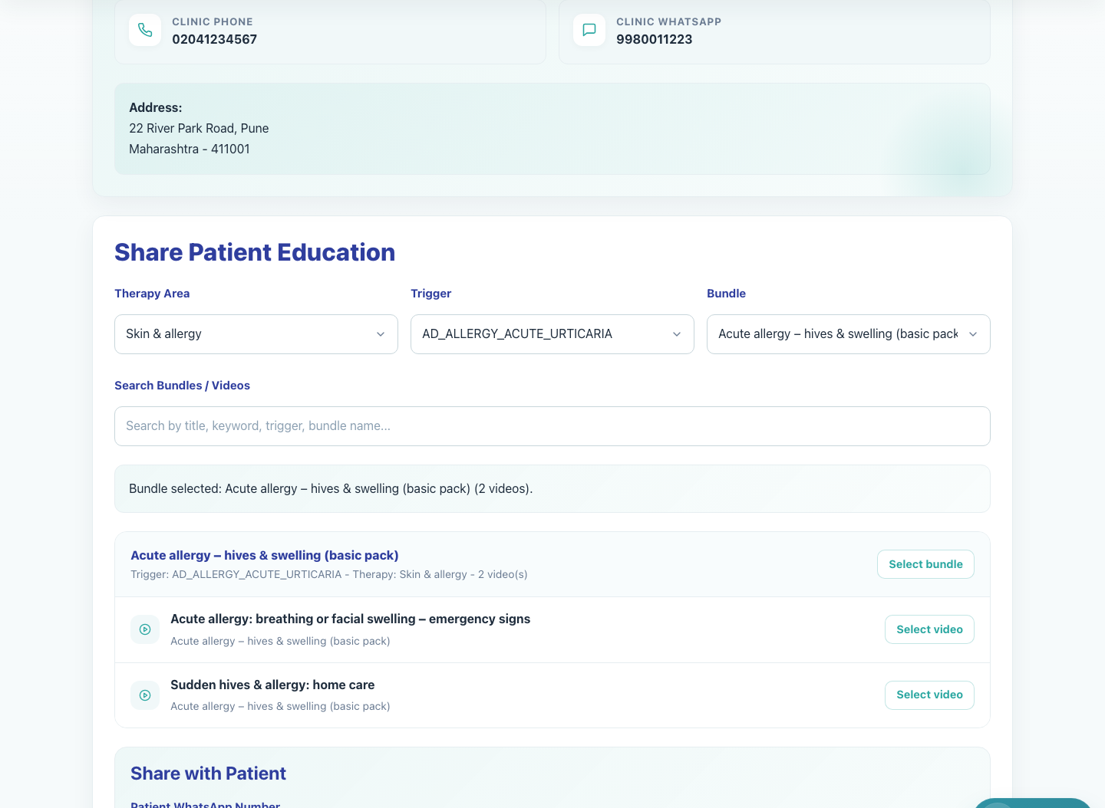
Workflow 06
Clinic Onboarding and Sharing
Step 2: Select the required bundle
Clinic staff workspace with a selected bundle.
What the user does
What the user sees
Uses the bundle selector and search tools to choose the correct caregiver education bundle.
The active bundle context with the videos listed beneath it.
Why it matters
Expected result
Bundle selection determines the collection of videos the caregiver will receive.
The correct bundle is active and visible in the clinic workspace.
Trainer note
For this workflow the staff user should stop at the bundle level instead of clicking down into a single video.
Step 2 • Clinic Staff Bundle Share

Slide 6
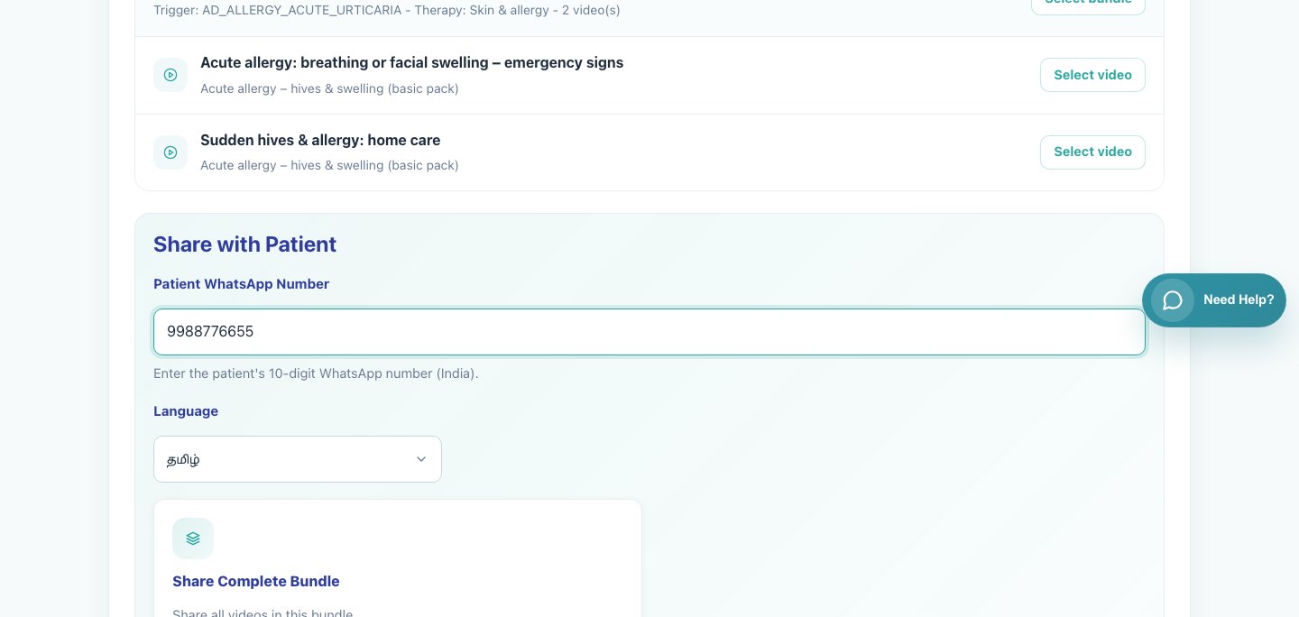
Workflow 06
Clinic Onboarding and Sharing
Step 3: Enter the caregiver number and set language
Bundle share panel ready for action.
What the user does
What the user sees
Types the caregiver WhatsApp number and selects the preferred language for the bundle link.
The Share with Patient panel containing the WhatsApp field and language picker.
Why it matters
Expected result
The caregiver's number and chosen language are required to build the correct WhatsApp message.
The share panel is ready for the bundle action.
Trainer note
Bundle shares are especially useful when the clinic wants caregivers to review a full set of counseling videos over time.
Step 3 • Clinic Staff Bundle Share

Slide 7
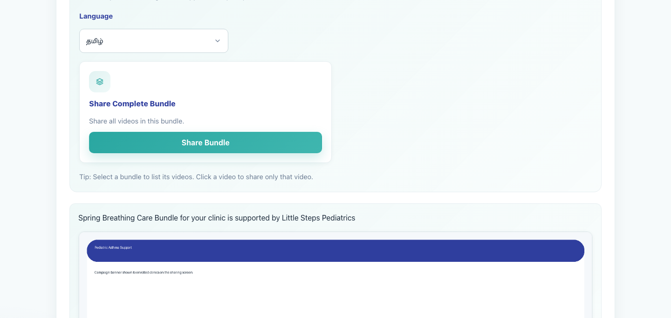
Workflow 06
Clinic Onboarding and Sharing
Step 4: Share the complete bundle
Share Bundle action tile.
What the user does
What the user sees
Clicks Share Bundle once the patient number, language, and bundle are confirmed.
The Share Complete Bundle card with the Share Bundle button and a redirect into WhatsApp.
Why it matters
Expected result
This action creates a secure bundle page that preserves the clinic context and language choice.
WhatsApp opens with a prefilled message containing the secure bundle link.
Trainer note
If Share Bundle is hidden, confirm that the user selected the bundle instead of a single video.
Step 4 • Clinic Staff Bundle Share

Slide 8
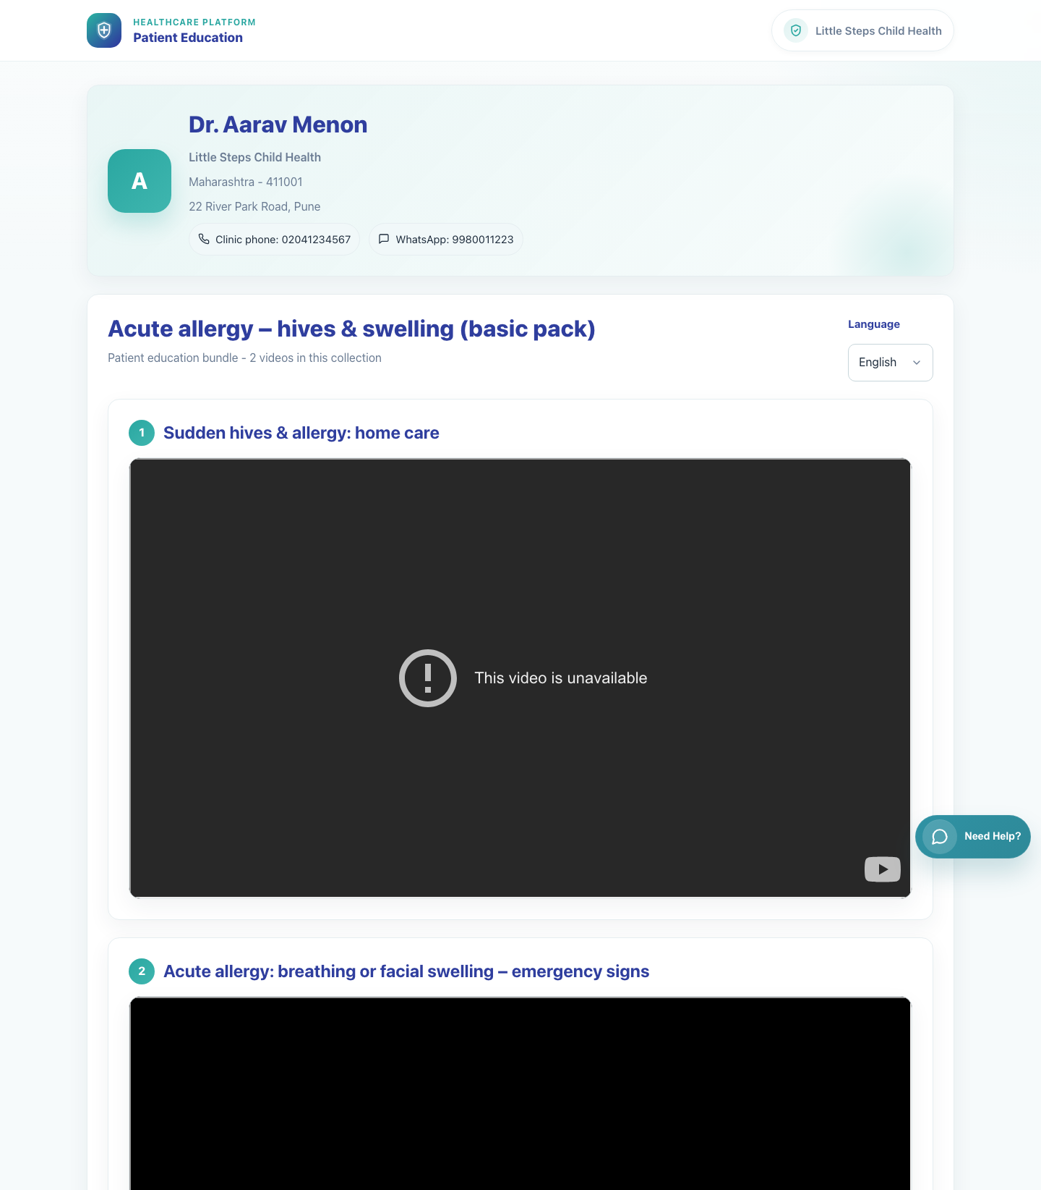
Workflow 06
Clinic Onboarding and Sharing
Step 5: Review the caregiver bundle page outcome
Caregiver bundle page in English.
What the user does
What the user sees
Checks the recipient experience to make sure the caregiver receives the full collection.
A secure bundle page listing multiple videos under the selected bundle title.
Why it matters
Expected result
This confirms that the clinic sent a collection and not only a single item.
The clinic staff user can describe how the caregiver will step through the bundle.
Trainer note
Language changes happen on the patient page and refresh the bundle display.
Step 5 • Clinic Staff Bundle Share

Slide 9
Workflow 06
Clinic Onboarding and Sharing
Trainer Tips And Common Issues
The highest-value coaching points to cover during rollout or onboarding sessions.
Single-video selection by mistake
Incomplete caregiver number
If a staff user clicks a video, the UI switches toward Share Video. Return to the bundle selector to share the whole collection.
Bundle sharing expects the same 10-digit WhatsApp number format as single-video sharing.
Campaign visibility limits
If the expected bundle does not appear, confirm that the current clinic is supported by the campaign that contains that bundle.
Success markers
• The clinic staff user can log in to the correct clinic workspace.
• A full bundle is selected and the caregiver number and language are set.
• The WhatsApp deeplink contains the secure bundle page rather than a single-video link.
Trainer tips • Clinic Staff Bundle Share

Slide 10
Workflow complete
Clinic Staff Share Bundle
Related manuals
• 05-doctor-share-single-video.md
• 08-caregiver-bundle-view.md
Follow this deck with the caregiver bundle view deck whenever staff need to understand the recipient experience.
Success criteria
• The clinic staff user can log in to the correct clinic workspace.
• A full bundle is selected and the caregiver number and language are set.
• The WhatsApp deeplink contains the secure bundle page rather than a single-video link.
Status
Live-verified against the local demo environment and refreshed with real screenshots on 2026-04-23.
Workflow complete • Clinic Staff Bundle Share

