Slide 1
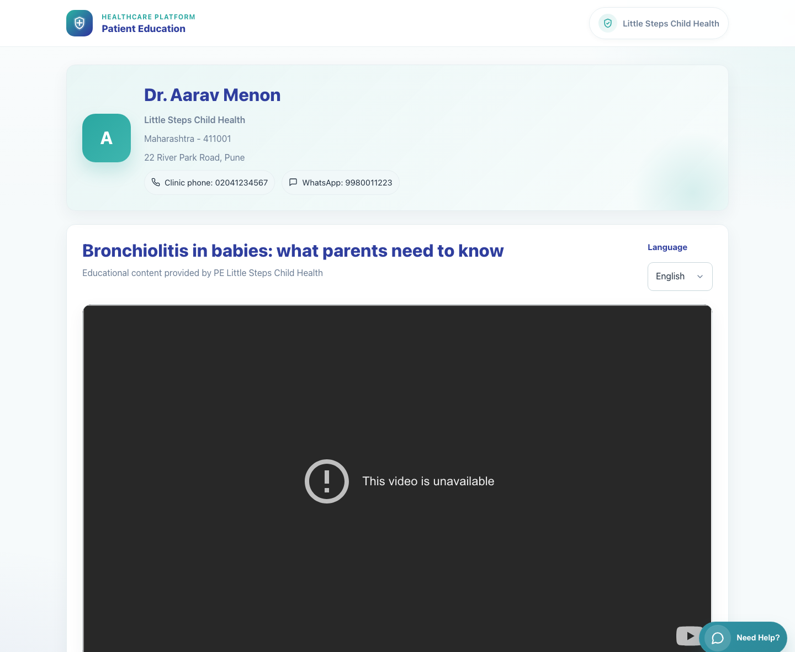
Caregiver Experience
Caregiver Single Video View
Show what a caregiver sees after opening a shared single-video link from WhatsApp.
Primary user
Entry point
Caregiver receiving a single-video patient link
Secure patient link in WhatsApp such as `/p/<doctor_id>/v/<video_code>/?lang=<code>&d=<signed-payload>`.
This view is the direct result of a single-video WhatsApp share from the clinic workspace.
Caregiver Single Video View • Verified 2026-04-23

Slide 2
Workflow 07
Caregiver Experience
Workflow At A Glance
Purpose, user, entry point, and the operational outcome of this workflow.
Purpose
Primary user
Entry point
Show what a caregiver sees after opening a shared single-video link from WhatsApp.
Caregiver receiving a single-video patient link
Secure patient link in WhatsApp such as `/p/<doctor_id>/v/<video_code>/?lang=<code>&d=<signed-payload>`.
Workflow summary
• The caregiver does not log in and is taken directly to a patient page branded with the clinic and doctor context.
• The page exposes clinic phone and WhatsApp contact options, the selected video, and a language picker.
• Changing language reloads the page content in the chosen language while keeping the clinic context intact.
Workflow summary • Caregiver Single Video View

Slide 3

Workflow 07
Caregiver Experience
Step 1: Open the secure patient link from WhatsApp
Single-video caregiver page in Hindi.
What the user does
What the user sees
Taps the shared clinic link in WhatsApp.
A branded patient page showing the doctor name, clinic name, address, contact options, and the selected educational video.
Why it matters
Expected result
The caregiver immediately knows which clinic sent the content and that no login is required.
The patient page loads successfully in the default shared language.
Trainer note
The link is signed and tied to the clinic context, so caregivers should use the original shared message rather than trying to rebuild the URL.
Step 1 • Caregiver Single Video View

Slide 4
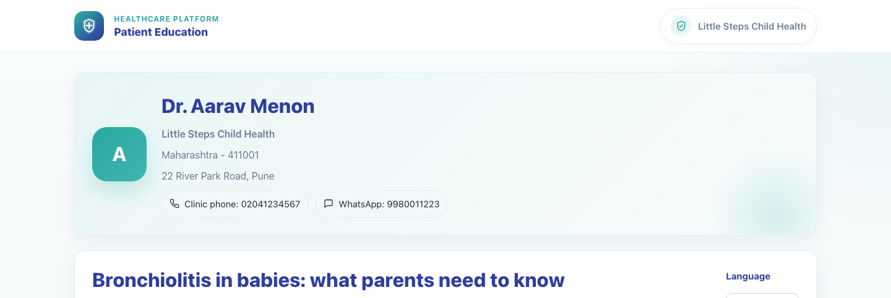
Workflow 07
Caregiver Experience
Step 2: Review clinic contact information and context
Clinic context on the caregiver page.
What the user does
What the user sees
Checks the doctor identity, clinic name, address, phone, and WhatsApp contact chips before watching the content.
Doctor and clinic details at the top of the patient page.
Why it matters
Expected result
This reinforces trust and gives the caregiver clear return-contact options.
The caregiver can identify the sending clinic and the available contact routes.
Trainer note
Use this section during training to show where caregivers go if they need to call or message the clinic.
Step 2 • Caregiver Single Video View

Slide 5
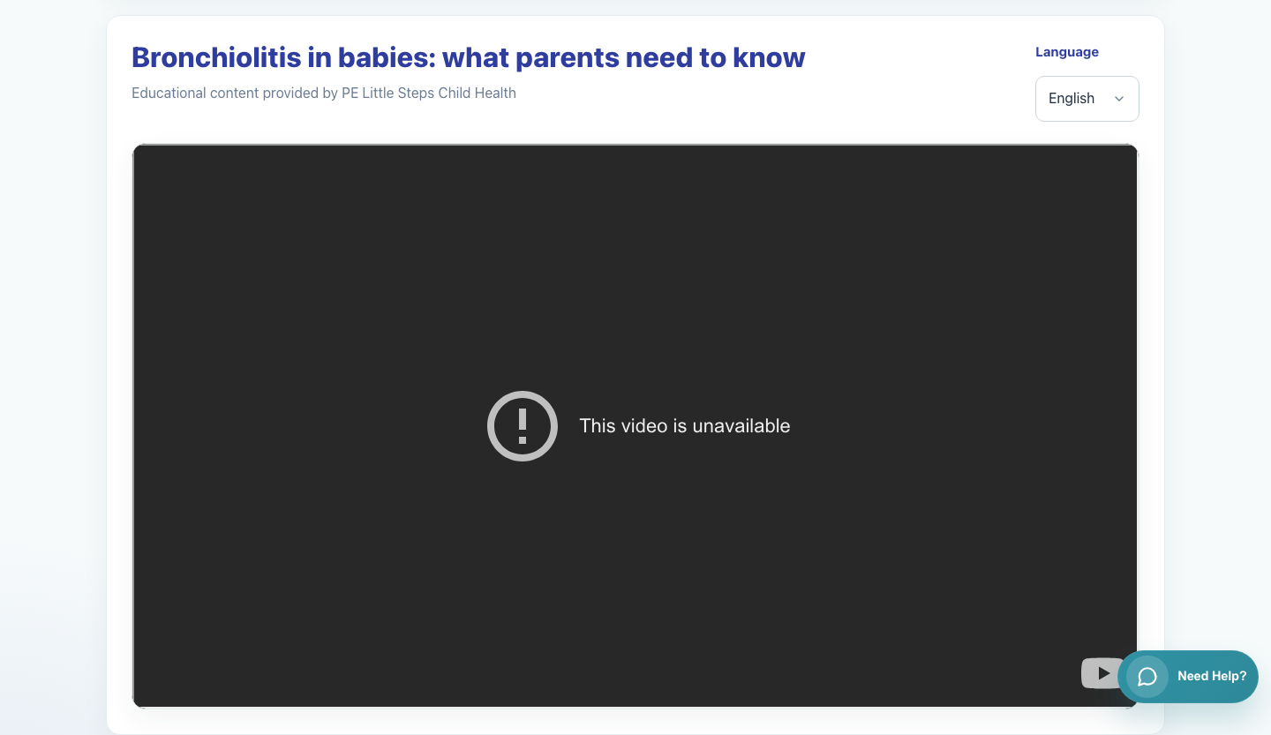
Workflow 07
Caregiver Experience
Step 3: Watch the educational video
Embedded single-video player.
What the user does
What the user sees
Plays the embedded video or uses the fallback behavior if the source cannot be embedded.
A video player area underneath the title and language selector.
Why it matters
Expected result
The patient page keeps the clinic identity visible while the caregiver consumes the content.
The caregiver can start the content from the same page without extra navigation.
Trainer note
Some source videos may have external playback limitations. If that occurs, direct the caregiver to the fallback action shown by the page.
Step 3 • Caregiver Single Video View

Slide 6
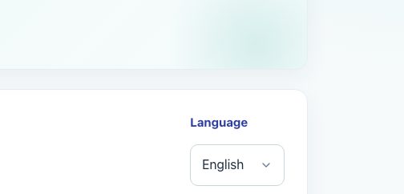
Workflow 07
Caregiver Experience
Step 4: Switch language on the patient page
Language selector on the single-video page.
What the user does
What the user sees
Uses the Language selector to change from the originally shared language to another supported language.
A language dropdown on the top-right of the patient content card.
Why it matters
Expected result
The caregiver can self-serve into a more comfortable language without asking the clinic to resend the link.
The page reloads with the selected language and retains the clinic context.
Trainer note
Changing language reloads the content rather than opening a separate application.
Step 4 • Caregiver Single Video View

Slide 7
Workflow 07
Caregiver Experience
Trainer Tips And Common Issues
The highest-value coaching points to cover during rollout or onboarding sessions.
Link opened outside the original message
Video source limitations
Caregivers should use the original shared link because it contains the signed context needed by the patient page.
If a source blocks inline playback, rely on the page's fallback behavior rather than assuming the clinic shared the wrong link.
Language expectations
The shared link may open in a preset language, but the caregiver can change it from the page itself.
Success markers
• The caregiver can identify which clinic sent the content.
• The video page loads with the selected language and content title.
• The caregiver can switch language without re-requesting a new share link.
Trainer tips • Caregiver Single Video View

Slide 8
Workflow complete
Caregiver Single Video View
Related manuals
• 05-doctor-share-single-video.md
This view is the direct result of a single-video WhatsApp share from the clinic workspace.
Success criteria
• The caregiver can identify which clinic sent the content.
• The video page loads with the selected language and content title.
• The caregiver can switch language without re-requesting a new share link.
Status
Live-verified against the local demo environment and refreshed with real screenshots on 2026-04-23.
Workflow complete • Caregiver Single Video View

