Slide 1
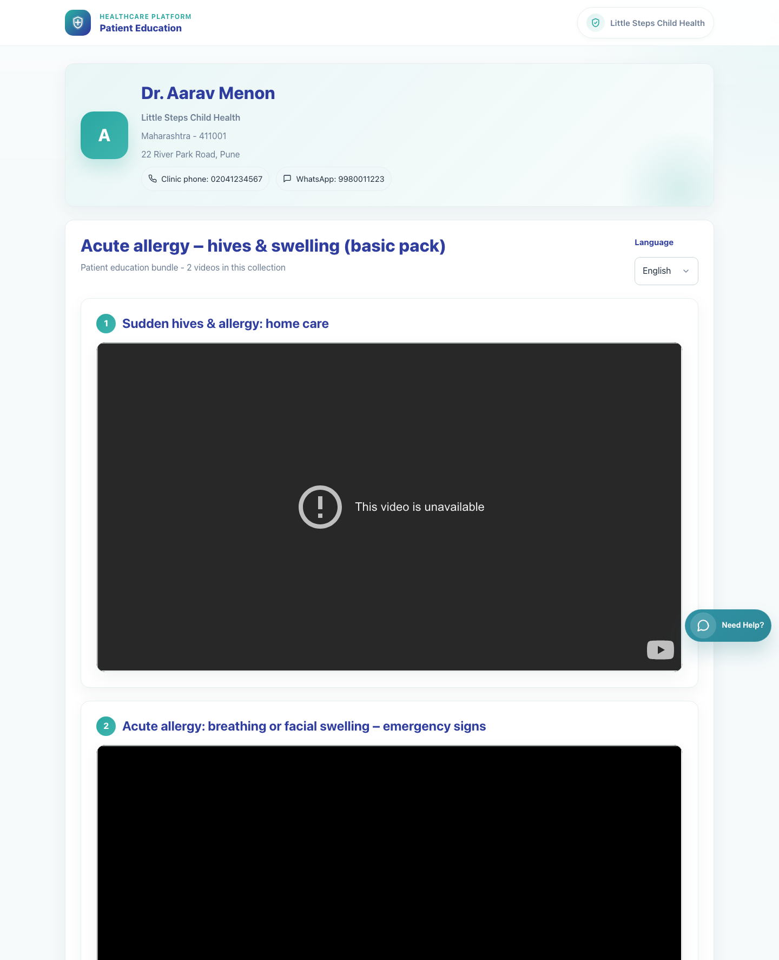
Caregiver Experience
Caregiver Bundle View
Show what a caregiver sees after receiving a bundle link that contains multiple educational videos.
Primary user
Entry point
Caregiver receiving a bundle patient link
Secure bundle link in WhatsApp such as `/p/<doctor_id>/c/<cluster_code>/?lang=<code>&d=<signed-payload>`.
This page is the caregiver outcome when clinic staff or doctors use Share Bundle from the clinic workspace.
Caregiver Bundle View • Verified 2026-04-23

Slide 2
Workflow 08
Caregiver Experience
Workflow At A Glance
Purpose, user, entry point, and the operational outcome of this workflow.
Purpose
Primary user
Entry point
Show what a caregiver sees after receiving a bundle link that contains multiple educational videos.
Caregiver receiving a bundle patient link
Secure bundle link in WhatsApp such as `/p/<doctor_id>/c/<cluster_code>/?lang=<code>&d=<signed-payload>`.
Workflow summary
• The caregiver lands on a multi-video patient page that retains the same clinic context as the single-video flow.
• The bundle page presents the collection title, the number of videos, and each video in sequence on the same page.
• The caregiver can switch language directly on the bundle page to reload the collection in another language.
Workflow summary • Caregiver Bundle View

Slide 3
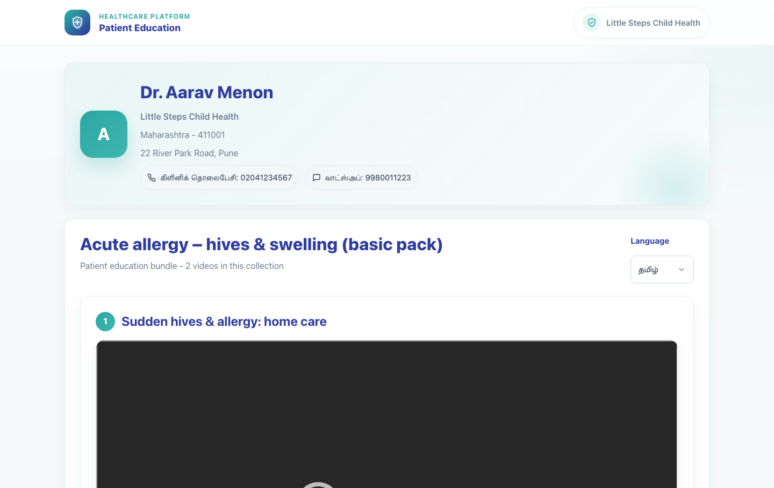
Workflow 08
Caregiver Experience
Step 1: Open the secure bundle link
Bundle page in Tamil.
What the user does
What the user sees
Taps the WhatsApp link that was shared from the clinic.
A clinic-branded bundle page showing the doctor identity, clinic details, bundle title, and video count.
Why it matters
Expected result
The caregiver immediately knows this is a collection of related educational videos rather than a single item.
The bundle page opens in the shared language and shows the correct clinic context.
Trainer note
The bundle page keeps the same trust signals as the single-video page: doctor, clinic, address, and contact options.
Step 1 • Caregiver Bundle View

Slide 4
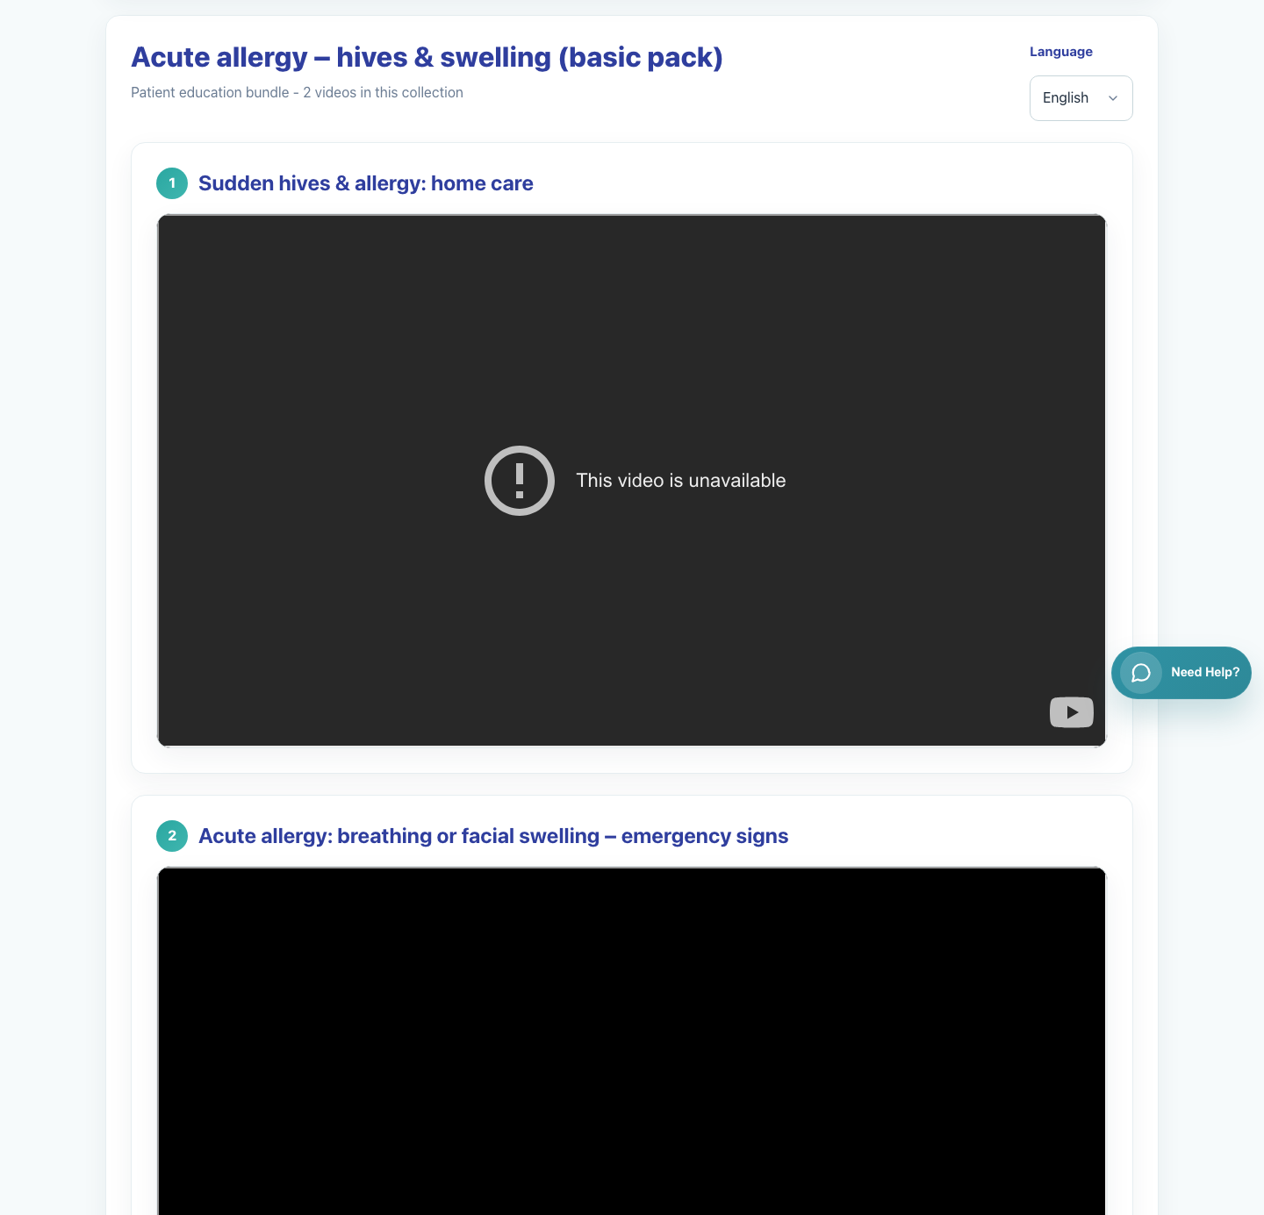
Workflow 08
Caregiver Experience
Step 2: Review the bundle title and listed videos
Bundle page showing multiple video entries.
What the user does
What the user sees
Scrolls through the bundle to understand the sequence of educational videos provided by the clinic.
Multiple video cards stacked under the bundle heading.
Why it matters
Expected result
The caregiver can consume the collection as a guided set rather than looking for separate links.
The caregiver can identify how many videos are included and where each video begins.
Trainer note
During training, show caregivers how to continue scrolling after the first video rather than assuming the page stops there.
Step 2 • Caregiver Bundle View

Slide 5
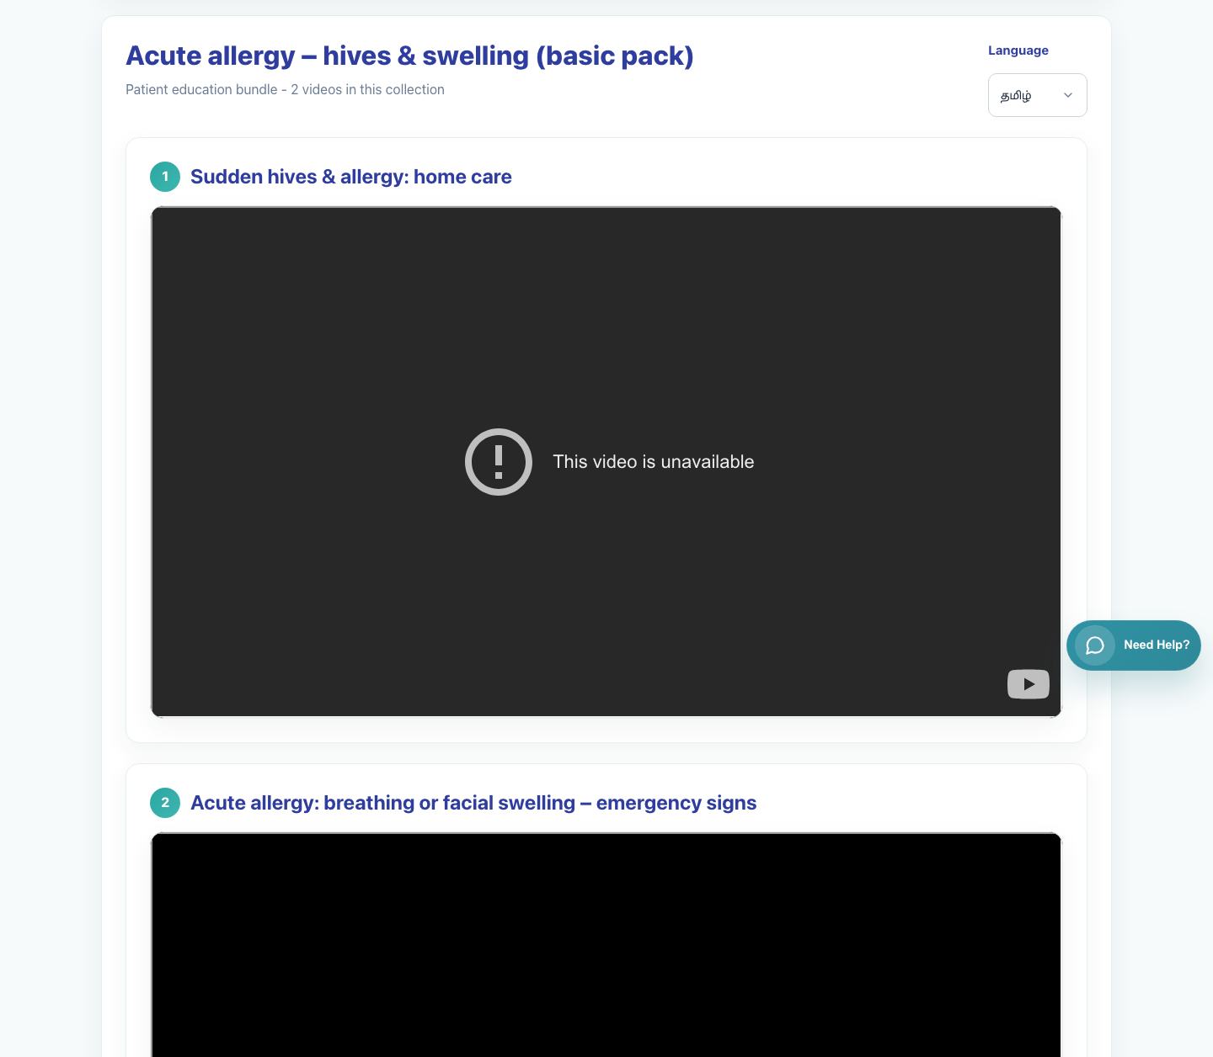
Workflow 08
Caregiver Experience
Step 3: Play the videos in sequence
Embedded videos inside the bundle page.
What the user does
What the user sees
Starts with the first item and continues through the remaining content in the bundle.
Each video embedded inside its own content card on the same patient page.
Why it matters
Expected result
The bundle workflow is designed for structured counseling or follow-up, not one-off playback.
The caregiver can navigate the sequence without needing more links.
Trainer note
Some sources may show video-availability limitations from the provider. That is a source behavior, not a clinic-sharing failure.
Step 3 • Caregiver Bundle View

Slide 6
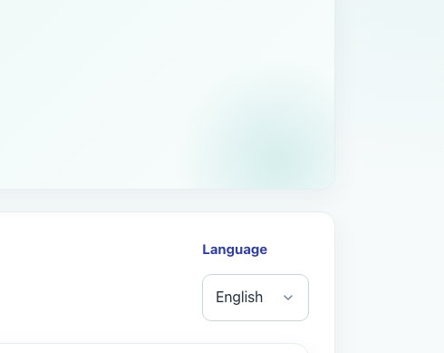
Workflow 08
Caregiver Experience
Step 4: Change language for the full bundle
Language selector on the bundle page.
What the user does
What the user sees
Uses the Language dropdown to switch the bundle page into another supported language.
A single language control that refreshes the full bundle page.
Why it matters
Expected result
The caregiver does not need the clinic to send a second bundle link for another language.
The bundle page reloads in the chosen language while keeping the clinic context and video sequence.
Trainer note
Show caregivers that the language control lives in the bundle header area and applies across the whole page.
Step 4 • Caregiver Bundle View

Slide 7
Workflow 08
Caregiver Experience
Trainer Tips And Common Issues
The highest-value coaching points to cover during rollout or onboarding sessions.
Bundle versus single-video expectation
Video source restrictions
Caregivers should expect a scrollable sequence of videos on this page, not a single embedded item only.
When a provider blocks embedded playback, the issue is with the source content rather than the clinic share action.
Language confusion
The selected language applies to the bundle page itself, so remind caregivers to use the top-right selector if the default language is not ideal.
Success markers
• The caregiver can see that the page contains a full collection rather than one video.
• The page shows the clinic identity and the selected bundle title clearly.
• Language can be changed on the same page without needing a new message from the clinic.
Trainer tips • Caregiver Bundle View

Slide 8
Workflow complete
Caregiver Bundle View
Related manuals
• 06-clinic-staff-share-bundle.md
This page is the caregiver outcome when clinic staff or doctors use Share Bundle from the clinic workspace.
Success criteria
• The caregiver can see that the page contains a full collection rather than one video.
• The page shows the clinic identity and the selected bundle title clearly.
• Language can be changed on the same page without needing a new message from the clinic.
Status
Live-verified against the local demo environment and refreshed with real screenshots on 2026-04-23.
Workflow complete • Caregiver Bundle View

