Slide 1
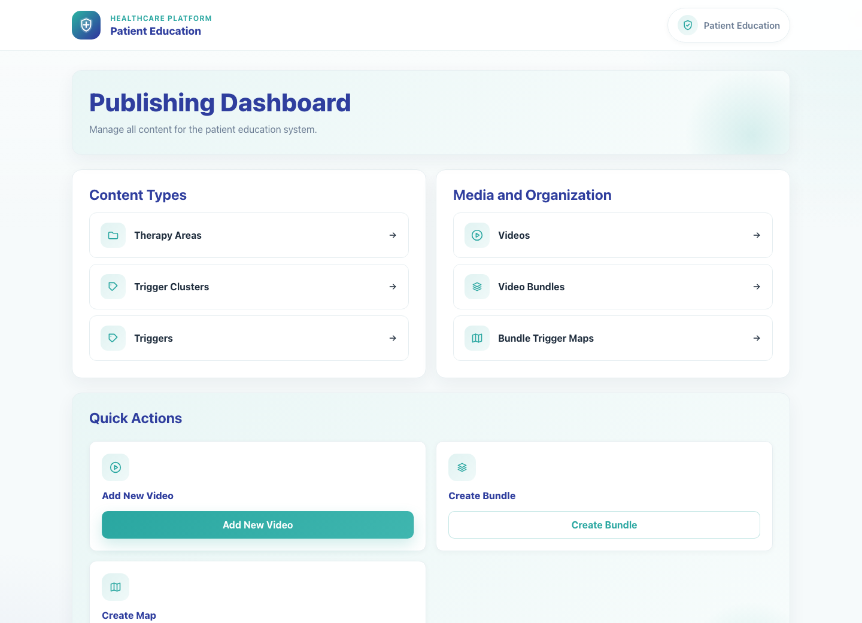
Internal Operations
Admin Content Management
Show internal staff how to enter the publishing dashboard, review the video catalog, and edit a video's metadata and language rows.
Primary user
Entry point
Internal admin or staff user with access to the publishing dashboard
Staff login at `/admin/login/?next=/publisher/` leading into `/publisher/`.
Catalog maintenance is global. Use the PE Records or System Records dashboards when the work involves campaign, field-rep, or doctor records instead of reusable content.
Admin Content Management • Verified 2026-04-23

Slide 2
Workflow 09
Internal Operations
Workflow At A Glance
Purpose, user, entry point, and the operational outcome of this workflow.
Purpose
Primary user
Entry point
Show internal staff how to enter the publishing dashboard, review the video catalog, and edit a video's metadata and language rows.
Internal admin or staff user with access to the publishing dashboard
Staff login at `/admin/login/?next=/publisher/` leading into `/publisher/`.
Workflow summary
• The publishing dashboard is the internal catalog-management surface for therapy areas, triggers, videos, bundles, and bundle-trigger maps.
• The Videos list is the fastest route for reviewing published media and opening a specific video for editing.
• Video edit pages enforce the rule that each video belongs to at least one bundle and carries language-specific title and YouTube URL rows.
• Campaign record governance and master data cleanup happen in the separate PE Records and System Records workflows, not on this dashboard.
Workflow summary • Admin Content Management

Slide 3
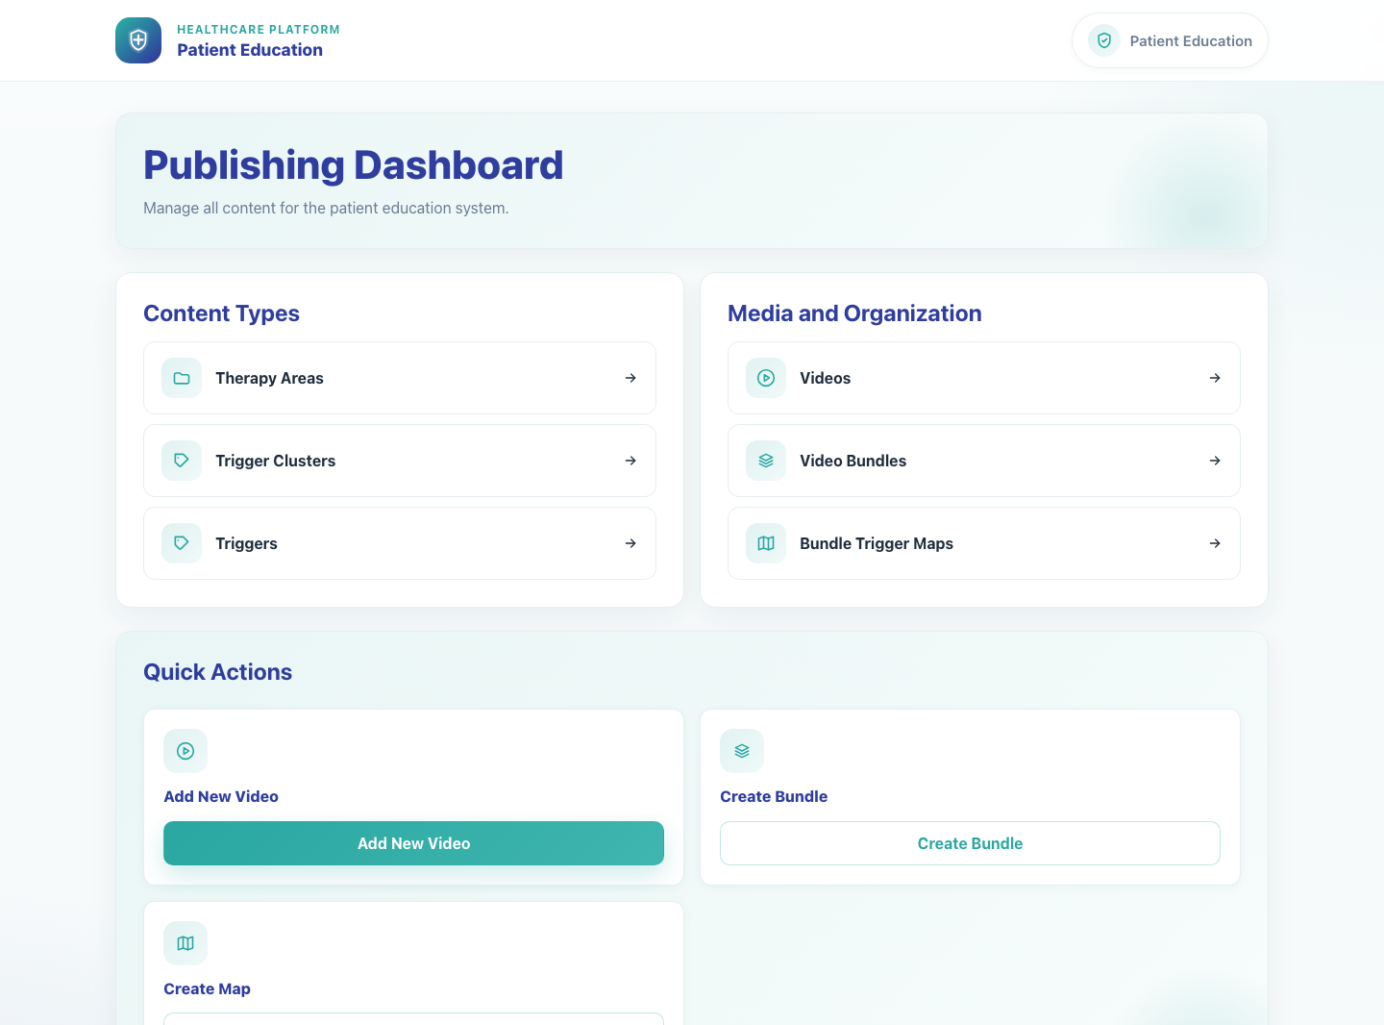
Workflow 09
Internal Operations
Step 1: Open the Publishing Dashboard
Internal Publishing Dashboard.
What the user does
Signs in with an internal staff account and lands on the publishing dashboard.
What the user sees
Publishing Dashboard with grouped links for content types, videos, bundles, maps, and quick actions.
Why it matters
This is the root navigation page for all internal content maintenance.
Expected result
The admin can see the internal sections and choose the right management area.
Trainer note
This workflow is staff-only and is separate from the clinic-facing share experience. Record-governance tasks use separate internal dashboards.
Step 1 • Admin Content Management

Slide 4
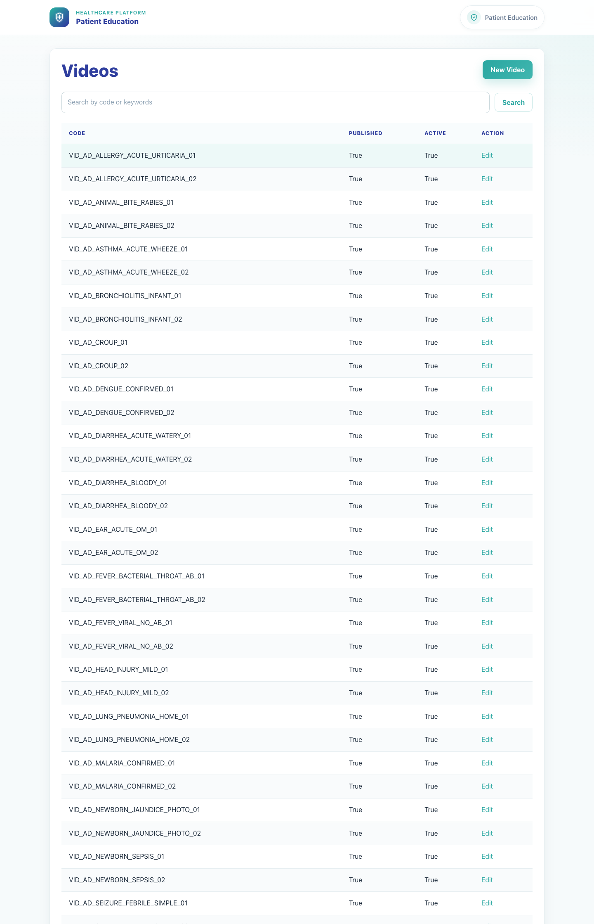
Workflow 09
Internal Operations
Step 2: Open the Videos list
Videos list in the publishing dashboard.
What the user does
What the user sees
Chooses Videos from the dashboard or uses the quick route into the media list.
A searchable Videos table with code, published state, active state, and Edit actions.
Why it matters
Expected result
This list is the operational entry point for finding and maintaining specific videos.
The admin can scan or search the video catalog and identify the right row.
Trainer note
The video table can be long, so use search when a code or topic is known.
Step 2 • Admin Content Management

Slide 5
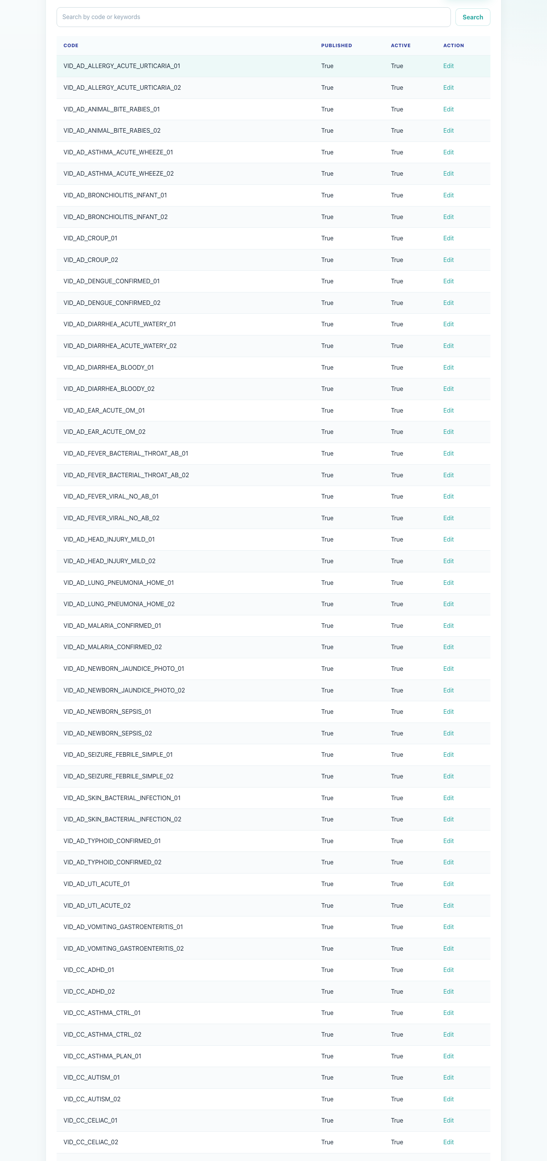
Workflow 09
Internal Operations
Step 3: Search for the target video
Video rows and edit actions.
What the user does
What the user sees
Uses the list search field or scrolls to the desired video code.
Many video rows, each with an Edit action in the last column.
Why it matters
Expected result
Large catalogs are easier to work with when the admin understands how to narrow the list.
The target video row is located and ready to open.
Trainer note
Use code-based lookup where possible because titles live in the per-language edit rows.
Step 3 • Admin Content Management

Slide 6
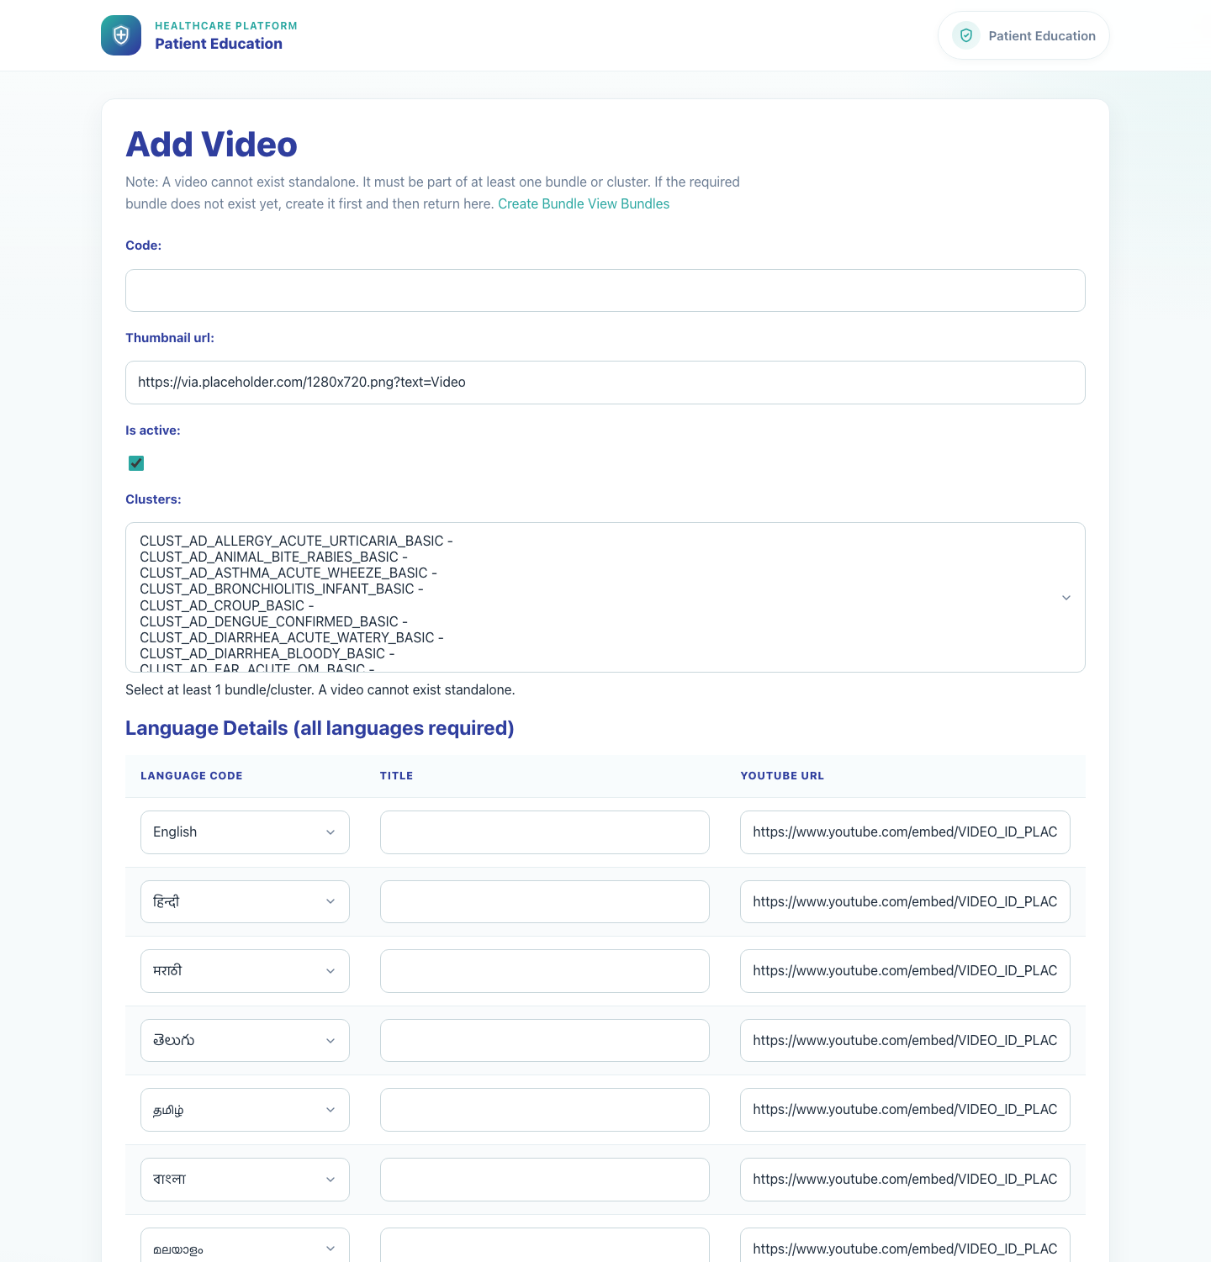
Workflow 09
Internal Operations
Step 4: Open the video edit form
Edit Video form.
What the user does
What the user sees
Clicks Edit on the selected video row.
Edit Video with the bundle membership summary, main video fields, and the language-details table.
Why it matters
Expected result
The edit form is where both global metadata and language-specific content are maintained.
The video edit screen opens successfully.
Trainer note
The form explicitly reminds users that a video cannot exist standalone; it must belong to at least one bundle.
Step 4 • Admin Content Management

Slide 7
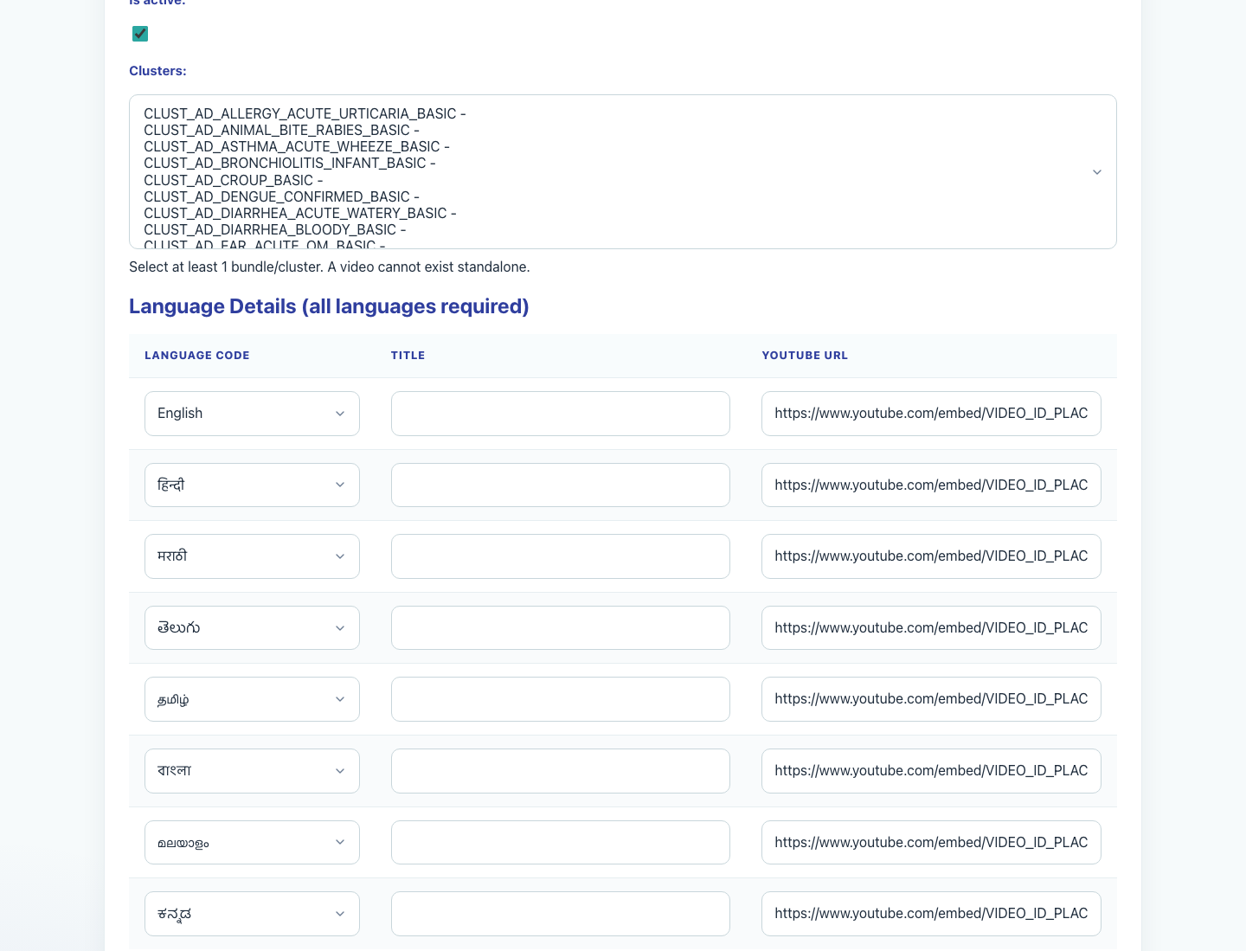
Workflow 09
Internal Operations
Step 5: Maintain language rows and save
Language detail rows inside the Edit Video form.
What the user does
What the user sees
Updates the video metadata and the title and YouTube URL fields for the required language rows, then clicks Save.
A language-details table that expects complete per-language entries before saving.
Why it matters
Expected result
The caregiver-facing playback experience depends on accurate localized titles and source URLs.
The video record saves cleanly with the updated language details.
Trainer note
After saving, validate a downstream share flow if the change affects live caregiver content.
Step 5 • Admin Content Management

Slide 8
Workflow 09
Internal Operations
Trainer Tips And Common Issues
The highest-value coaching points to cover during rollout or onboarding sessions.
Video-bundle dependency
Large catalog navigation
The app does not allow videos to exist outside a bundle, so bundle planning often needs to happen before adding or editing a video.
Use search and known codes to avoid manually scrolling the full video list.
Global impact
Wrong internal tool
Internal video edits affect downstream clinic and caregiver experiences, so validate carefully after saving production content changes.
If the task is to update campaigns, field reps, or doctor records, move to the PE Records or System Records workflows instead of editing content here.
Success markers
• The admin can open the publishing dashboard and navigate to Videos.
• The target video can be found from the list and opened for editing.
• Language rows and video metadata are updated without breaking the bundle relationship rule.
Trainer tips • Admin Content Management

Slide 9
Workflow complete
Admin Content Management
Related manuals
• 01-platform-overview-and-role-map.md
• 11-pe-records-dashboard.md
• 12-system-records-hub.md
Catalog maintenance is global. Use the PE Records or System Records dashboards when the work involves campaign, field-rep, or doctor records instead of reusable content.
Success criteria
• The admin can open the publishing dashboard and navigate to Videos.
• The target video can be found from the list and opened for editing.
• Language rows and video metadata are updated without breaking the bundle relationship rule.
Status
Live-verified against the local demo environment and refreshed with real screenshots on 2026-04-23.
Workflow complete • Admin Content Management

