Slide 1
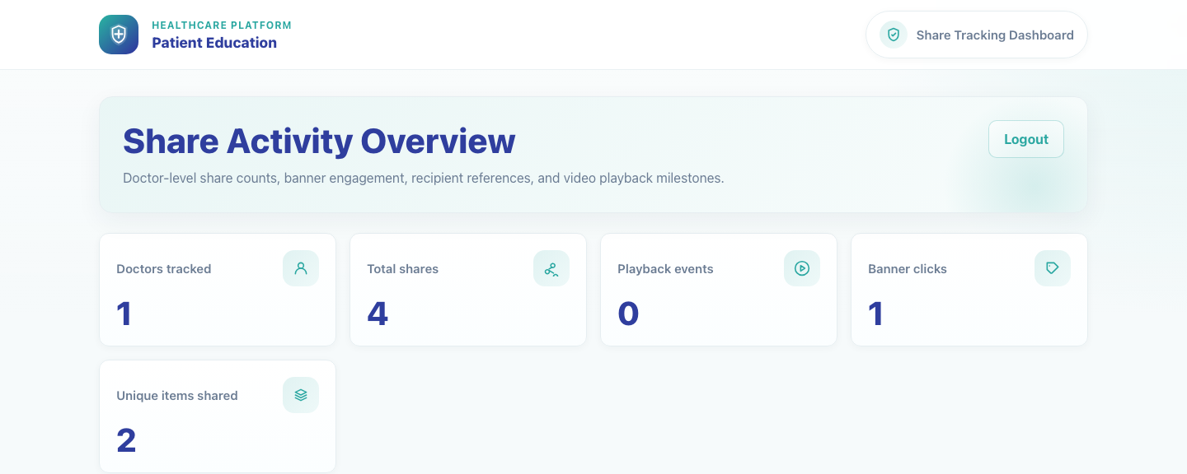
Internal Operations
Share Tracking Dashboard
Show internal superusers how to open the share tracking dashboard and review doctor shares, playback milestones, and banner engagement.
Primary user
Entry point
Internal analytics, audit, or operations user with superuser access
Tracking login at `/tracking/login/`.
Use this dashboard after live clinic sharing is in progress. It complements the operational setup decks by proving what has actually been shared and viewed.
Share Tracking Dashboard • Verified 2026-04-23

Slide 2
Workflow 10
Internal Operations
Workflow At A Glance
Purpose, user, entry point, and the operational outcome of this workflow.
Purpose
Primary user
Entry point
Show internal superusers how to open the share tracking dashboard and review doctor shares, playback milestones, and banner engagement.
Internal analytics, audit, or operations user with superuser access
Tracking login at `/tracking/login/`.
Workflow summary
• The tracking flow starts from a dedicated login page that is limited to superusers.
• The dashboard summarizes doctor-level sharing activity, playback events, and banner clicks in one place.
• Recent activity tables help trainers or operations teams confirm that clinic sharing is flowing into analytics correctly.
Workflow summary • Share Tracking Dashboard

Slide 3
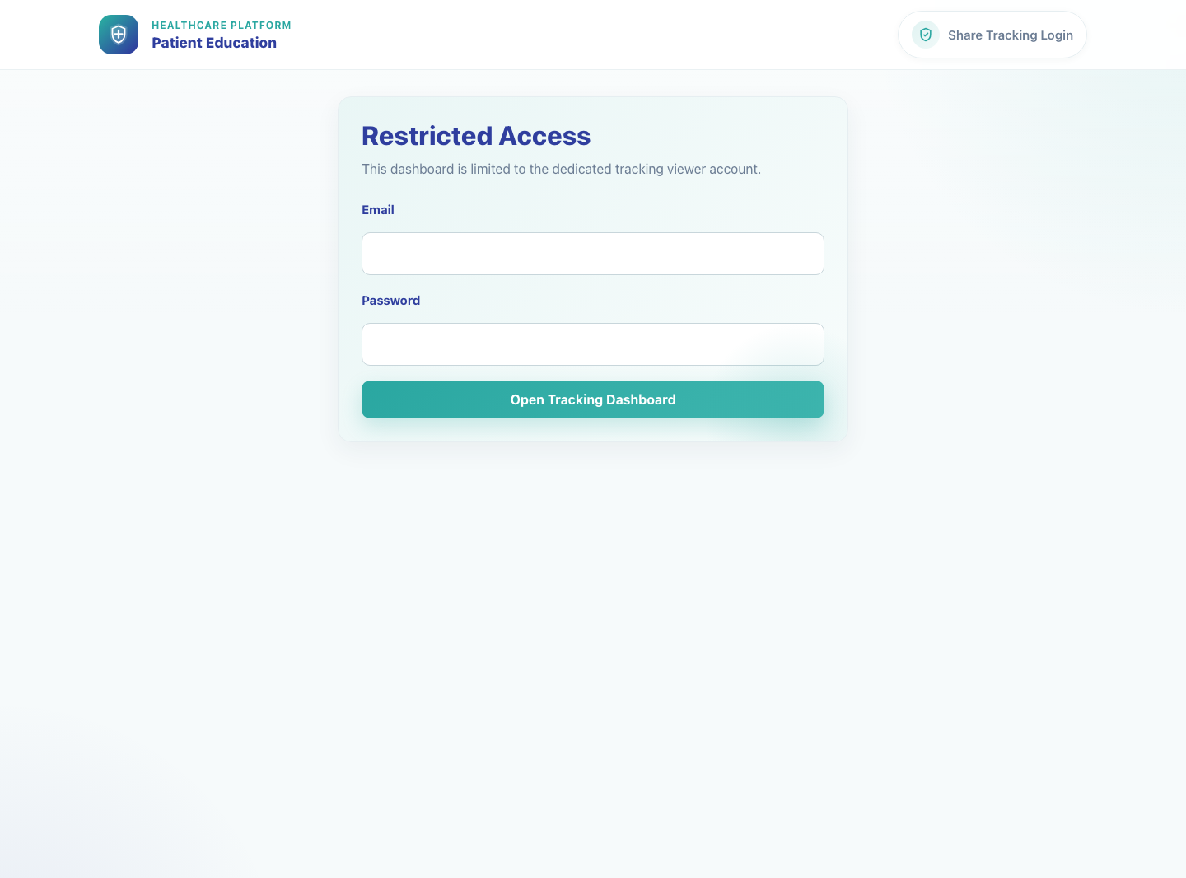
Workflow 10
Internal Operations
Step 1: Open the tracking login page
Tracking login page.
What the user does
Navigates to the dedicated tracking login route and enters the approved superuser credentials.
What the user sees
A restricted-access login page with email and password fields plus the Open Tracking Dashboard action.
Why it matters
The tracking dashboard is isolated from the clinic workflow so only authorized internal users can review share analytics.
Expected result
The user can submit valid credentials and continue to the dashboard.
Trainer note
Only a superuser can enter this flow. Clinic credentials do not work here.
Step 1 • Share Tracking Dashboard

Slide 4
Workflow 10
Internal Operations
Step 2: Review the activity overview cards
Share tracking dashboard overview.
What the user does
What the user sees
Signs in and reviews the top summary cards before drilling into the detail tables.
Share Activity Overview with counts for doctors tracked, total shares, playback events, banner clicks, and unique items shared.
Why it matters
Expected result
The summary cards give trainers and operations users an immediate health check of adoption and content engagement.
The user can confirm that share counts and downstream activity totals are being recorded, even if playback remains at zero before a video starts.
Trainer note
If counts are unexpectedly zero, verify that live share activity was created. Playback remains at zero until the embedded player actually starts.
Step 2 • Share Tracking Dashboard

Slide 5
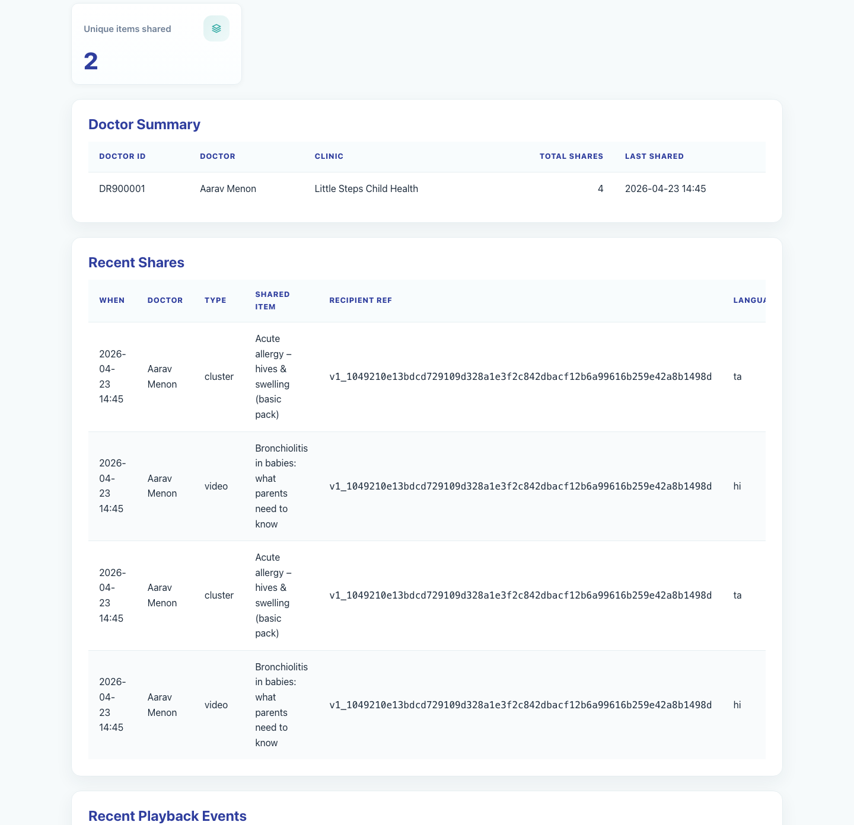
Workflow 10
Internal Operations
Step 3: Inspect doctor summary and recent shares
Doctor summary and recent share tables.
What the user does
What the user sees
Scrolls through the Doctor Summary and Recent Shares sections to see which clinics are sharing which items.
Tables for doctor-level totals, recent share timestamps, item names, anonymized recipient references, and language codes.
Why it matters
Expected result
These tables are the fastest route to confirm who shared content and whether the correct videos or bundles were used.
The user can identify the doctor, shared item, language, and share timing for recent activity.
Trainer note
Recipient references are anonymized hashes, so trainers should not expect to see raw caregiver phone numbers here.
Step 3 • Share Tracking Dashboard

Slide 6
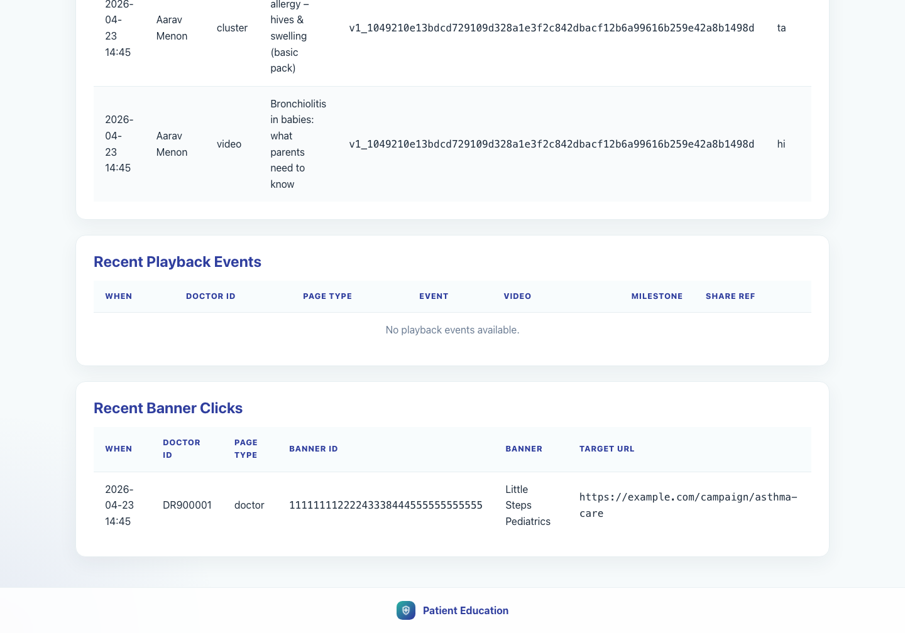
Workflow 10
Internal Operations
Step 4: Inspect playback and banner events
Playback and banner event tables.
What the user does
What the user sees
Reviews the playback milestones and banner click tables to confirm downstream caregiver engagement.
Recent Playback Events and Recent Banner Clicks tables with doctor IDs, event types, milestone percentages, and banner targets.
Why it matters
Expected result
These tables show whether a share translated into viewing behavior and whether campaign banners were interacted with.
The user can confirm whether playback data is present yet and can still review any recorded banner activity.
Trainer note
Playback rows appear only after the caregiver starts a video. Bundle shares can generate multiple playback rows because each embedded video logs play and progress milestones separately.
Step 4 • Share Tracking Dashboard

Slide 7
Workflow 10
Internal Operations
Trainer Tips And Common Issues
The highest-value coaching points to cover during rollout or onboarding sessions.
Wrong account type
No recent activity
The tracking dashboard only allows a superuser account, so clinic or publisher credentials will be rejected.
If the tables are empty, confirm that a doctor or clinic staff member completed a share and that the caregiver page was opened afterward.
Recipient privacy
Recipient references are intentionally anonymized. Use doctor, item, and timestamp context for troubleshooting instead of expecting raw phone numbers.
Success markers
• The user can open the tracking login page and authenticate successfully.
• The dashboard summary cards and recent activity tables are visible.
• The user can identify where to audit doctor share volume, playback milestones, and banner click activity.
Trainer tips • Share Tracking Dashboard

Slide 8
Workflow complete
Share Tracking Dashboard
Related manuals
• 01-platform-overview-and-role-map.md
• 05-doctor-share-single-video.md
• 06-clinic-staff-share-bundle.md
• 07-caregiver-single-video-view.md
• 08-caregiver-bundle-view.md
Use this dashboard after live clinic sharing is in progress. It complements the operational setup decks by proving what has actually been shared and viewed.
Success criteria
• The user can open the tracking login page and authenticate successfully.
• The dashboard summary cards and recent activity tables are visible.
• The user can identify where to audit doctor share volume, playback milestones, and banner click activity.
Status
Live-verified against the local demo environment and refreshed with real screenshots on 2026-04-23.
Workflow complete • Share Tracking Dashboard

