Slide 1
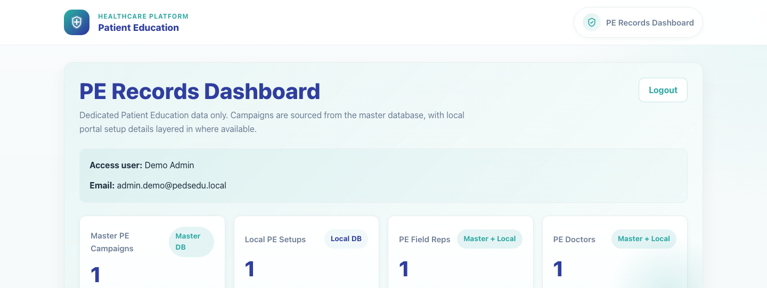
Internal Operations
PE Records Dashboard
Show internal superusers how to open the PE-only records dashboard and manage campaign, field-rep, and doctor records scoped to Patient Education campaigns.
Primary user
Entry point
System superuser responsible for PE-only record governance
Dedicated PE records login at `/publisher/pe-system/login/`.
Use this dashboard when the task is specific to Patient Education campaigns and their linked people. Use the broader System Records Hub for cross-campaign record maintenance.
PE Records Dashboard • Verified 2026-04-23

Slide 2
Workflow 11
Internal Operations
Workflow At A Glance
Purpose, user, entry point, and the operational outcome of this workflow.
Purpose
Primary user
Entry point
Show internal superusers how to open the PE-only records dashboard and manage campaign, field-rep, and doctor records scoped to Patient Education campaigns.
System superuser responsible for PE-only record governance
Dedicated PE records login at `/publisher/pe-system/login/`.
Workflow summary
• The PE Records Dashboard uses its own superuser session and only surfaces campaigns marked as Patient Education campaigns.
• Campaign rows merge master campaign data with local portal setup status so teams can see whether PE campaigns are configured downstream.
• Field rep and doctor sections only show PE-linked records, with direct update and delete actions for operational cleanup.
Workflow summary • PE Records Dashboard

Slide 3
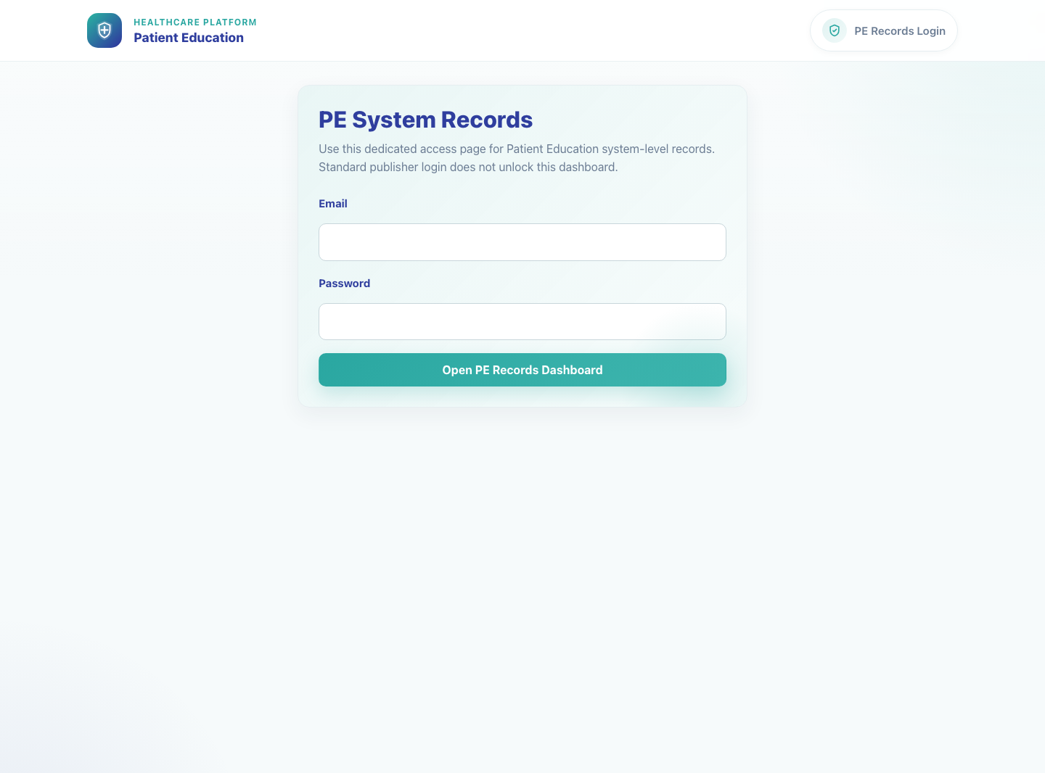
Workflow 11
Internal Operations
Step 1: Open the PE records login
PE records login page.
What the user does
Navigates to the PE records login page and signs in with a local superuser account.
What the user sees
PE System Records login with a dedicated email and password form.
Why it matters
This dashboard keeps PE-only record governance separate from the broader publisher dashboard and other superuser tools.
Expected result
The PE records session opens and redirects to the dashboard.
Trainer note
This flow creates a separate PE records session, so it is different from the standard `/admin/` login redirect into `/publisher/`.
Step 1 • PE Records Dashboard

Slide 4
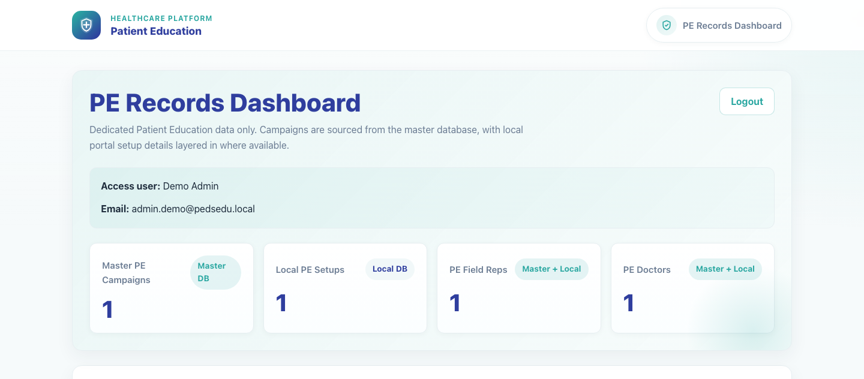
Workflow 11
Internal Operations
Step 2: Review the PE records dashboard
PE records dashboard overview.
What the user does
What the user sees
Scans the dashboard cards and campaign table to compare master PE campaigns with local portal setup coverage.
PE Records Dashboard with summary cards for master campaigns, local PE setups, PE field reps, and PE doctors, followed by searchable tables.
Why it matters
Expected result
This page is the operational command center for understanding which PE campaigns are configured and which related records exist.
The user can identify configured versus unconfigured PE campaigns and the volume of related field reps and doctors.
Trainer note
The Local PE Setups count comes from the portal-side `publisher_campaign` data layered onto the master PE campaign list.
Step 2 • PE Records Dashboard

Slide 5
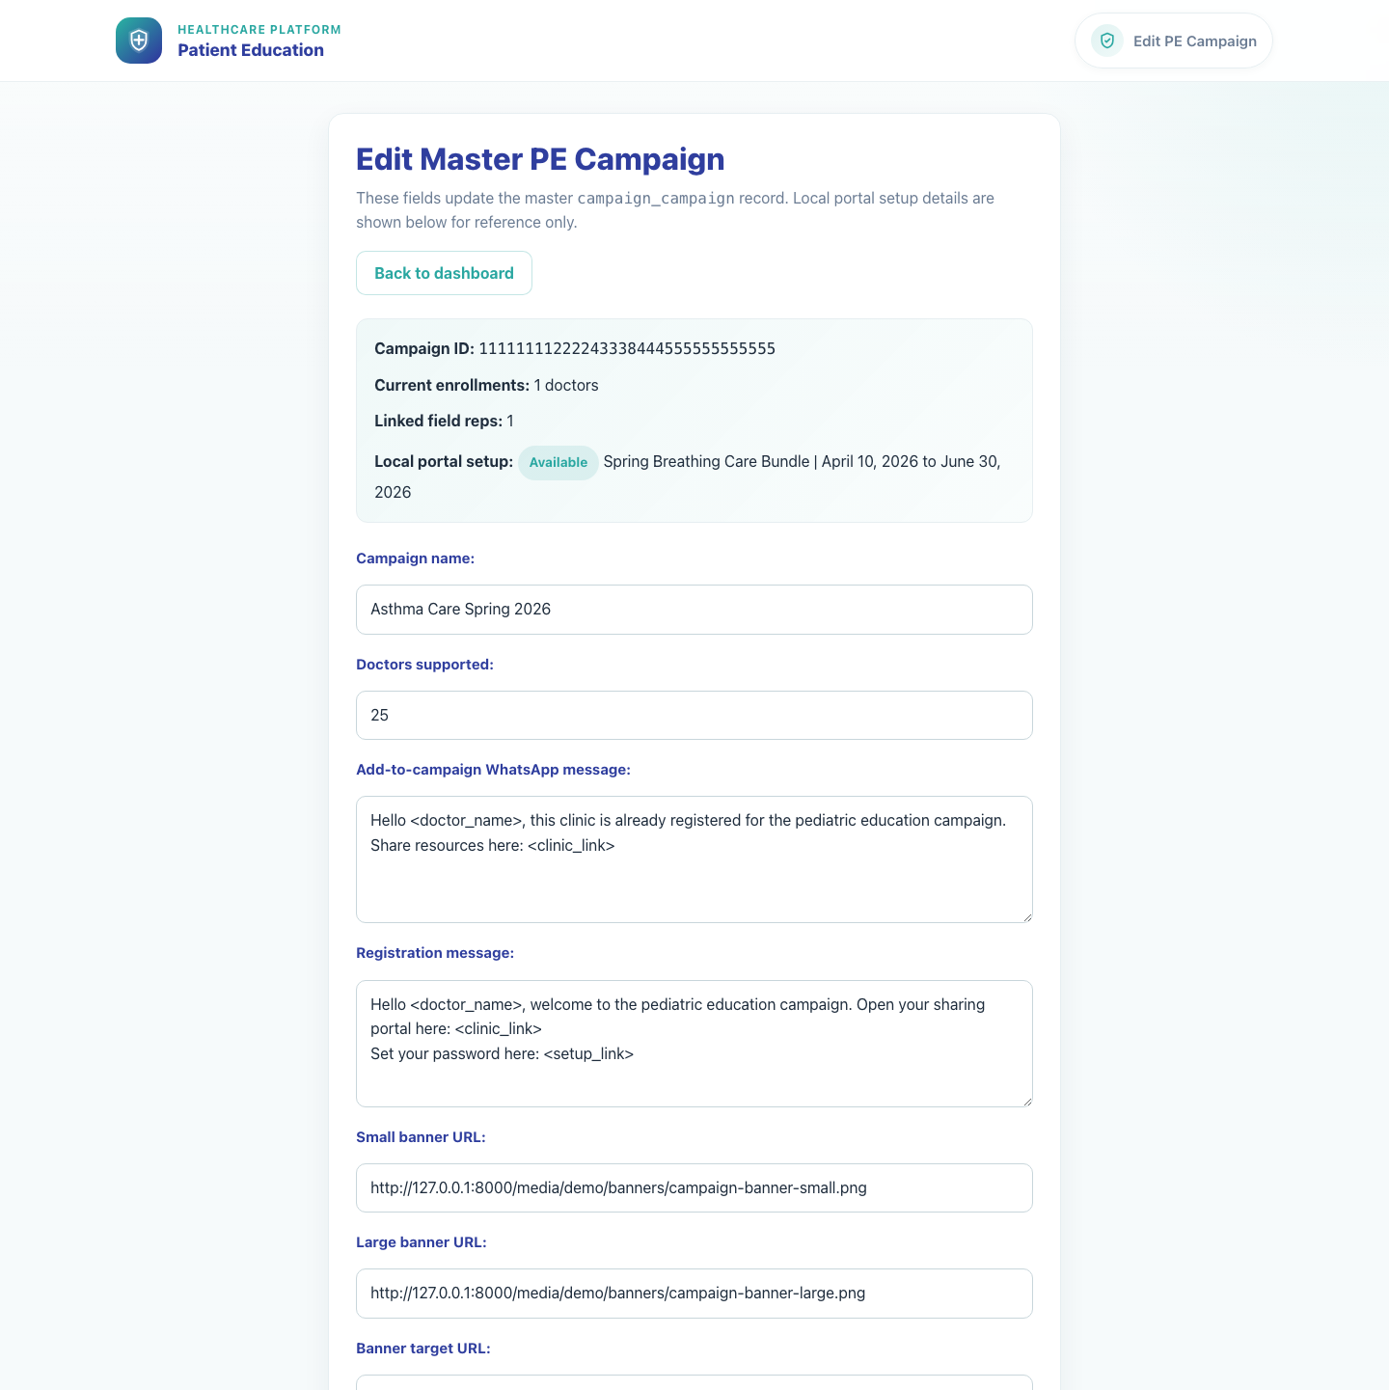
Workflow 11
Internal Operations
Step 3: Update a PE campaign record
Master PE campaign edit form.
What the user does
What the user sees
Opens Update from a campaign row to edit master PE campaign details such as doctor limits, templates, banner URLs, and dates.
A PE campaign edit form populated from the master campaign record, with linked local setup context shown alongside it.
Why it matters
Expected result
Campaign metadata drives field-rep onboarding, campaign messaging, and banner behavior, so PE campaign records need a dedicated update path.
The user can edit a master PE campaign without leaving the PE records flow.
Trainer note
Deleting from this flow removes both the master PE campaign record and any linked local portal setup, so confirm scope before using Delete.
Step 3 • PE Records Dashboard

Slide 6
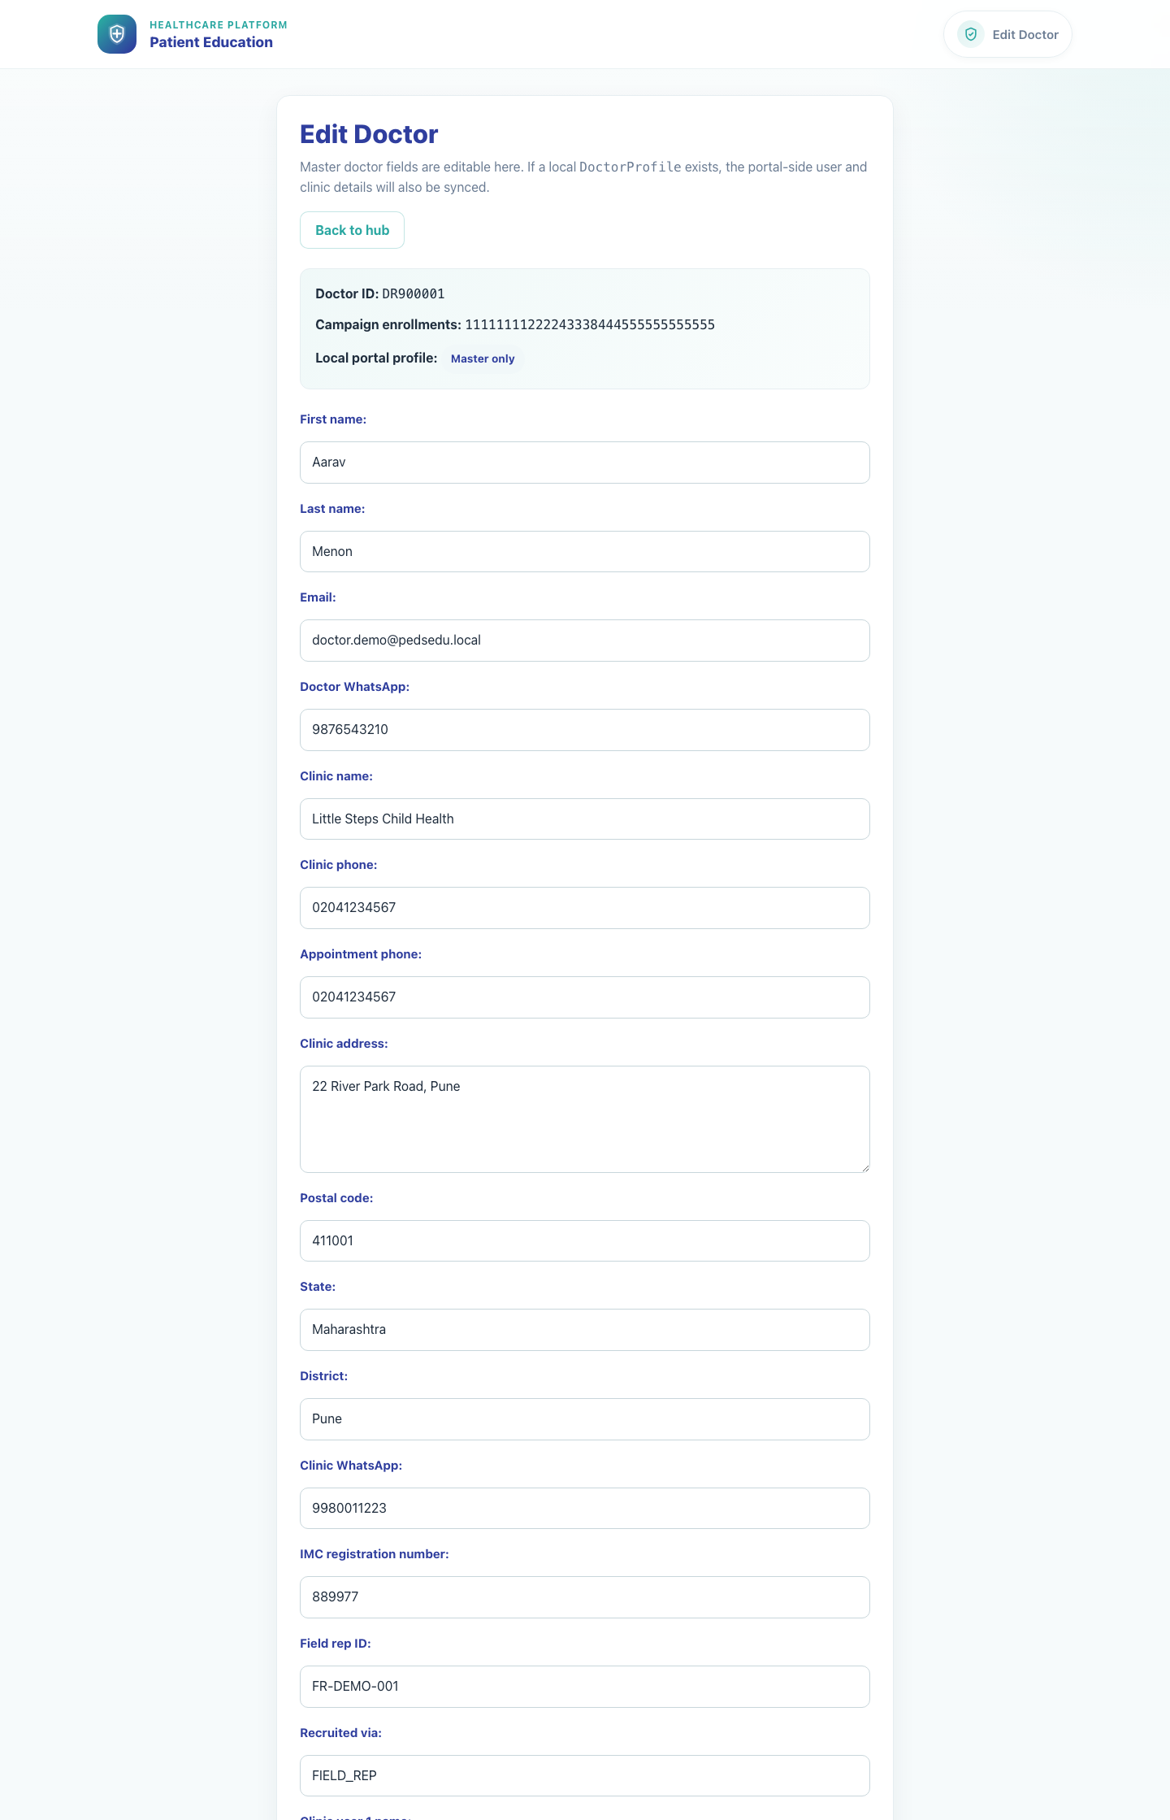
Workflow 11
Internal Operations
Step 4: Review a PE-linked doctor record
PE-linked doctor edit form.
What the user does
What the user sees
Opens Update from the Doctors table to review and edit a PE-linked doctor record.
A doctor record form showing master identity fields, clinic details, field rep context, and whether a local profile is also present.
Why it matters
Expected result
PE doctors often need cleanup or alignment when field-rep recruitment and clinic registration intersect.
The user can review or update a PE-linked doctor from the PE-specific governance flow.
Trainer note
If a local portal profile exists, the system attempts to sync that local profile after a successful master-record update.
Step 4 • PE Records Dashboard

Slide 7
Workflow 11
Internal Operations
Trainer Tips And Common Issues
The highest-value coaching points to cover during rollout or onboarding sessions.
Session confusion
Scope confusion
The PE records dashboard uses its own session. Logging into `/admin/` alone does not automatically open this PE-only tool.
This dashboard only shows Patient Education-linked campaigns, field reps, and doctors. Broader record maintenance belongs in the System Records Hub.
Delete impact
Deleting from the PE campaign section can remove both master and linked local setup data, so confirm scope before proceeding.
Success markers
• The user can authenticate into the PE records session and open the dashboard.
• PE campaign, field rep, and doctor sections are visible and searchable.
• The user can open an edit form for a PE campaign or PE-linked doctor and understand the scope of those changes.
Trainer tips • PE Records Dashboard

Slide 8
Workflow complete
PE Records Dashboard
Related manuals
• 01-platform-overview-and-role-map.md
• 02-publisher-campaign-setup.md
• 03-field-rep-doctor-recruitment.md
Use this dashboard when the task is specific to Patient Education campaigns and their linked people. Use the broader System Records Hub for cross-campaign record maintenance.
Success criteria
• The user can authenticate into the PE records session and open the dashboard.
• PE campaign, field rep, and doctor sections are visible and searchable.
• The user can open an edit form for a PE campaign or PE-linked doctor and understand the scope of those changes.
Status
Live-verified against the local demo environment and refreshed with real screenshots on 2026-04-23.
Workflow complete • PE Records Dashboard

