Slide 1
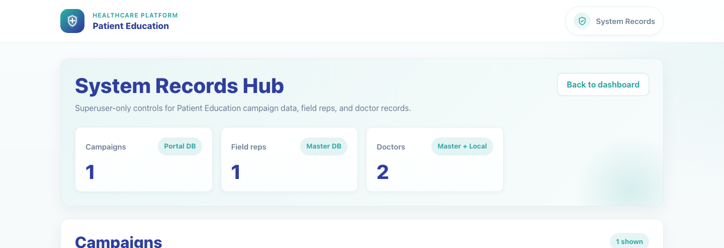
Internal Operations
System Records Hub
Show local superusers how to use the broader System Records Hub to review local campaign configurations and maintain master field-rep and doctor records.
Primary user
Entry point
Local superuser responsible for system-wide campaign, field-rep, and doctor record maintenance
Superuser route at `/publisher/system-records/` after logging in through `/admin/login/`.
Use the System Records Hub when the task spans local campaign configurations or broader master record cleanup. Use the PE Records Dashboard when the scope is strictly PE-linked data.
System Records Hub • Verified 2026-04-23

Slide 2
Workflow 12
Internal Operations
Workflow At A Glance
Purpose, user, entry point, and the operational outcome of this workflow.
Purpose
Primary user
Entry point
Show local superusers how to use the broader System Records Hub to review local campaign configurations and maintain master field-rep and doctor records.
Local superuser responsible for system-wide campaign, field-rep, and doctor record maintenance
Superuser route at `/publisher/system-records/` after logging in through `/admin/login/`.
Workflow summary
• The System Records Hub combines local `publisher_campaign` rows with master field-rep and doctor records in one superuser-only view.
• Campaign rows update through the existing campaign editor, while field-rep and doctor rows open dedicated maintenance forms.
• Doctor rows show whether a local portal profile exists, which helps operators understand whether master edits will also sync local data.
Workflow summary • System Records Hub

Slide 3
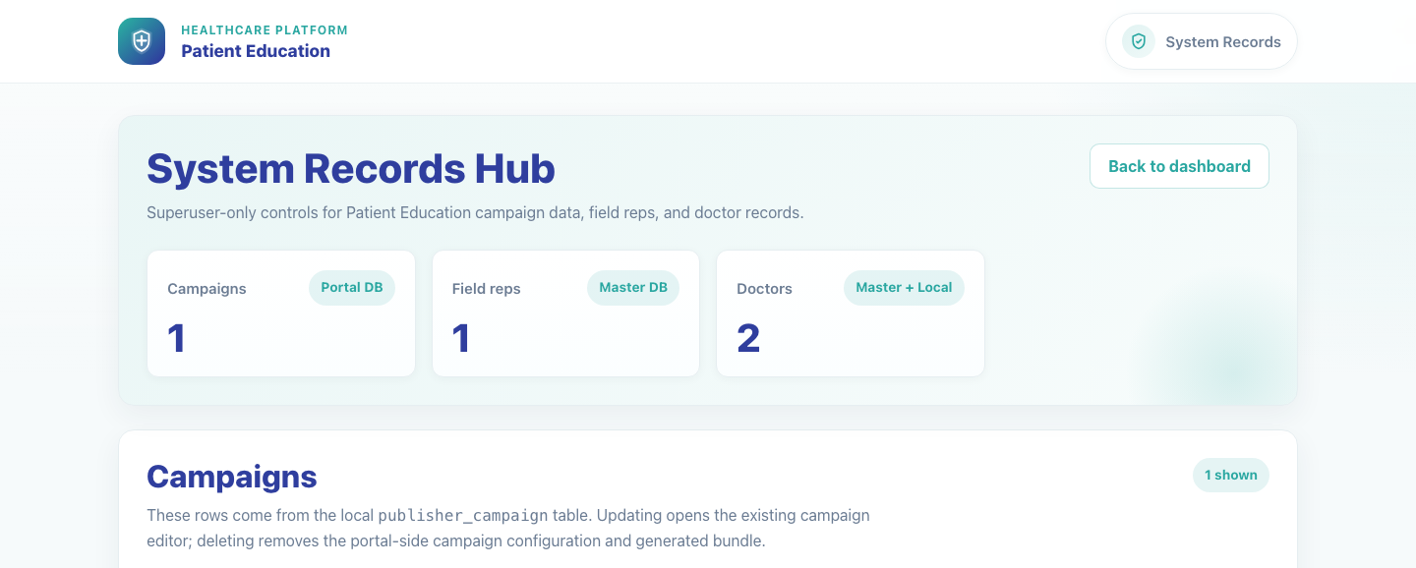
Workflow 12
Internal Operations
Step 1: Open the System Records Hub
System Records Hub overview.
What the user does
What the user sees
Signs in as a local superuser and navigates to the System Records Hub.
A superuser-only dashboard with summary cards for campaigns, field reps, and doctors plus searchable maintenance sections.
Why it matters
Expected result
This hub is the broadest record-maintenance surface in the product and is separate from day-to-day content editing.
The superuser can access the full System Records Hub.
Trainer note
This route is part of the internal publisher area and requires a normal local superuser session, not the dedicated PE records login.
Step 1 • System Records Hub

Slide 4
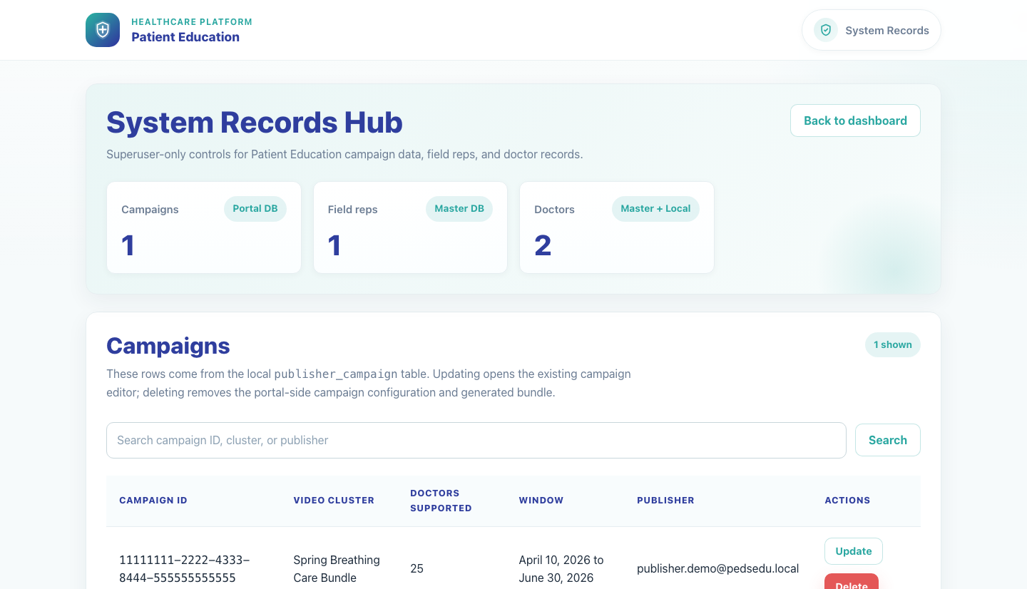
Workflow 12
Internal Operations
Step 2: Review local campaign configurations
System records campaign table.
What the user does
What the user sees
Uses the Campaigns section to search for a local `publisher_campaign` row and open the linked update path.
Local campaign rows with campaign ID, generated bundle name, supported doctor count, active window, and publisher owner.
Why it matters
Expected result
This is the fastest route to confirm or clean up portal-side PE campaign configuration records.
The superuser can find the correct local campaign row and reach the update or delete action.
Trainer note
Deleting from this section removes the local campaign configuration and the generated bundle, but it does not edit the upstream master campaign record.
Step 2 • System Records Hub

Slide 5
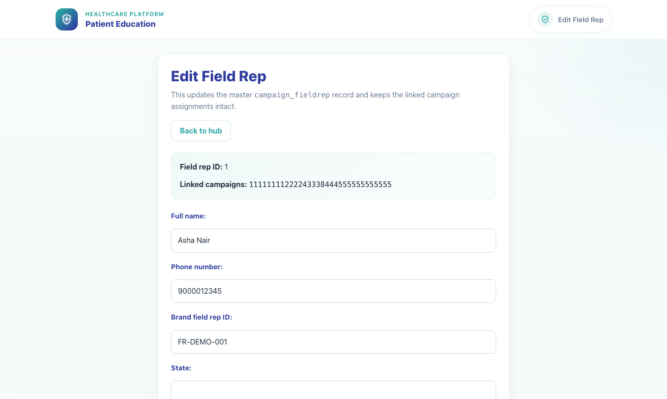
Workflow 12
Internal Operations
Step 3: Update a field rep record
System field-rep edit form.
What the user does
What the user sees
Opens Update from the Field Reps section to maintain a master field-rep record and its campaign links.
A field rep edit form with full name, phone number, external brand ID, state, and active status.
Why it matters
Expected result
Field rep accuracy is essential because campaign onboarding links and doctor recruitment depend on these master records.
The superuser can edit or delete a field rep record from the broader system hub.
Trainer note
This form edits master DB-backed data, so the impact can extend across campaigns.
Step 3 • System Records Hub

Slide 6
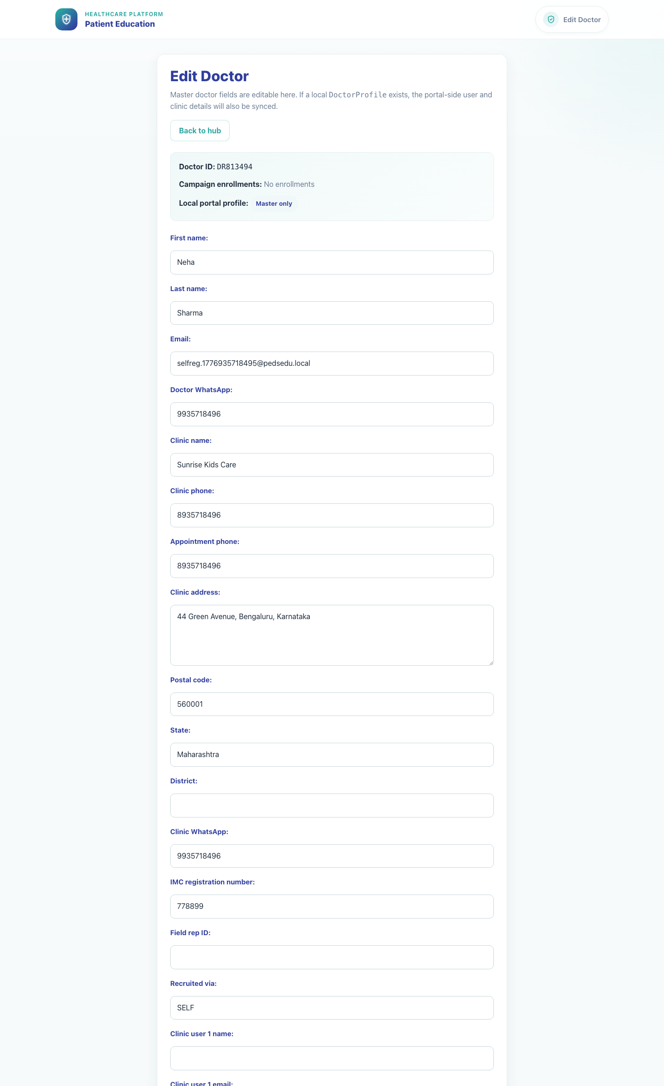
Workflow 12
Internal Operations
Step 4: Review doctor sync state and update the doctor record
System doctor edit form.
What the user does
What the user sees
Uses the Doctors section to inspect whether a doctor is master-only or also synced to a local portal profile, then opens the update form.
A doctor edit form with identity, clinic details, recruiter fields, clinic user emails, and local-profile context.
Why it matters
Expected result
The local-profile badge helps operations teams understand whether a master update should also cascade into the local portal record.
The superuser can update a doctor with clear awareness of local-sync implications.
Trainer note
If a doctor has a local profile, updates attempt to sync both the master row and the local portal profile. Delete actions may also remove the local profile.
Step 4 • System Records Hub

Slide 7
Workflow 12
Internal Operations
Trainer Tips And Common Issues
The highest-value coaching points to cover during rollout or onboarding sessions.
PE versus system scope
Local versus master impact
Use this hub for broader record cleanup. Use the PE Records Dashboard when the task is specific to PE-linked campaigns, reps, or doctors only.
Campaign rows here are local portal records, while field-rep and doctor rows are master records. The scope is different depending on which section you edit.
Local profile sync
When a doctor has a local portal profile, master updates can also affect the local profile. Trainers should call out that badge before editing.
Success markers
• The superuser can open the System Records Hub from the internal admin session.
• Campaign, field-rep, and doctor sections are visible and searchable.
• The superuser can open the field-rep and doctor maintenance forms and understand the local-versus-master scope.
Trainer tips • System Records Hub

Slide 8
Workflow complete
System Records Hub
Related manuals
• 01-platform-overview-and-role-map.md
• 02-publisher-campaign-setup.md
• 09-admin-content-management.md
Use the System Records Hub when the task spans local campaign configurations or broader master record cleanup. Use the PE Records Dashboard when the scope is strictly PE-linked data.
Success criteria
• The superuser can open the System Records Hub from the internal admin session.
• Campaign, field-rep, and doctor sections are visible and searchable.
• The superuser can open the field-rep and doctor maintenance forms and understand the local-versus-master scope.
Status
Live-verified against the local demo environment and refreshed with real screenshots on 2026-04-23.
Workflow complete • System Records Hub

