Slide 1
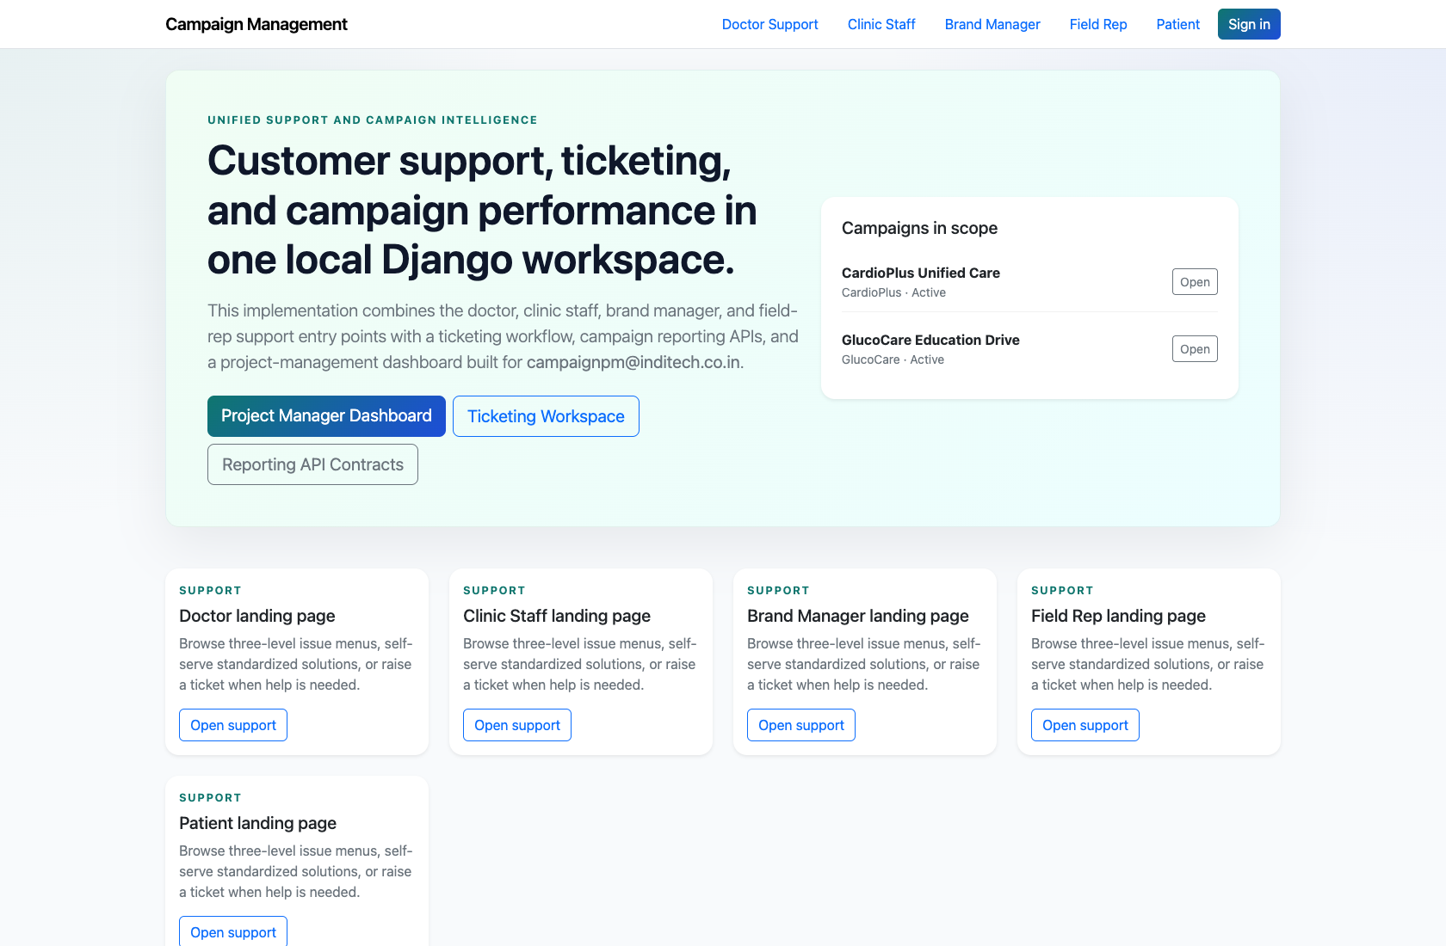
PLATFORM OVERVIEW
Platform Overview and Role Map
Explain the live product surface, the implemented user roles, and the handoff points between self-service support, project-management triage, and ticket execution.
PRIMARY USER
ENTRY POINT
Internal trainer, implementation lead, or any new team member onboarding to the platform.
/
Verified against the live application on 2026-04-11.

Slide 2
WORKFLOW OVERVIEW
Verified 2026-04-11
Platform Overview and Role Map
A training-ready summary of the workflow entry point, ownership, and outcomes.
PRIMARY USER
ENTRY POINT
VERIFIED
STEPS
Internal trainer, implementation lead, or any new team member onboarding to the platform.
/
2026-04-11
4
Workflow summary
Success criteria
The product is a Django-based campaign operations hub with public support experiences and authenticated PM/ticketing dashboards.
Self-service users enter through role-specific support hubs, while internal teams use the PM dashboard, ticket queue, and reporting pages.
The implemented product centers on support enablement, escalation, reporting, and ticket routing rather than separate branded portals for every role.
The audience can name the implemented user roles and their starting pages.
The audience can explain how public support flows hand unresolved issues into the PM dashboard.
The audience understands that the codebase currently emphasizes support, PM operations, reporting, and ticketing over custom role-specific portals.

Slide 3
PLATFORM OVERVIEW AND ROLE MAP
Verified 2026-04-11
Role Map
How the implemented roles hand work off across the live product.
Project Manager
Role-based support
PM dashboard
Ticket execution
Landing pages, FAQs, widgets, assistant
Triage, review, escalation, performance
Department queue, notes, status, routing
Department Owner / Support Lead
Doctor
What to tell learners
External roles start in public support centers, not in separate operational portals.
Project Managers own triage, unresolved support reviews, and campaign performance monitoring.
Department owners execute the ticket lifecycle inside the scoped queue and ticket detail pages.
Clinic Staff
Brand Manager

Slide 4
PLATFORM OVERVIEW AND ROLE MAP
Verified 2026-04-11
Step 1. Open the platform home page
Platform home page
What the user does
Open the root URL to view the shared navigation and campaign landing page.
What the user sees
A public home page with campaign summary content plus links into every role-specific support center.
Why it matters
This is the simplest way to orient a new user to the main product surfaces before discussing role-specific tasks.
The trainer can point to the support-role navigation, sign-in path, and campaign context on one screen.
Trainer note: Use this step to explain that most external users stay in the public support flows, while internal users move into authenticated dashboards.

Slide 5
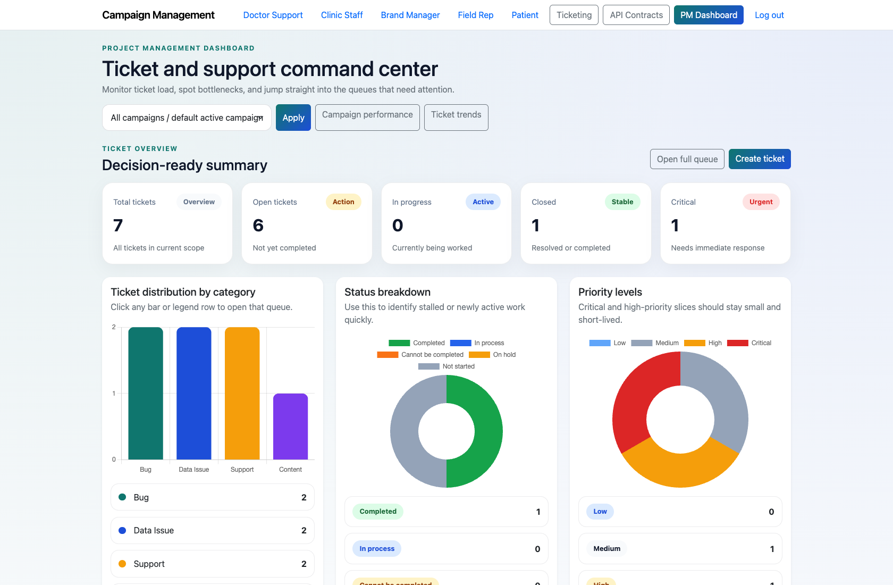
PLATFORM OVERVIEW AND ROLE MAP
Verified 2026-04-11
Step 2. Explain the internal command center
Project Management dashboard
What the user does
Move from the public home page into the Project Management dashboard after sign-in.
What the user sees
A decision-focused dashboard with ticket KPIs, pending PM reviews, and navigation to ticketing and performance views.
Why it matters
This screen anchors every internal workflow and shows where unresolved external issues are managed.
New team members understand that `/app/` is the operational hub for PM-led work.
Trainer note: The PM dashboard is the main internal entry point for project managers and is prioritized throughout this pack.

Slide 6
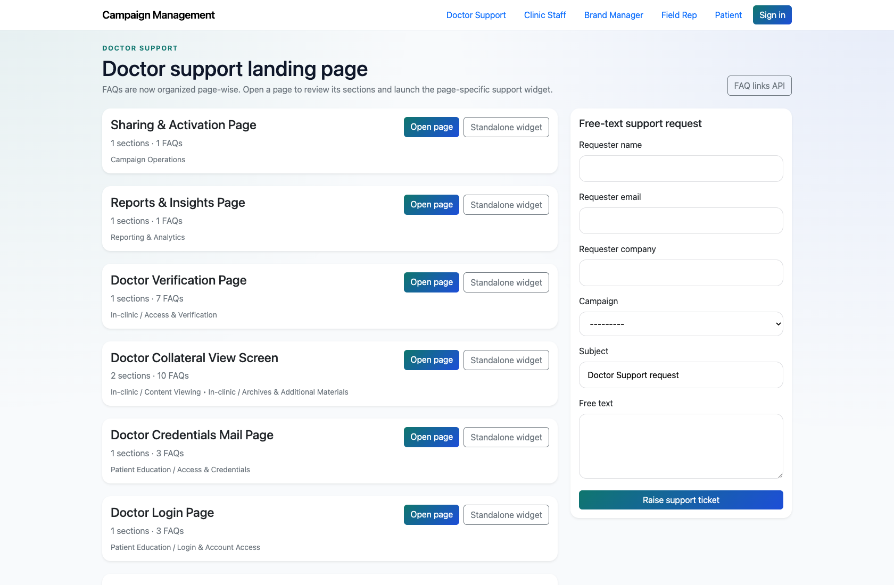
PLATFORM OVERVIEW AND ROLE MAP
Verified 2026-04-11
Step 3. Show the self-service support experience
Role-based support landing page
What the user does
Open a live role-specific support center such as Doctor Support.
What the user sees
Page-wise FAQ cards, widget launch links, and escalation options that feed the PM queue.
Why it matters
This shows how external users begin a support journey without requiring a separate authenticated portal.
The audience understands where self-service begins and how issues reach the internal team if unresolved.
Trainer note: This implementation differs from older extracted notes that describe richer standalone portals for some roles.

Slide 7
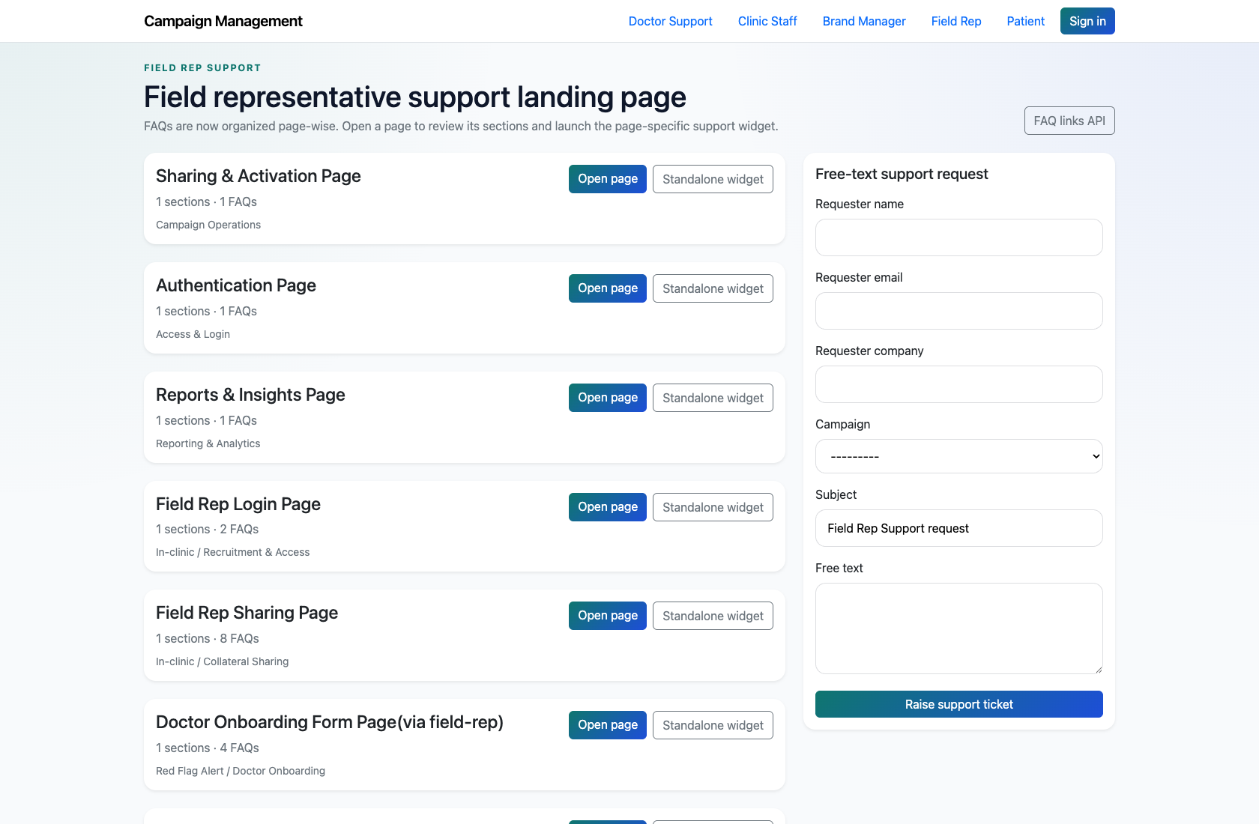
PLATFORM OVERVIEW AND ROLE MAP
Verified 2026-04-11
Step 4. Connect role handoffs end to end
Field Rep support entry point
What the user does
Walk through the role map from support user to PM review to departmental ticket ownership.
What the user sees
A clear explanation of where each workflow starts, what happens when an issue is unresolved, and which role owns the next action.
Why it matters
This gives trainers a single narrative to introduce the whole system before diving into detail decks.
Participants can describe the high-level journey without needing to inspect the codebase.
Trainer note: Use the role map and flow diagram in this manual when presenting to new internal teams.

Slide 8
PLATFORM OVERVIEW AND ROLE MAP
Verified 2026-04-11
Trainer Tips and Common Issues
Use this slide to coach facilitators on pacing, known caveats, and product reality.
Trainer tips
Status and caveats
Lead with the PM dashboard, because it ties together support escalation, ticketing, and campaign performance.
Call out the difference between live product behavior and older extracted notes where necessary.
Live-verified against the application on 2026-04-11. Older extracted notes mention richer role-specific portals, but the implemented product surface is primarily role-specific support centers plus PM and ticketing dashboards.

Slide 9
PLATFORM OVERVIEW AND ROLE MAP
Verified 2026-04-11
Close-Out
End the walkthrough by confirming success and pointing learners to the next reference.
Success criteria
Related documents
The audience can name the implemented user roles and their starting pages.
The audience can explain how public support flows hand unresolved issues into the PM dashboard.
The audience understands that the codebase currently emphasizes support, PM operations, reporting, and ticketing over custom role-specific portals.
README.md
docs/extracted/our-systems.txt
docs/extracted/customer-support.txt
docs/extracted/ticketing.txt
Source of truth: live app, then code/templates, then project docs. Verified on 2026-04-11.

