Slide 1
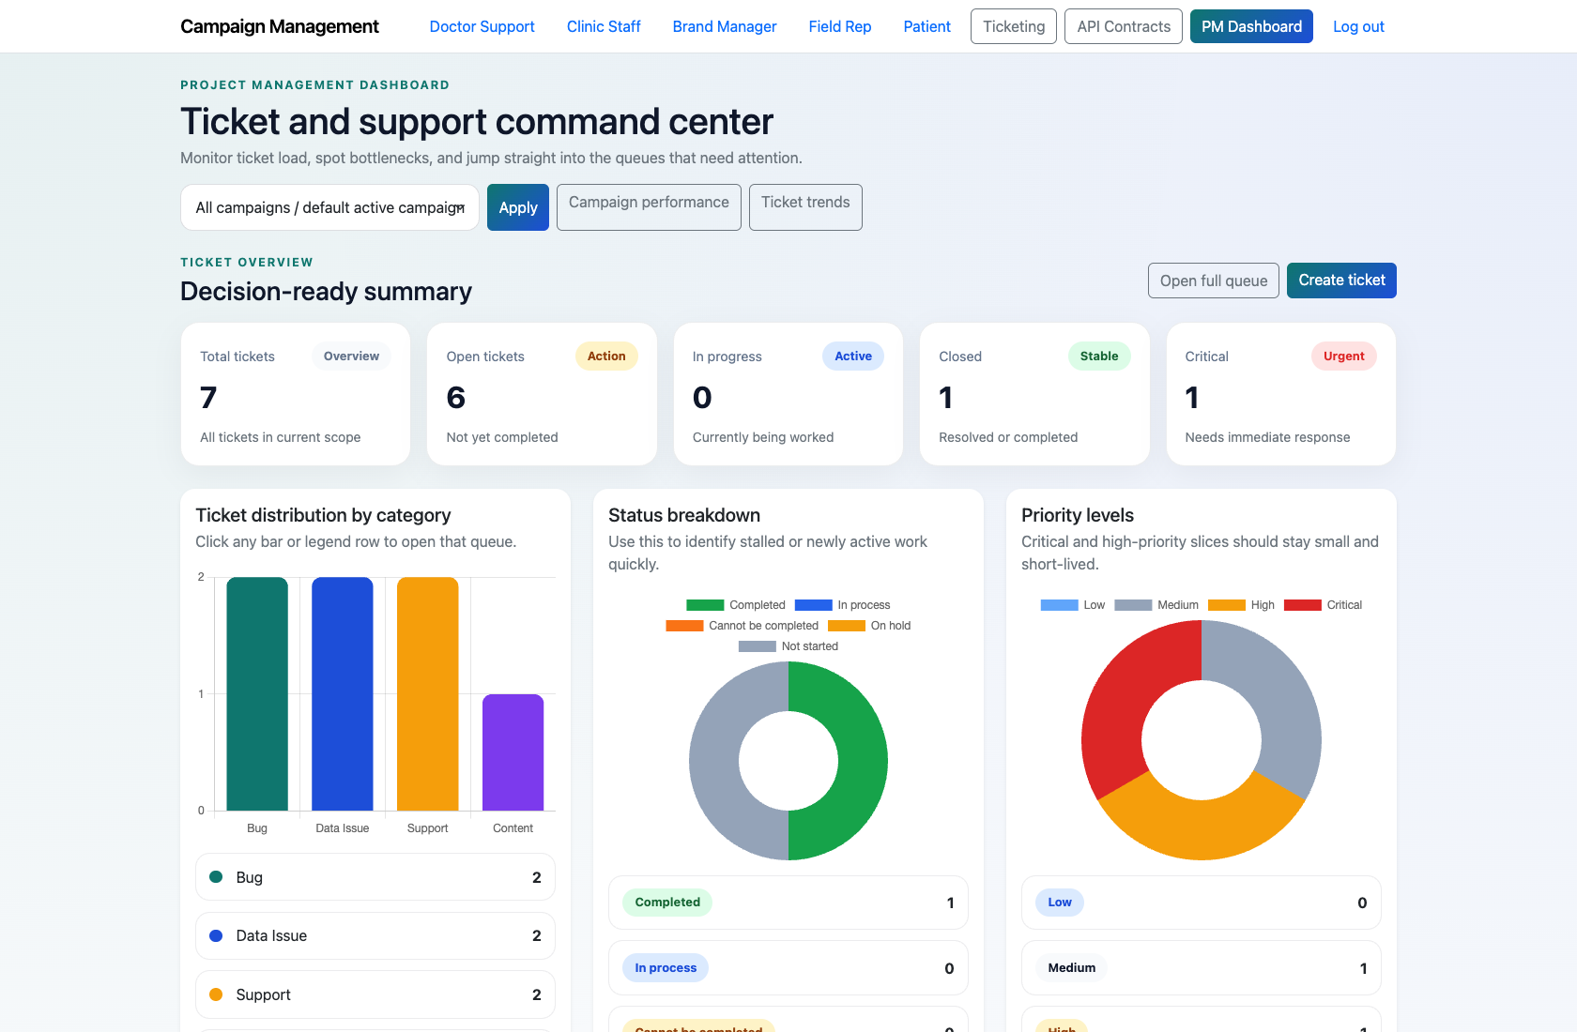
PROJECT MANAGEMENT & OPERATIONS
Project Manager Dashboard and Triage
Document how a Project Manager uses the command-center dashboard to monitor workload, inspect pending items, and launch the next operational action.
PRIMARY USER
ENTRY POINT
Project Manager
/accounts/dev-login/
Verified against the live application on 2026-04-11.

Slide 2
WORKFLOW OVERVIEW
Verified 2026-04-11
Project Manager Dashboard and Triage
A training-ready summary of the workflow entry point, ownership, and outcomes.
PRIMARY USER
ENTRY POINT
VERIFIED
STEPS
Project Manager
/accounts/dev-login/
2026-04-11
4
Workflow summary
Success criteria
The PM dashboard centralizes ticket KPIs, quick links, pending support reviews, a high-priority queue, and operational drill-downs.
Campaign filters can change the dashboard scope without leaving the page.
The page is the fastest way to move from monitoring into ticket creation or deeper analysis.
The PM can find current workload, pending support reviews, and urgent tickets without leaving `/app/`.
The PM can explain when to stay on the dashboard versus when to open ticketing or performance views.

Slide 3
PROJECT MANAGER DASHBOARD AND TRIAGE
Verified 2026-04-11
Decision Guide
Use this slide to explain how the workflow branches from entry to completion.
START HERE
CONTINUE WHEN RESOLVED
ESCALATE OR HAND OFF
Sign in and open the PM dashboard
Review summary KPIs and the current queue shape
Launch the next action from the dashboard
This is the primary operational entry point for PM-led work.
The PM can find current workload, pending support reviews, and urgent tickets without leaving `/app/`.
The PM can explain when to stay on the dashboard versus when to open ticketing or performance views.

Slide 4
PROJECT MANAGER DASHBOARD AND TRIAGE
Verified 2026-04-11
Step 1. Sign in and open the PM dashboard
PM dashboard overview
What the user does
Use the development login shortcut or the standard authenticated sign-in flow, then open `/app/`.
What the user sees
A dashboard hero area, campaign filter, and quick links for ticketing and performance.
Why it matters
This is the primary operational entry point for PM-led work.
The PM lands on the dashboard without needing to open multiple admin pages.
Trainer note: In the demo environment, `/accounts/dev-login/` is the fastest path for capture and training.

Slide 5
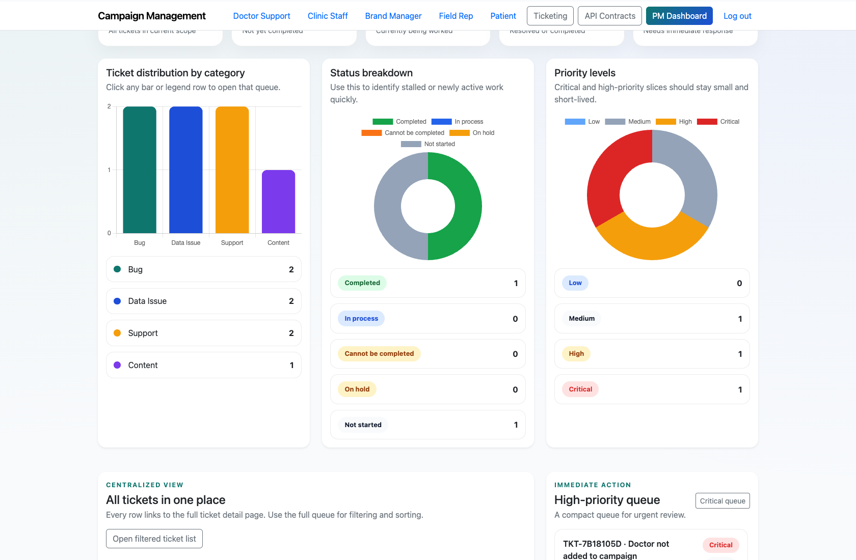
PROJECT MANAGER DASHBOARD AND TRIAGE
Verified 2026-04-11
Step 2. Review summary KPIs and the current queue shape
PM dashboard KPI and queue breakdown
What the user does
Scan the KPI cards and category, status, and priority breakdowns.
What the user sees
Decision-ready counts for total tickets, open work, critical issues, and queue distribution.
Why it matters
This lets the PM understand workload and urgency before drilling into the queue.
The PM knows which queue slices deserve immediate attention.
Trainer note: Use the category and status blocks to explain how the dashboard surfaces bottlenecks without opening the full ticket list first.

Slide 6
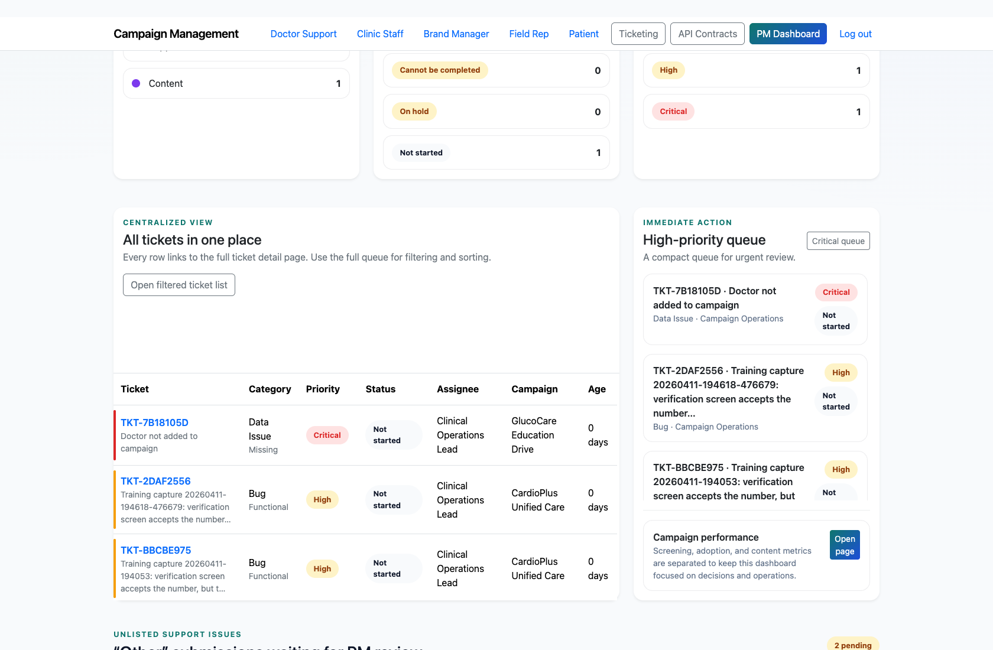
PROJECT MANAGER DASHBOARD AND TRIAGE
Verified 2026-04-11
Step 3. Inspect unresolved support submissions
PM review queue
What the user does
Scroll to the PM review table for “Other” submissions that came from widgets or the assistant.
What the user sees
A pending-review table with the originating system, flow, page context, and the escalation action.
Why it matters
This connects public support journeys directly into PM operations.
The PM can decide whether to raise a formal ticket from the unresolved issue.
Trainer note: If the table is empty, trainers should explain that unresolved support requests are created only when users choose “Other” or submit a PM-review route.

Slide 7
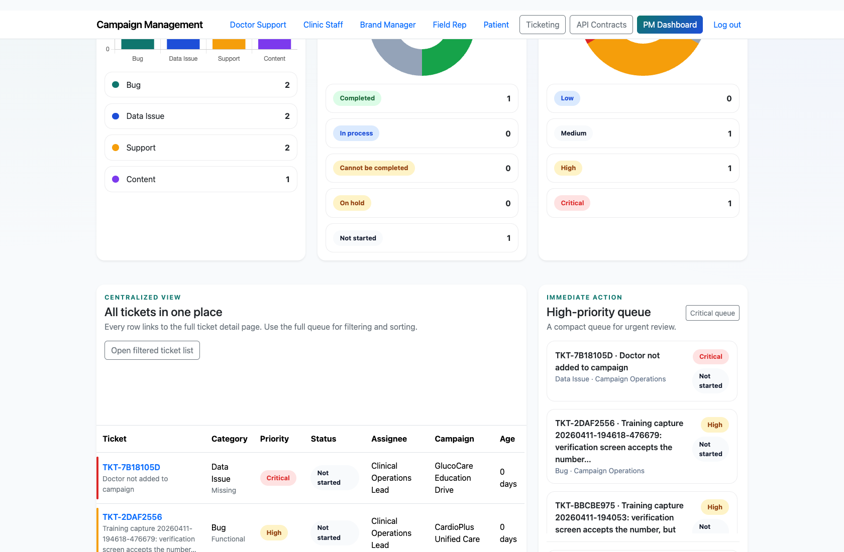
PROJECT MANAGER DASHBOARD AND TRIAGE
Verified 2026-04-11
Step 4. Launch the next action from the dashboard
High-priority queue from the PM dashboard
What the user does
Use the quick actions to open the full ticket queue, create a ticket, or move into the performance dashboard.
What the user sees
Clickable navigation paths that keep the PM inside the main operations loop.
Why it matters
The dashboard is designed to reduce context-switching and keep the PM in one command center.
The PM can move from overview to execution in one click.
Trainer note: Show both the full queue and the campaign performance link so the PM understands the dashboard’s dual operational and analytical roles.

Slide 8
PROJECT MANAGER DASHBOARD AND TRIAGE
Verified 2026-04-11
Trainer Tips and Common Issues
Use this slide to coach facilitators on pacing, known caveats, and product reality.
Trainer tips
Status and caveats
Start every PM training session here to establish a consistent operating rhythm.
Use the pending-review table as the bridge into the unresolved support workflow deck.
Live-verified against the seeded demo environment on 2026-04-11.

Slide 9
PROJECT MANAGER DASHBOARD AND TRIAGE
Verified 2026-04-11
Close-Out
End the walkthrough by confirming success and pointing learners to the next reference.
Success criteria
Related documents
The PM can find current workload, pending support reviews, and urgent tickets without leaving `/app/`.
The PM can explain when to stay on the dashboard versus when to open ticketing or performance views.
README.md
docs/testing-guide.md
Source of truth: live app, then code/templates, then project docs. Verified on 2026-04-11.

