Slide 1
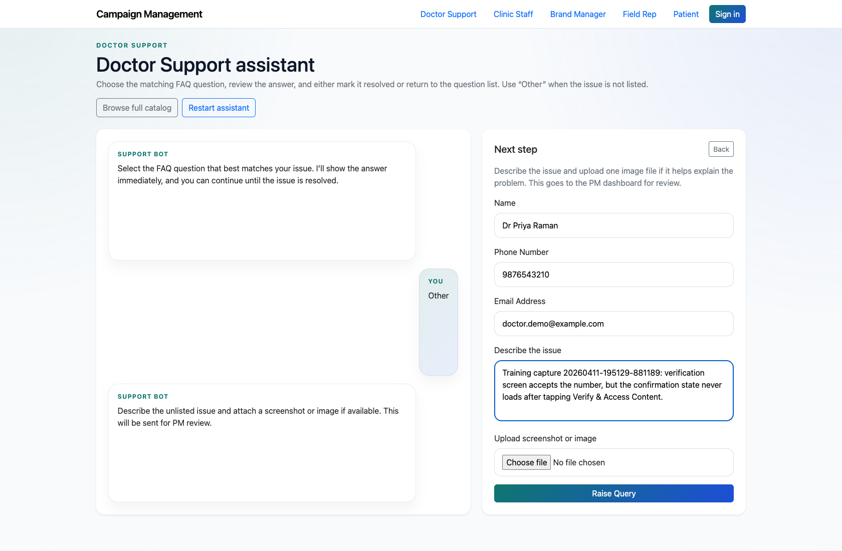
PROJECT MANAGEMENT & OPERATIONS
Project Manager Review of “Other” Support Submissions
Document the end-to-end escalation path from an unresolved assistant/widget issue into a PM-reviewed ticket.
PRIMARY USER
ENTRY POINT
Project Manager
/support/doctor/assistant/
Verified against the live application on 2026-04-11.

Slide 2
WORKFLOW OVERVIEW
Verified 2026-04-11
Project Manager Review of “Other” Support Submissions
A training-ready summary of the workflow entry point, ownership, and outcomes.
PRIMARY USER
ENTRY POINT
VERIFIED
STEPS
Project Manager
/support/doctor/assistant/
2026-04-11
5
Workflow summary
Success criteria
Public users can select “Other” in the guided support assistant or widget when no FAQ resolves their issue.
Those submissions land in the PM dashboard for review before a ticket is created.
The PM can open the pre-filled raise-ticket screen, confirm routing, and create the formal ticket.
The audience can explain how unresolved support issues move into PM review.
The PM can create a formal ticket without losing system, flow, or page context.

Slide 3
PROJECT MANAGER REVIEW OF “OTHER” SUPPORT SUBMISSIONS
Verified 2026-04-11
Decision Guide
Use this slide to explain how the workflow branches from entry to completion.
START HERE
CONTINUE WHEN RESOLVED
ESCALATE OR HAND OFF
Capture the unresolved issue in the assistant
Confirm that the support request was logged
Verify the created ticket detail
This path preserves the context the PM needs to classify the problem accurately.
The audience can explain how unresolved support issues move into PM review.
The PM can create a formal ticket without losing system, flow, or page context.

Slide 4
PROJECT MANAGER REVIEW OF “OTHER” SUPPORT SUBMISSIONS
Verified 2026-04-11
Step 1. Capture the unresolved issue in the assistant
Assistant unresolved issue form
What the user does
A support user drills down to the relevant system, flow, and screen, then chooses “Other” and describes the issue.
What the user sees
The assistant’s “Other issue” form with fields for name, phone number, email, description, and optional image upload.
Why it matters
This path preserves the context the PM needs to classify the problem accurately.
The unresolved issue is ready to be submitted for PM review.
Trainer note: This is the core public-to-internal escalation handoff in the live product.

Slide 5
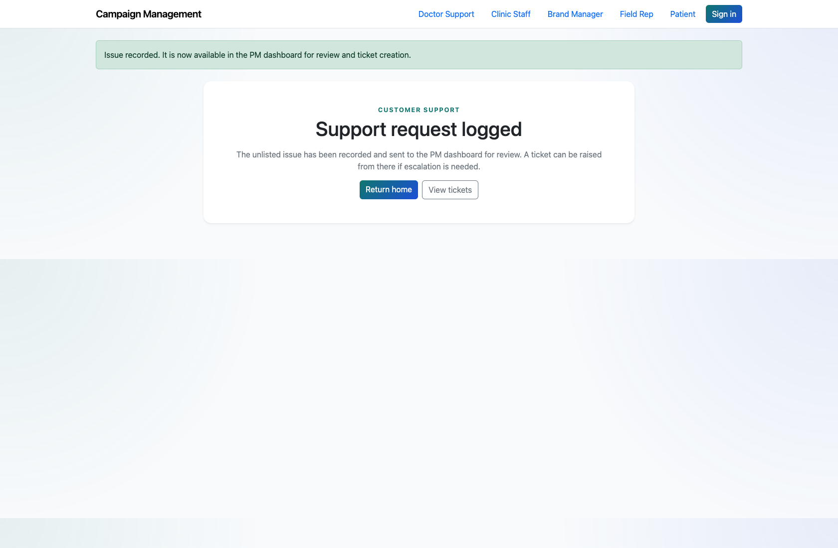
PROJECT MANAGER REVIEW OF “OTHER” SUPPORT SUBMISSIONS
Verified 2026-04-11
Step 2. Confirm that the support request was logged
Support request logged confirmation
What the user does
Submit the unresolved issue form from the assistant.
What the user sees
A success page confirming that the issue is recorded and available in the PM dashboard.
Why it matters
This reassures the external user and sets expectations that the issue has moved into PM review.
A `SupportRequest` exists in pending PM review status.
Trainer note: Use the success message wording during training so users understand they are not yet looking at a final support resolution.

Slide 6
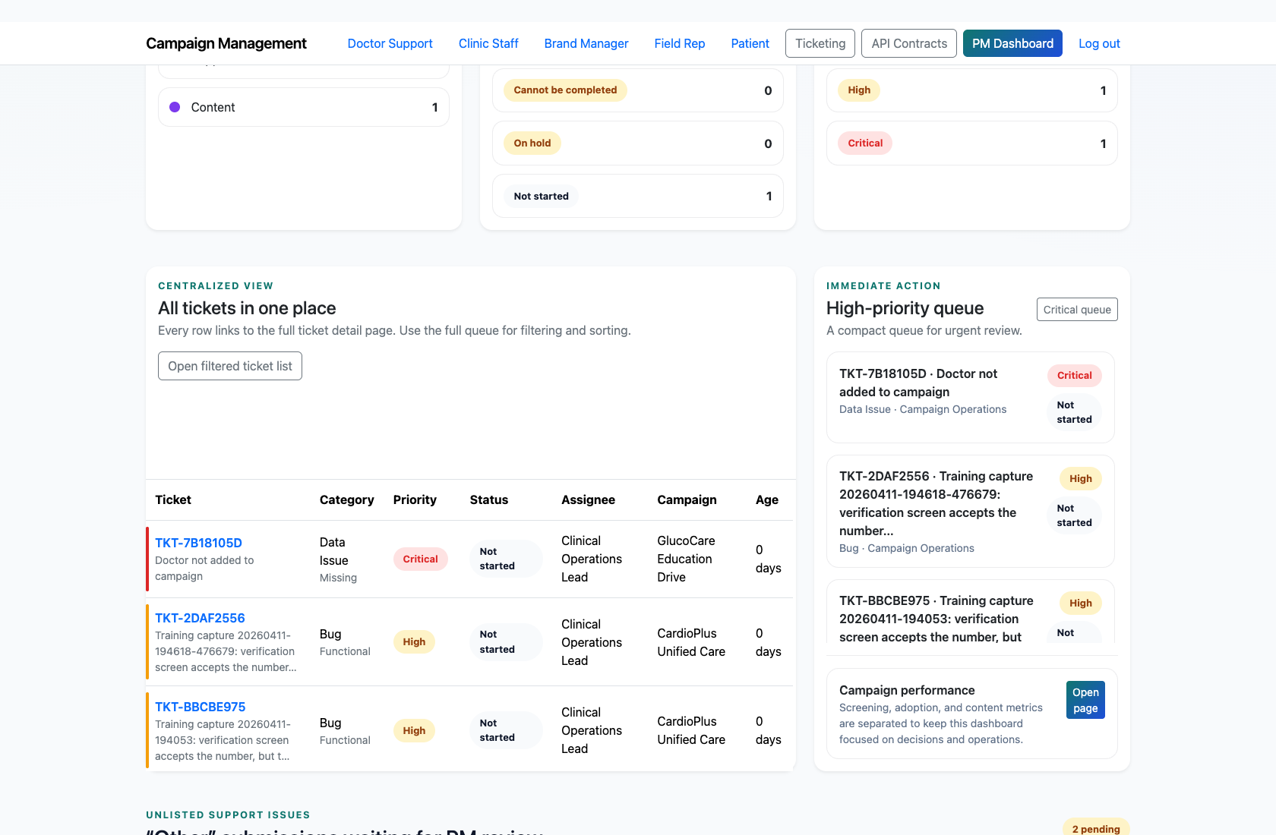
PROJECT MANAGER REVIEW OF “OTHER” SUPPORT SUBMISSIONS
Verified 2026-04-11
Step 3. Review the pending issue on the PM dashboard
Pending unresolved issue in the PM queue
What the user does
Open `/app/` and locate the pending “Other” submission in the PM review table.
What the user sees
The system, user type, flow, page, section, screen, issue description, and the `Raise Ticket` action.
Why it matters
This is where the PM decides whether the issue should become a ticket and where it should be routed.
The PM has enough context to continue into ticket creation without re-contacting the user.
Trainer note: Use this step to show that the assistant preserves the screen-level context in the PM review queue.

Slide 7
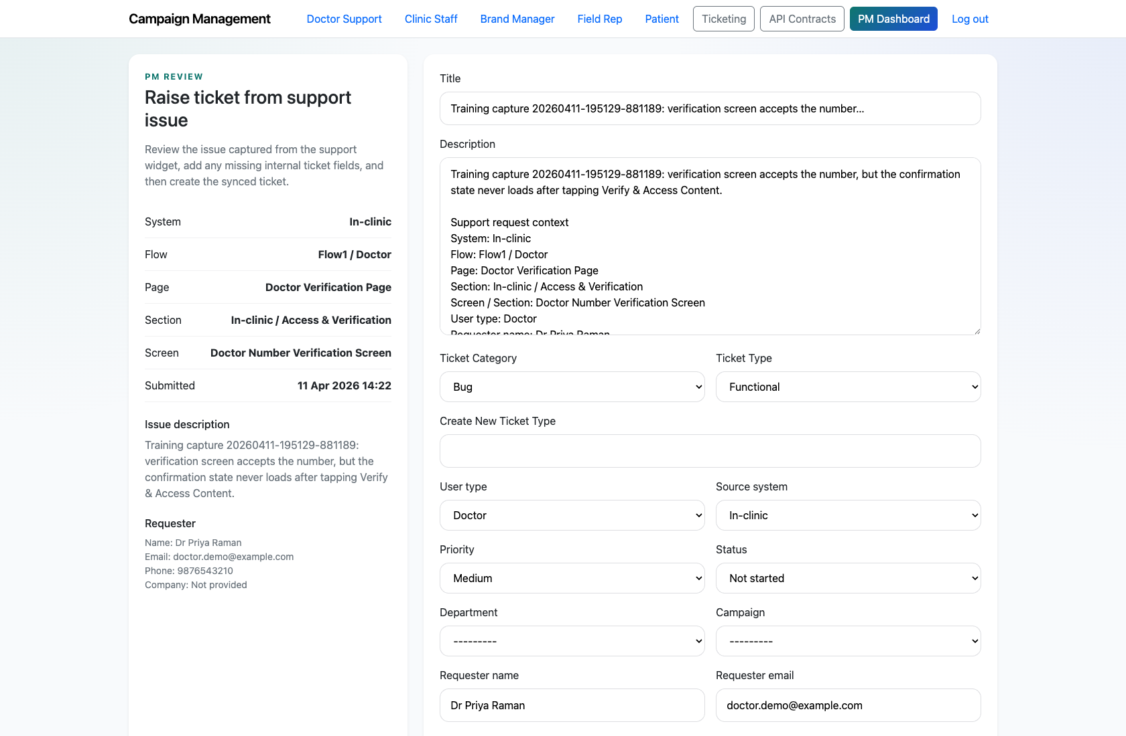
PROJECT MANAGER REVIEW OF “OTHER” SUPPORT SUBMISSIONS
Verified 2026-04-11
Step 4. Create the formal ticket from the pre-filled PM form
Raise ticket from support issue
What the user does
Open the `Raise Ticket` screen, confirm the category and type, choose a department and campaign, and submit the form.
What the user sees
A ticket-creation page pre-filled with the support request description and routing context.
Why it matters
This minimizes re-entry and keeps the original support context attached to the ticket.
A new ticket is created and linked back to the originating support request.
Trainer note: The PM only needs to fill missing internal routing fields such as department and campaign.

Slide 8
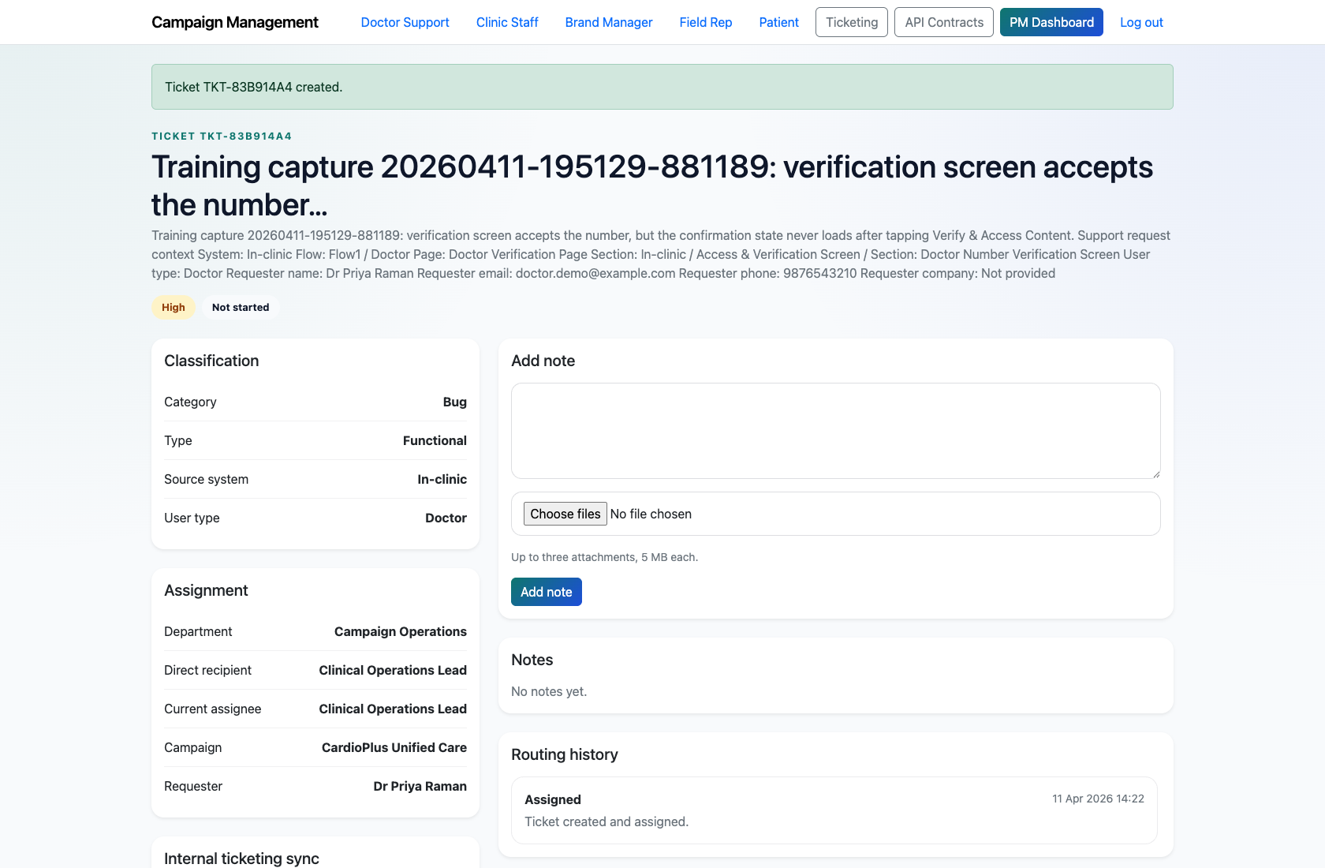
PROJECT MANAGER REVIEW OF “OTHER” SUPPORT SUBMISSIONS
Verified 2026-04-11
Step 5. Verify the created ticket detail
Ticket created from a support request
What the user does
Open the resulting ticket detail page after the PM submits the synced ticket form.
What the user sees
The new ticket’s title, description, classification, assignment, and workflow controls.
Why it matters
This confirms the unresolved support issue is now in the internal execution workflow.
The PM can hand the work off to the correct department or begin managing it immediately.
Trainer note: If an image was uploaded, trainers should also point out where the resulting note attachment appears on the ticket detail page.

Slide 9
PROJECT MANAGER REVIEW OF “OTHER” SUPPORT SUBMISSIONS
Verified 2026-04-11
Trainer Tips and Common Issues
Use this slide to coach facilitators on pacing, known caveats, and product reality.
Trainer tips
Status and caveats
Show the assistant capture and PM review together so the handoff feels continuous rather than like two unrelated screens.
Emphasize that this workflow is for unresolved support gaps, not every FAQ interaction.
Live-verified against the assistant, PM dashboard, and ticket-creation flow on 2026-04-11.

Slide 10
PROJECT MANAGER REVIEW OF “OTHER” SUPPORT SUBMISSIONS
Verified 2026-04-11
Close-Out
End the walkthrough by confirming success and pointing learners to the next reference.
Success criteria
Related documents
The audience can explain how unresolved support issues move into PM review.
The PM can create a formal ticket without losing system, flow, or page context.
README.md
docs/testing-guide.md
docs/support-widget-integration.md
Source of truth: live app, then code/templates, then project docs. Verified on 2026-04-11.

