Slide 1
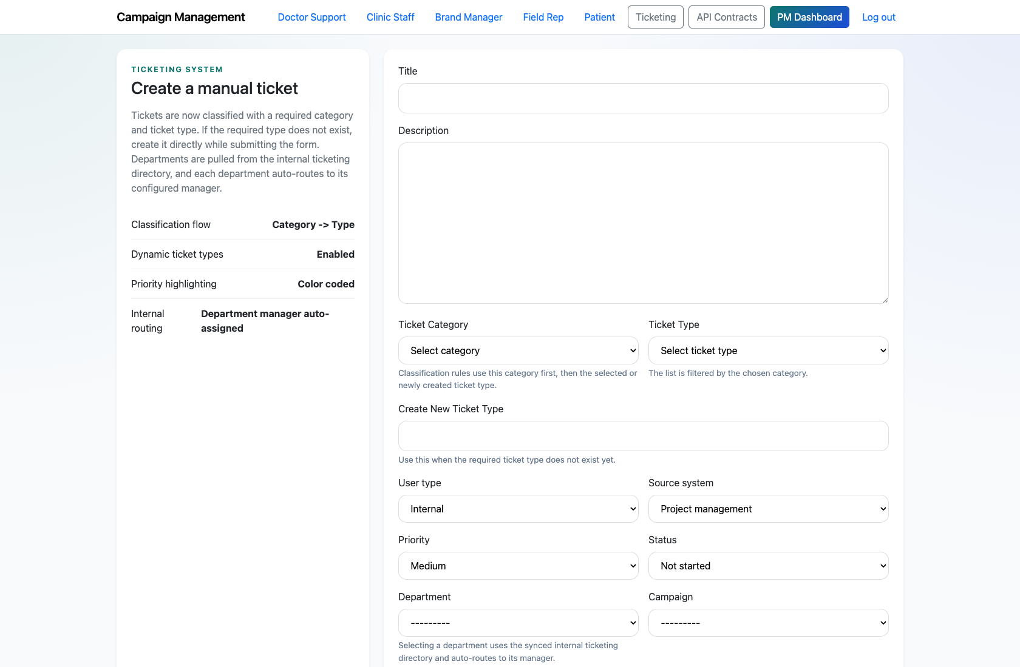
PROJECT MANAGEMENT & OPERATIONS
Project Manager Manual Ticket Creation and Routing
Document how a Project Manager creates a new ticket directly from the ticketing workspace when the issue did not originate in the support assistant or widget.
PRIMARY USER
ENTRY POINT
Project Manager
/ticketing/new/
Verified against the live application on 2026-04-11.

Slide 2
WORKFLOW OVERVIEW
Verified 2026-04-11
Project Manager Manual Ticket Creation and Routing
A training-ready summary of the workflow entry point, ownership, and outcomes.
PRIMARY USER
ENTRY POINT
VERIFIED
STEPS
Project Manager
/ticketing/new/
2026-04-11
4
Workflow summary
Success criteria
The PM can create tickets directly from `/ticketing/new/` using the configured categories, ticket types, and departments.
The form supports category and ticket-type selection, source-system tagging, campaign association, requester details, and status/priority defaults.
On submission, the PM lands directly on the ticket detail page to continue routing or execution.
The PM can create a new ticket without relying on a support-originated request.
The ticket appears in the queue with the expected category, department, and requester context.

Slide 3
PROJECT MANAGER MANUAL TICKET CREATION AND ROUTING
Verified 2026-04-11
Decision Guide
Use this slide to explain how the workflow branches from entry to completion.
START HERE
CONTINUE WHEN RESOLVED
ESCALATE OR HAND OFF
Open the ticket creation form
Complete classification and routing
Return to the queue and validate the entry
This is the starting point for manually raised internal issues, back-office requests, or PM-created escalations.
The PM can create a new ticket without relying on a support-originated request.
The ticket appears in the queue with the expected category, department, and requester context.

Slide 4
PROJECT MANAGER MANUAL TICKET CREATION AND ROUTING
Verified 2026-04-11
Step 1. Open the ticket creation form
Manual ticket creation form
What the user does
From the PM dashboard or ticket queue, choose `Create ticket`.
What the user sees
A form for the title, description, category, ticket type, user type, source system, priority, department, campaign, and requester details.
Why it matters
This is the starting point for manually raised internal issues, back-office requests, or PM-created escalations.
The PM is ready to enter the full routing payload for the new issue.
Trainer note: Use the live form to show the seeded department and taxonomy options during training.

Slide 5
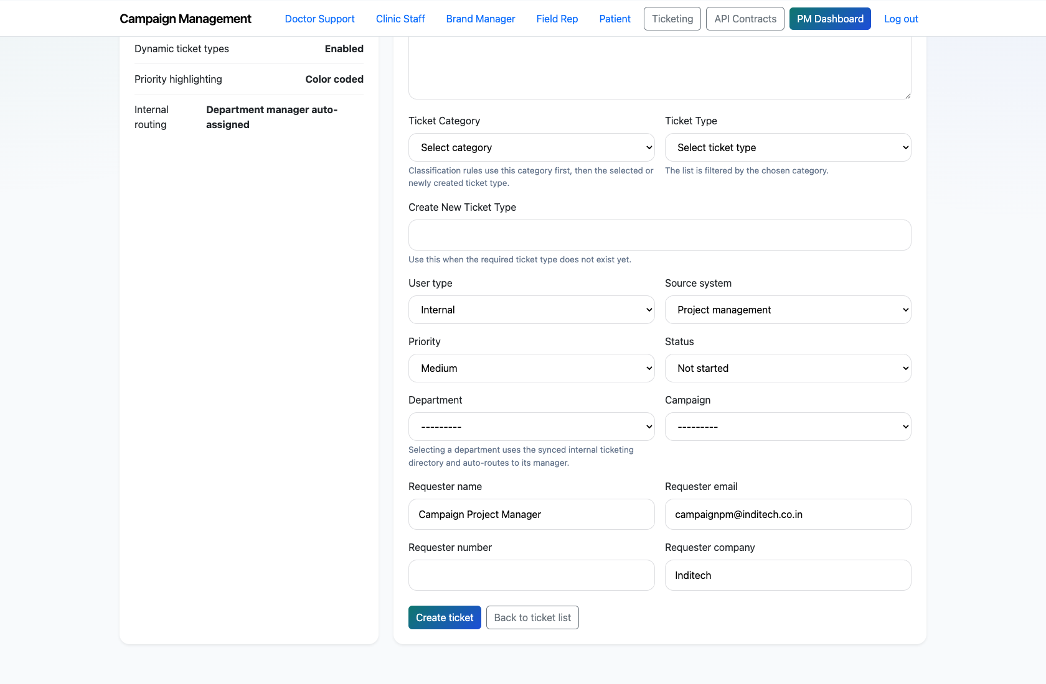
PROJECT MANAGER MANUAL TICKET CREATION AND ROUTING
Verified 2026-04-11
Step 2. Complete classification and routing
Manual ticket routing fields
What the user does
Choose the ticket category, type, priority, department, and campaign, then confirm the requester details.
What the user sees
A routing-ready form that can classify the ticket before it is created.
Why it matters
Correct classification and routing reduce rework later in the lifecycle.
The form is complete and ready to submit.
Trainer note: If the desired type is missing, the PM can create a new ticket type inline during submission.

Slide 6
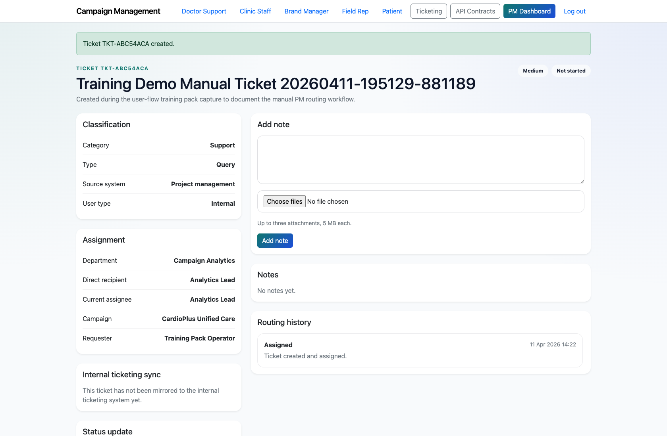
PROJECT MANAGER MANUAL TICKET CREATION AND ROUTING
Verified 2026-04-11
Step 3. Create the ticket and review the result
Manual ticket detail page
What the user does
Submit the form and open the resulting ticket detail page.
What the user sees
A new ticket with the chosen classification, assignment, requester details, and workflow controls.
Why it matters
This is where the PM confirms the new issue entered the system as expected.
The ticket exists in the queue and can be delegated, updated, or reviewed immediately.
Trainer note: In training, point out that the PM lands on the detail page rather than back on the list view.

Slide 7
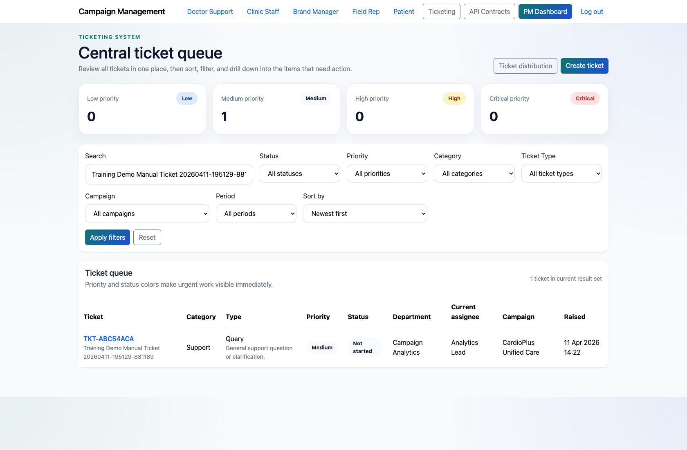
PROJECT MANAGER MANUAL TICKET CREATION AND ROUTING
Verified 2026-04-11
Step 4. Return to the queue and validate the entry
Manual ticket visible in the queue
What the user does
Open the ticket queue and confirm the new ticket appears in the expected sort order or filtered slice.
What the user sees
The central queue with the newly created ticket listed alongside existing work.
Why it matters
This demonstrates where manually created work becomes visible to the broader operations team.
The PM can see the new ticket in the queue and continue into execution if needed.
Trainer note: Use search or filters to highlight the new ticket quickly during training.

Slide 8
PROJECT MANAGER MANUAL TICKET CREATION AND ROUTING
Verified 2026-04-11
Trainer Tips and Common Issues
Use this slide to coach facilitators on pacing, known caveats, and product reality.
Trainer tips
Status and caveats
Use this workflow for internal issues, discovered defects, or requests raised outside the self-service support surface.
Reinforce the difference between manually created tickets and PM-reviewed support requests.
Live-verified against the ticket-create form and queue on 2026-04-11.

Slide 9
PROJECT MANAGER MANUAL TICKET CREATION AND ROUTING
Verified 2026-04-11
Close-Out
End the walkthrough by confirming success and pointing learners to the next reference.
Success criteria
Related documents
The PM can create a new ticket without relying on a support-originated request.
The ticket appears in the queue with the expected category, department, and requester context.
README.md
docs/testing-guide.md
Source of truth: live app, then code/templates, then project docs. Verified on 2026-04-11.

