Slide 1
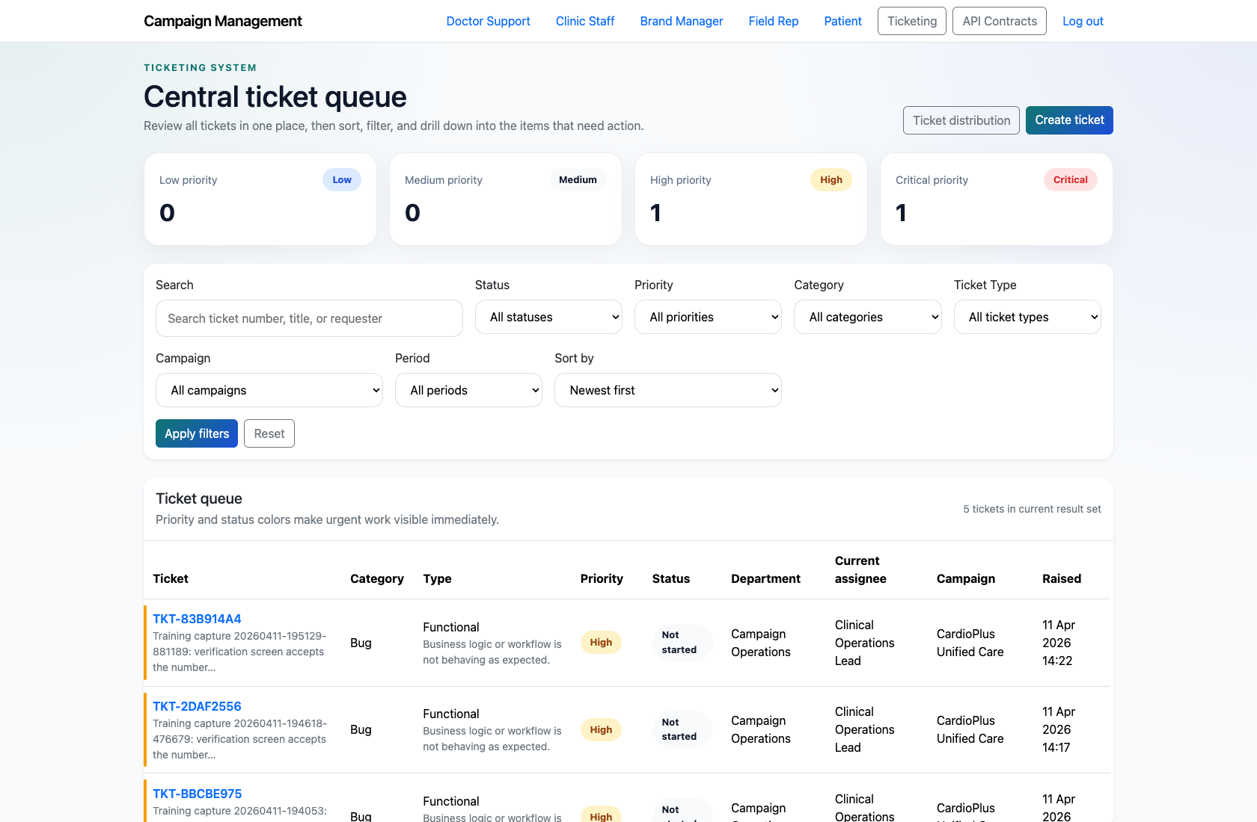
PROJECT MANAGEMENT & OPERATIONS
Department Owner Ticket Execution
Document how a departmental owner or support lead works their scoped queue, opens ticket detail, and updates the ticket lifecycle.
PRIMARY USER
ENTRY POINT
Department Owner / Support Lead
/admin/login/ then /ticketing/
Verified against the live application on 2026-04-11.

Slide 2
WORKFLOW OVERVIEW
Verified 2026-04-11
Department Owner Ticket Execution
A training-ready summary of the workflow entry point, ownership, and outcomes.
PRIMARY USER
ENTRY POINT
VERIFIED
STEPS
Department Owner / Support Lead
/admin/login/ then /ticketing/
2026-04-11
4
Workflow summary
Success criteria
Department owners see a scoped subset of the ticket queue rather than the full PM command center.
They can open ticket detail pages, change status, delegate the ticket, add notes, and review routing history.
This workflow is the execution layer that follows PM triage and ticket creation.
The department owner can open only their relevant queue and work a ticket without PM assistance.
The department owner knows where to update status, delegate work, and record notes.

Slide 3
DEPARTMENT OWNER TICKET EXECUTION
Verified 2026-04-11
Decision Guide
Use this slide to explain how the workflow branches from entry to completion.
START HERE
CONTINUE WHEN RESOLVED
ESCALATE OR HAND OFF
Authenticate as a department owner
Open a ticket from the queue
Record execution notes and review history
This keeps operational users focused on the work they own.
The department owner can open only their relevant queue and work a ticket without PM assistance.
The department owner knows where to update status, delegate work, and record notes.

Slide 4
DEPARTMENT OWNER TICKET EXECUTION
Verified 2026-04-11
Step 1. Authenticate as a department owner
Department-owner ticket queue
What the user does
Sign in as a staff user and open the ticket queue.
What the user sees
A ticket list limited to the departmental scope relevant to that user.
Why it matters
This keeps operational users focused on the work they own.
The department owner sees only the queue slice they are meant to manage.
Trainer note: In the demo environment, staff users can authenticate through the Django admin login and then navigate into `/ticketing/`.

Slide 5
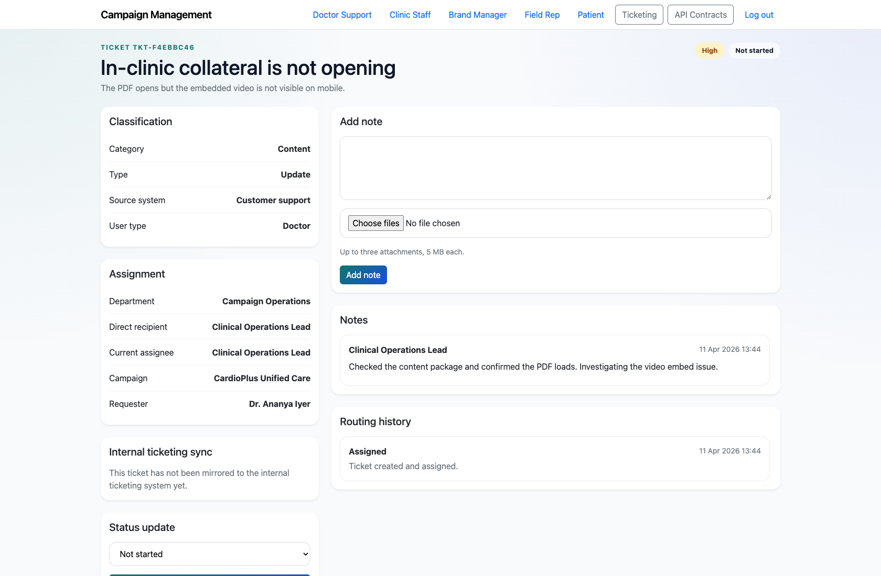
DEPARTMENT OWNER TICKET EXECUTION
Verified 2026-04-11
Step 2. Open a ticket from the queue
Department-owner ticket detail
What the user does
Select a ticket number from the scoped queue.
What the user sees
The ticket detail page with classification, assignment, requester data, notes, and routing history.
Why it matters
This is the operational workspace for day-to-day execution.
The department owner can review the full context of the issue before making changes.
Trainer note: Use this step to point out the difference between the PM dashboard summary and the detailed execution workspace.

Slide 6
DEPARTMENT OWNER TICKET EXECUTION
Verified 2026-04-11
Step 3. Update status or delegate the work
Department-owner routing controls
What the user does
Use the status-change and delegate controls in the ticket detail sidebar.
What the user sees
Status and assignee controls that update the ticket without leaving the detail page.
Why it matters
These controls keep ticket execution lightweight and traceable.
The department owner can move work forward or hand it to the right individual.
Trainer note: Show the routing controls even if you do not change the live ticket during training.

Slide 7
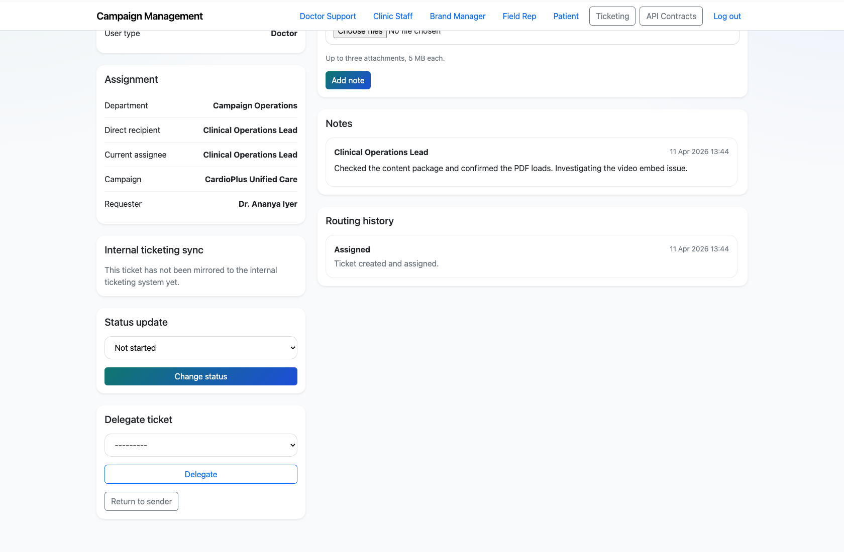
DEPARTMENT OWNER TICKET EXECUTION
Verified 2026-04-11
Step 4. Record execution notes and review history
Notes and routing history
What the user does
Use the note form and review the routing history timeline on the ticket detail page.
What the user sees
A notes section for operational commentary plus an immutable routing history panel.
Why it matters
These sections document how the ticket was worked over time.
The department owner understands where to record progress and how to audit prior movement.
Trainer note: If attachments are used in production, explain that note uploads appear alongside the note history.

Slide 8
DEPARTMENT OWNER TICKET EXECUTION
Verified 2026-04-11
Trainer Tips and Common Issues
Use this slide to coach facilitators on pacing, known caveats, and product reality.
Trainer tips
Status and caveats
Clarify that the PM dashboard is not the primary operational screen for department owners.
Use a real scoped queue to explain role-based visibility and responsibility.
Live-verified using a staff department-owner account and scoped ticket queue on 2026-04-11.

Slide 9
DEPARTMENT OWNER TICKET EXECUTION
Verified 2026-04-11
Close-Out
End the walkthrough by confirming success and pointing learners to the next reference.
Success criteria
Related documents
The department owner can open only their relevant queue and work a ticket without PM assistance.
The department owner knows where to update status, delegate work, and record notes.
README.md
docs/testing-guide.md
Source of truth: live app, then code/templates, then project docs. Verified on 2026-04-11.

