Slide 1
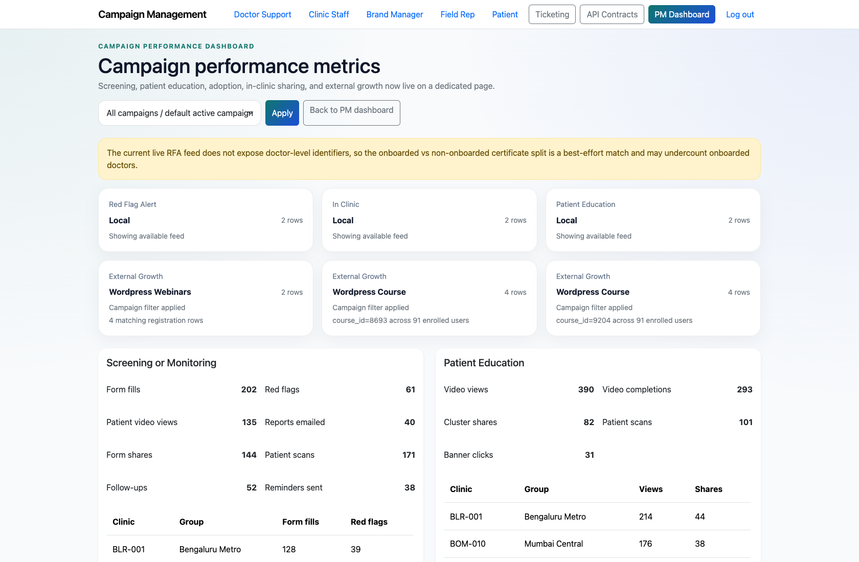
PROJECT MANAGEMENT & OPERATIONS
Project Manager Campaign Performance and Reporting
Document how a Project Manager reviews campaign performance, subsystem metrics, and reporting contracts.
PRIMARY USER
ENTRY POINT
Project Manager
/app/performance/
Verified against the live application on 2026-04-11.

Slide 2
WORKFLOW OVERVIEW
Verified 2026-04-11
Project Manager Campaign Performance and Reporting
A training-ready summary of the workflow entry point, ownership, and outcomes.
PRIMARY USER
ENTRY POINT
VERIFIED
STEPS
Project Manager
/app/performance/
2026-04-11
4
Workflow summary
Success criteria
The performance dashboard separates analytical review from the PM dashboard’s operational triage surface.
It aggregates campaign metrics, subsystem sections, adoption data, and external growth metrics.
The reporting contracts page exposes the expected JSON contract for downstream integration or validation.
The PM can use the performance dashboard to review campaign health independently from ticket triage.
The PM knows where to inspect the reporting payload contract when needed.

Slide 3
PROJECT MANAGER CAMPAIGN PERFORMANCE AND REPORTING
Verified 2026-04-11
Decision Guide
Use this slide to explain how the workflow branches from entry to completion.
START HERE
CONTINUE WHEN RESOLVED
ESCALATE OR HAND OFF
Open the campaign performance dashboard
Review campaign KPIs and subsystem sections
Use performance insights to inform operational work
This keeps analytical review separate from the main ticket operations surface.
The PM can use the performance dashboard to review campaign health independently from ticket triage.
The PM knows where to inspect the reporting payload contract when needed.

Slide 4
PROJECT MANAGER CAMPAIGN PERFORMANCE AND REPORTING
Verified 2026-04-11
Step 1. Open the campaign performance dashboard
Campaign performance dashboard
What the user does
From the PM dashboard, choose `Campaign performance` or navigate directly to `/app/performance/`.
What the user sees
A performance-oriented dashboard with campaign filter controls and metric sections.
Why it matters
This keeps analytical review separate from the main ticket operations surface.
The PM can switch from triage mode into performance review without losing campaign context.
Trainer note: Use the campaign filter to demonstrate how PMs can narrow the scope when discussing a single program.

Slide 5
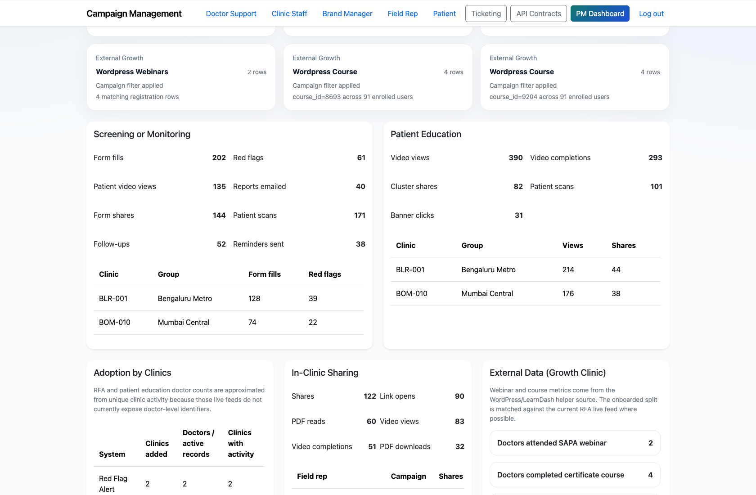
PROJECT MANAGER CAMPAIGN PERFORMANCE AND REPORTING
Verified 2026-04-11
Step 2. Review campaign KPIs and subsystem sections
Performance metrics and subsystem sections
What the user does
Scroll through the subsystem blocks and supporting KPI cards.
What the user sees
Live-or-fallback reporting sections for Red Flag Alert, In-clinic, Patient Education, adoption, and external growth.
Why it matters
This is where the PM reviews health and growth across delivery systems.
The PM can describe current performance without manually aggregating multiple reporting feeds.
Trainer note: If live data is unavailable, the UI still presents fallback content sourced from local snapshots.

Slide 6
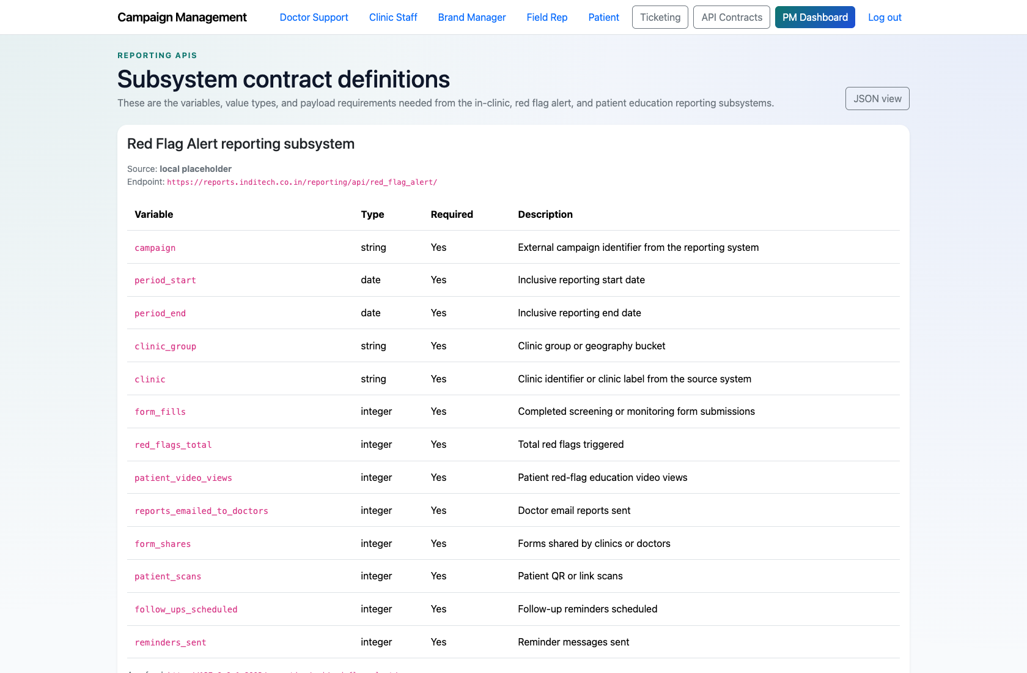
PROJECT MANAGER CAMPAIGN PERFORMANCE AND REPORTING
Verified 2026-04-11
Step 3. Open the reporting contracts reference
Reporting contracts reference
What the user does
Navigate to `/reporting/contracts/` from the global nav.
What the user sees
The human-readable reporting contract page that documents the expected payload structure.
Why it matters
This helps PMs, analysts, and implementers align on what the reporting APIs return.
The PM knows where to find contract definitions when investigating metric discrepancies.
Trainer note: This page is especially useful during cross-team troubleshooting or data-validation conversations.

Slide 7
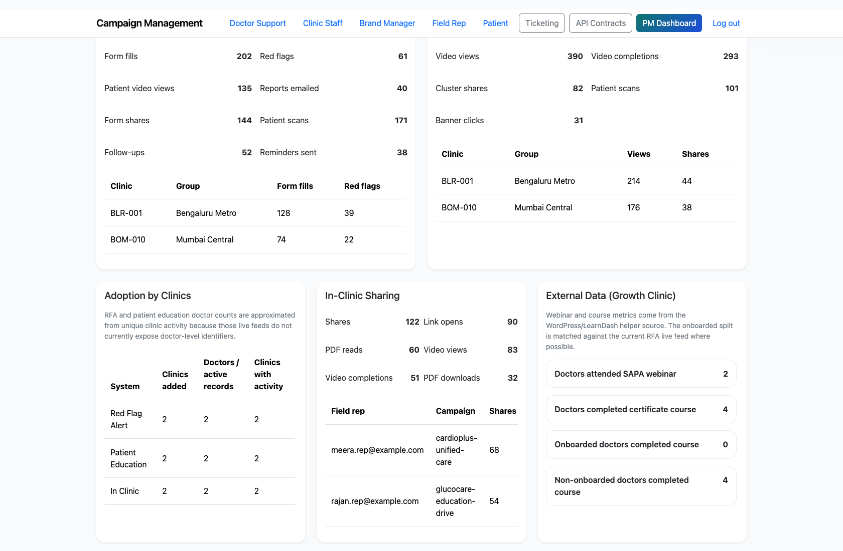
PROJECT MANAGER CAMPAIGN PERFORMANCE AND REPORTING
Verified 2026-04-11
Step 4. Use performance insights to inform operational work
Performance dashboard operational context
What the user does
Cross-reference performance findings with ticketing and PM triage as needed.
What the user sees
A clear separation between analytical review and operational workflows, linked through shared campaign scope.
Why it matters
PMs often move from performance anomalies into ticketing or support follow-up.
The PM can connect performance review to operational follow-through.
Trainer note: This workflow intentionally complements, rather than duplicates, the main PM dashboard.

Slide 8
PROJECT MANAGER CAMPAIGN PERFORMANCE AND REPORTING
Verified 2026-04-11
Trainer Tips and Common Issues
Use this slide to coach facilitators on pacing, known caveats, and product reality.
Trainer tips
Status and caveats
Keep this workflow distinct from the PM dashboard so trainees understand which page is for action versus analysis.
Use one campaign-filter example to show how the same program can be tracked across operations and performance.
Live-verified using the performance dashboard and reporting contract page on 2026-04-11.

Slide 9
PROJECT MANAGER CAMPAIGN PERFORMANCE AND REPORTING
Verified 2026-04-11
Close-Out
End the walkthrough by confirming success and pointing learners to the next reference.
Success criteria
Related documents
The PM can use the performance dashboard to review campaign health independently from ticket triage.
The PM knows where to inspect the reporting payload contract when needed.
README.md
docs/reporting-api-contract.md
docs/testing-guide.md
Source of truth: live app, then code/templates, then project docs. Verified on 2026-04-11.

