Slide 1
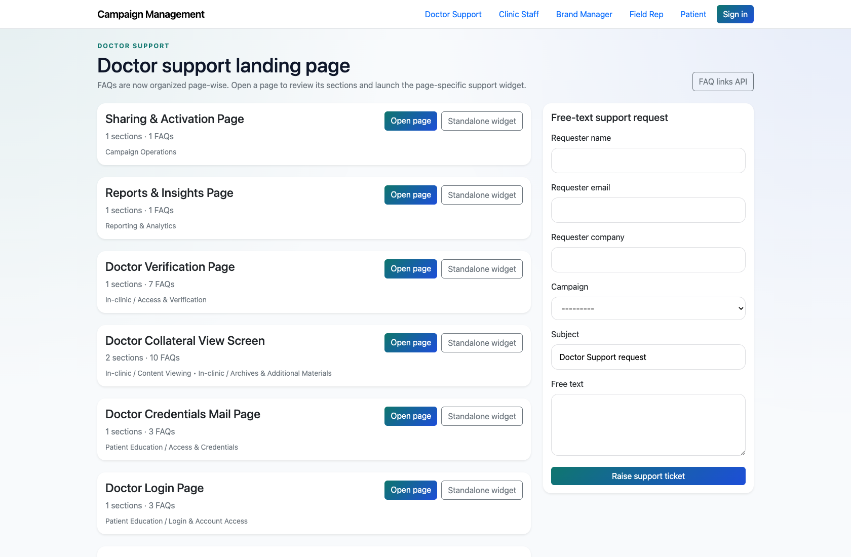
SELF-SERVICE SUPPORT
Doctor Self-Service Support
Document how a doctor uses the support landing page, FAQ pages, widgets, and assistant to resolve issues or escalate them.
PRIMARY USER
ENTRY POINT
Doctor
/support/doctor/
Verified against the live application on 2026-04-11.

Slide 2
WORKFLOW OVERVIEW
Verified 2026-04-11
Doctor Self-Service Support
A training-ready summary of the workflow entry point, ownership, and outcomes.
PRIMARY USER
ENTRY POINT
VERIFIED
STEPS
Doctor
/support/doctor/
2026-04-11
4
Workflow summary
Success criteria
Doctors enter through a dedicated support center with page-wise FAQ cards for Customer Support, In-clinic, Patient Education, and Red Flag Alert topics.
Each page can be opened as a full article set or as an embeddable widget.
If the issue is not solved, the doctor can escalate through the assistant or free-text support form.
A doctor can find the correct support page or assistant path without internal help.
A doctor can recognize when to escalate through the assistant or support form.

Slide 3
DOCTOR SELF-SERVICE SUPPORT
Verified 2026-04-11
Decision Guide
Use this slide to explain how the workflow branches from entry to completion.
START HERE
CONTINUE WHEN RESOLVED
ESCALATE OR HAND OFF
Open the Doctor Support landing page
Open a page-wise FAQ view
Escalate an unresolved issue
This is the doctor’s main starting point for self-service support.
A doctor can find the correct support page or assistant path without internal help.
A doctor can recognize when to escalate through the assistant or support form.

Slide 4
DOCTOR SELF-SERVICE SUPPORT
Verified 2026-04-11
Step 1. Open the Doctor Support landing page
Doctor support landing page
What the user does
Navigate to `/support/doctor/`.
What the user sees
A page-wise FAQ landing page with cards for each supported doctor-facing screen or journey.
Why it matters
This is the doctor’s main starting point for self-service support.
The doctor can identify the relevant screen or flow without needing an internal user.
Trainer note: The support catalog is organized page-wise, which is different from a generic help-center structure.

Slide 5
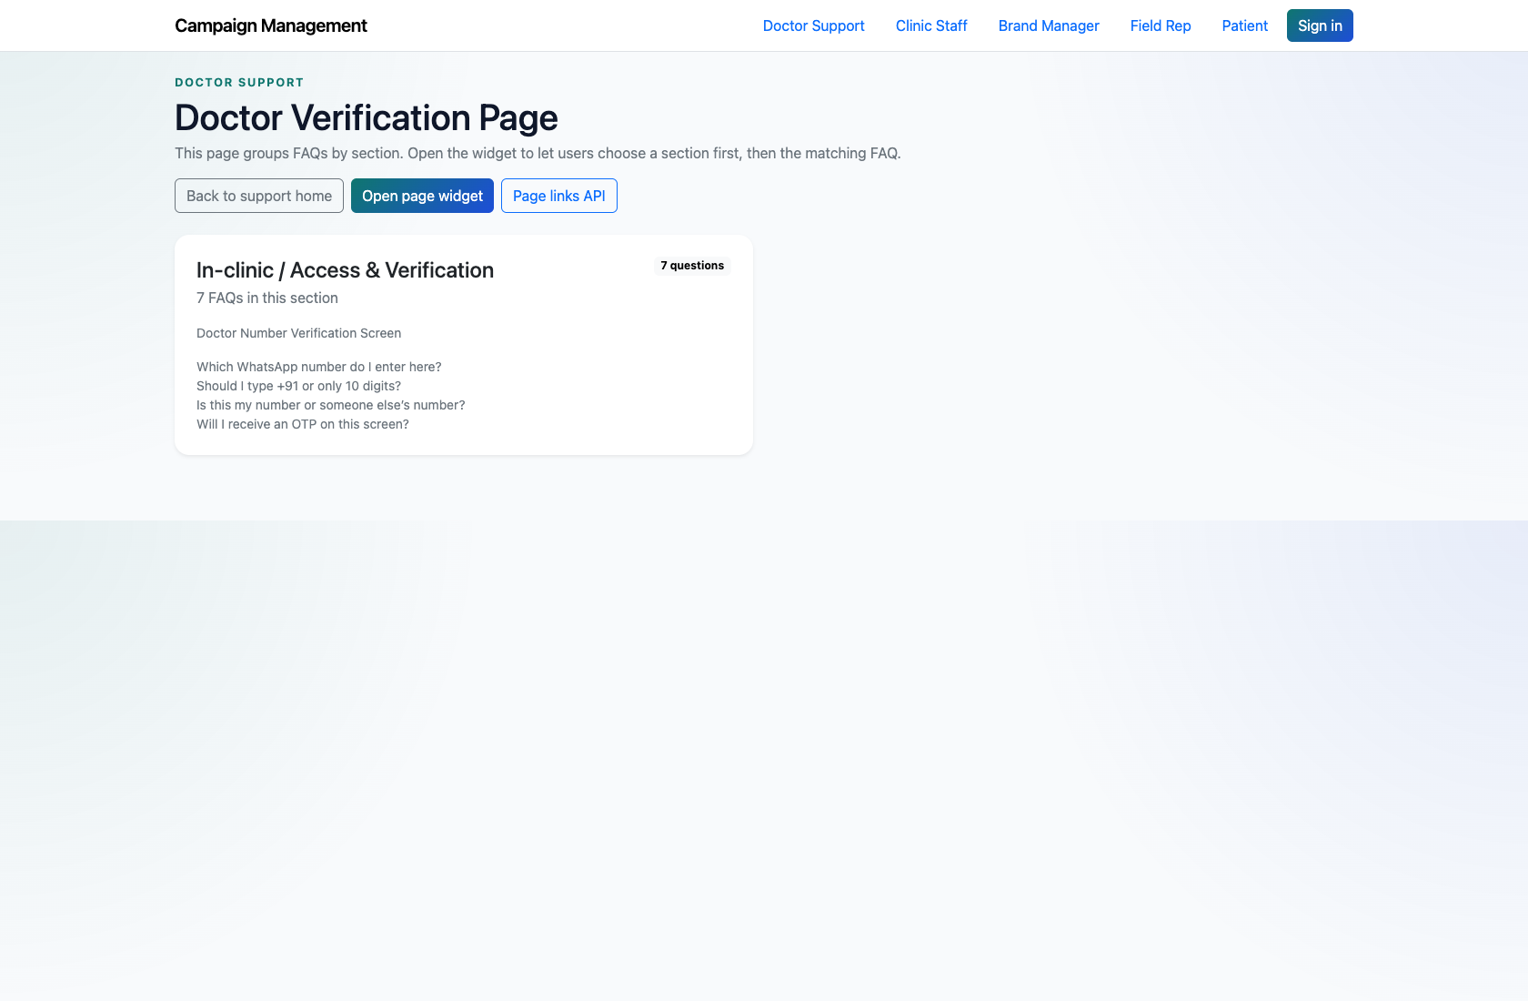
DOCTOR SELF-SERVICE SUPPORT
Verified 2026-04-11
Step 2. Open a page-wise FAQ view
Doctor FAQ page
What the user does
Choose a page such as the In-clinic doctor verification page.
What the user sees
A full FAQ page with sections, question cards, and page context.
Why it matters
This gives the doctor a richer reading experience than the compact widget.
The doctor can scan the relevant FAQs for the current screen.
Trainer note: Use a page with multiple FAQs during training so the structure is obvious.

Slide 6
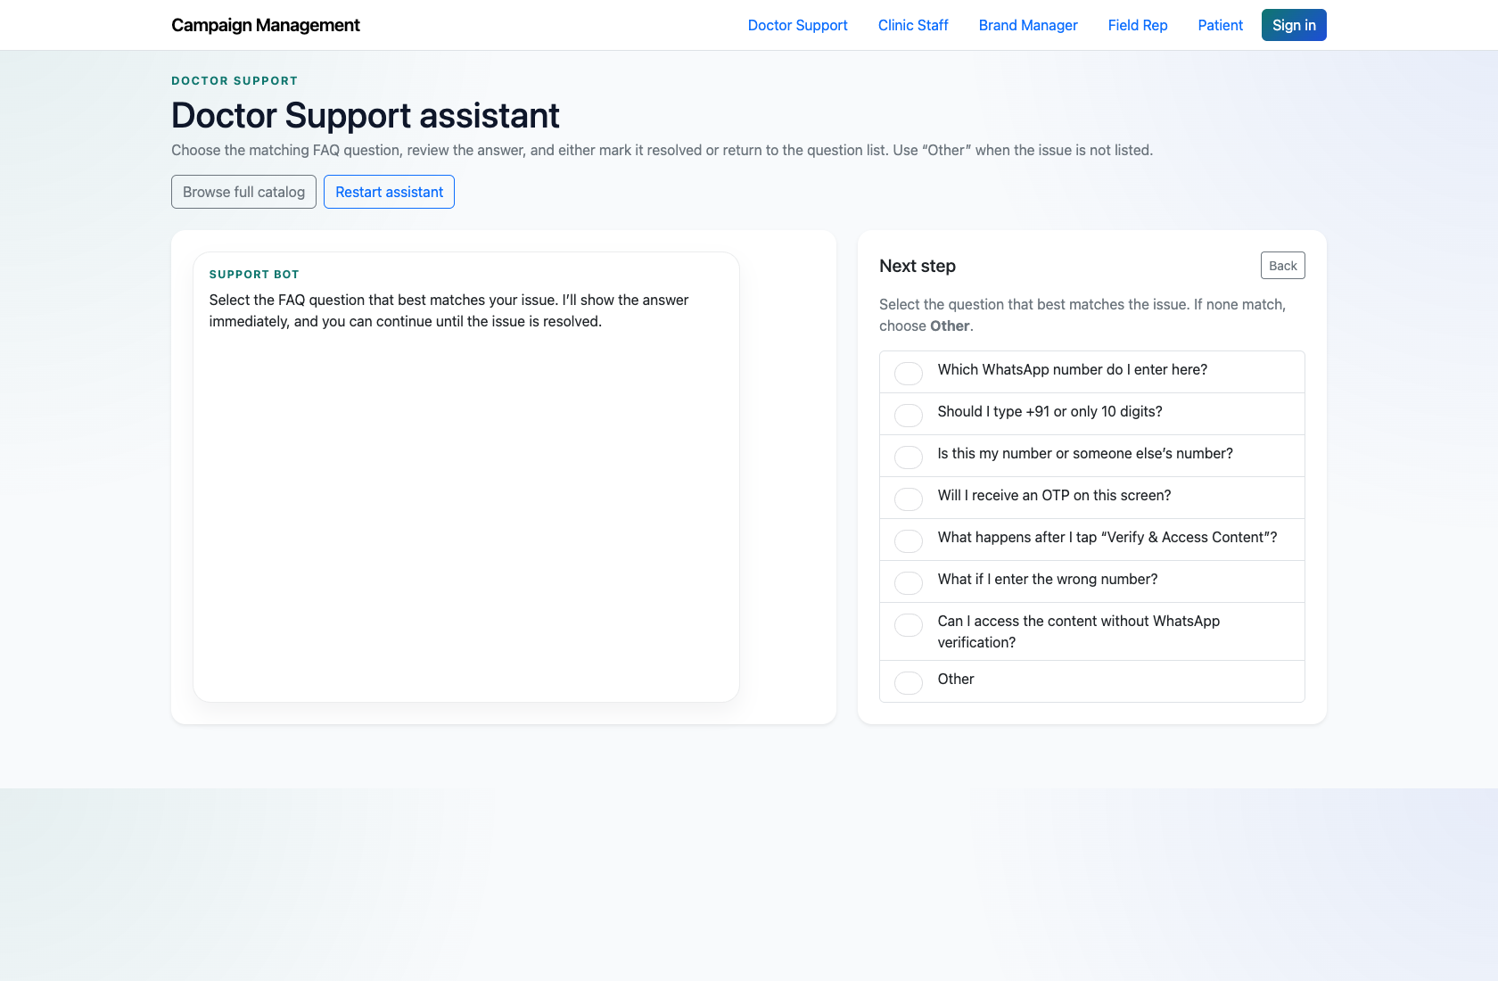
DOCTOR SELF-SERVICE SUPPORT
Verified 2026-04-11
Step 3. Use the guided assistant when the exact page is unclear
Doctor support assistant
What the user does
Open the doctor support assistant and choose the system, flow, and screen that matches the issue.
What the user sees
A guided, step-by-step support assistant that narrows the support context before showing answers.
Why it matters
This helps doctors who know the problem but not the exact FAQ page name.
The doctor either resolves the issue from a matching answer or chooses “Other.”
Trainer note: The assistant preserves the selected system, flow, and page context for escalation.

Slide 7
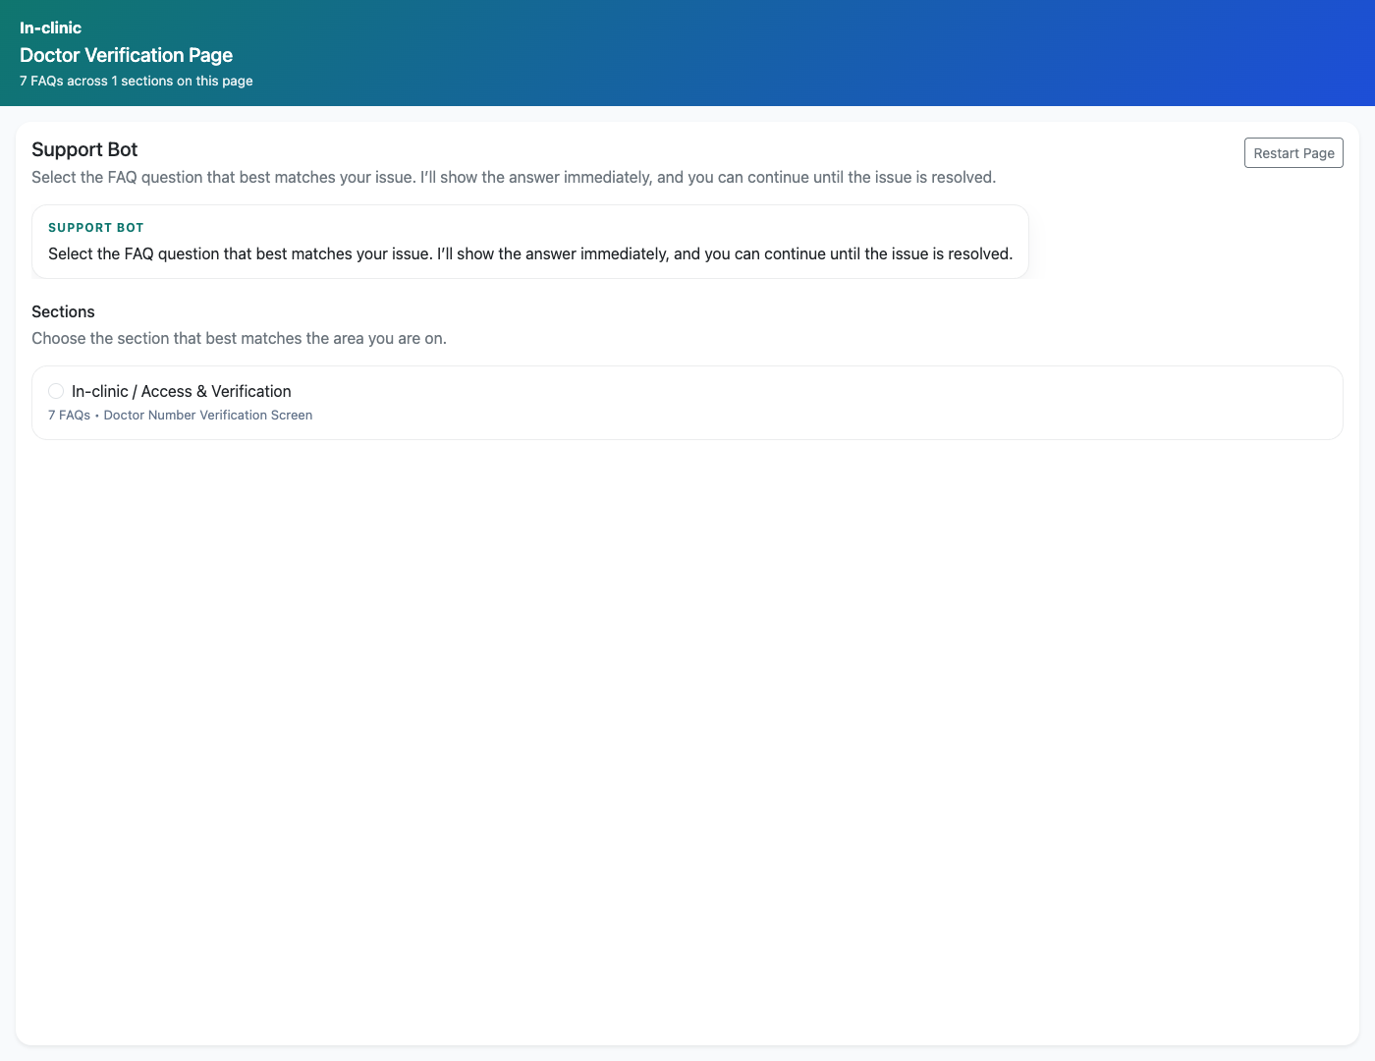
DOCTOR SELF-SERVICE SUPPORT
Verified 2026-04-11
Step 4. Escalate an unresolved issue
Doctor page-wise support widget
What the user does
Choose `Other` or use the landing-page form when the answer is missing or not resolved.
What the user sees
A form that records the issue for PM review or direct support follow-up, depending on the entry path.
Why it matters
This ensures doctors can continue even when self-service content is incomplete.
The issue is recorded and routed into the internal workflow.
Trainer note: Use the assistant-based escalation when you want to demonstrate the richer PM-review context.

Slide 8
DOCTOR SELF-SERVICE SUPPORT
Verified 2026-04-11
Trainer Tips and Common Issues
Use this slide to coach facilitators on pacing, known caveats, and product reality.
Trainer tips
Status and caveats
Show both the page-wise FAQ experience and the assistant so doctors understand when each is more efficient.
Use the widget screenshot to explain how the same content can be embedded elsewhere.
Live-verified against the doctor landing page, FAQ page, assistant, and widget on 2026-04-11.

Slide 9
DOCTOR SELF-SERVICE SUPPORT
Verified 2026-04-11
Close-Out
End the walkthrough by confirming success and pointing learners to the next reference.
Success criteria
Related documents
A doctor can find the correct support page or assistant path without internal help.
A doctor can recognize when to escalate through the assistant or support form.
README.md
docs/support-widget-integration.md
Source of truth: live app, then code/templates, then project docs. Verified on 2026-04-11.

