Slide 1
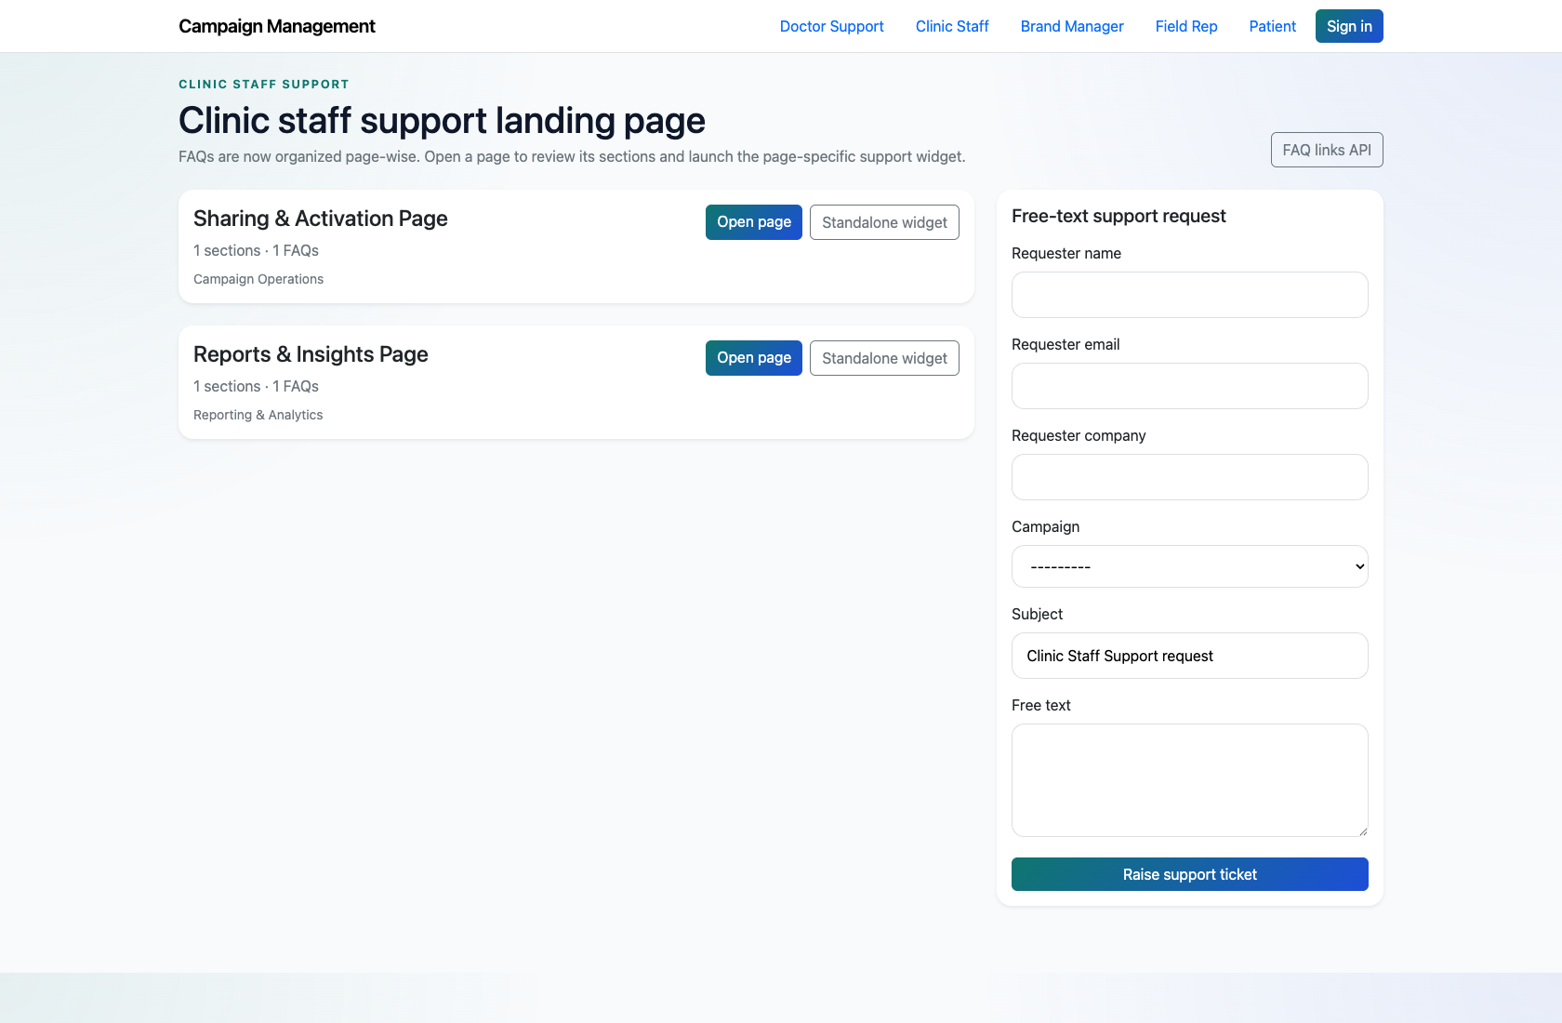
SELF-SERVICE SUPPORT
Clinic Staff Self-Service Support
Document the clinic-staff self-service path for shared support topics and escalation into the internal queue.
PRIMARY USER
ENTRY POINT
Clinic Staff
/support/clinic_staff/
Verified against the live application on 2026-04-11.

Slide 2
WORKFLOW OVERVIEW
Verified 2026-04-11
Clinic Staff Self-Service Support
A training-ready summary of the workflow entry point, ownership, and outcomes.
PRIMARY USER
ENTRY POINT
VERIFIED
STEPS
Clinic Staff
/support/clinic_staff/
2026-04-11
3
Workflow summary
Success criteria
Clinic staff use a lighter support catalog focused on shared operational topics such as support activation and reports.
They can open page-wise FAQs or submit a free-text request from the landing page.
This workflow is intentionally smaller than the doctor or field-rep flows in the current implementation.
Clinic staff can use the implemented role page to self-serve shared support topics.
Clinic staff know how to escalate when the smaller catalog does not answer the question.

Slide 3
CLINIC STAFF SELF-SERVICE SUPPORT
Verified 2026-04-11
Decision Guide
Use this slide to explain how the workflow branches from entry to completion.
START HERE
CONTINUE WHEN RESOLVED
ESCALATE OR HAND OFF
Open the Clinic Staff support center
Open a shared FAQ page
Escalate when the answer is missing
This is the implemented entry point for clinic-staff support needs.
Clinic staff can use the implemented role page to self-serve shared support topics.
Clinic staff know how to escalate when the smaller catalog does not answer the question.

Slide 4
CLINIC STAFF SELF-SERVICE SUPPORT
Verified 2026-04-11
Step 1. Open the Clinic Staff support center
Clinic Staff support landing page
What the user does
Navigate to `/support/clinic_staff/`.
What the user sees
A clinic-staff support landing page with a short page-wise FAQ catalog and a free-text request form.
Why it matters
This is the implemented entry point for clinic-staff support needs.
Clinic staff can quickly identify the relevant shared support topic.
Trainer note: Explain that the clinic-staff support surface is intentionally narrower than the doctor catalog in the live app.

Slide 5
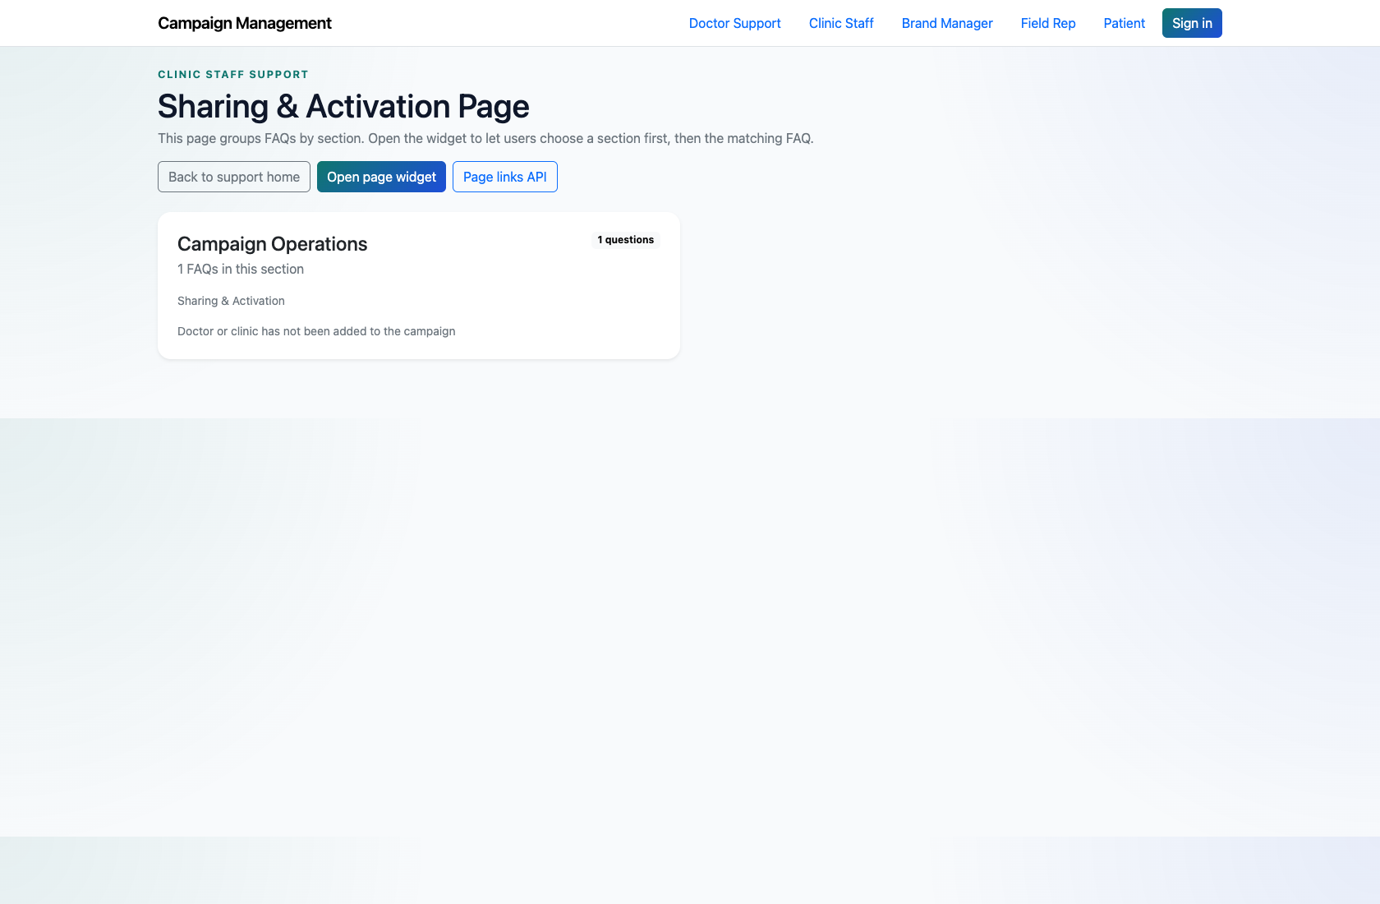
CLINIC STAFF SELF-SERVICE SUPPORT
Verified 2026-04-11
Step 2. Open a shared FAQ page
Clinic Staff FAQ page
What the user does
Choose a page such as `Sharing & Activation Page` or `Reports & Insights Page`.
What the user sees
A page-level FAQ view with the selected operational topic and corresponding answers.
Why it matters
This is the main self-service path for clinic-staff users.
Clinic staff can review the available answers before escalating.
Trainer note: Use a short FAQ page for quick walkthroughs in training.

Slide 6
CLINIC STAFF SELF-SERVICE SUPPORT
Verified 2026-04-11
Step 3. Escalate when the answer is missing
Clinic Staff free-text support form
What the user does
Submit the free-text support request from the landing page if the FAQ does not resolve the issue.
What the user sees
A form for requester details, subject, optional campaign, and issue description.
Why it matters
This provides a fallback path when the smaller clinic-staff catalog is not enough.
The issue is recorded for internal handling.
Trainer note: Point out that this route differs from the assistant-driven PM-review path used in other support flows.

Slide 7
CLINIC STAFF SELF-SERVICE SUPPORT
Verified 2026-04-11
Trainer Tips and Common Issues
Use this slide to coach facilitators on pacing, known caveats, and product reality.
Trainer tips
Status and caveats
Set expectations that this role currently has a focused support catalog rather than a large guided experience.
Live-verified against the clinic-staff role page and page-wise FAQ flow on 2026-04-11.

Slide 8
CLINIC STAFF SELF-SERVICE SUPPORT
Verified 2026-04-11
Close-Out
End the walkthrough by confirming success and pointing learners to the next reference.
Success criteria
Related documents
Clinic staff can use the implemented role page to self-serve shared support topics.
Clinic staff know how to escalate when the smaller catalog does not answer the question.
README.md
Source of truth: live app, then code/templates, then project docs. Verified on 2026-04-11.

