Slide 1
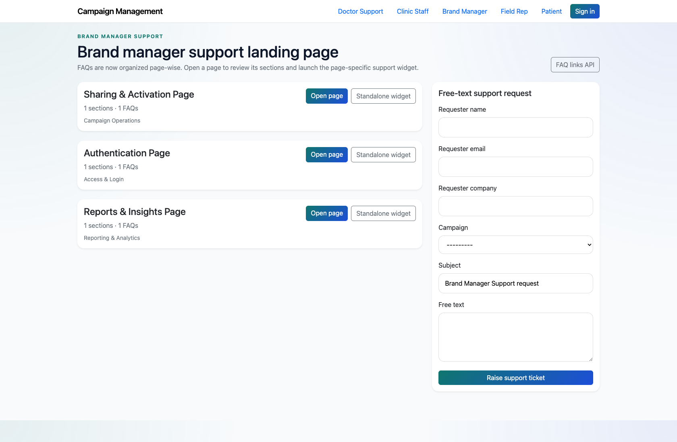
SELF-SERVICE SUPPORT
Brand Manager Self-Service Support
Document the implemented brand-manager support center and clarify how it differs from older portal-oriented notes.
PRIMARY USER
ENTRY POINT
Brand Manager
/support/brand_manager/
Verified against the live application on 2026-04-11.

Slide 2
WORKFLOW OVERVIEW
Verified 2026-04-11
Brand Manager Self-Service Support
A training-ready summary of the workflow entry point, ownership, and outcomes.
PRIMARY USER
ENTRY POINT
VERIFIED
STEPS
Brand Manager
/support/brand_manager/
2026-04-11
3
Workflow summary
Success criteria
The live product exposes brand-manager support as a role-specific support center rather than a separate authenticated portal.
The available catalog focuses on customer support authentication, sharing, and reports.
Brand managers can browse page-wise FAQs or escalate through the landing-page support form.
Brand managers understand the implemented support center entry point.
Trainers can clearly explain the difference between live behavior and older portal-oriented notes.

Slide 3
BRAND MANAGER SELF-SERVICE SUPPORT
Verified 2026-04-11
Decision Guide
Use this slide to explain how the workflow branches from entry to completion.
START HERE
CONTINUE WHEN RESOLVED
ESCALATE OR HAND OFF
Open the Brand Manager support center
Review an authentication or sharing FAQ page
Submit a support request when needed
This is the actual implemented starting point for brand-manager support in the current product.
Brand managers understand the implemented support center entry point.
Trainers can clearly explain the difference between live behavior and older portal-oriented notes.

Slide 4
BRAND MANAGER SELF-SERVICE SUPPORT
Verified 2026-04-11
Step 1. Open the Brand Manager support center
Brand Manager support landing page
What the user does
Navigate to `/support/brand_manager/`.
What the user sees
A role-specific support landing page for brand-manager topics.
Why it matters
This is the actual implemented starting point for brand-manager support in the current product.
The brand manager sees the available support pages and escalation form.
Trainer note: Older extracted notes describe a richer brand-manager portal, but the live product currently implements a support center instead.

Slide 5
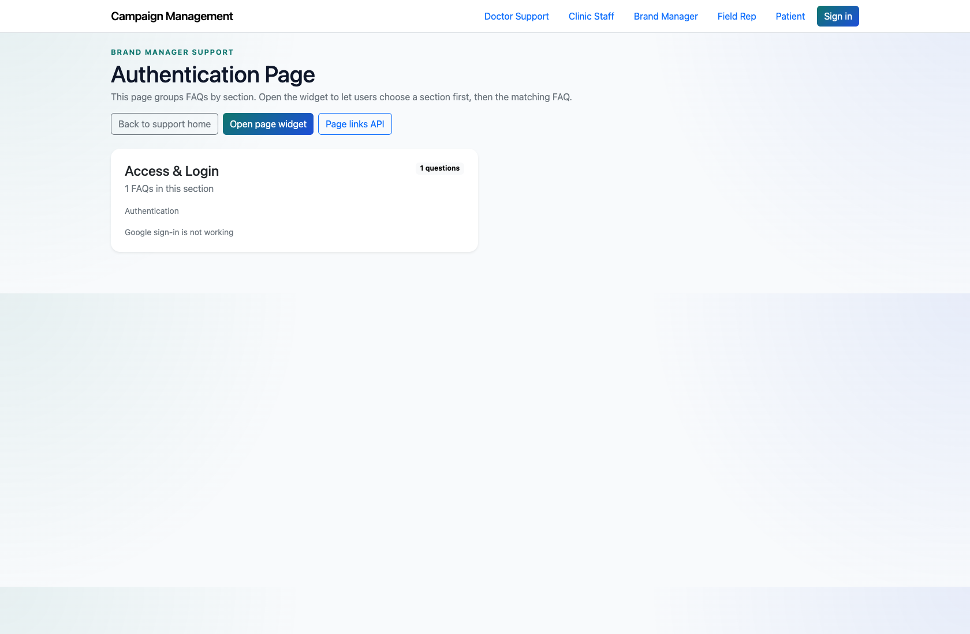
BRAND MANAGER SELF-SERVICE SUPPORT
Verified 2026-04-11
Step 2. Review an authentication or sharing FAQ page
Brand Manager FAQ page
What the user does
Open the `Authentication Page` or `Sharing & Activation Page` from the role page.
What the user sees
A page-wise FAQ view focused on the selected brand-manager support topic.
Why it matters
This reflects how brand managers self-serve in the live implementation.
The brand manager can review the relevant answers before escalating.
Trainer note: Use the authentication page for training because it most clearly differentiates brand-manager content from clinic-staff content.

Slide 6
BRAND MANAGER SELF-SERVICE SUPPORT
Verified 2026-04-11
Step 3. Submit a support request when needed
Brand Manager support request form
What the user does
Use the free-text support form on the landing page if the available pages do not resolve the issue.
What the user sees
A standard support request form that captures requester details and the issue summary.
Why it matters
This is the fallback when the support catalog does not cover the required action.
The issue is recorded for internal handling.
Trainer note: Call out the product/documentation mismatch here if trainees expect a dedicated brand-manager portal.

Slide 7
BRAND MANAGER SELF-SERVICE SUPPORT
Verified 2026-04-11
Trainer Tips and Common Issues
Use this slide to coach facilitators on pacing, known caveats, and product reality.
Trainer tips
Status and caveats
Be explicit about the mismatch between older notes and the live product to avoid confusion during onboarding.
Live-verified against the brand-manager support center on 2026-04-11. Known mismatch noted against older extracted documentation.

Slide 8
BRAND MANAGER SELF-SERVICE SUPPORT
Verified 2026-04-11
Close-Out
End the walkthrough by confirming success and pointing learners to the next reference.
Success criteria
Related documents
Brand managers understand the implemented support center entry point.
Trainers can clearly explain the difference between live behavior and older portal-oriented notes.
README.md
docs/extracted/customer-support.txt
Source of truth: live app, then code/templates, then project docs. Verified on 2026-04-11.

