Slide 1
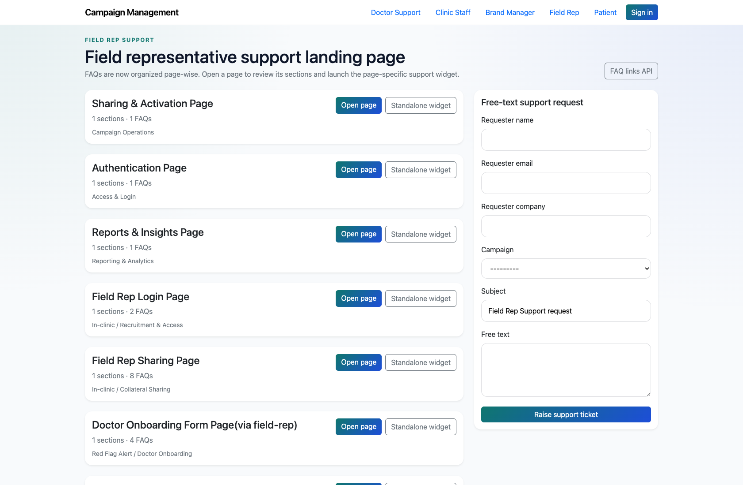
SELF-SERVICE SUPPORT
Field Rep Self-Service Support
Document how field reps use the role-specific support center for login, onboarding, sharing, and dashboard-menu issues.
PRIMARY USER
ENTRY POINT
Field Rep
/support/field_rep/
Verified against the live application on 2026-04-11.

Slide 2
WORKFLOW OVERVIEW
Verified 2026-04-11
Field Rep Self-Service Support
A training-ready summary of the workflow entry point, ownership, and outcomes.
PRIMARY USER
ENTRY POINT
VERIFIED
STEPS
Field Rep
/support/field_rep/
2026-04-11
4
Workflow summary
Success criteria
Field reps have one of the richer public support catalogs in the current product, with In-clinic and Red Flag Alert flow pages.
The role page exposes page-wise support pages and standalone widgets for field-rep workflows.
If the content does not resolve the issue, field reps can escalate using the shared support form.
Field reps can find the correct page-level support content for their flow.
Field reps understand the difference between page, widget, and escalation paths.

Slide 3
FIELD REP SELF-SERVICE SUPPORT
Verified 2026-04-11
Decision Guide
Use this slide to explain how the workflow branches from entry to completion.
START HERE
CONTINUE WHEN RESOLVED
ESCALATE OR HAND OFF
Open the Field Rep support center
Open a field-rep-specific FAQ page
Escalate unresolved issues
This is the live field-rep support entry point.
Field reps can find the correct page-level support content for their flow.
Field reps understand the difference between page, widget, and escalation paths.

Slide 4
FIELD REP SELF-SERVICE SUPPORT
Verified 2026-04-11
Step 1. Open the Field Rep support center
Field Rep support landing page
What the user does
Navigate to `/support/field_rep/`.
What the user sees
A field-rep support page with page-wise cards for login, sharing, onboarding, dashboard menu, and shared support topics.
Why it matters
This is the live field-rep support entry point.
The field rep can identify the closest page or screen name to the current issue.
Trainer note: Use the role page to explain how multiple subsystems are combined into a single support experience.

Slide 5
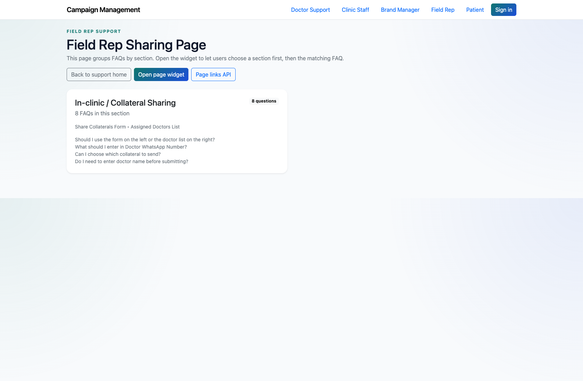
FIELD REP SELF-SERVICE SUPPORT
Verified 2026-04-11
Step 2. Open a field-rep-specific FAQ page
Field Rep FAQ page
What the user does
Choose a field-rep page such as `Field Rep Sharing Page` or `Field Rep Dashboard/Menu Page`.
What the user sees
A page-level FAQ screen with the selected field-rep questions and answers.
Why it matters
This is the primary self-service experience for field-rep issues.
The field rep can review answers tied to the exact screen or flow they are using.
Trainer note: The In-clinic sharing page works well for training because it is easy to describe visually.

Slide 6
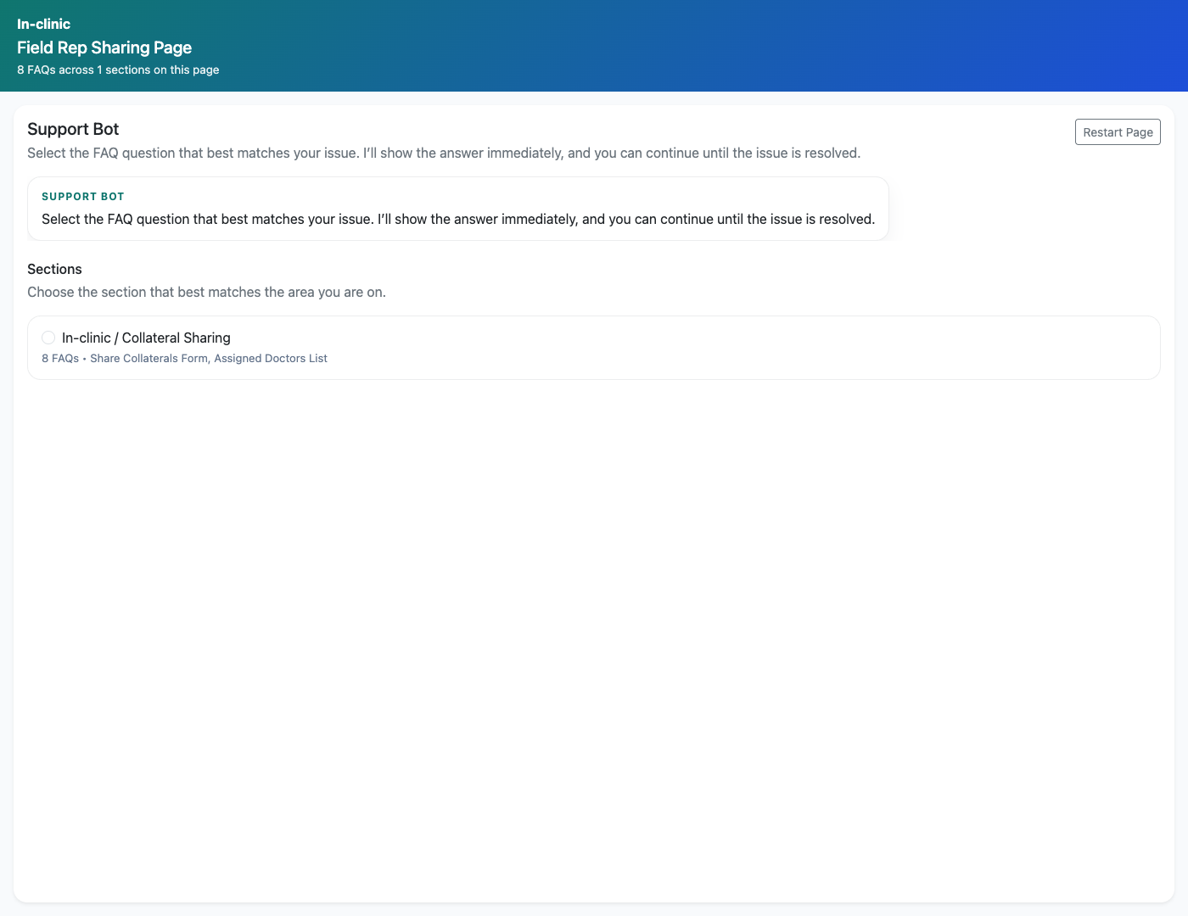
FIELD REP SELF-SERVICE SUPPORT
Verified 2026-04-11
Step 3. Use the standalone widget when embedded support is needed
Field Rep support widget
What the user does
Open the standalone widget link for a field-rep page.
What the user sees
A compact support bot experience that can be embedded into another property.
Why it matters
This shows how the same content can support embedded experiences for field reps.
The field rep understands the smaller widget flow for quick support access.
Trainer note: This is also a good lead-in to the technical widget-integration workflow deck.

Slide 7
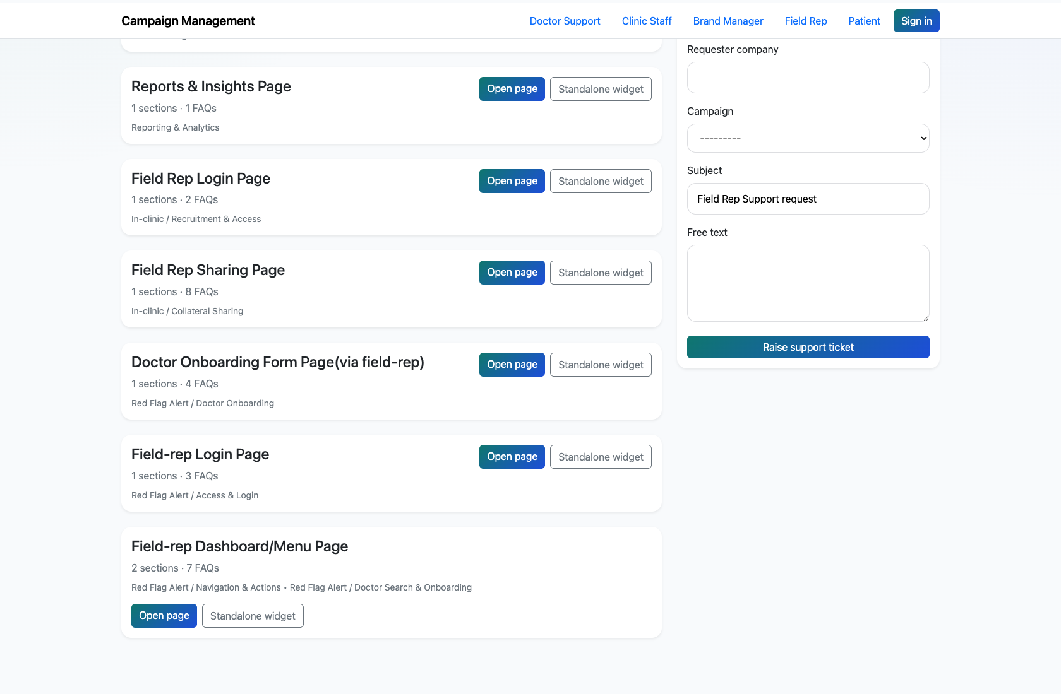
FIELD REP SELF-SERVICE SUPPORT
Verified 2026-04-11
Step 4. Escalate unresolved issues
Field Rep support request form
What the user does
Submit the support form from the role page when the widget or page content is not enough.
What the user sees
A standard support request form that captures the user’s issue and optional campaign context.
Why it matters
This keeps field-rep issues moving even when a FAQ gap exists.
The issue is handed off to the internal support workflow.
Trainer note: Explain that the live product does not currently implement a separate authenticated field-rep portal beyond support and ticketing context.

Slide 8
FIELD REP SELF-SERVICE SUPPORT
Verified 2026-04-11
Trainer Tips and Common Issues
Use this slide to coach facilitators on pacing, known caveats, and product reality.
Trainer tips
Status and caveats
Field-rep support is one of the best examples of page-wise support coverage across multiple systems, so use it when demonstrating breadth.
Live-verified against the field-rep support center, FAQ page, and widget on 2026-04-11.

Slide 9
FIELD REP SELF-SERVICE SUPPORT
Verified 2026-04-11
Close-Out
End the walkthrough by confirming success and pointing learners to the next reference.
Success criteria
Related documents
Field reps can find the correct page-level support content for their flow.
Field reps understand the difference between page, widget, and escalation paths.
README.md
docs/support-widget-integration.md
docs/extracted/customer-support.txt
Source of truth: live app, then code/templates, then project docs. Verified on 2026-04-11.

