Slide 1
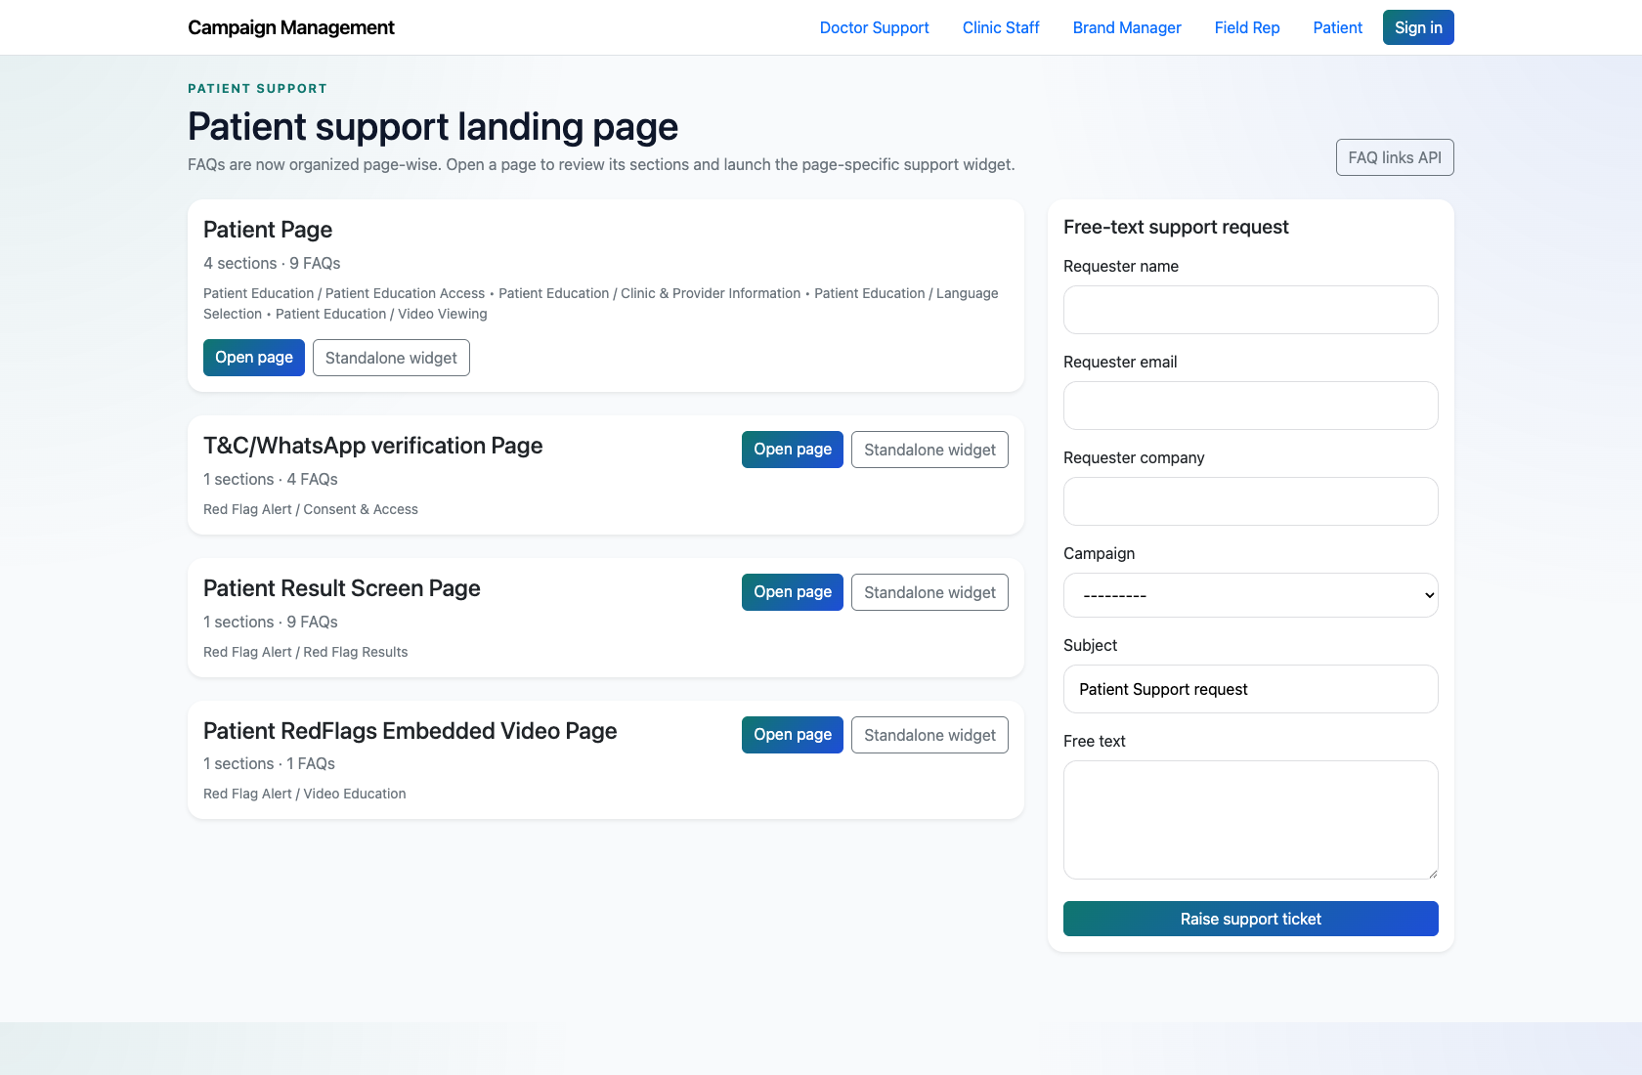
SELF-SERVICE SUPPORT
Patient Self-Service Support
Document how patients reach patient-facing support pages and widgets for Patient Education and Red Flag Alert issues.
PRIMARY USER
ENTRY POINT
Patient
/support/patient/
Verified against the live application on 2026-04-11.

Slide 2
WORKFLOW OVERVIEW
Verified 2026-04-11
Patient Self-Service Support
A training-ready summary of the workflow entry point, ownership, and outcomes.
PRIMARY USER
ENTRY POINT
VERIFIED
STEPS
Patient
/support/patient/
2026-04-11
4
Workflow summary
Success criteria
Patients use a dedicated support center with Patient Education and Red Flag Alert content.
The support pages cover page-specific FAQs, while widgets provide a compact support-bot experience.
Patients can escalate unresolved issues through the landing-page form or widget-driven support path.
Patients can navigate the role page, page-wise FAQs, and widgets without help.
Patients know there is still an escalation path if the FAQ does not resolve the issue.

Slide 3
PATIENT SELF-SERVICE SUPPORT
Verified 2026-04-11
Decision Guide
Use this slide to explain how the workflow branches from entry to completion.
START HERE
CONTINUE WHEN RESOLVED
ESCALATE OR HAND OFF
Open the Patient support center
Open a patient-facing FAQ page
Escalate when self-service does not resolve the issue
This is the starting point for patient self-service in the live app.
Patients can navigate the role page, page-wise FAQs, and widgets without help.
Patients know there is still an escalation path if the FAQ does not resolve the issue.

Slide 4
PATIENT SELF-SERVICE SUPPORT
Verified 2026-04-11
Step 1. Open the Patient support center
Patient support landing page
What the user does
Navigate to `/support/patient/`.
What the user sees
A patient-facing support landing page with page-wise cards for patient content and Red Flag Alert flows.
Why it matters
This is the starting point for patient self-service in the live app.
The patient can identify the relevant page or journey without internal help.
Trainer note: The patient role page is intentionally simpler than the doctor and field-rep catalogs.

Slide 5
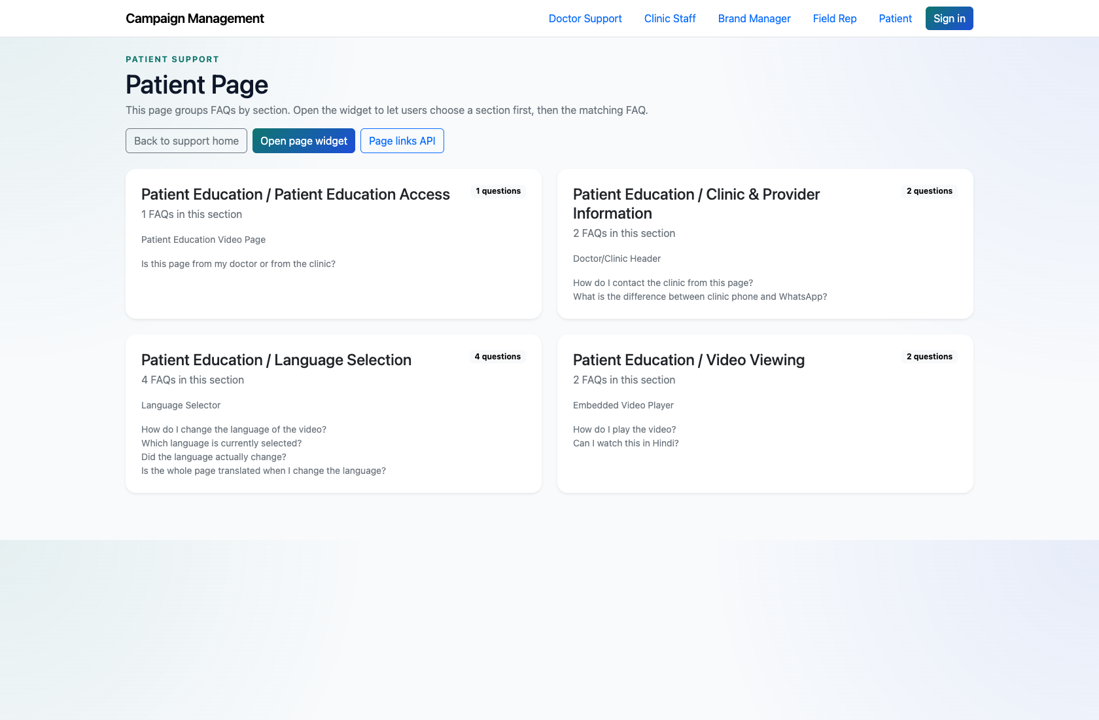
PATIENT SELF-SERVICE SUPPORT
Verified 2026-04-11
Step 2. Open a patient-facing FAQ page
Patient FAQ page
What the user does
Choose a page such as the patient page or Red Flag Alert result screen page.
What the user sees
A page-wise FAQ experience tailored to patient issues.
Why it matters
This is the main content view for patient self-service.
The patient can review the available guidance before escalating.
Trainer note: Choose a page with recognizably patient-friendly wording when presenting to client teams.

Slide 6
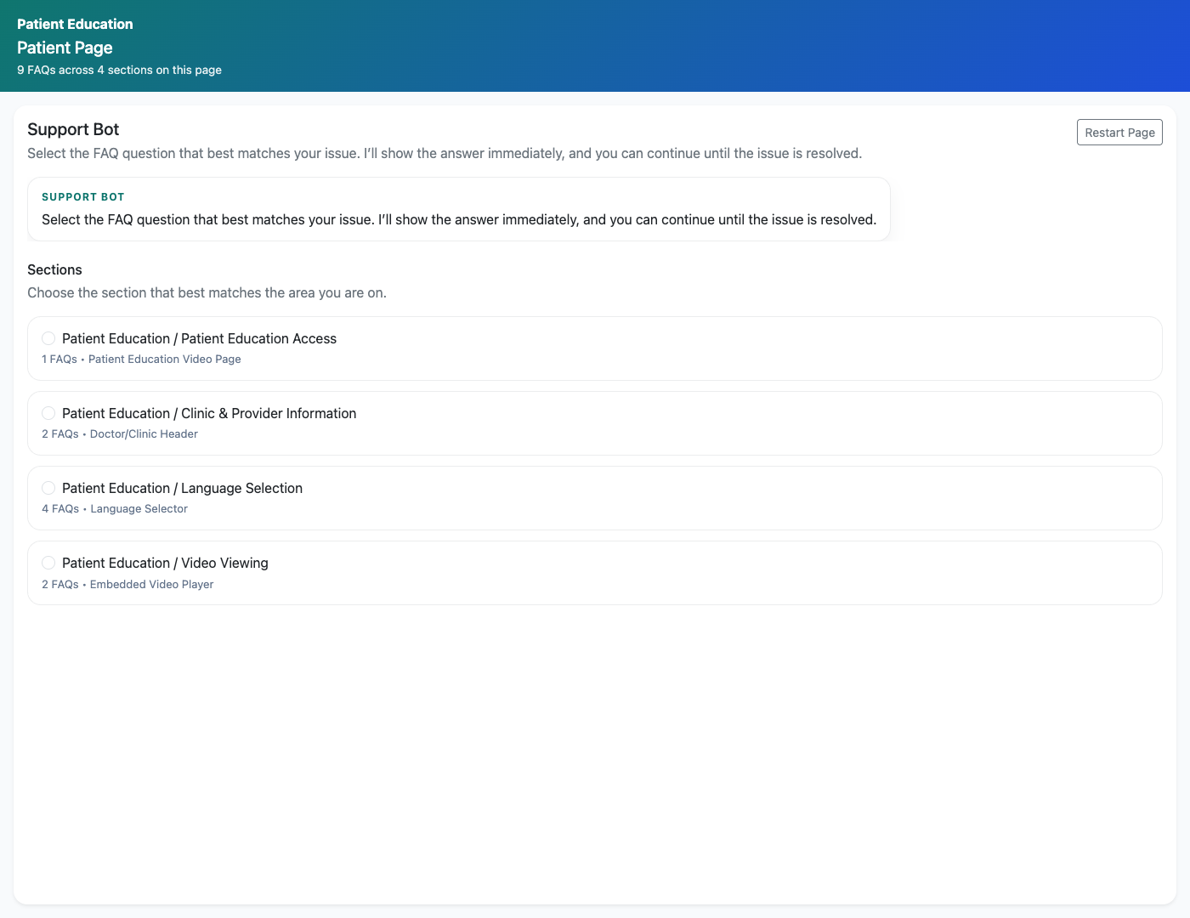
PATIENT SELF-SERVICE SUPPORT
Verified 2026-04-11
Step 3. Use the widget for embedded support
Patient support widget
What the user does
Open a standalone patient widget for one of the patient pages.
What the user sees
A compact support bot that can guide the patient through the page’s FAQs.
Why it matters
The widget is the most portable patient-facing support surface in the product.
The patient can access the same content in a smaller guided format.
Trainer note: This is a useful example when explaining how support content can be embedded in other patient journeys.

Slide 7
PATIENT SELF-SERVICE SUPPORT
Verified 2026-04-11
Step 4. Escalate when self-service does not resolve the issue
Patient support request form
What the user does
Use the support form or unresolved-issue path if a patient answer is missing.
What the user sees
A capture form that routes the issue into the internal support workflow.
Why it matters
This prevents patient issues from stalling when FAQ coverage is incomplete.
The unresolved issue is recorded for internal review.
Trainer note: Keep the language client-friendly during training, since this role is often shown to external audiences.

Slide 8
PATIENT SELF-SERVICE SUPPORT
Verified 2026-04-11
Trainer Tips and Common Issues
Use this slide to coach facilitators on pacing, known caveats, and product reality.
Trainer tips
Status and caveats
Use the patient workflow when you need an example of the smallest, most client-shareable support surface.
Live-verified against the patient support center, page view, and widget on 2026-04-11.

Slide 9
PATIENT SELF-SERVICE SUPPORT
Verified 2026-04-11
Close-Out
End the walkthrough by confirming success and pointing learners to the next reference.
Success criteria
Related documents
Patients can navigate the role page, page-wise FAQs, and widgets without help.
Patients know there is still an escalation path if the FAQ does not resolve the issue.
README.md
docs/support-widget-integration.md
Source of truth: live app, then code/templates, then project docs. Verified on 2026-04-11.

