Slide 1
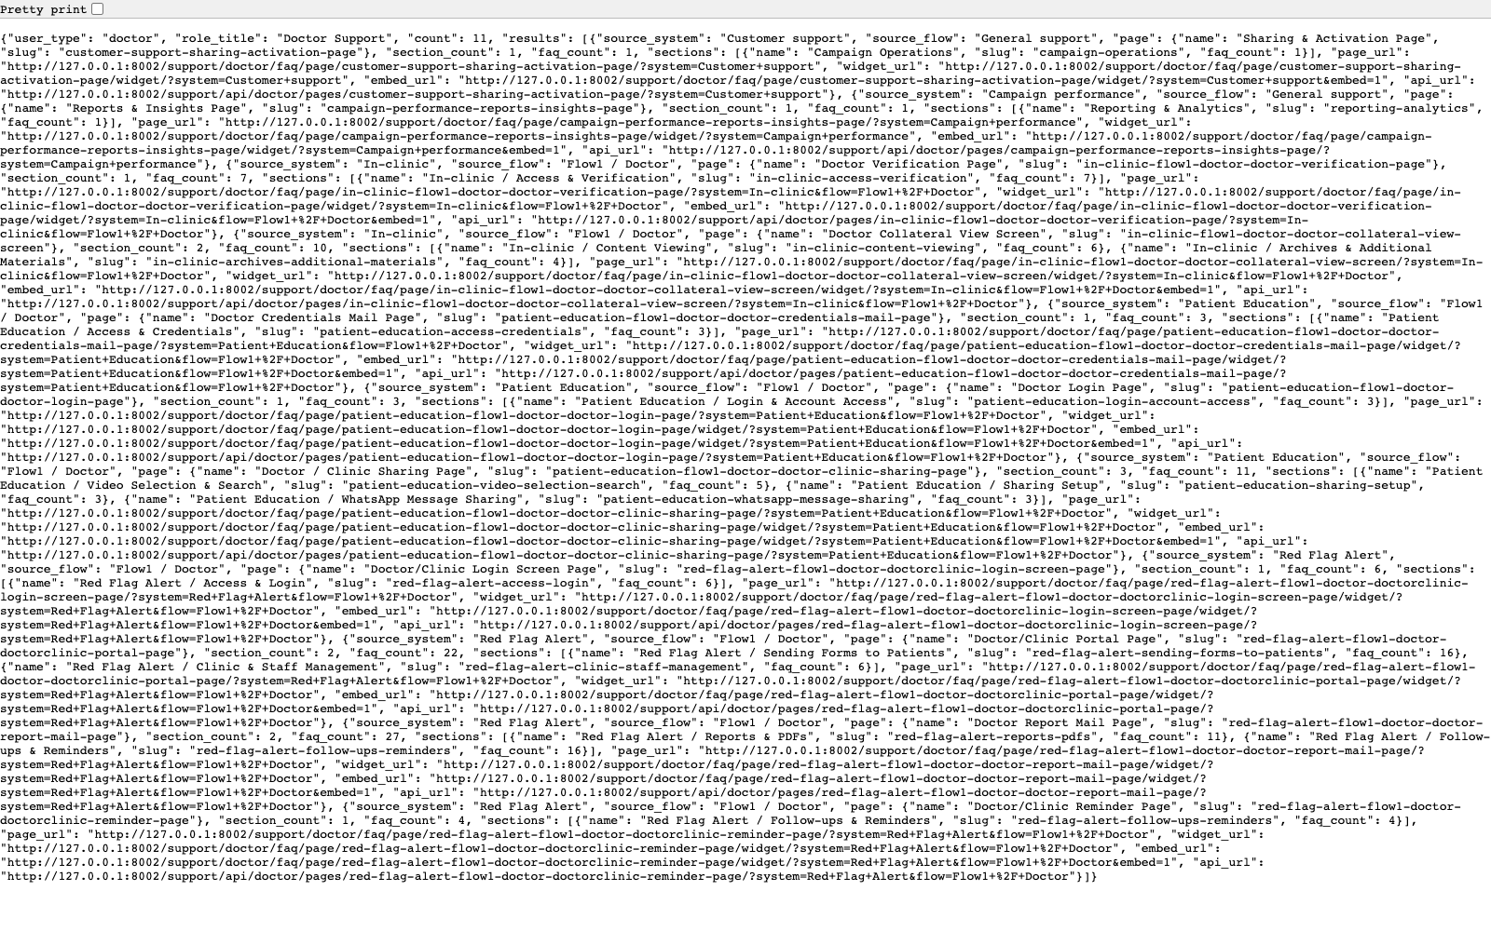
TECHNICAL ENABLEMENT
Support Widget Integration
Document how an implementation partner or trainer discovers the available support links and uses the embeddable widget endpoints.
PRIMARY USER
ENTRY POINT
Implementation partner, trainer, or technical owner embedding support content into another property.
/support/api/doctor/faq-links/
Verified against the live application on 2026-04-11.

Slide 2
WORKFLOW OVERVIEW
Verified 2026-04-11
Support Widget Integration
A training-ready summary of the workflow entry point, ownership, and outcomes.
PRIMARY USER
ENTRY POINT
VERIFIED
STEPS
Implementation partner, trainer, or technical owner embedding support content into another property.
/support/api/doctor/faq-links/
2026-04-11
4
Workflow summary
Success criteria
The application exposes JSON link catalogs and embeddable page-wise or combination widgets for role-specific support content.
Partners can use the FAQ links API to discover available pages and then embed a widget URL in another product surface.
Unresolved issues raised from widgets still flow back into the PM review queue, preserving the support context.
A partner can find the available support pages and widgets for a role.
A partner understands how embedded support escalations continue into PM review.

Slide 3
SUPPORT WIDGET INTEGRATION
Verified 2026-04-11
Decision Guide
Use this slide to explain how the workflow branches from entry to completion.
START HERE
CONTINUE WHEN RESOLVED
ESCALATE OR HAND OFF
Inspect the FAQ links API
Open a page-wise widget
Understand the escalation handoff
This is the discovery layer for downstream integration and link export.
A partner can find the available support pages and widgets for a role.
A partner understands how embedded support escalations continue into PM review.

Slide 4
SUPPORT WIDGET INTEGRATION
Verified 2026-04-11
Step 1. Inspect the FAQ links API
FAQ links API response
What the user does
Expected result
Trainer note
Open a FAQ links API endpoint such as `/support/api/doctor/faq-links/`.
The implementation owner can identify which page or widget URL to embed.
The repo also includes exported link files in `docs/` for quick reference.

Slide 5
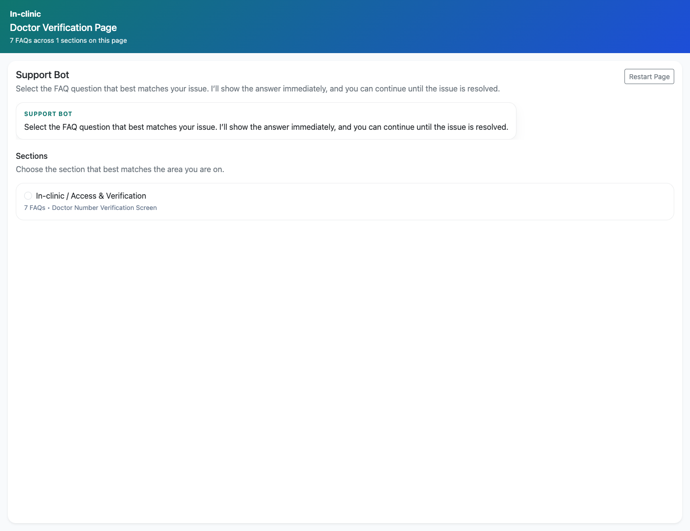
SUPPORT WIDGET INTEGRATION
Verified 2026-04-11
Step 2. Open a page-wise widget
Page-wise support widget
What the user does
Use one of the returned widget URLs and open it in standalone mode or with `?embed=1`.
What the user sees
A compact support bot with section selection, question selection, and unresolved issue capture.
Why it matters
This is the embeddable support surface that partner systems can consume directly.
The widget is ready to embed into another system or training environment.
Trainer note: The widget is intentionally iframe-friendly and optimized for compact support access.

Slide 6
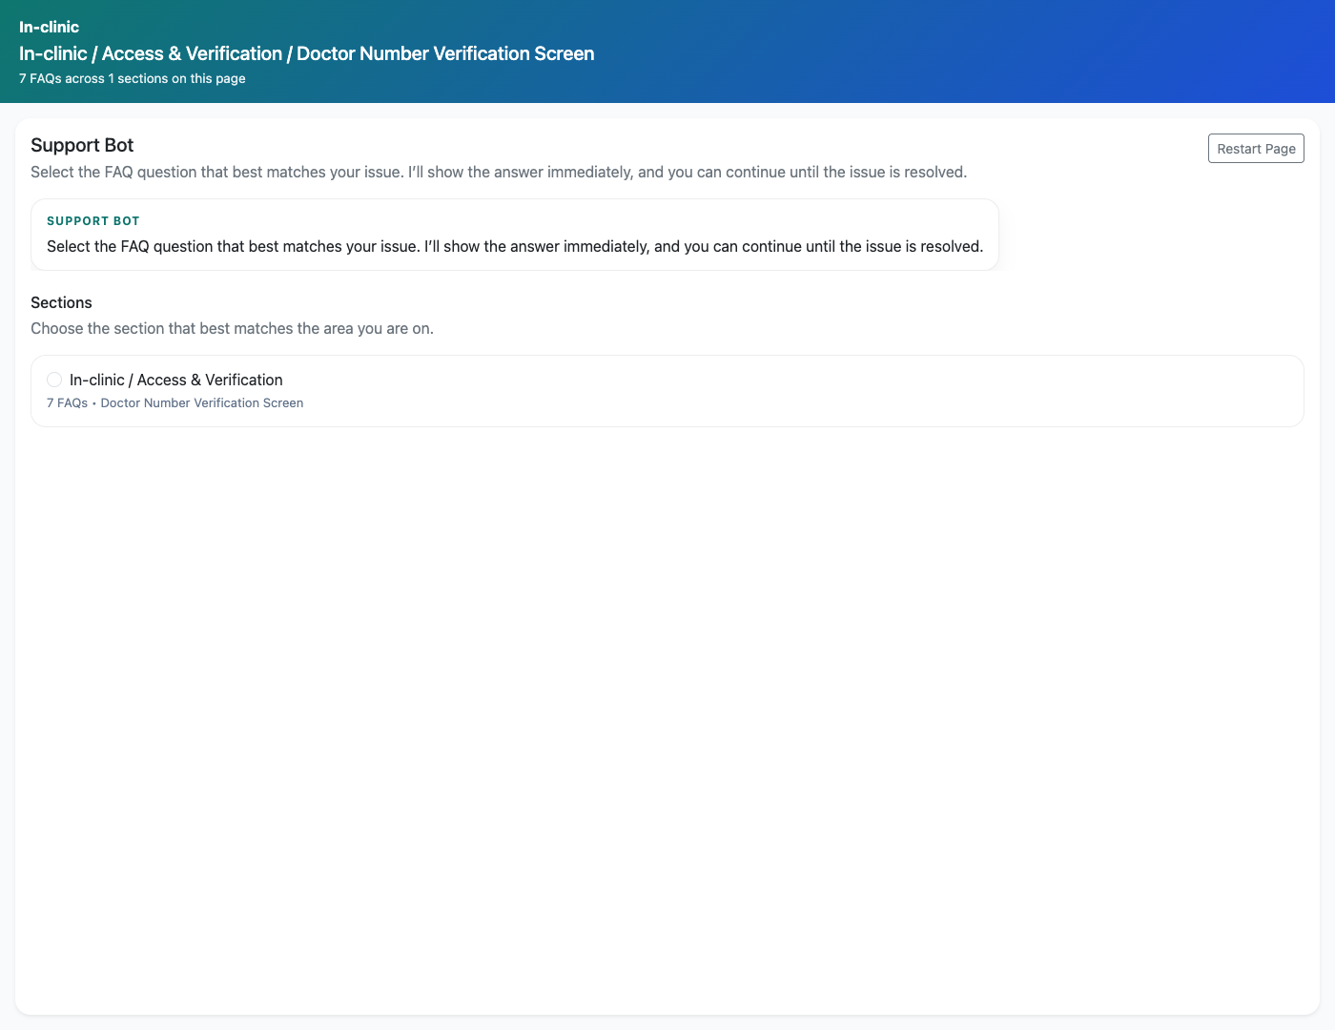
SUPPORT WIDGET INTEGRATION
Verified 2026-04-11
Step 3. Open a combination widget
Combination support widget
What the user does
Use a category-level widget endpoint for a role and open it in standalone mode.
What the user sees
A category-specific widget showing questions for a narrower support slice.
Why it matters
Combination widgets support more targeted embed scenarios than full page-wise widgets.
The implementation owner understands when to use page-wise versus category-level widgets.
Trainer note: This distinction is helpful when integrating into screen-specific help drawers or microsites.

Slide 7
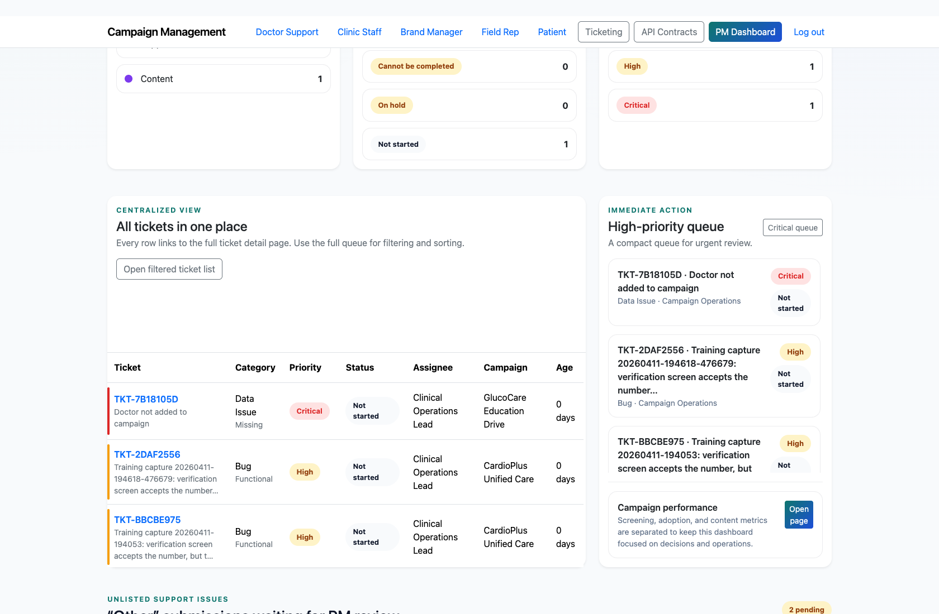
SUPPORT WIDGET INTEGRATION
Verified 2026-04-11
Step 4. Understand the escalation handoff
Widget escalation context
What the user does
Review how unresolved widget issues move into the PM review queue.
What the user sees
A consistent escalation path that preserves widget context and PM-review routing.
Why it matters
Partners need to know that embedded support still feeds the internal operations workflow.
The integration owner can explain how widget-originated support issues are handled downstream.
Trainer note: Reference the PM review workflow deck when teaching the full end-to-end escalation path.

Slide 8
SUPPORT WIDGET INTEGRATION
Verified 2026-04-11
Trainer Tips and Common Issues
Use this slide to coach facilitators on pacing, known caveats, and product reality.
Trainer tips
Status and caveats
Show both the API discovery response and the rendered widget so the integration path feels concrete.
Live-verified against the FAQ links API and rendered widgets on 2026-04-11.

Slide 9
SUPPORT WIDGET INTEGRATION
Verified 2026-04-11
Close-Out
End the walkthrough by confirming success and pointing learners to the next reference.
Success criteria
Related documents
A partner can find the available support pages and widgets for a role.
A partner understands how embedded support escalations continue into PM review.
README.md
docs/support-widget-integration.md
docs/support-widget-links.md
docs/support-widget-page-links.md
Source of truth: live app, then code/templates, then project docs. Verified on 2026-04-11.

