Slide 1

BACKUP BOT V-1.0
FOR MIGRATED AND NON MIGRATED UK AND ROI SERVERS
P. Gopala Krishnan

Slide 2
WHAT WE DO
Backup of CFEED and extract files in migrated(UK and ROI) and non-migrated(UK and ROI) servers should be ensured to prevent data loss.
This process is carried out after every EOD done on these servers.
In a long run this process becomes more time consuming as we have to access the location of CFEED and extract files on each server.
In this process chances of mistakes are found to be more as backup is done manually for each servers.
Create a tool for backup of CFEED and all extract files in a SINGLE CLICK !!
WHAT CAN BE DONE

Slide 3
Features
Reduces time consumption.
Eliminates mistakes.
Less manual work.
Files are copied based on timestamp so all the files modified or even created after an EOD can be backed up at one click.
CFEED for the particular date is also taken care of and will be backed up along with other files.

Slide 4

HOW TO USE

Slide 5
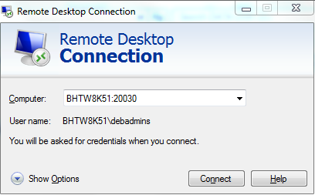
LOG IN TO SERVER BHTW8k51

Slide 6
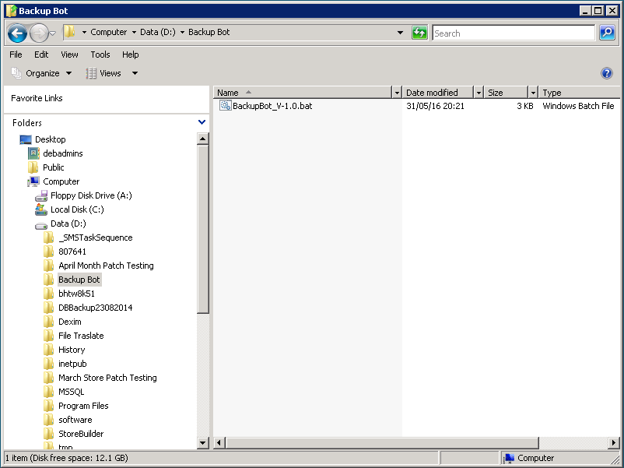
NAVIGATE TO D:/backupbot

Slide 7
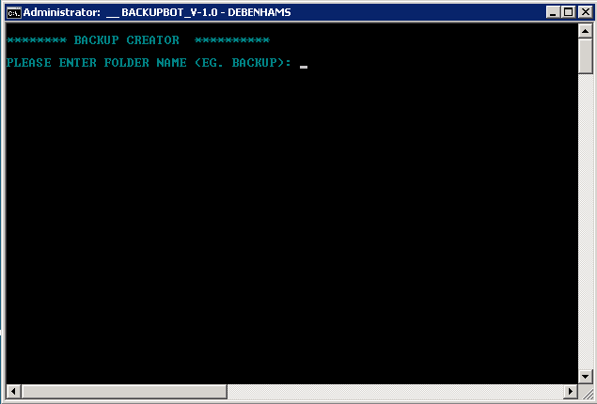
Click on backupbot.bat

Slide 8
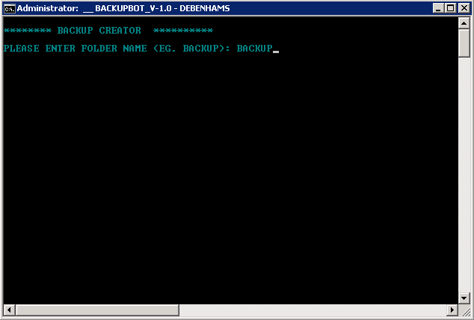
Input a folder name of your choice

Slide 9
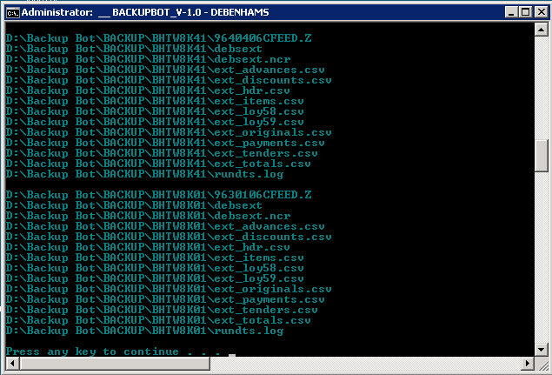
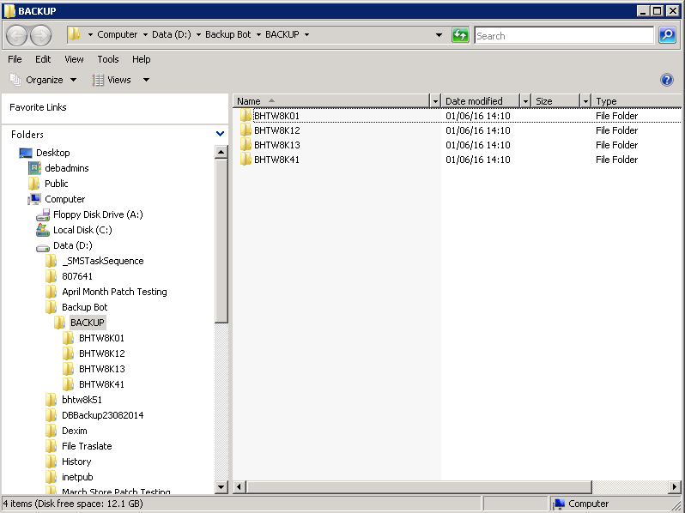
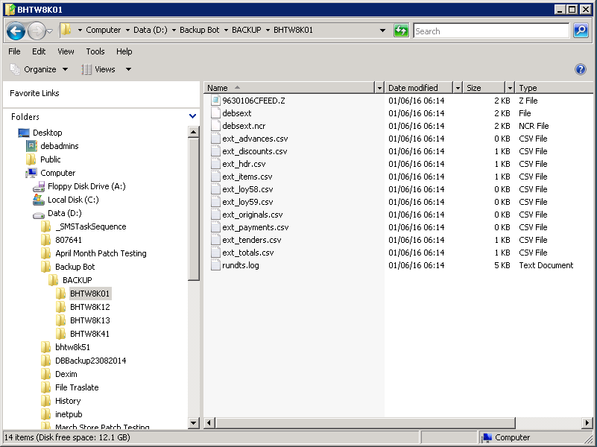
Rest is done by the script itself !!
Displays Backed up Files
Creates Separate Folders for Each server Backed up
Opens up the folder to make it more easy to copy to local machine

Slide 10
DRAWBACKS
You cannot run the script from your local machine.
The reasons are :
The files we need to take backup is in the client server so we should have the script in any one on the servers.
Password for remote desktop cannot be provided in the script as it is easily readable and may lead to security violations

Slide 11
conclusion
By this way you will get the data from each server at one location.
Copy the folder which is opened by the script to your local computer.
From now on never worry about losing data !!

Slide 12

Your Suggestions are greatly Appreciated..!

