Slide 1
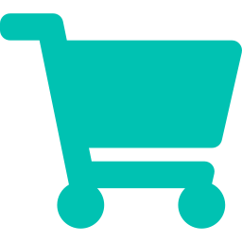
RetailPOS
A Full-Stack Microservices Point-of-Sale Platform
Angular 19
ASP.NET Core 9
SQL Server
RabbitMQ · MassTransit
Docker
Your Name
Full-Stack Developer
Notes:
Say: 'Hi, I'm [Your Name]. Today I'll walk you through RetailPOS — a production-grade Point-of-Sale system I built using a microservices architecture with Angular on the front end and ASP.NET Core on the back end. Let me start with the problem this solves.'

Slide 2
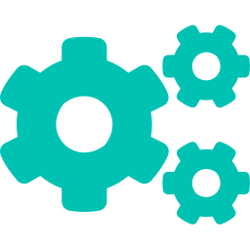

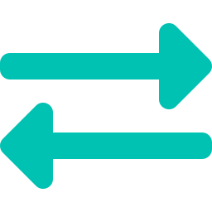

02 PROBLEM STATEMENT
The Problem with Traditional POS
Monolithic Systems
No Multi-Tenancy
Legacy POS = single deployable unit. One bug takes down everything.
Different stores can't share one platform securely.
No Real-Time Sync
Zero Business Insights
Inventory, payments, and notifications are out of sync.
No dashboard, no reports, no data-driven decisions.
Notes:
Say: 'Traditional retail software is monolithic — a single bug brings the entire system down. There's no multi-store support, no real-time data, and managers are flying blind without analytics. RetailPOS solves all of these.'

Slide 3
03 OBJECTIVE
What RetailPOS Achieves
01
Multi-tenant POS supporting multiple stores from one platform
02
Role-based access: Admin, StoreManager, Cashier — each with fine-grained permissions
03
Real-time billing, payments, returns and inventory management
04
Event-driven microservices ensuring data consistency across services
05
AI chatbot assistant for staff guidance and support
06
Admin analytics dashboard with live sales, returns and stock data
Notes:
Say: 'RetailPOS gives retailers a complete platform — secure multi-store login, permission-based roles, real-time billing and returns, and a built-in AI assistant. Everything a modern retail business needs.'

Slide 4


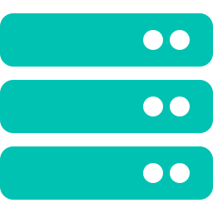
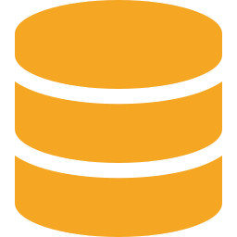
04 ARCHITECTURE
Microservices Architecture
Angular 19 SPA
Ocelot API Gateway
IdentityService
CatalogService
UI + Routing + Guards + Interceptors
Routing · QoS · CORS · JWT Auth
JWT + OTP + Google Auth
Products + Categories
OrdersService
PaymentService
Bills + Checkout Saga
Cash/Card/UPI
AdminService
ReturnsService
Dashboard + Reports
Return Processing
SQL Server 2025 | EF Core | Per-service DB
NotifService
AIService
SignalR + Events
Gemini Chatbot
RabbitMQ (MassTransit) — Event Bus: All services communicate asynchronously via messages / sagas
Notes:
Say: 'The architecture is a classic microservices setup. Angular talks to the Ocelot API Gateway, which routes to 8 independently deployable .NET services. They share a message bus through RabbitMQ using MassTransit. Each service owns its own SQL Server database — this is the Database-per-Service pattern, key for microservices.'

Slide 5
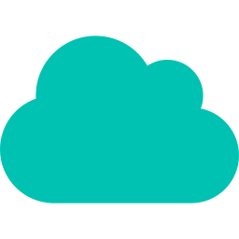


05 TECH STACK
Technology Choices — Why Each One?
FRONTEND
BACKEND
Angular 19 (Standalone)
ASP.NET Core 9 Web API
Signals, lazy-loading, strong typing — enterprise-grade SPA
High-performance, DI built-in, best-in-class async support
DATABASE
MESSAGING
SQL Server 2025 + EF Core
RabbitMQ + MassTransit
ACID transactions; EF Core migrations keep schema version-controlled
Decoupled async events; Saga orchestration for distributed transactions
GATEWAY
REAL-TIME
Ocelot API Gateway
SignalR (NotificationService)
Single entry point, QoS (circuit-breaker, timeouts), JWT validation
Push notifications to UI without polling — low-latency, WebSocket-based
AI
INFRA / DEVOPS
Google Gemini via AIService
Docker + Docker Compose
Context-aware chatbot assistant for staff — REST wrapper microservice
Reproducible environments; all 10+ services run with one command
Notes:
Say: 'Every tech choice was deliberate. Angular Signals replace NgRx for reactive state with less boilerplate. ASP.NET Core 9 is the fastest .NET version ever. MassTransit's Saga pattern solves distributed transaction problems — I'll explain that shortly. Everything runs in Docker so it's fully reproducible.'

Slide 6
06 E2E FLOW
End-to-End: Billing a Sale
1
Cashier scans items
Angular Billing Component
2
POST /gateway/orders/bills
Ocelot routes → OrdersService
3
Cart saved to DB
BillService → EF Core → SQL Server
4
Cashier clicks Checkout
POST /finalize → Saga initiated
5
PaymentService processes
Event: PaymentProcessed published
6
CatalogService deducts stock
Event: StockDeducted published
7
OrdersService finalizes bill
Saga completes → bill marked Paid
8
SignalR notification pushed
Angular UI updates in real time
Notes:
Say: 'This is the checkout flow — 8 steps, completely event-driven. The Checkout Saga orchestrates PaymentService and CatalogService. If payment fails, the saga rolls back. If stock fails, payment is refunded. This is exactly how real distributed systems maintain consistency without a single database.'

Slide 7
07 API DESIGN
Key API Endpoints
POST
/gateway/auth/login
IdentityService
Login + OTP trigger
POST
/gateway/auth/verify-login-otp
IdentityService
OTP verify → JWT issued
POST
/gateway/auth/google-login
IdentityService
Google OAuth integration
GET
/gateway/catalog/products
CatalogService
Paginated product list
POST
/gateway/orders/bills
OrdersService
Create/update cart
POST
/gateway/orders/bills/{id}/finalize
OrdersService
Trigger checkout saga
POST
/gateway/payment/pay
PaymentService
Process payment
GET
/gateway/admin/dashboard
AdminService
Sales + inventory KPIs
Notes:
Say: 'All requests go through the Ocelot gateway — the Angular app never knows individual service ports. The gateway applies QoS: 3 exceptions before circuit break, 5-second timeout. Each endpoint is protected by fine-grained permission policies, not just roles.'

Slide 8



08 CORE CONCEPTS
Engineering Concepts Applied
Dependency Injection
Repository + Service Pattern
All services registered in DI container. Interfaces injected — not concrete classes. Enables unit testing with mocks.
Data access isolated in repositories. Business logic in services. Controllers are thin — just HTTP in/out.
DTOs (Data Transfer Objects)
Saga Pattern (MassTransit)
Domain models never exposed directly. DTOs decouple API contract from DB schema — safer & versioable.
Checkout Saga: multi-step distributed transaction. State machine handles success, failure and timeout compensation.
Middleware Pipeline
EF Core + Migrations
Global ExceptionMiddleware catches all errors. Returns consistent JSON error shape. No try-catch in controllers.
Code-first schema. Migrations are version-controlled. Supports stored procedures for complex paginated queries.
Notes:
Say: 'These are the patterns that make the code maintainable and testable. The Saga pattern is the most interesting — it's a state machine that coordinates OrdersService, PaymentService, and CatalogService. If any step fails, it compensates — like a database transaction, but across services.'

Slide 9
09 FRONTEND
Angular Frontend Architecture
App Structure
Key Angular Features Used
src/app/
Standalone Components (no NgModule)
core/
Lazy-loaded routes (loadComponent)
guards/ → authGuard
interceptors/ → auth + error
Angular Signals for reactive state
services/ → api, auth, signalr
HTTP Interceptors: auto-attach JWT
features/
Service → API Call Pattern
Route Guards: authGuard + role check
auth/ → login, signup, otp
1. Component → inject(OrderApiService)
pos/ → billing, payment, returns
admin/ → dashboard, inventory, staff
2. service.createBill(dto).subscribe()
shared/
3. HttpClient → Auth Interceptor adds JWT
ai-chatbot, navbar, sidebar
4. Error Interceptor → global toast msg
Notes:
Say: 'The Angular app is organized into core, features, and shared. Features are lazy-loaded — the billing module only downloads when the cashier navigates there. The auth interceptor automatically attaches the JWT to every request. The error interceptor shows a toast for any 4xx/5xx response globally.'

Slide 10
10 SECURITY
Security & Validation
JWT + OTP Authentication
Login issues short-lived JWT. Login OTP adds 2FA layer. Refresh token stored in HttpOnly cookie — XSS-proof.
Permission-Based Authorization
Every endpoint uses [Authorize(Policy = Permissions.X.Y)]. Fine-grained policies (e.g. Orders.Finalize) — not just role checks.
Google OAuth Integration
Staff can sign in via Google. Server validates IdToken with Google API before issuing JWT.
Input Validation + Error Handling
Global ExceptionMiddleware: NotFoundException → 404, DomainException → 400, unhandled → 500. Consistent JSON error responses.
Notes:
Say: 'Security is layered. First, OTP-based 2FA on login. Second, every API endpoint has a specific permission policy — even admins can't call endpoints outside their permission set. Refresh tokens are HttpOnly cookies — can't be stolen by JavaScript. The global middleware catches all exceptions uniformly.'

Slide 11
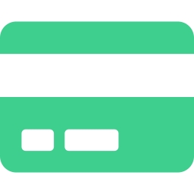

11 KEY FEATURES
What RetailPOS Can Do
Real-Time Billing
Flexible Payments
Returns Management
Scan products, manage cart, apply discounts, finalize — live. Cart persists (hold/resume).
Cash, Card, UPI. Payment service handles each type with event publishing on success/failure.
ReturnsService processes refunds, restores stock via events, notifies admin in real-time.
Admin Dashboard
Multi-Store & Multi-Tenant
AI Chatbot (Gemini)
Live KPIs: revenue, top products, stock alerts. Data aggregated via event consumers.
Each store is a tenant. TenantProvider scopes all queries by StoreId from the JWT claim.
Staff can ask the AI chatbot for help. Context-aware, powered by Google Gemini API.
Notes:
Say: 'Six major feature areas — and each one is backed by a dedicated microservice. The multi-tenancy is interesting: TenantProvider extracts the StoreId from the JWT and scopes every database query. So a cashier in Store A can never see Store B data, even through the same API.'

Slide 12

12 CHALLENGES
Real Challenges & How I Solved Them
⚡ Distributed Transaction Consistency
✓ Implemented Checkout Saga (MassTransit StateMachine). 5-minute timeout, automatic compensation on failure. Outbox pattern prevents message loss on crash.
⚡ Race Condition: Payment & Stock Events Out of Order
✓ Saga handles both orderings: 'WaitingForInitiation' state catches early PaymentProcessed events before CheckoutInitiated arrives.
⚡ Multi-Tenant Data Isolation
✓ TenantProvider extracts StoreId from JWT. Every EF query scoped at repository level — no chance of cross-store data leak.
⚡ Real-Time Notifications Across Services
✓ NotificationService listens to RabbitMQ events and pushes SignalR messages to connected Angular clients. Fully decoupled.
Notes:
Say: 'The hardest challenge was distributed transaction consistency. When a cashier checks out, three services must all succeed or all roll back. The MassTransit Saga solved this with a state machine. I also hit a race condition where payment events arrived before the saga was initialized — I handled that with a WaitingForInitiation state.'

Slide 13

13 SCALABILITY
Improvements & Scaling Strategy
What I'd Improve
How This System Scales
Add Redis caching for product catalog
Horizontal Scaling
Each microservice scales independently. Spin up 5 OrdersService instances during peak — RabbitMQ distributes load.
Implement CQRS with separate read models
Database per Service
Add OpenTelemetry distributed tracing
No shared database = no schema coupling. Each DB scales (read replicas, sharding) independently.
Introduce gRPC for internal service calls
Event-Driven Decoupling
Add Kubernetes manifests for prod deploy
Publishers don't wait for consumers. System stays responsive under load.
Automated CI/CD pipeline with GitHub Actions
API Gateway as Single Entry
Ocelot can load-balance across service instances. Add rate limiting for DDoS protection.
Notes:
Say: 'The architecture is already built for scale. Because each service is independent, I can scale just the OrdersService during a sale rush without touching anything else. My top improvement would be Redis caching for the product catalog — that's the most-hit endpoint and currently goes to the database every time.'

Slide 14
14 DEMO FLOW
Live Demo Walkthrough
1
Open Landing Page
2
Register & Verify Email
Marketing page — show responsive design
OTP email verification flow, pending approval
3
Admin approves Staff
4
Cashier Login
Admin panel → Staff management → Approve user
Login with OTP 2FA — JWT stored, role detected
5
Billing Screen
6
Checkout + Payment
Add products, search by name/barcode, cart update
Select payment method → Saga runs → Bill finalized
7
Real-Time Notification
8
Process a Return
Admin dashboard updates live via SignalR
ReturnsService → stock restored → refund issued
9
Admin Dashboard
10
AI Chatbot
Revenue, top products, inventory alerts — live KPIs
Ask chatbot a question — Gemini responds in context
Notes:
Say: 'My demo follows this exact script. Start with registration to show the OTP email flow. Then admin approval — this shows multi-role architecture. Then billing to show real-time cart. Checkout to demonstrate the saga. End with the admin dashboard and AI chatbot — these are the most impressive parts.'

Slide 15
15 CONCLUSION
What I Built
8 independently deployable microservices
Event-driven with Saga pattern for consistency
Production-Grade
Thinking
JWT + OTP + Google OAuth security stack
Real-time notifications via SignalR
Multi-tenant, multi-role, permission-scoped
Not just a CRUD app.
A system built the way
real companies build software.
AI chatbot assistant (Gemini API)
Containerized with Docker Compose
Unit-tested with xUnit across all services
Notes:
Say: 'To wrap up — RetailPOS is not a CRUD tutorial project. It uses the same patterns you'll find in enterprise software: microservices, sagas, event sourcing, multi-tenancy, real-time push. I built this to understand how production systems actually work — and I'm ready to discuss any part of it in depth.'

Slide 16

16 Q&A PREP
Likely Interview Questions & Answers
Q: Why microservices vs monolith?
Q: How does the Saga pattern work?
A: Independent scaling, deploy, fault isolation. Monolith fine for MVP — I chose microservices to learn real patterns.
A: State machine across services. CheckoutSaga: Initiated → PaymentProcessing → StockDeduction → Complete. Compensates on failure.
Q: How do you prevent duplicate messages?
Q: What's the role of the API Gateway?
A: MassTransit Outbox pattern. Messages are written to DB atomically with the state change, then published after commit.
A: Single entry point. Handles routing, QoS (circuit breaker, timeout), CORS, JWT validation before services are hit.
Q: How does multi-tenancy work?
Q: How would you add a new feature?
A: StoreId extracted from JWT claim by TenantProvider. Every EF query scoped by StoreId — no cross-store data leak.
A: New service with its own DB. Publish/subscribe to existing events. Zero changes to other services.
Notes:
Say: 'I'm ready for deep technical questions. The Saga and multi-tenancy questions are the trickiest — I've explained both in previous slides and can go deeper on any of them.'

