Slide 1
Luxury Housing Sales Analysis – Bengaluru
Business Dashboard Report | 2023–2025

Slide 2
Executive Summary
This report presents a business-focused analysis of Bengaluru’s luxury housing market from 2023 to 2025.
It integrates Python, SQL, and Power BI to deliver insights on:
- Sales performance by builder and micro-market
- Buyer preferences and booking patterns
- Amenity-driven demand insights

Slide 3
Data Pipeline Summary
1. Data Cleaning – Python (Pandas, NumPy)
2. Data Preprocessing – Feature transformation and standardization
3. SQL Warehousing – KPI and metric queries in MySQL
4. Power BI Visualization – Interactive dashboards
5. Business Insights – Performance and trend extraction

Slide 4
Real-world Usefulness of Insights
- Developers: Identify profitable micro-markets and optimize pricing.
- Buyers: Understand popular locations and property trends.
- Investors: Target high-performing luxury zones.
- Agencies: Improve campaigns and conversion rates.
- Planners: Guide infrastructure based on demand clusters.

Slide 5
Methods & Tools Used
Tools: Python (Pandas, NumPy), MySQL, Power BI
Techniques: Data Cleaning, EDA, SQL Querying, KPI Modeling
Visuals: Line Charts, Maps, KPI Cards, Donut Charts
Metrics: Avg Ticket Size, Total Sales, Booking Conversion Rate

Slide 6
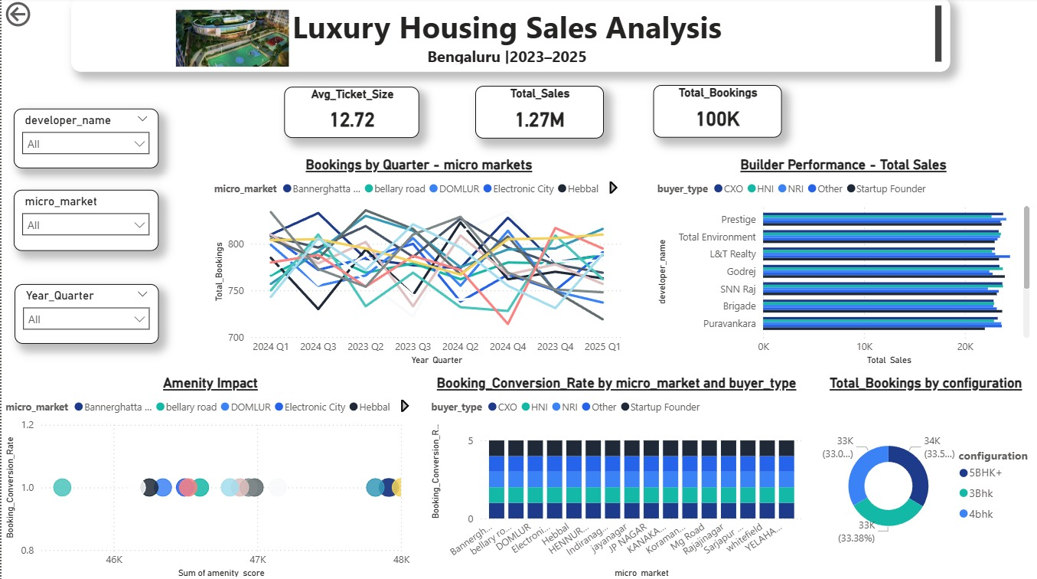

Slide 7
