Slide 1
Programming in C and CPP
Mitali Hora
Department of Computer Applications

Slide 2
Arrays in C
An array in C/C++ or be it in any programming language is a collection of similar data items stored at contiguous memory locations and elements can be accessed randomly using indices of an array.
We can random access of elements using array index.
Use of less line of code as it creates a single array of multiple elements.
Easy access to all the elements.
Traversal through the array becomes easy using a single loop.
Sorting becomes easy as it can be accomplished by writing less line of code.

Slide 3
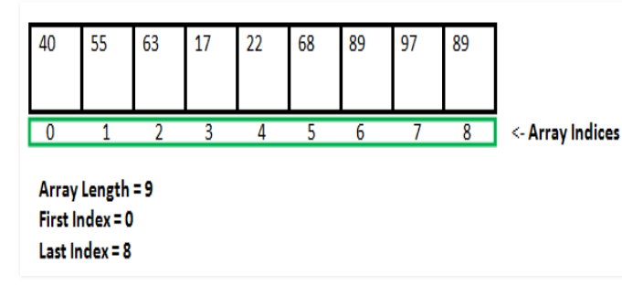
Arrays in C

Slide 4
Arrays in C
Array declaration by specifying size
// Array declaration by specifying size
int arr1[10];
// declare an array of user specified size
int n = 10;
int arr2[n];

Slide 5
Arrays in C
Array declaration by initializing elements
// Array declaration by initializing elements
int arr[] = { 10, 20, 30, 40 }
Array declaration by specifying size and initializing
// elements
int arr[4] = {10, 20, 30, 40}

Slide 6
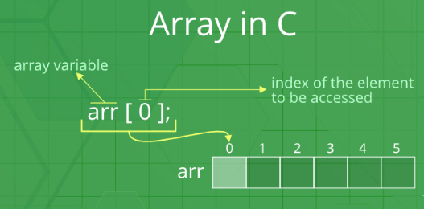
Accessing Array Elements:

Slide 7
Arrays in C
No Index Out of bound Checking.
In C, it is not a compiler error to initialize an array with more elements than the specified size.
The elements are stored at contiguous memory locations

Slide 8
Multidimensional Arrays in C / C++
In C/C++, we can define multidimensional arrays in simple words as array of arrays. Data in multidimensional arrays are stored in tabular form.
Syntax:
data_type array_name[size1][size2]....[sizeN];
Total number of elements that can be stored in a multidimensional array can be calculated by multiplying the size of all the dimensions.
For example: The array int x[10][20] can store total (10*20) = 200 elements. Similarly array int x[5][10][20] can store total (5*10*20) = 1000 elements.

Slide 9
Size of Multidimensional Arrays:
The total number of elements that can be stored in a multidimensional array can be calculated by multiplying the size of all the dimensions. For example:
The array int x[10][20] can store total (10*20) = 200 elements.
Similarly array int x[5][10][20] can store total (5*10*20) = 1000 elements.

Slide 10
The most commonly used forms of the multidimensional array are:
Two Dimensional Array
Three Dimensional Array
Two-Dimensional Array in C
A two-dimensional array or 2D array in C is the simplest form of the multidimensional array. We can visualize a two-dimensional array as an array of one-dimensional arrays arranged one over another forming a table with ‘x’ rows and ‘y’ columns where the row number ranges from 0 to (x-1) and the column number ranges from 0 to (y-1).

Slide 11
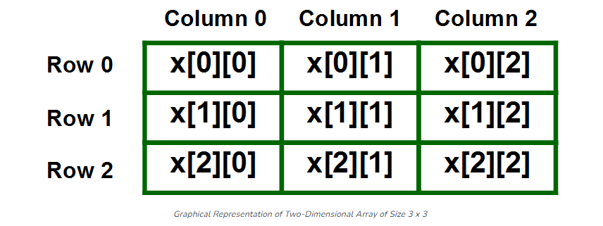
Two dimensional Array

Slide 12
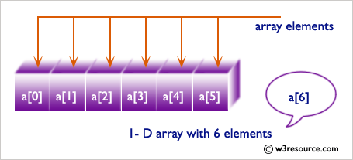
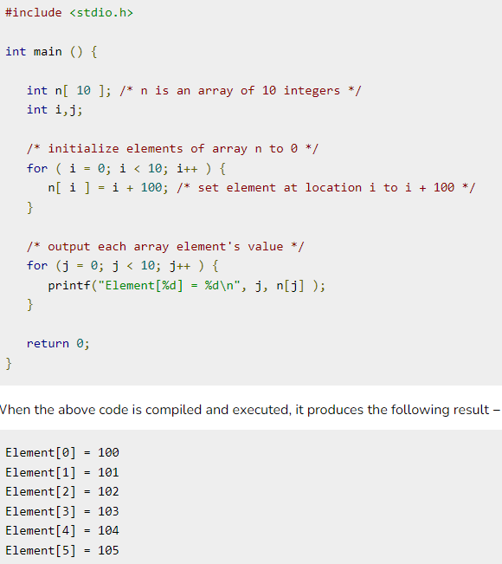

Slide 13
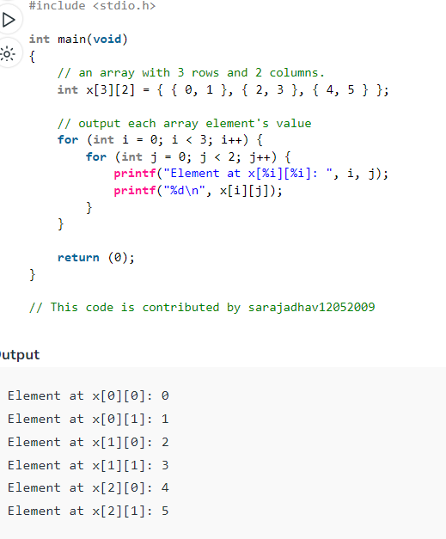
Example of Two dimensional Array

