Slide 1
Programming in C and CPP
Mitali Hora
Department of Computer Applications

Slide 2
History
C is a general-purpose, high-level language that was originally developed by Dennis M. Ritchie to develop the UNIX operating system at Bell Labs.
C was originally first implemented on the DEC PDP-11 computer in 1972.
C is a successor of B language which was introduced around the early 1970s.
The language was formalized in 1989 by the American National Standard Institute (ANSI).
The UNIX OS was totally written in C.
Today's most popular Linux OS and RDBMS MySQL have been written in C.

Slide 3
C Programming Language
C as a mother language
C language is considered as the mother language of all the modern programming languages because most of the compilers, JVMs, Kernels, etc. are written in C language, and most of the programming languages follow C syntax, for example, C++, Java, C#, etc.
C as a system programming language
A system programming language is used to create system software. C language is a system programming language because it is generally used to create hardware devices, OS, drivers, kernels, etc. For example, Linux kernel is written in C.

Slide 4
C Programming Language
C as a procedural language
A procedure is known as a function, method, routine, subroutine, etc. A procedural language specifies a series of steps for the program to solve the problem.
A procedural language breaks the program into functions, data structures, etc.
C as a structured programming language
A structured programming language is a subset of the procedural language. Structure means to break a program into parts or blocks so that it may be easy to understand. In the C language, we break the program into parts using functions. It makes the program easier to understand and modify.

Slide 5
C Programming Language
C as a mid-level programming language
C is considered as a middle-level language because it supports the feature of both low-level and high-level languages. C language program is converted into assembly code, it supports pointer arithmetic (low-level), but it is machine independent (a feature of high-level).
A Low-level language is specific to one machine, i.e., machine dependent. It is machine dependent, fast to run. But it is not easy to understand.
A High-Level language is not specific to one machine, i.e., machine independent. It is easy to understand.

Slide 6
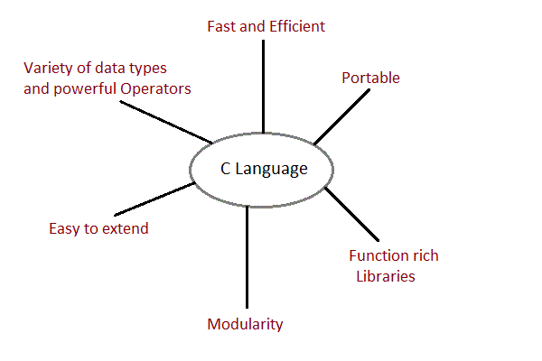
Features of ‘C’
Portable, but not platform independent
Procedural / Modular
Structured Language
Statically typed
Middle level language

Slide 7
Character Set
Every language has its own character set.
‘C’ language has its own character set.
‘C’ program basically consists of keywords, identifiers, constants, operators and some special symbols.
The characters that can be used in a ‘C’ program are Alphabets (A – Z and a – z), Digits (0 – 9), Special characters (~ ! @ # $ % ^ & * ( ) [ ] { } ; : ‘ “ , . < > / ? \ |) and White space characters (Space, Tab, New Line, Form feed etc).

Slide 8
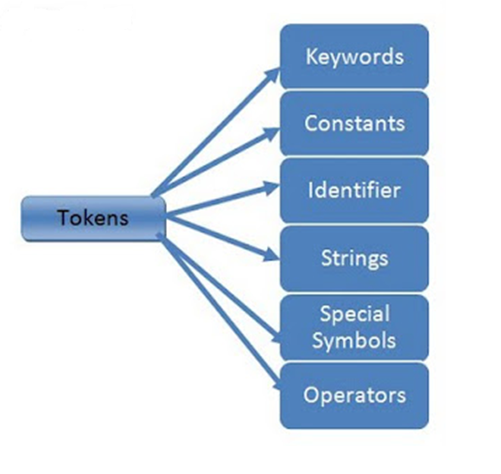
Tokens in c

Slide 9
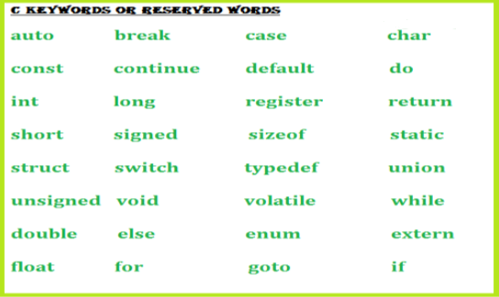
Tokens in C
Keywords
Whose meaning is fixed and is known by the compiler, cannot change the meaning of keyword. These are reserved words of the C language. For example int, float, if, else, for, while etc.
In C, we have 32 keywords, which have their predefined meaning and cannot be used as a variable name.

Slide 10
Tokens in C
Constants
Whose value does not change throughout the program.
Numeric Constants
Integer constants like 13, -15, 0, +15, 012, 0x48 etc.
Real constants like 0.004, -0.34, 0.4e-2 etc.
Non-numeric constants / Character constants
Single Character constants : ‘B’, ‘a’, ‘5’, ‘+’ etc.
Back slash constants are special type of character constants which actually consists of two characters. These are known as escape sequences. Escape sequences start with backslash ‘\’ character. E.g. ‘\t’ – horizontal tab, ‘\n’ - newline etc.
String constants: “Computer”, “-345”, “B” etc.

Slide 11
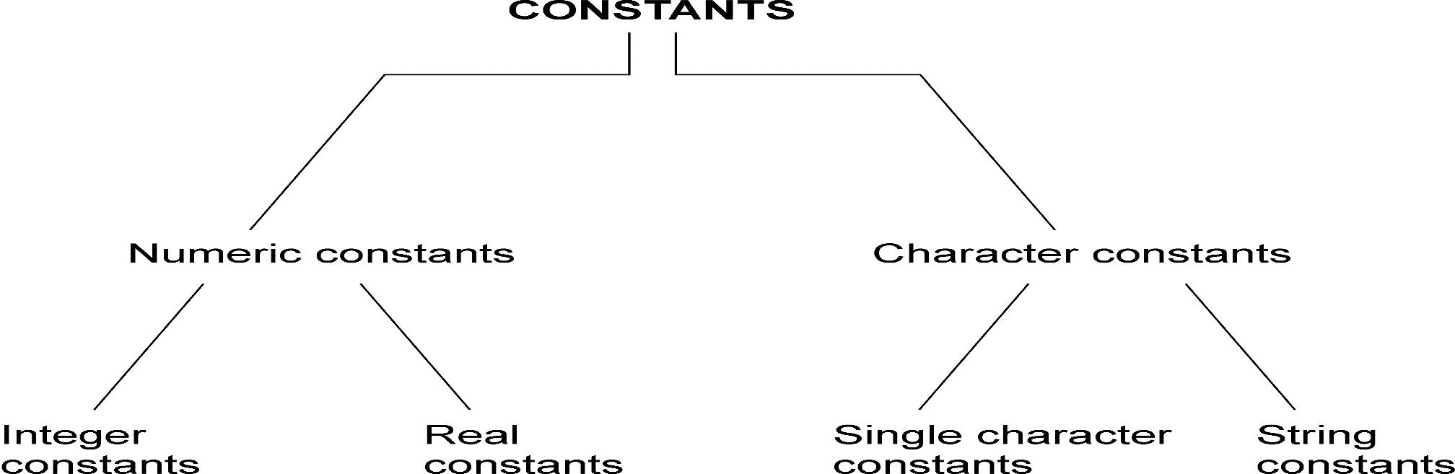
Basic types of C constants

Slide 12
Tokens in C
Identifiers
An Identifier is a sequence of letters and digits, but must start with a letter. Underscore ( _ ) is treated as a letter. Identifiers are case sensitive. Identifiers are used to name variables, functions etc.
Characters Allowed :
Underscore(_)
Capital Letters ( A –Z )
Small Letters ( a –z )
Digits ( 0 –9 )
Blanks & Commas are not allowed
No Special Symbols other than underscore(_) are allowed
First Character should be alphabet or Underscore
Variable name Should not be Reserved Word

Slide 13
Tokens in C
Identifiers
Valid: Root, _getchar, __sin, x1, x2, x3, x_1, If
Invalid: 324, short, price$, My Name
String Literals
A sequence of characters enclosed in double quotes as “…”. For example “13” is a string literal and not number 13. ‘a’ and “a” are different.

Slide 14
Tokens in C
Operators
Arithmetic operators like +, -, *, / ,% etc.
Logical operators like ||, &&, ! etc. and so on.
White Spaces
Spaces, new lines, tabs, comments ( A sequence of characters enclosed in /* and */ ) etc. These are used to separate the adjacent identifiers, kewords and constants.

Slide 15
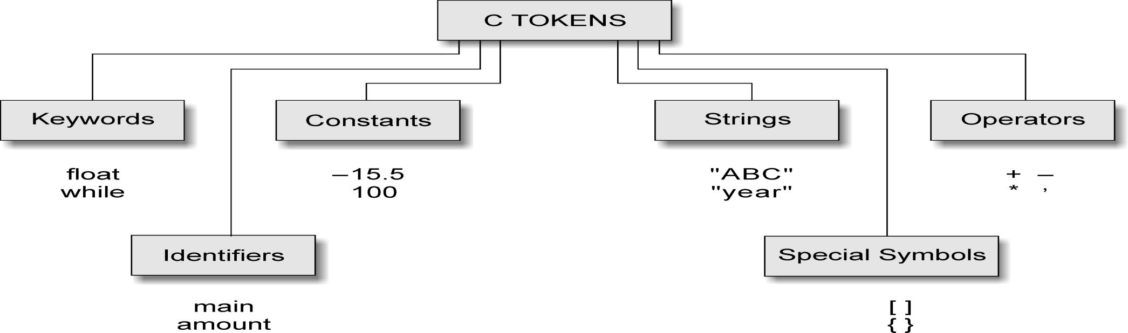
C tokens and examples

Slide 16
Escape Sequences
Escape Sequences Character
\b Backspace
\f Form feed
\n Newline
\r Return
\t Horizontal tab
\v Vertical tab
\\ Backslash
\’ Single quotation mark
\” Double quotation mark
\? Question mark
\0 Null character

Slide 17
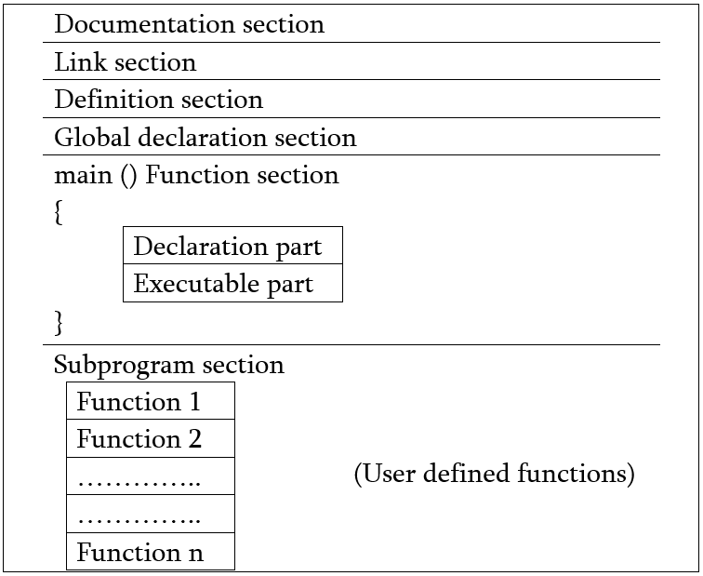
Structure of ‘C’ program

Slide 18
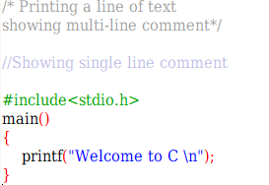
A Simple C Program: Printing a Line of Text
Comments
Text surrounded by /* and */ and // is ignored by computer
Used to describe program
#include <stdio.h>
Preprocessor directive
Tells computer to load contents of a certain file
<stdio.h> allows standard input/output operations

Slide 19
A Simple C Program: Printing a Line of Text
main( )
C programs contain one or more functions, exactly one of which must be main
Parenthesis used to indicate a function
Braces { and } indicate a block
The bodies of all functions must be contained in braces
void main( )
Indicates no return type of main( ) function.
Does not require the return statement at the end of the function.
int main( )
Indicates return type of main( ) function.
Requires a return statement at the end of the function.

Slide 20
A Simple C Program: Printing a Line of Text
printf( "Welcome to C!\n" );
Instructs computer to perform an action
Specifically, prints the string of characters within quotes (“ ”)
Entire line called a statement
All statements must end with a semicolon (;)
Escape character (\)
Indicates that printf should do something out of the ordinary
\n is the newline character

Slide 21
A Simple C Program: Printing a Line of Text
Right brace }
Indicates end of main has been reached
Linker
When a function is called, linker locates it in the library
Inserts it into program
If function name is misspelled, the linker will produce an error because it will not be able to find function in the library

Slide 22
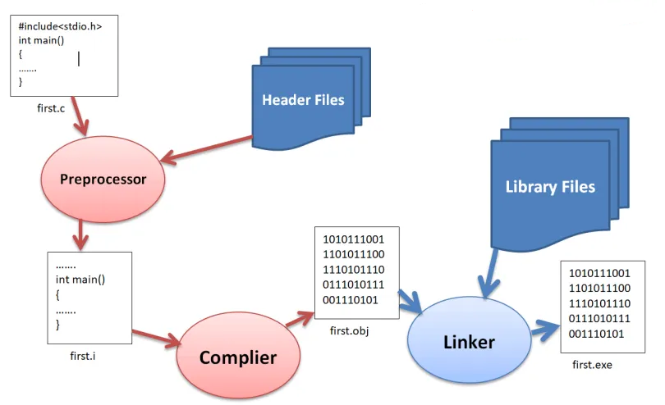
Procedure of execution of ‘C’ program

Slide 23
Variables
A variable is defined as a meaningful name given to a data storage location in computer memory.
When using a variable, we actually refer to address of the memory where data is stored.
Naming a Variable
Must be a valid identifier.
Must not be a keyword
Names are case sensitive.
Variables are identified by only first 32 characters.
Library commonly uses names beginning with _.
Naming Styles: Uppercase style and Underscore style
lowerLimit lower_limit
incomeTax income_tax

Slide 24
Declarations
Declaring a Variable
Each variable used must be declared.
A form of a declaration statement is
data-type var1, var2,…;
Declaration announces the data type of a variable and allocates appropriate memory location. No initial value (like 0 for integers) should be assumed.
It is possible to assign an initial value to a variable in the declaration itself.
data-type var = expression;
Declaration and Initialization Examples
int sum = 10;
char letter = ‘a’;
float marks = 78.5;

Slide 25
Data Types in C
“Data type can be defined as the type of data of variable or constant store.”
When we use a variable in a program then we have to mention the type of data. This can be handled using data type in C.

Slide 26
Basic Data Types
Primitive or fundamental data types
Integer data types
Floating-point data types
Character data type
void data type
Derived data types
Arrays
Pointers
Structures
User-defined data types
typedef
enum

Slide 27
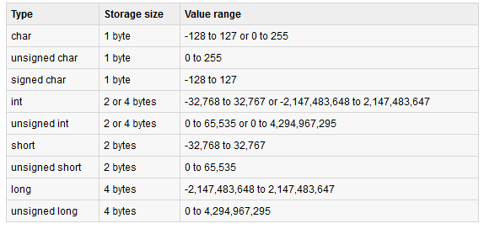
Primitive Data Types
Integer data types
Notes:
C guarantees only following:
Sizeof(short) <= sizeof(int) <= sizeof(long).

Slide 28
Primitive Data Types
Floating Point Numbers
Floating point numbers are rational numbers. Always signed numbers.
float
Typically stored in 4 bytes
double
Typically stored in 8 bytes

Slide 29
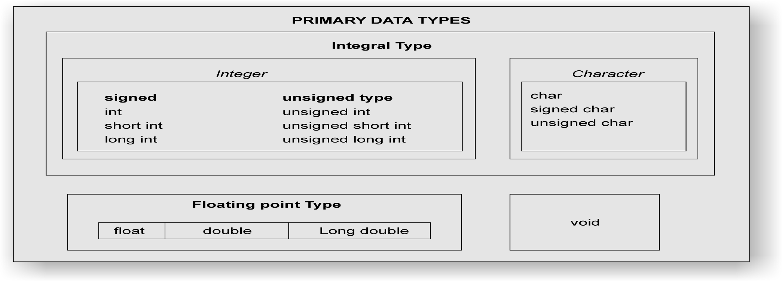
Primary data types in C

Slide 30
Character Types
char ch = ‘a’;
int i;
i = ‘a’; /* i is now 97 */
ch = 65; /* ch is now ‘A’ */
ch = ch + 1; /* ch is now ‘B’ */
ch++; /* ch is now ‘C’ */

Slide 31
PRINTING DATAON SCREEN
For printing values of variables is to output data on screen using the printf function.
The format is:
printf(“control string”, variable1, variable2, … );
The control string contains the format of the data being received. Also called “Format specifier”.
variable1, variable2 specifies the variables whose values are needed to be outputted.

Slide 32
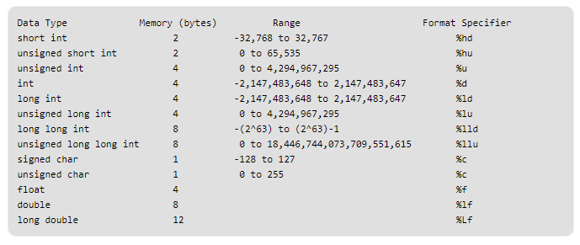
Format Specifiers

Slide 33
Reading data from keyboard
For giving values to variables is to input data from keyboard using the scanf function.
The format is:
scanf(“control string”, &variable1, &variable2, … );
The control string contains the format of the data being received.
The ampersand symbol & before each variable name is an operator that specifies the variable name’s address.

Slide 34
User defined data types
“type definition” allows users to define an identifier that would represent an existing data type.
The user-defined data type identifier can later be used to declare variables.
It takes the general form:
typedef type identifier;
Where “type” refers to an existing data type and “identifier” refers to the new name given to the data type.
Remember that the new type is “new” only in name, but not the data type, typedef cannot create a new type.
E.g.
typedef int units;
typedef float marks;
Now, units symbolizes int and marks symbolizes float.
units marks1, marks2;

Slide 35
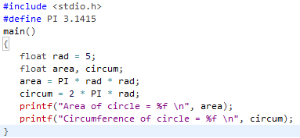

Defining symbolic constants
When a constant is used at many places in a program, due to some reason if the value of that constant needs to be changed, then we need to change at every statement where that constant occurs in the program – so modification becomes difficult.
The symbolic constant helps in solving these problems.
Here, the constant is given a symbolic name and instead of constant value, symbolic name is used in the program.
It is defined as below:
#define symbolic_name value
#define PI 3.1415

Slide 36
User defined data types
Enumerated data type
We can define more than one integer symbolic constants.
Syntax:
enum identifier (value1, value2, … , value n);
Example:
enum day {sun, mon, tue, wed, thu, fri, sat};
Here, enum is a keyword, day is a data type defined and the possible values are as specified in brackets. So any variable declared of day type can have values which we have specified within brackets.
We can declare variable of enum type as
enum day today;
We can assign value to variable as
today = sun;
The compiler automatically assigns integer digits beginning with 0 to all enumerated constants. For the above example, sun = 0, mon = 1, … and sat = 6.

Slide 37
Type Conversions
Type casting or type conversions is a way to convert a variable from one data type to another data type.
Whenever an expression involves two different types of operands, ‘C’ language applies the type conversion rules to evaluate an expression.
At a time only one operator under consideration is taken.
If the operands are of different type, then the operand with a lower type is upgraded to the higher type and then the operation is performed.
Types:
Automatic type conversion (Implicit casting)
Explicit type conversion : Also called type casting.

Slide 38
Automatic Type conversion
char and short operands are converted to int
Lower data types are converted to the higher data types and result is of higher type.
The conversions between unsigned and signed types may not yield intuitive results.
Example
float f; double d; long l;
int i; short s;
d + f f will be converted to double
i / s s will be converted to int
l / i i is converted to long; long result
Hierarchy
double
float
long
int
short and char

Slide 39
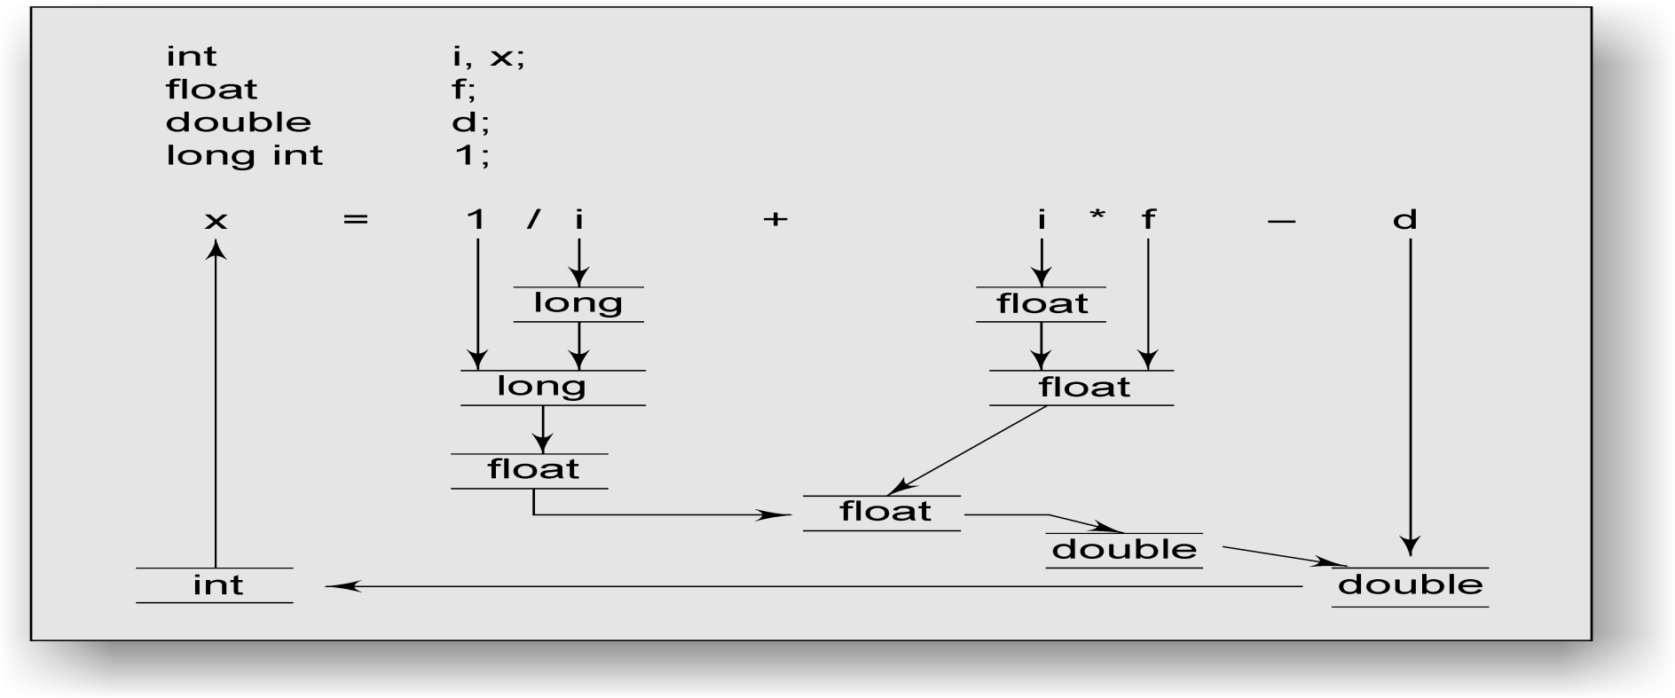
Process of implicit type conversion

Slide 40
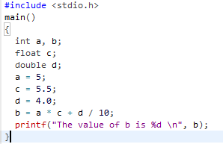
Automatic Type conversion
a * c will be done first, here a will be upgraded to float because other operand c is float.
So, a*c will evaluate to 27.5. Then, d/10 will be evaluated, 10 will be converted to 10.0 (double) because d is double. So, d/10 will evaluate to 0.4. Then, 27.5 + 0.4 evaluates to 27.9. This value is assigned to variable b, which is integer, so truncated value of 27.9 will be the value of b i.e. 27 will be assigned to b.

Slide 41
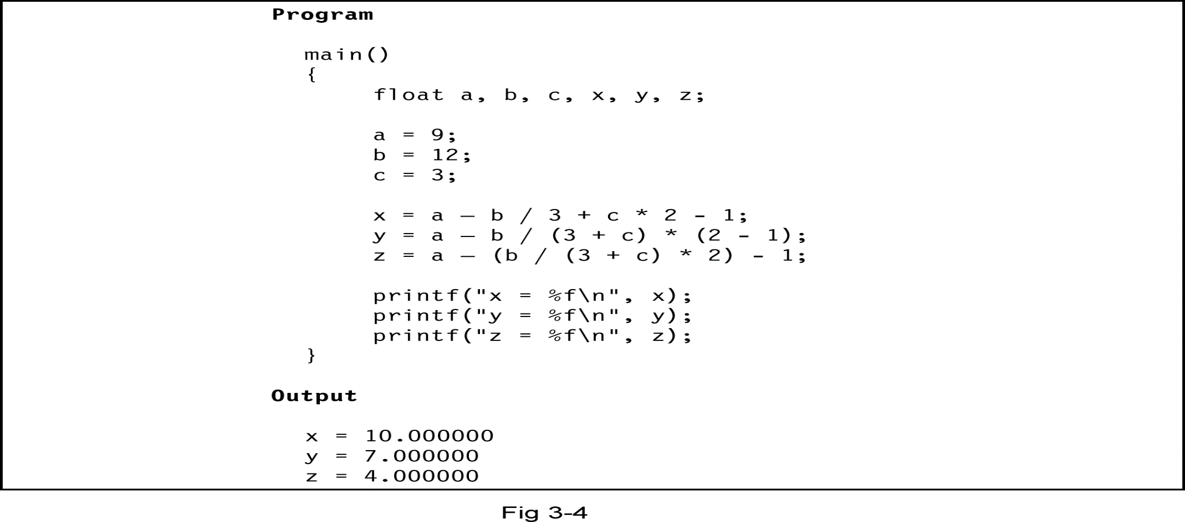
Illustrations of evaluation of expressions

Slide 42
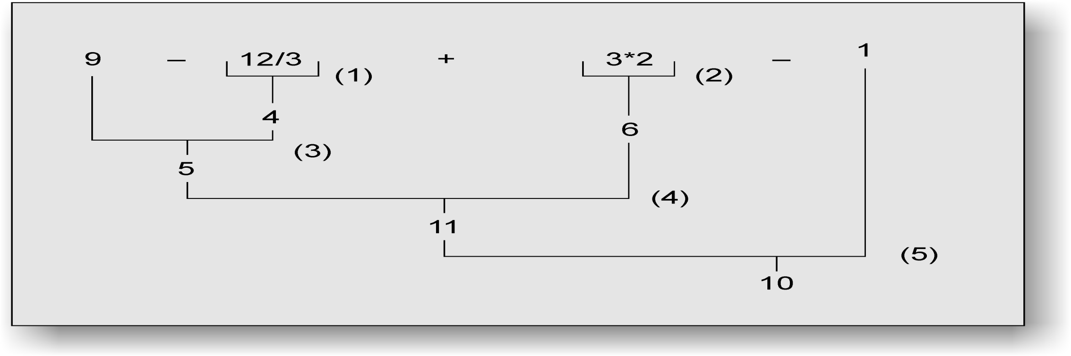
Illustration of hierarchy of operations

Slide 43
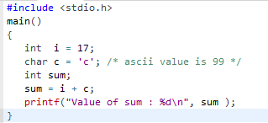
Integer promotion
Integer promotion is the process by which values of integer type "smaller" than int or unsigned int are converted either to int or unsigned int. Consider an example of adding a character in an int:
Here, value of sum is coming as 116 because compiler is doing integer promotion and converting the value of 'c' to ascii before performing actual addition operation.

Slide 44
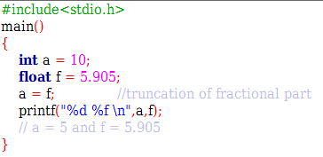
Explicit Type Conversion or Type Casting
You can convert values from one type to another explicitly by using the cast operator.
The general form of a type casting operator is
(type-name) expression
Here, type-name is the name of the data type we want to convert the expression to. The converted value is used during evaluation of expression only, it does not change the basic data type of operands of an expression.
float to int conversion causes truncation of fractional part

Slide 45
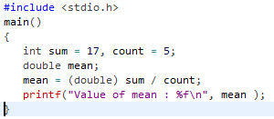

Type Casting
It should be noted here that the cast operator has precedence over division, so the value of sum is first converted to type double and finally it gets divided by count yielding a double value.

Slide 46
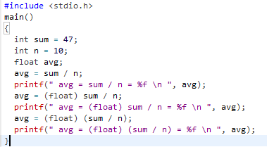

Type Casting
In the first line of output, integer arithmetic takes place, while in second, sum which is 47 is converted into 47.0, so automatically i.e. type conversion takes place and 10 becomes 10.0. So, floating-point arithmetic takes place. While in the last line of output, float type casting takes place on sum / n which is 4, converted into float becomes 4.0.

Slide 47
Operator precedence
Operator precedence determines which operator is performed first in an expression with more than one operators with different precedence.
For example:
10 + 20 * 30

Slide 48
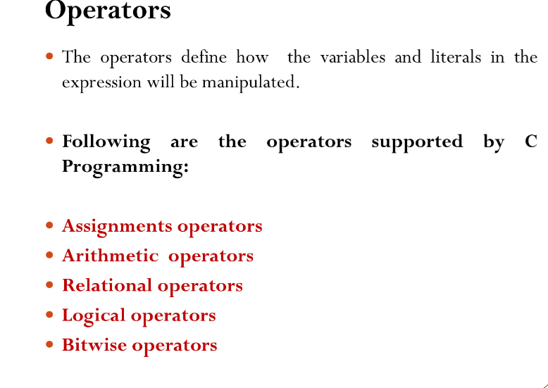
Operators

Slide 49
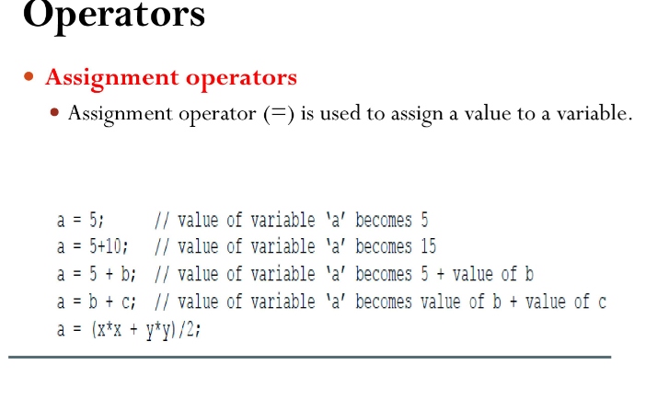

Slide 50
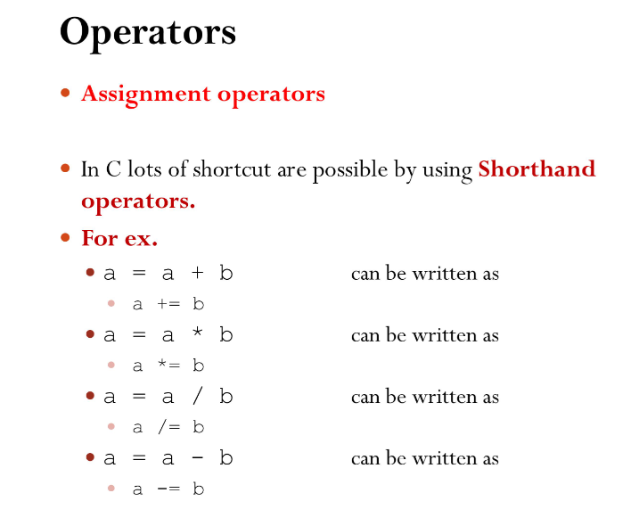

Slide 51
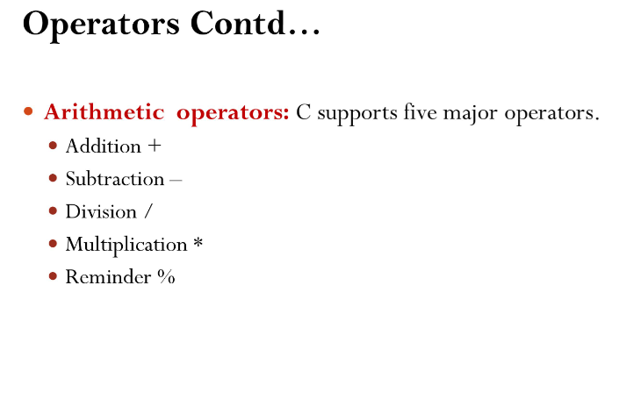

Slide 52
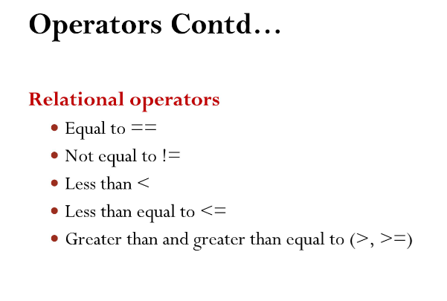

Slide 53
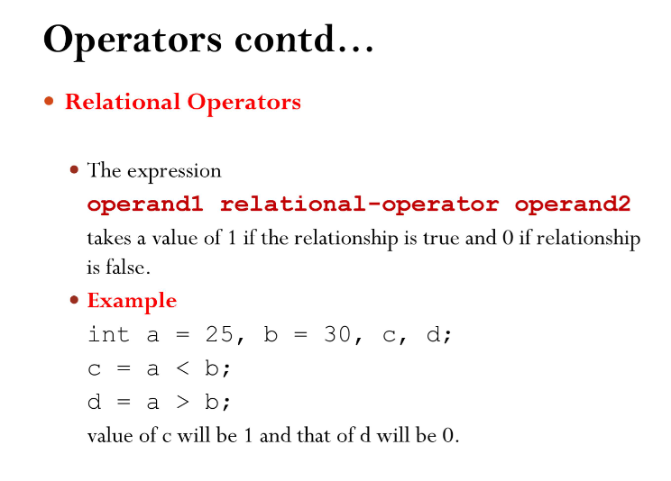

Slide 54
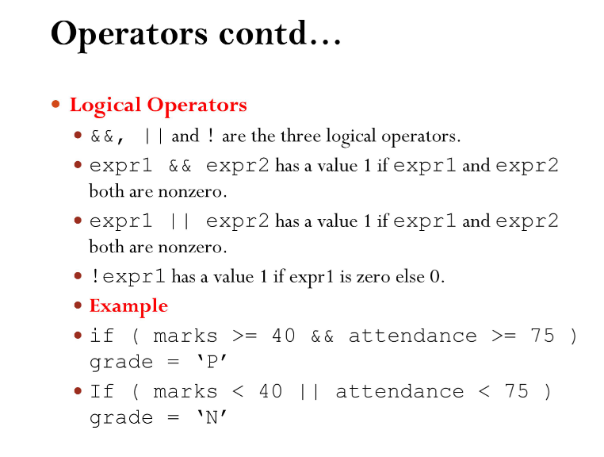

Slide 55
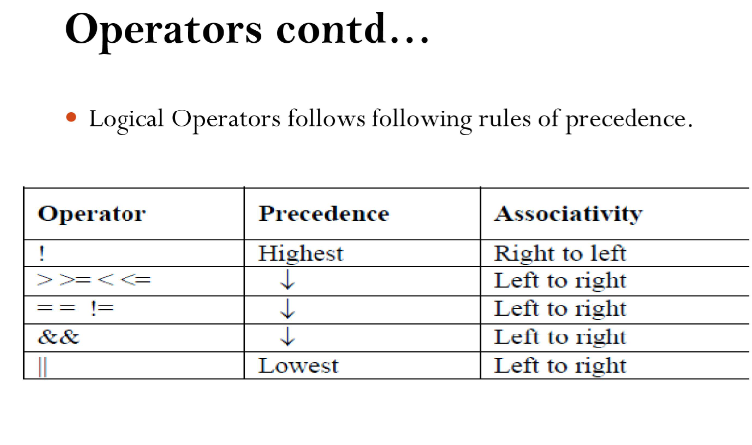

Slide 56
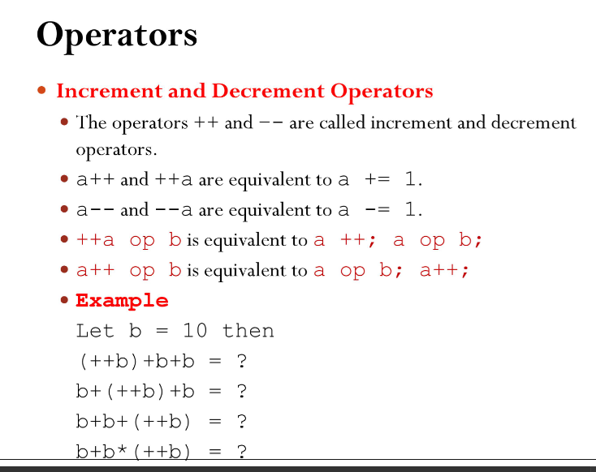

Slide 57
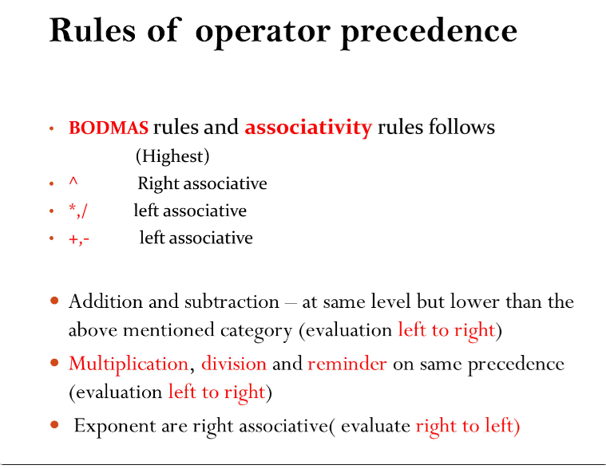

Slide 58
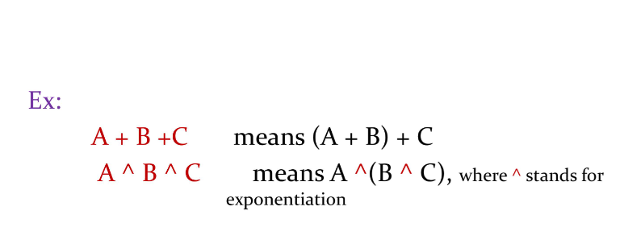

Slide 59
Operators Associativity
Operators Associativity is used when two operators of same precedence appear in an expression. Associativity can be either Left to Right or Right to Left.
For example: ‘*’ and ‘/’ have same precedence and their associativity is Left to Right, so the expression “100 / 10 * 10” is treated as “(100 / 10) * 10”.

Slide 60
Thank you!!!

