Slide 1
Programming in C and CPP
Mitali Hora
Department of Computer Applications

Slide 2
Conditional Statement
Conditional Statements in C programming are used to make decisions based on the conditions.
If you put some condition for a block of statements, the execution flow may change based on the result evaluated by the condition.
This process is called decision making in 'C.
In 'C' programming conditional statements are possible with the help of the following two constructs:
1. If statement
2. If-else statement
It is also called as branching as a program decides which statement to execute based on the result of the evaluated condition.
Keep in mind that a condition that evaluates to a non-zero value is considered as true

Slide 3
if...else Statement
if (test expression)
{
// code
}

Slide 4
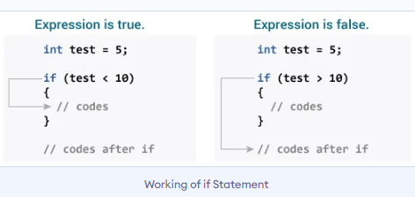
if...else Statement

Slide 5
if...else Statement
if (test expression)
{
// run code if test expression is true
}
else
{
// run code if test expression is false
}

Slide 6
if...else Ladder
if (test expression1)
{
// statement(s)
}
else if(test expression2)
{
// statement(s)
}
else if (test expression3)
{
// statement(s)
}
. .
else
{
// statement(s)
}

Slide 7
Switch Statement in C
Switch statement in C tests the value of a variable and compares it with multiple cases.
Once the case match is found, a block of statements associated with that particular case is executed.
Each case in a block of a switch has a different name/number which is referred to as an identifier.
The value provided by the user is compared with all the cases inside the switch block until the match is found.
If a case match is NOT found, then the default statement is executed, and the control goes out of the switch block.

Slide 8
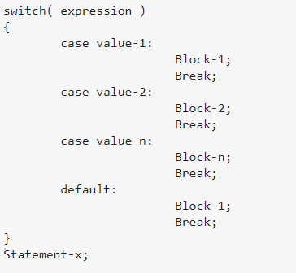
Switch Case

Slide 9
Switch Case
The expression can be integer expression or a character expression.
Value-1, 2, n are case labels which are used to identify each case individually. Remember that case labels should not be same as it may create a problem while executing a program.
Case labels always end with a colon ( : ). Each of these cases is associated with a block.
A block is nothing but multiple statements which are grouped for a particular case.
Whenever the switch is executed, the value of test-expression is compared with all the cases which we have defined inside the switch.

Slide 10
Switch Case
The break keyword in each case indicates the end of a particular case. If we do not put the break in each case then even though the specific case is executed, the switch in C will continue to execute all the cases until the end is reached. This should not happen; hence we always have to put break keyword in each case. Break will terminate the case once it is executed and the control will fall out of the switch.
The default case is an optional one. Whenever the value of test-expression is not matched with any of the cases inside the switch, then the default will be executed. Otherwise, it is not necessary to write default in the switch.
Once the switch is executed the control will go to the statement-x, and the execution of a program will continue.

Slide 11
Loop in C
In programming, a loop is used to repeat a block of code until the specified condition is true.
The purpose of the C loop is to repeat the same code a number of times.
C programming has three types of loops:
for loop
while loop
do...while loop

Slide 12
C for Loop
Syntax :
for (initial value; condition; incrementation or decrementation )
{
statements;
}
The initial value of the for loop is performed only once.
The condition is a Boolean expression that tests and compares the counter to a fixed value after each iteration, stopping the for loop when false is returned.
The incrementation/decrementation increases (or decreases) the counter by a set value.
It is an entry-controlled loop.

Slide 13
While Loop in C
Syntax :
while (condition)
{
statements;
}
It is an entry-controlled loop.
In while loop, a condition is evaluated before processing a body of the loop.
If a condition is true then and only then the body of a loop is executed.
After the body of a loop is executed then control again goes back at the beginning, and the condition is checked if it is true, the same process is executed until the condition becomes false.
Once the condition becomes false, the control goes out of the loop.
In while loop, if the condition is not true, then the body of a loop will not be executed, not even once.

Slide 14
Do-While loop in C
Syntax:
do
{
statements
} while (expression);
A do...while loop in C is similar to the while loop except that the condition is always executed after the body of a loop.
It is also called an exit-controlled loop.
In the do-while loop, the body of a loop is always executed at least once.
After the body is executed, then it checks the condition. If the condition is true, then it will again execute the body of a loop otherwise control is transferred out of the loop.

Slide 15
Break Statement in C
The break statement is used mainly in in the switch statement.
It is also useful for immediately stopping a loop.
int i; for (i = 0; i < 10; i++) { if (i == 4) { break; } printf("%d\n", i); }

Slide 16
Continue Statement in C
When you want to skip to the next iteration but remain in the loop, you should use the continue statement.
int i; for (i = 0; i < 10; i++) { if (i == 4) { continue; } printf("%d\n", i); }

