Slide 1
Programming in C and CPP
Mitali Hora
Department of Computer Applications
1

Slide 2
Function
In c, we can divide a large program into the basic building blocks known as function.
The function contains the set of programming statements enclosed by {}.
A function can be called multiple times to provide reusability and modularity to the C program.
In other words, we can say that the collection of functions creates a program.
Every C program has at least one function, which is main().
The function is also known as procedureor subroutinein other programming languages.

Slide 3
Advantage of functions
By using functions, we can avoid rewriting same logic/code again and again in a program.
We can call functions any number of times in a program and from any place in a program.
We can track a large C program easily when it is divided into multiple functions.
Reusability is the main achievement of C functions.

Slide 4
Types of Functions
Library Functions: are the functions which are declared in the C header files such as scanf(), printf(), gets(), puts(), ceil(), floor() etc.
User-defined functions: are the functions which are created by the C programmer, so that he/she can use it many times. It reduces the complexity of a big program and optimizes the code.

Slide 5
Defining a Function
return_type function_name( parameter list )
{
body of the function
}
A function definition in C programming consists of a function header and a function body.
Return Type − A function may return a value. The return_type is the data type of the value the function returns. Some functions perform the desired operations without returning a value. In this case, the return_type is the keyword void.

Slide 6
Defining a Function
Function Name − This is the actual name of the function. The function name and the parameter list together constitute the function signature.
Parameters − A parameter is like a placeholder. When a function is invoked, you pass a value to the parameter. This value is referred to as actual parameter or argument. The parameter list refers to the type, order, and number of the parameters of a function. Parameters are optional; that is, a function may contain no parameters.
Function Body − The function body contains a collection of statements that define what the function does.

Slide 7
Function Declarations
A function declaration tells the compiler about a function name and how to call the function.
The actual body of the function can be defined separately.
Syntax:
return_type function_name( parameter list );
Parameter names are not important in function declaration only their type is required, so the following is also a valid declaration
int max(int, int);

Slide 8
Calling a Function
When a program calls a function, the program control is transferred to the called function. A called function performs a defined task and when its return statement is executed or when its function-ending closing brace is reached, it returns the program control back to the main program.
To call a function, you simply need to pass the required parameters along with the function name, and if the function returns a value, then you can store the returned value.

Slide 9
int myFunction(int, int); // The main method int main() { int result = myFunction(5, 3); // call the function printf("Result is = %d", result); return 0; } // Function definition int myFunction(int x, int y) { return x + y; }o/p =8

Slide 10
call by Value
The call by value method of passing arguments to a function copies the actual value of an argument into the formal parameter of the function.
In this case, changes made to the parameter inside the function have no effect on the argument.
By default, C programming uses call by value to pass arguments.
In general, it means the code within a function cannot alter the arguments used to call the function.

Slide 11
Call by reference
The call by reference method of passing arguments to a function copies the address of an argument into the formal parameter.
Inside the function, the address is used to access the actual argument used in the call.
It means the changes made to the parameter affect the passed argument.
To pass a value by reference, argument pointers are passed to the functions just like any other value.

Slide 12
Inline function
Inline Function are those function whose definitions are small and be substituted at the place where its function call is happened. Function substitution is totally compiler choice.
In an inline function, a function call is replaced by the actual program code.
Most of the Inline functions are used for small computations. They are not suitable for large computing.
An inline function is similar to a normal function. The only difference is that we place a keyword inline before the function name.

Slide 13
getc(),getchar(),getch()
All these functions read the character from input and return an integer. The value of EOF is used for this purpose.
getc()
It reads a single character from the input and return an integer value. If it fails, it returns EOF.
The easiest and simplest of all I/O operations are taking a character as input by reading that character from standard input (keyboard). getchar() function can be used to read a single character. This function is an alternative to scanf() function.
Syntax:

Slide 14
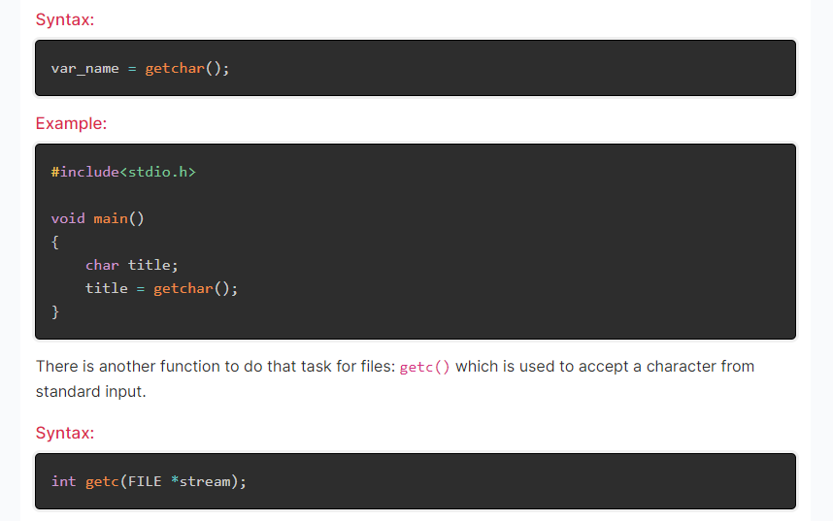
The difference between getc() and getchar() is getc() can read from any input stream, but getchar() reads a single input character from standard input. So getchar() is equivalent to getc(stdin).

Slide 15
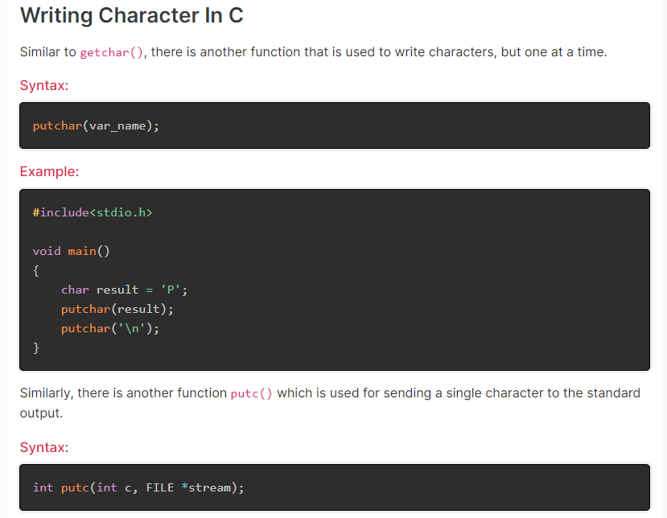

Slide 16
getch()
Like the above functions, getch() also reads a single character from the keyboard. But it does not use any buffer, so the entered character does not display on the screen and is immediately returned without waiting for the enter key.
getch() is a nonstandard function and is present in <conio.h> header file which is mostly used by MS-DOS compilers like Turbo C. It is not part of the C standard library or ISO C, nor is it defined by POSIX.
Syntax
int getch();

