Slide 1
IBM University Engagement Project Submission
“Exploring the Power of Agentic AI with IBM Granite and IBM Bob”

Slide 2

Project Tile – Nutrition Agent
Domain of Project – Healthcare
Student Name | Recent Passport Photo | Email ID | Mobile number [WhatsApp]
Gopal Krishna |  | gopal1892003@gmail.com | 7061990014

Slide 3
Problem Statement – Nutrition Agent
The Challenge - In an era where health awareness is growing, individuals increasingly seek personalized nutrition guidance. However, most existing tools provide generic diet plans, lack real-time adaptability, and fail to consider a person's holistic lifestyle, cultural preferences, allergies, and evolving health conditions. Furthermore, dieticians and nutritionists face limitations in scaling personalized consultations due to time and resource constraints. Generative AI presents a groundbreaking opportunity to revolutionize this space by enabling an intelligent, interactive, and adaptive virtual nutrition assistant. By leveraging natural language processing (NLP), multimodal understanding, and large-scale dietary databases, an AI-powered assistant can generate dynamic meal plans, recommend smart food swaps, and explain nutritional choices—all tailored to the individual.

Slide 4
Proposed Solution -
Proposed Solution: AI-Powered Nutrition Agent
The proposed solution is a multi-agent AI-powered Nutrition Agent built using IBM Bob, IBM watsonx.ai, and Granite Models to provide personalized, real-time dietary guidance. The system addresses challenges in diet planning, nutrition tracking, and preventive healthcare through an intelligent, modular architecture.
At its core, the solution uses a Retrieval-Augmented Generation (RAG) pipeline to fetch accurate nutritional data from trusted sources such as USDA and WHO datasets. This data is embedded and stored in a vector database, enabling the system to retrieve and summarize food nutrition details (calories, macros, vitamins) using Granite models.
The system consists of four key agents:
Nutrition Knowledge Agent retrieves and summarizes nutritional information using RAG.
Diet Recommendation Agent generates personalized meal plans based on user inputs such as age, health conditions, dietary preferences, and fitness goals.
Health Advisory Agent provides preventive health suggestions, including disease-specific diets (e.g., diabetes-friendly or heart-healthy plans).
Food Log & Feedback Agent allows users to log meals via text, voice, or images and delivers instant nutritional analysis with actionable feedback.
The solution includes a user-friendly dashboard (built with Streamlit or React) that visualizes daily and weekly nutrient intake, highlights deficiencies, and tracks progress toward health goals.
IBM Bob is used to orchestrate agent workflows, while watsonx.ai ensures scalable model deployment, embeddings, and AI governance. Granite models power reasoning, summarization, and personalization.
Overall, this solution delivers an end-to-end intelligent nutrition assistant that promotes healthier lifestyles through personalized insights, real-time feedback, and preventive healthcare recommendations.

Slide 5
Technology Used
IBM Bob platform -For designing and orchestrating multi-agent workflows visually
IBM Granite model - for eg – ibm-granite-3-2-8b – For natural language understanding, reasoning, and personalization
IBM Cloud – It provides the infrastructure to build, deploy, and scale the Nutrition Agent efficiently. IBM Cloud enables a reliable, secure, and scalable environment for deploying the Nutrition Agent.
RAG– RAG to fetch real data first, then generate intelligent answers, making the Nutrition Agent more trustworthy and effective.
IBM Watsonx.ai - For model deployment, embeddings, and AI governance
Vector Database (FAISS/Chroma) – For RAG-based nutritional data retrieval

Slide 6
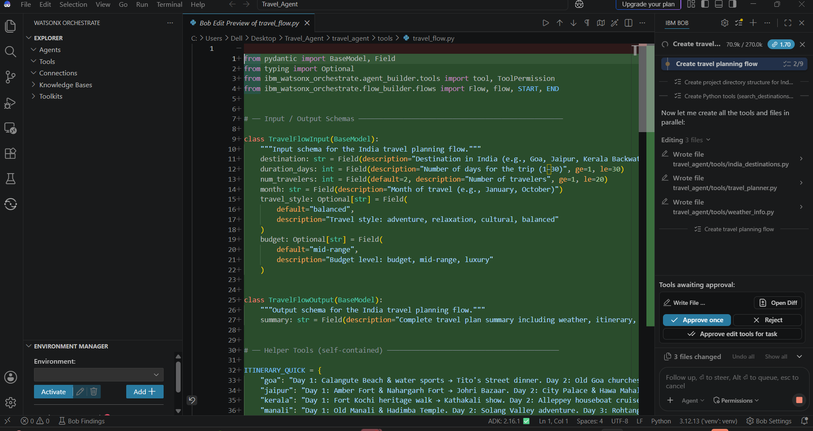
Required Files created using IBM bob -

Slide 7
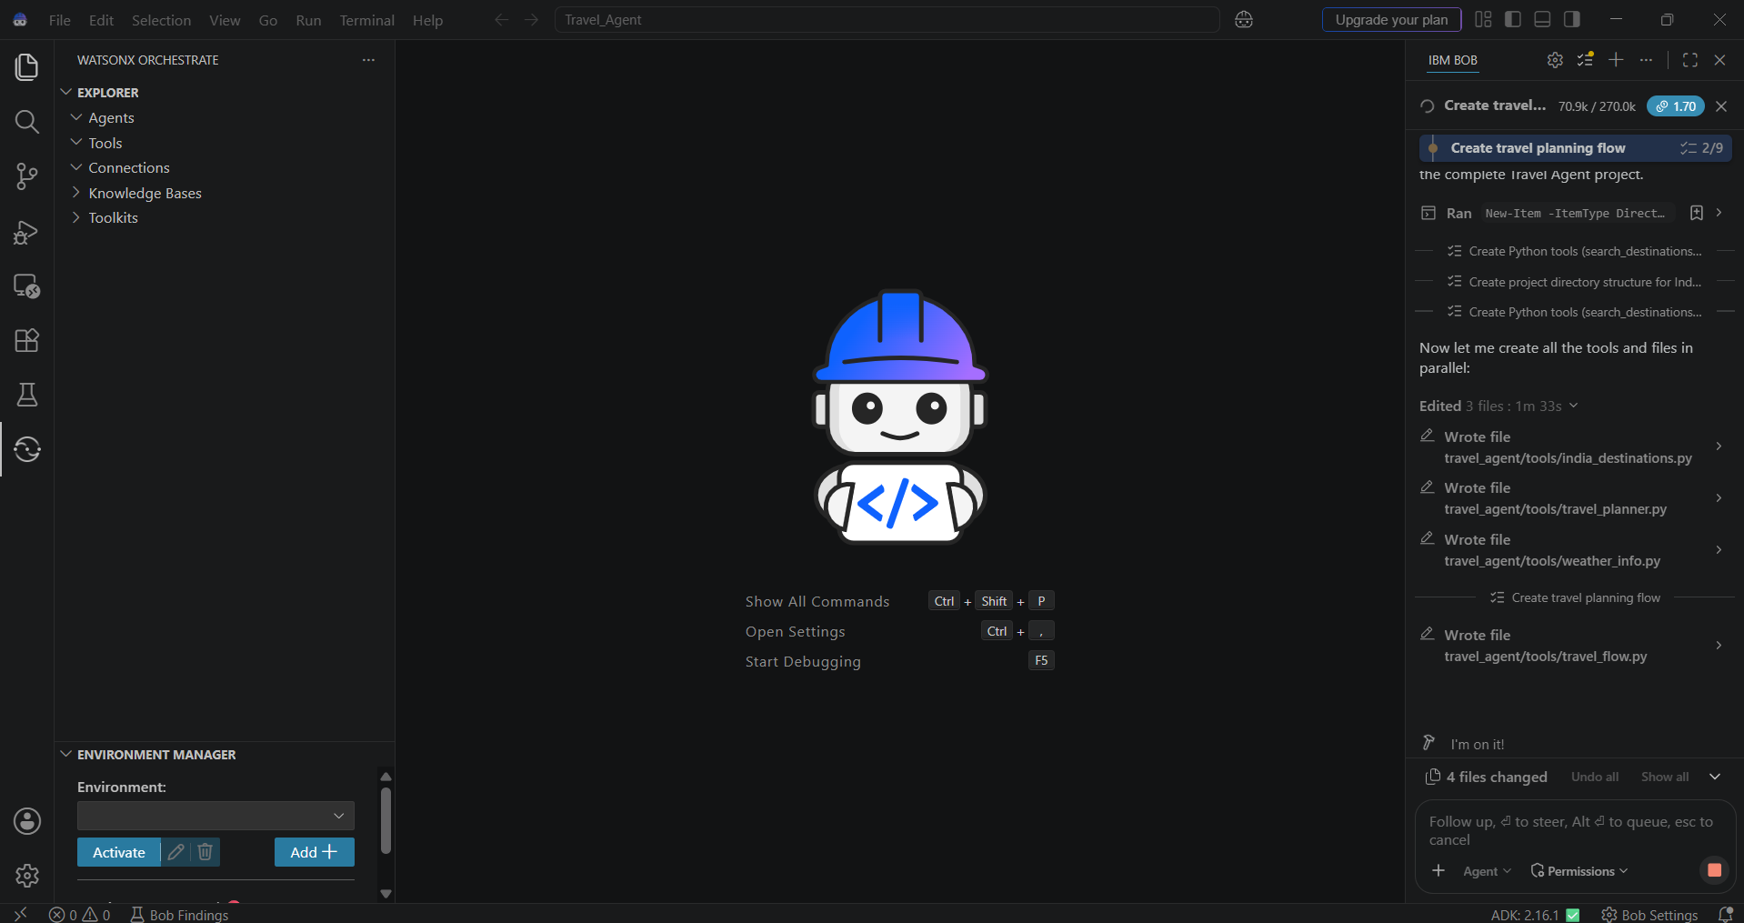
IBM Bob Screenshots:

Slide 8
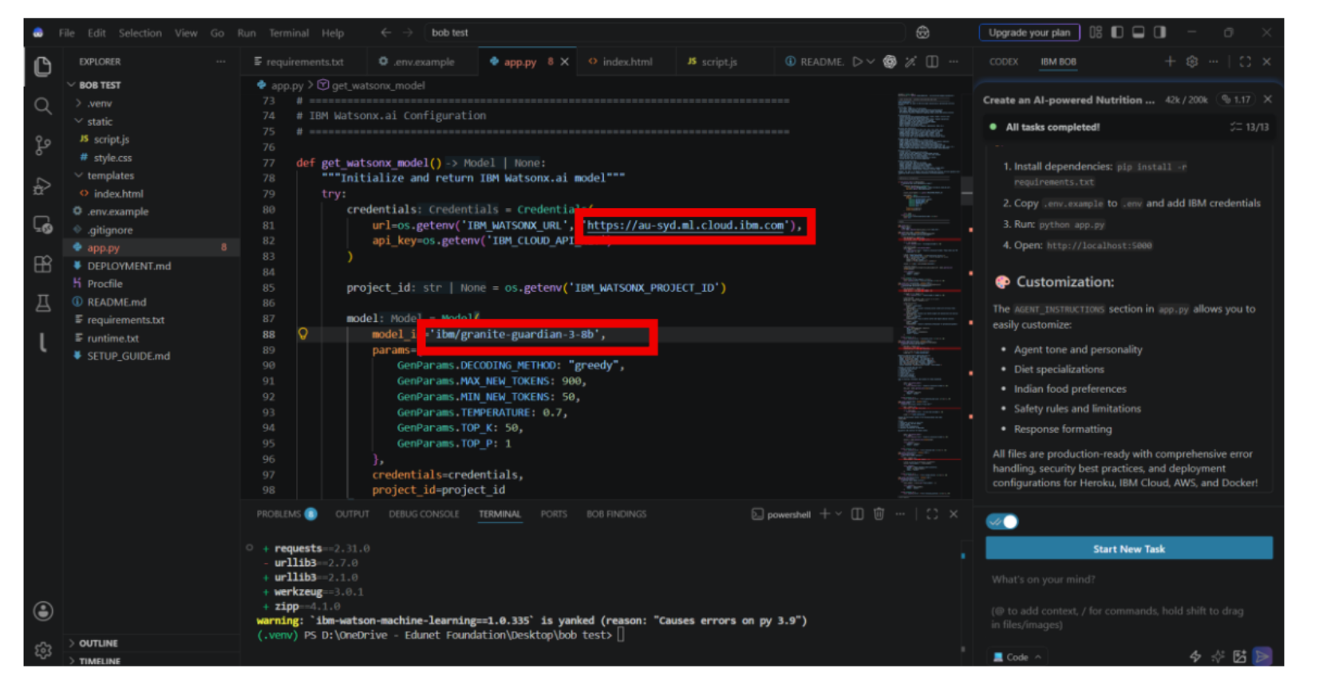

Slide 9
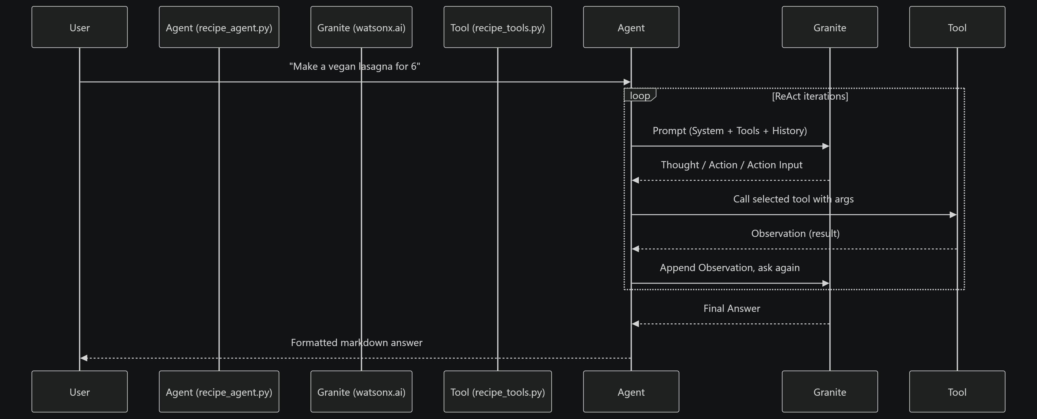
Architecture blueprint for IBM bob:

Slide 10
Role of Agentic AI in the solution
Role of Agentic AI in Nutrition Agent
Agentic AI enables the Nutrition Agent to function as an intelligent, autonomous system rather than a simple chatbot. Using IBM watsonx.ai and IBM Granite models, it coordinates multiple specialized agents to deliver personalized nutrition guidance.
Each agent performs a specific role—such as retrieving nutritional data, generating diet plans, providing health advice, and analyzing food logs—while working collaboratively. This multi-agent approach ensures efficient task execution and accurate results.
Agentic AI also brings context awareness, understanding user details like age, health conditions, and fitness goals to generate tailored recommendations. It supports real-time adaptation, continuously updating suggestions based on user inputs like daily meals.
Additionally, agents communicate with each other, enabling better decision-making and improved outcomes.
Overall, Agentic AI makes the system proactive, personalized, and goal-driven, acting like a smart digital nutritionist that helps users maintain a healthy lifestyle.

Slide 11
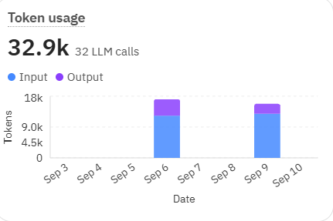
Token Usage
·
·
·

Slide 12
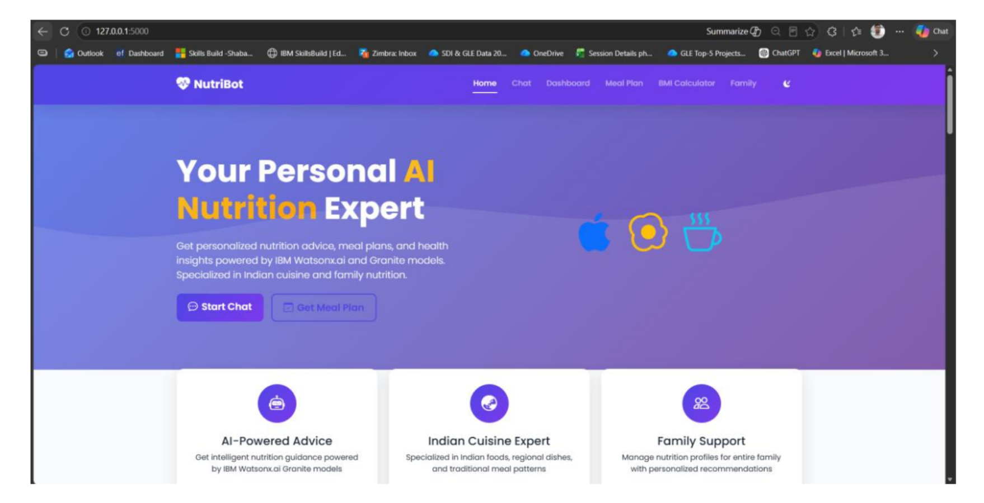
Project Output Screenshot
Please put IBM Bob output screenshots with 2-3 prompts.
You can take 2-3 more slides for each screenshot
·
·
·

Slide 13
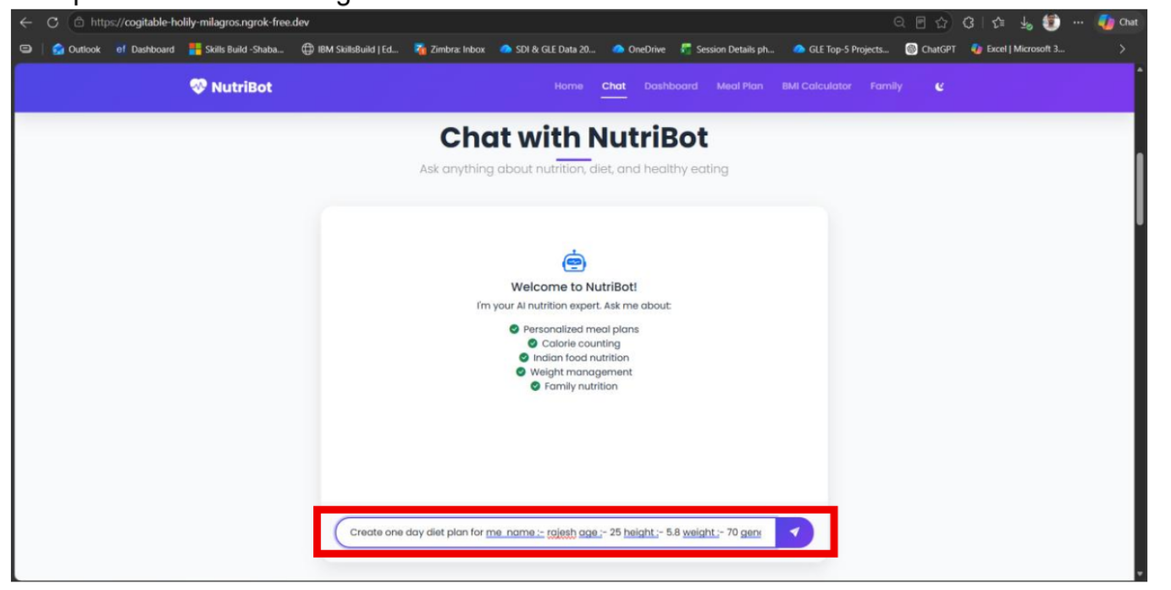
Project Output Screenshot
Please put IBM Bob output screenshots with 2-3 prompts.
You can take 2-3 more slides for each screenshot
·
·
·

Slide 14
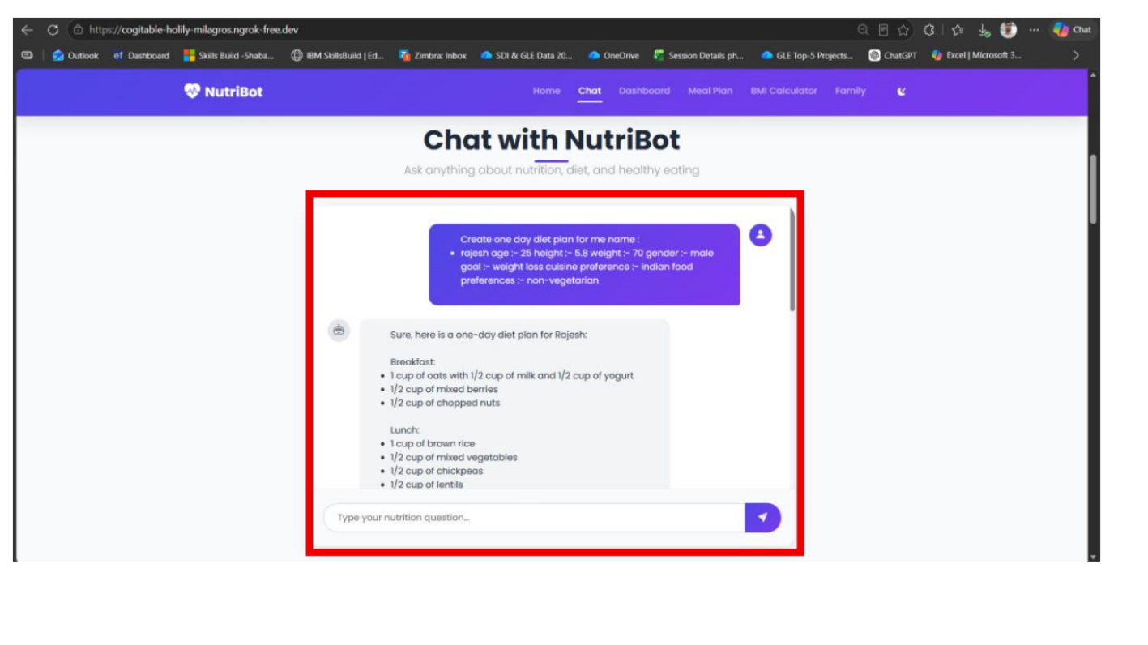
Project Output Screenshot
Please put IBM Bob output screenshots with 2-3 prompts.
You can take 2-3 more slides for each screenshot
·
·
·

Slide 15
Novelty and Uniqueness
Cultural Palate Integration:
Unlike Western-centric apps, our agent adapts recipes specifically to local culinary traditions (e.g., South Asian and regional cuisines) without breaking dietary goals.
Strict Safety Guardrails:
Built-in conditional safety checks block unauthorized medical diagnoses while ensuring absolute adherence to severe user food allergies.

Slide 16
Git Hub Link
https://github.com/gopalkrishna245/IBM-University-Engagement-Project-Submission.git
·
·
·

Slide 17
Future Scope
Cultural Palate Integration:
Unlike Western-centric apps, our agent adapts recipes specifically to local culinary traditions (e.g., South Asian and regional cuisines) without breaking dietary goals.
Strict Safety Guardrails:
Built-in conditional safety checks block unauthorized medical diagnoses while ensuring absolute adherence to severe user food allergies.
·
·
·

Slide 18
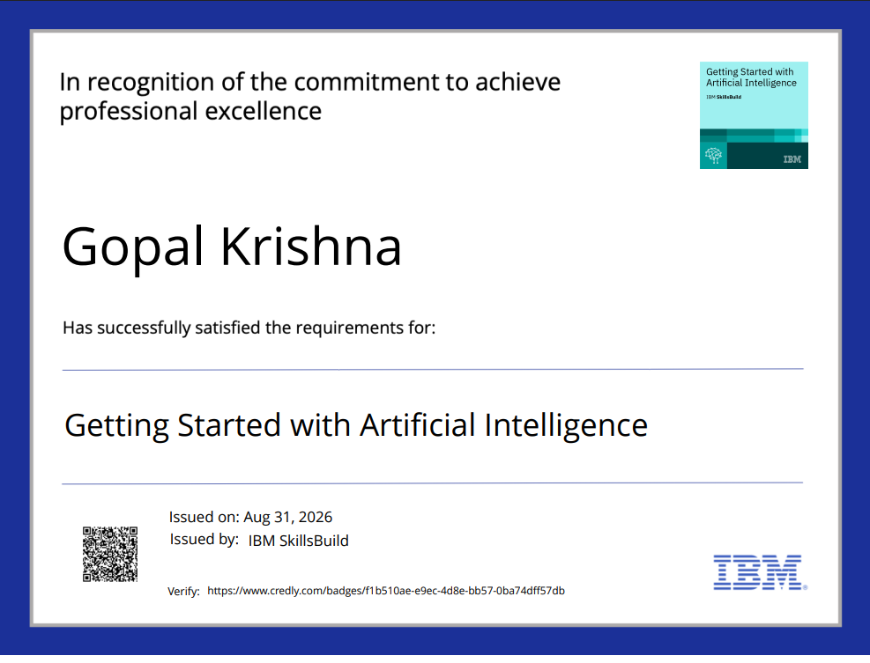
Certificates Earned:
Please add your credly certificate(Getting Started with Artificial Intelligence)

Slide 19
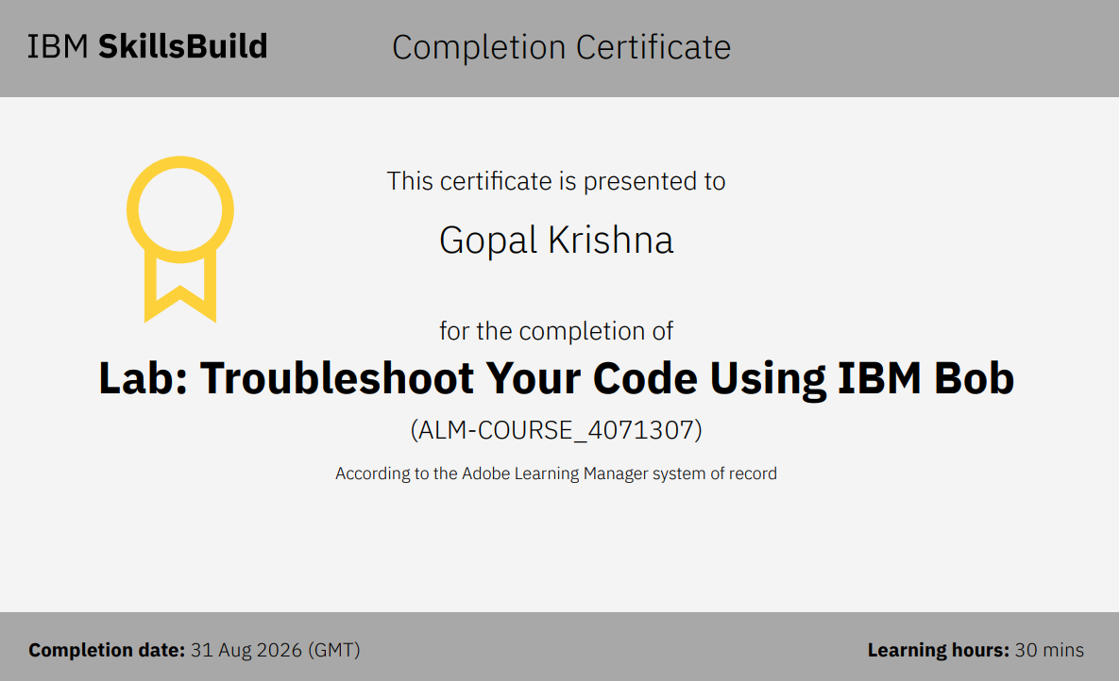
Certificates Earned:​
Add your IBM BOB Certificate

Slide 20


