Slide 1

Project Title -Seasonal Agriculture Performance Analysis
Name: Gopal Krishna
College: Bengal College Of Engineering And Technology
AICTE STU id: STU69ef438b5c6c21777288075

Slide 2

PROBLEM STATEMENT
Agricultural activities are influenced by seasonal variations in environmental conditions, farming practices, resource availability, and market conditions, causing agricultural performance to differ from one season to another. However, raw agricultural data does not clearly explain how agricultural performance changes across seasons or what patterns can be observed in different seasonal conditions. The problem is to analyse the given agricultural dataset and investigate seasonal differences in agricultural performance by identifying meaningful patterns, trends, relationships, and variations within the available data to support evidence-based agricultural planning and decision-making.

Slide 3
Project Description
Data Preparation: Clean and prepare raw datasets by handling missing values (via group-wise median imputation) and verifying data integrity.
Seasonal Comparison: Analyse how crop yields, operational costs, total revenues, and net profits vary across seasons such as Kharif, Rabi, and Zaid.
Environmental Correlation: Investigate relationships between environmental inputs—including rainfall, temperature, soil moisture, and nutrient levels—and agricultural outcomes.
Resource Efficiency Tracking: Evaluate resource utilization metrics, comparing water efficiency across various irrigation methods.

Slide 4
Key Insights and Outcomes
Yield & Profitability Disparities: The Kharif season records the highest average crop yields and profitability driven by monsoon support, while Zaid cycles frequently face negative average profit margins due to elevated input costs and reduced output.
Risk Factors: Pest and disease risks peak sharply during the Kharif season due to high ambient humidity and heavy rainfall patterns.
Resource Optimization: Drip irrigation consistently delivers superior water efficiency metrics compared to traditional flood methods.

Slide 5

WHO ARE THE END USERS?
Agricultural Students and Researchers: Students and academic learners exploring real-world data analytics problems, seasonal performance trends, and agricultural data modeling.
Farmers and Agricultural Practitioners: Growers who can utilize data-driven seasonal insights to optimize crop selection, manage input costs, and improve irrigation and pest management practices.
Agricultural Planners and Policymakers: Stakeholders and agricultural authorities who rely on evidence-based insights to support regional planning, resource allocation, and risk mitigation strategies.
Agribusiness and Farm Management Enterprises: Organizations that analyze seasonal performance, market pricing, and profitability metrics to guide commercial agricultural investments and operational decisions.

Slide 6

Technology Used
Python: The primary programming language utilized for data processing, statistical modeling, and analysis.
Google Colab: The cloud-based Jupyter notebook environment used to write, execute, and document the complete analytical workflow.
Pandas: Used for data manipulation, cleaning, missing value imputation, and structuring datasets.
NumPy: Employed for high-performance numerical computations and mathematical operations.
Matplotlib & Seaborn: Data visualization libraries utilized to generate descriptive plots, distribution histograms, seasonal comparison bar charts, and correlation heatmaps.

Slide 7
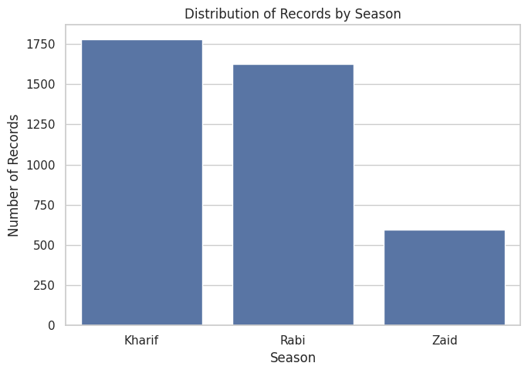
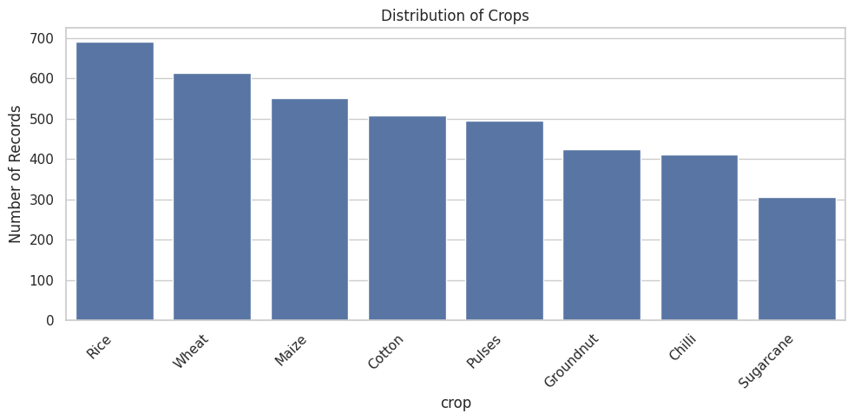
RESULTS

Slide 8
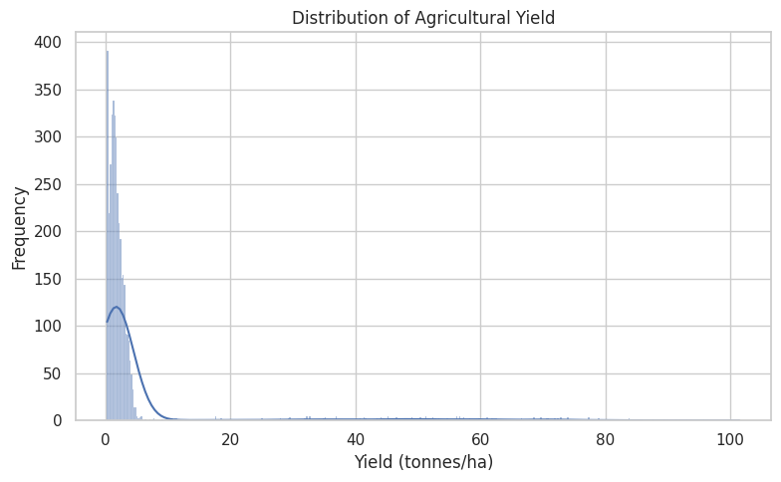
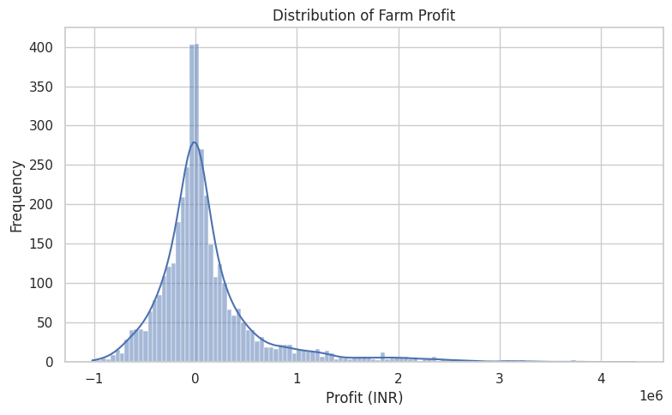
RESULTS

Slide 9
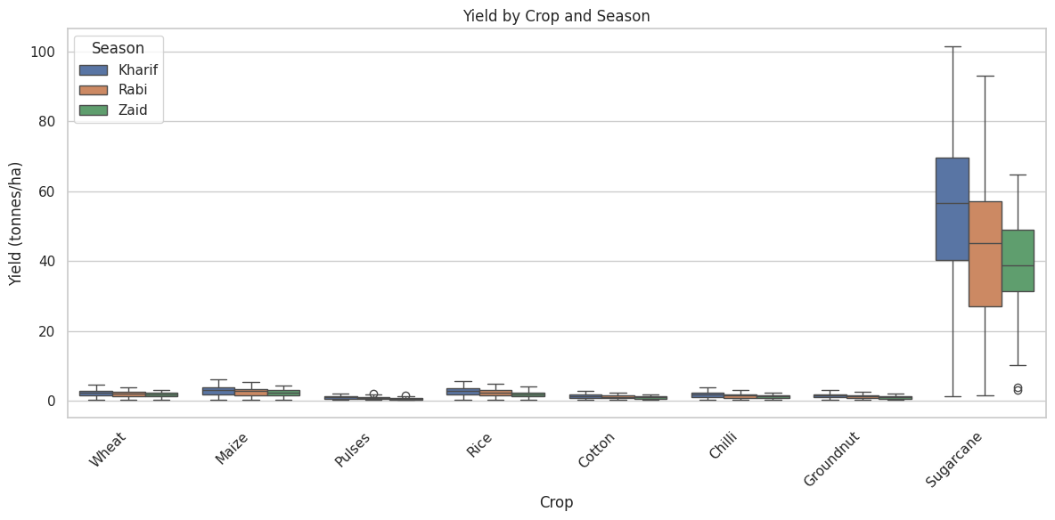
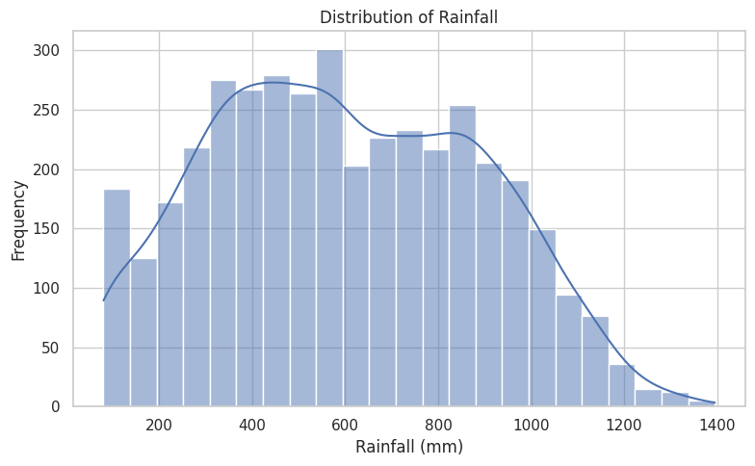
RESULTS

Slide 10
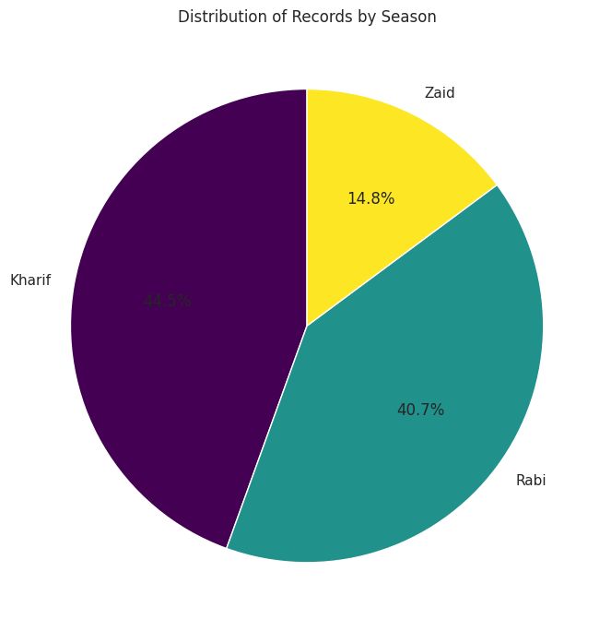
RESULTS

Slide 11
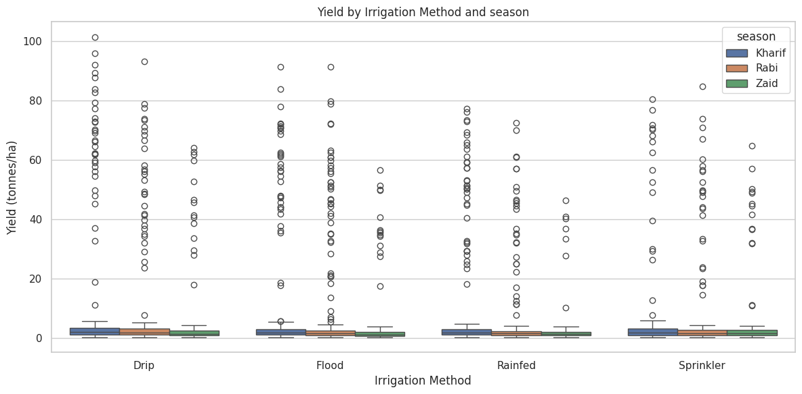
RESULTS

Slide 12
RESULTS

Slide 13
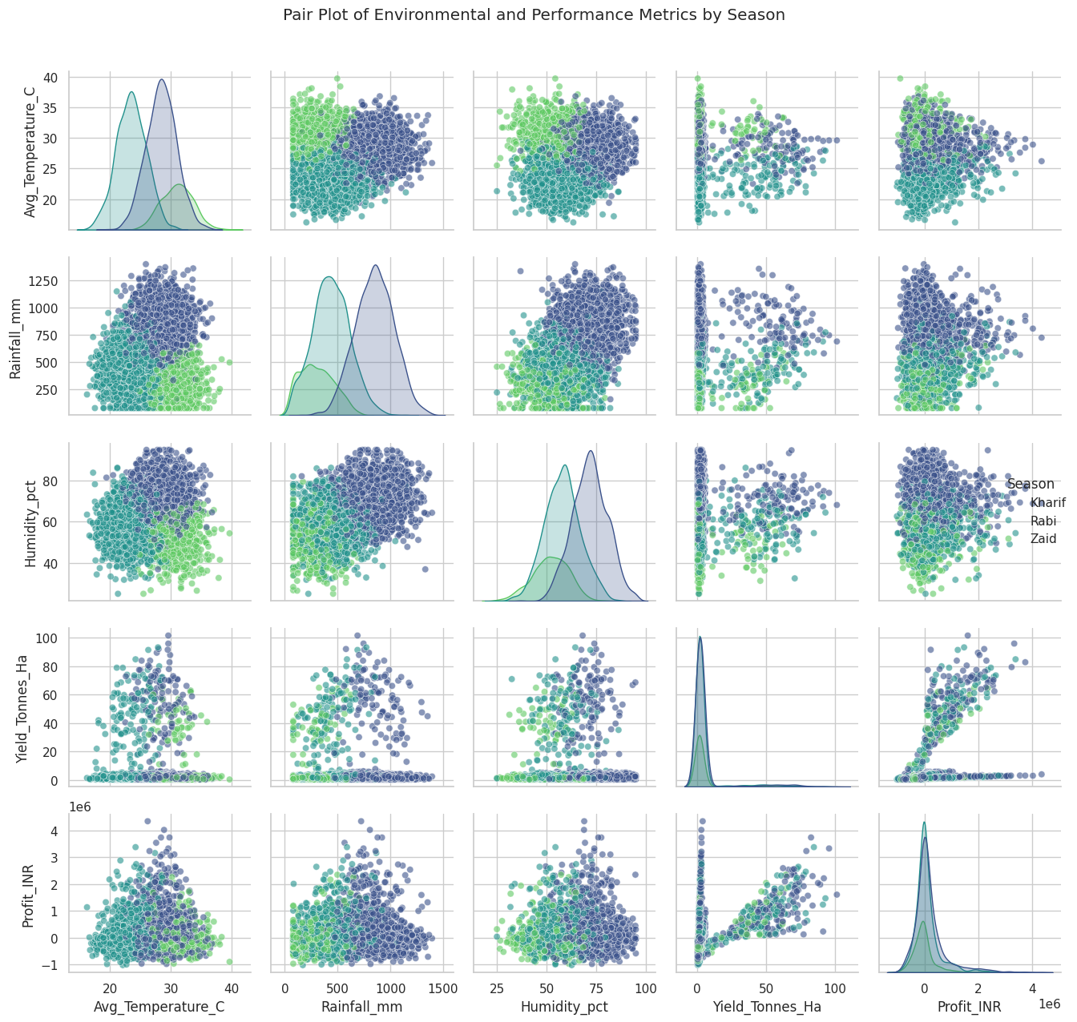
RESULTS

Slide 14
RESULTS

Slide 15
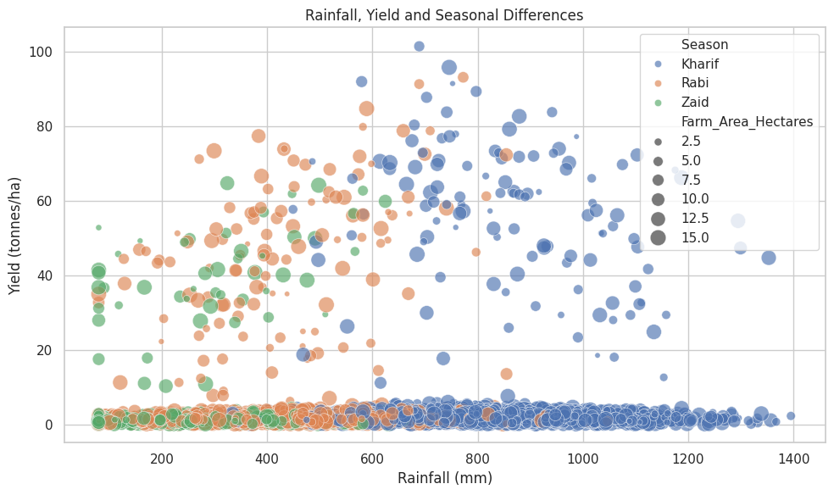
RESULTS

Slide 16
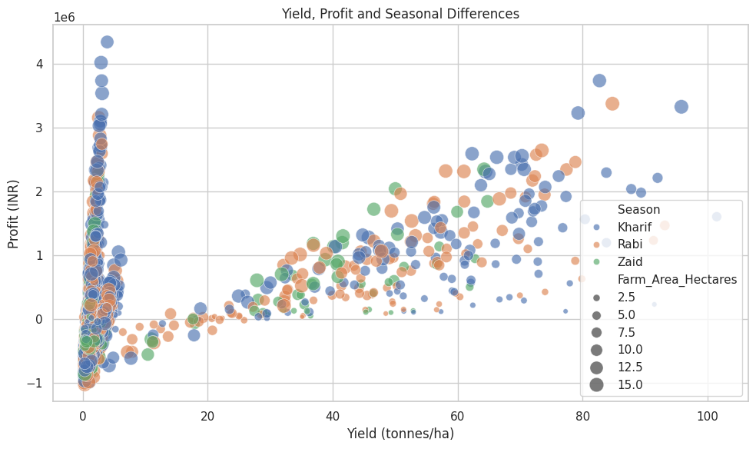
RESULTS
The scatter plot, titled "Yield, Profit and Seasonal Differences," visually depicts the relationships between agricultural yield (on the x-axis), farm profit (on the y-axis), and also incorporates season (through colour) and farm area (through the size of the points).

Slide 17
Future scope
The capabilities of the Seasonal Agriculture Performance Analysis project can be expanded from static analytics into a dynamic, production-ready decision-support system through several technical additions:
Predictive Machine Learning Modelling: Implement regression and ensemble algorithms (such as Random Forest, Boost, or Neural Networks) to accurately forecast future crop yields, market prices, and net profitability before planting begins.
Interactive Web Dashboard Deployment: Build an interactive user interface using frameworks like Streamlet, Dash, or Flask to allow farmers and stakeholders to input custom parameters and simulate seasonal outcomes dynamically.
IoT and Real-Time Weather Integration: Integrate live feeds from IoT soil sensors and real-time meteorological APIs to replace historical averages with live environmental data for instantaneous operational adjustments.
Geospatial & Satellite Imagery Mapping: Incorporate Geographic Information Systems (GIS) and remote sensing data (such as NDVI vegetation indices via Google Earth Engine) to track regional crop health at a micro-level.
Advanced Disease and Pest Risk Forecasting: Develop specialized classification models to predict precise pest outbreaks days in advance based on localized micro-climatic thresholds like humidity spikes and continuous rainfall patterns.

Slide 18
GitHub Link
https://github.com/gopalkrishna245/Seasonal_Agricultural_Perfomance_Analysis.git

Slide 19
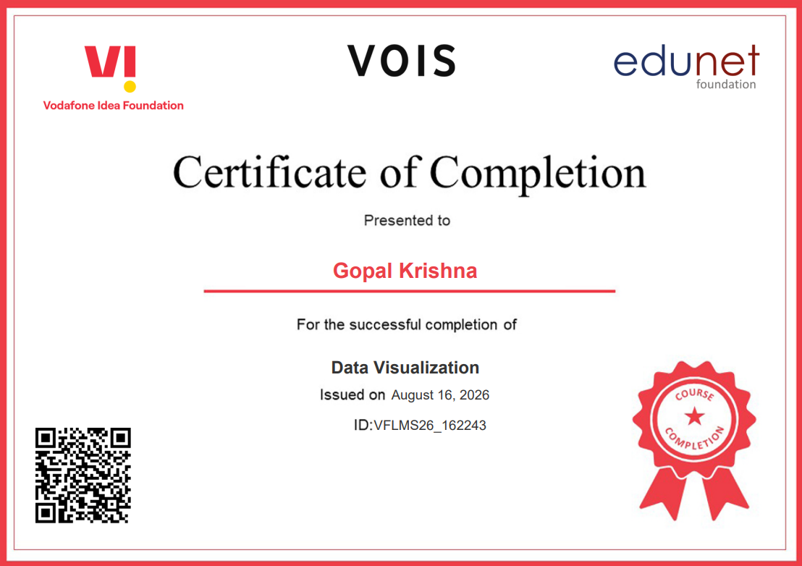
VOIS Course completion certificate - Course name- Data Visualization

Slide 20
Thank you
Email-gopal1892003@gmail.com
.
.

