Slide 1
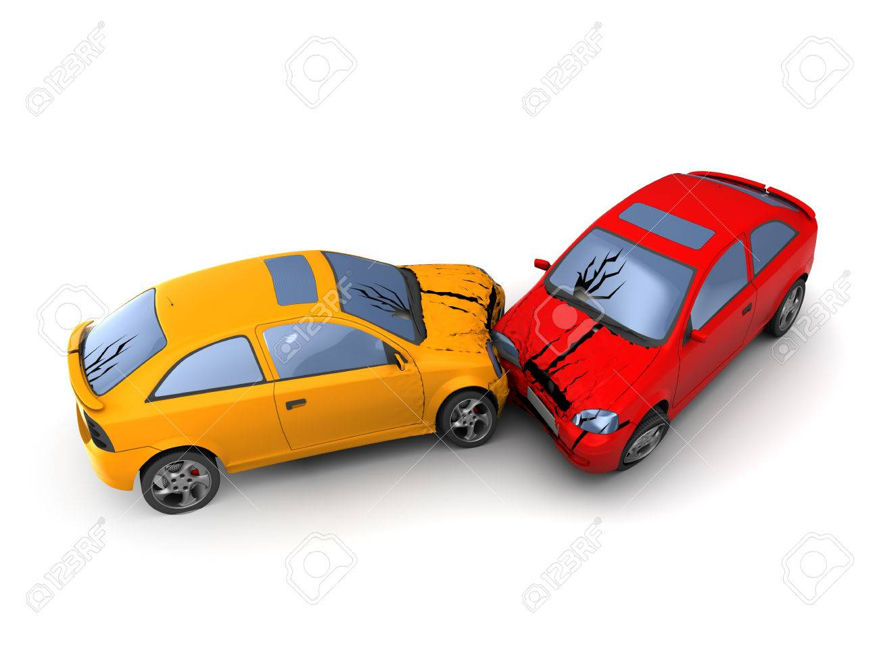
IINSTACC

Slide 2
AUTOMATIC VEHICLE ACCIDENT DETECTION”

Slide 3
1.WE CAN DETECT THE ACCIDENTS THROUGH SENSORS AND WE CAN SEND OUR LOCATION TO NEAR BY HOSIPATALS AND MAKE A CALL TO AMBULANCE 2.THE LOCATION OF THE CAR IS IDENTIFIED THROUGH THE GPS NETWORK

Slide 4
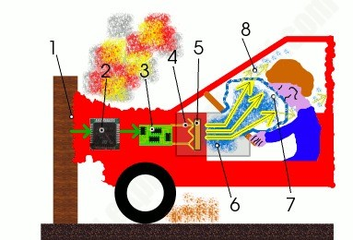
1.When a car hits something, it starts to decelerate (lose speed) very rapidly. 2.An accelerometer (electronic chip that measures acceleration or force) detects the change of speed. 3.If the deceleration is great enough, the accelerometer triggers the airbag circuit. 4.The airbag circuit passes an electric current through a heating. 5.The heating element ignites a chemical explosive. 6.As the explosive burns, it generates a massive amount of harmless gas that floods into a nylon bag packed behind the steering wheel. 7.As the bag expands, it blows the plastic cover off the steering wheel and inflates in front of the driver. 8.By the time the car stops, the bag should have completely deflated.

Slide 5

AUTO LOGIN PAGE

Slide 6
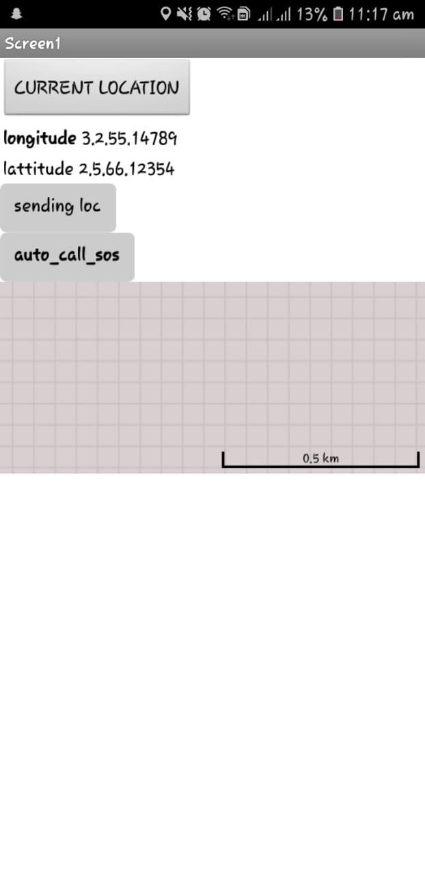
1. IT AUTO DETECTS THE GPS LOCATION WITH THE HELP OF LATTITUDES AND LONGITUDES. 2. AND SENDS THE USERS LOCATION TO THE NEARBY HOSPITALS. 3.AND MAKE A SOS SIGNAL TO EMERGENCY CONTROL ROOM.

Slide 7

FINALLY THE GPS LOCATION SHARED BY THE USER.

Slide 8
MAKE A CHANCE TO LIVE MORE BY INSTACCI

