Slide 1
Nexoraa
Turning Crisis into Action
By: Gopal Maurya

Slide 2
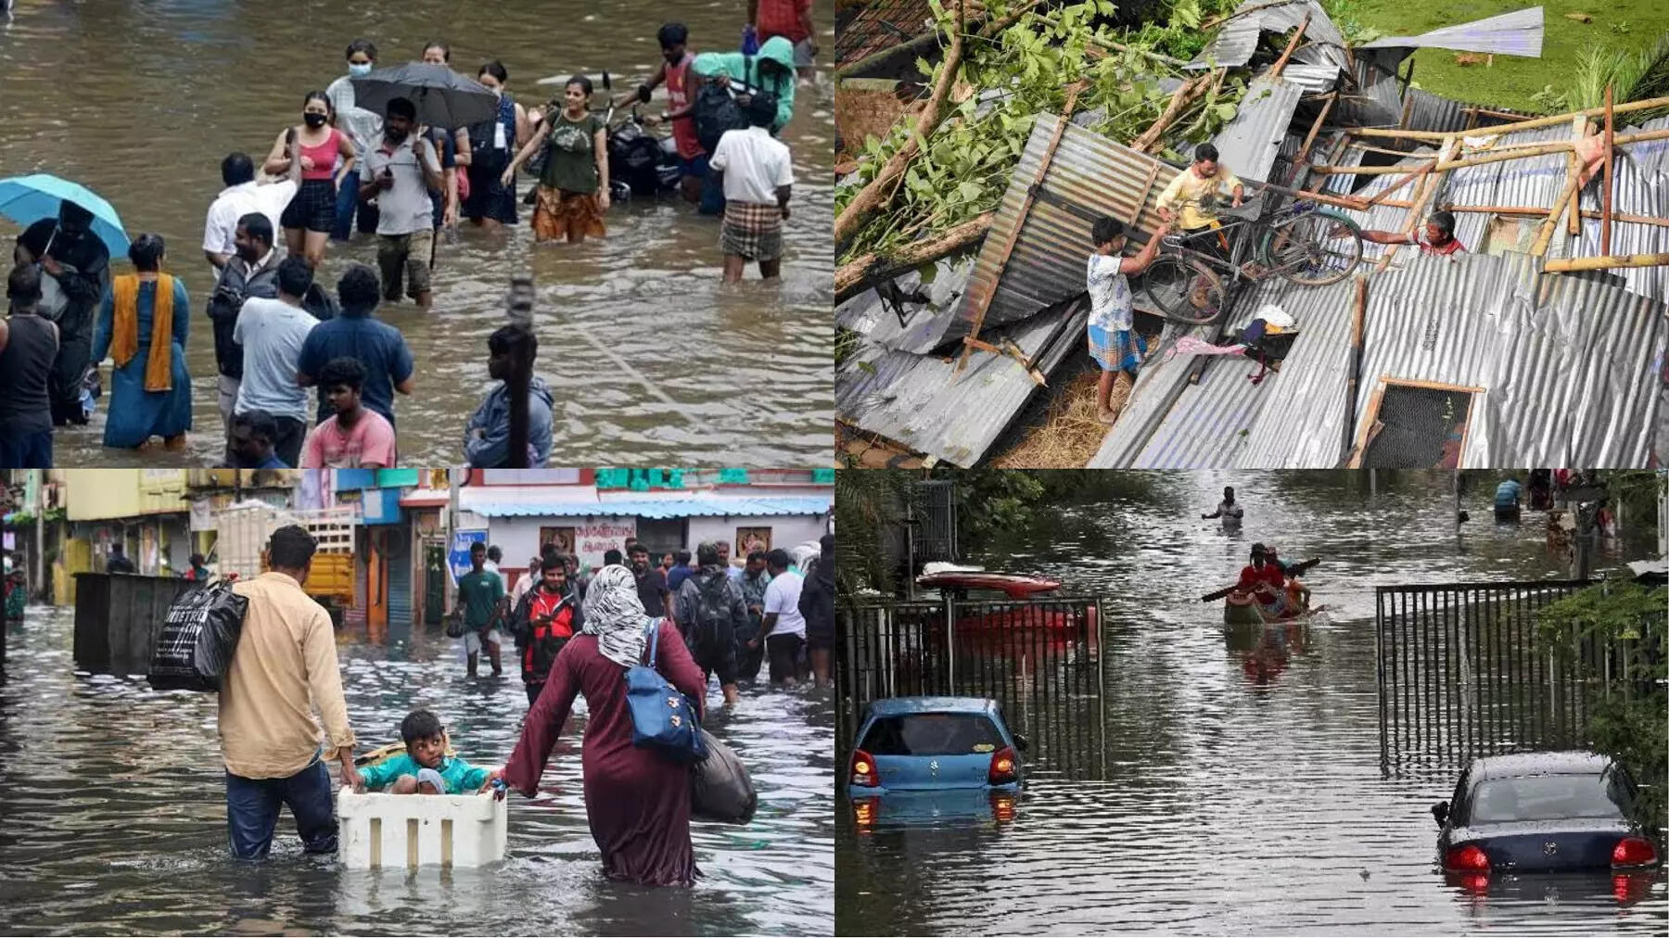
1. The Big Problem
• In a disaster, everyone posts on social media for help.
• Example: During the 2015 Chennai’s Flood, 100 crashed and Twitter was flooded with #ChennaiRainsHelp.
• Human rescue teams cannot read thousands of tweets fast enough.
• The result? People wait hours for help because their hope gets lost in the noise.

Slide 3
2. Our Simple AI Solution
What if a computer could read every message instantly?
How Nexoraa works in milliseconds:
1. Reads: Looks at the text (e.g., 'Need water in Surat!').
2. Understands: Knows that this is an urgent Food/Water need.
3. Maps: Instantly puts a red pin on a map right over their location.
https://nexora-1-bjh6.onrender.com/

Slide 4
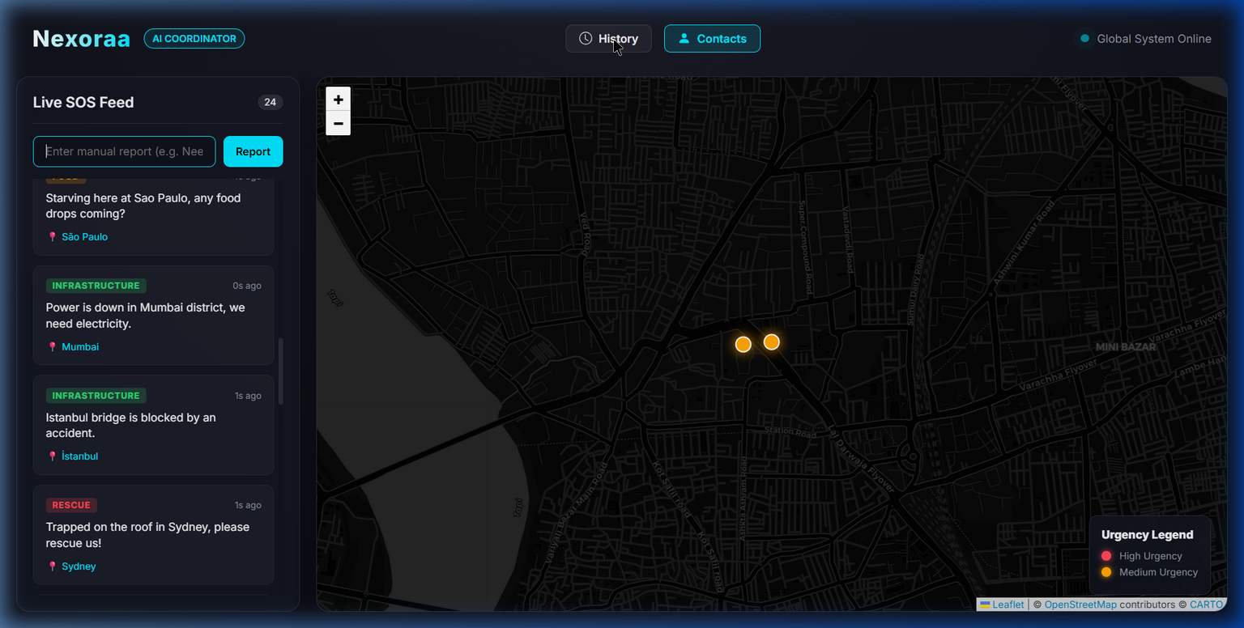
3. The Command Center
• Easy to use live dashboard.
• Automatically maps new pleas for help.
• Shows the exact place and type of emergency so teams just know where to drive.

Slide 5
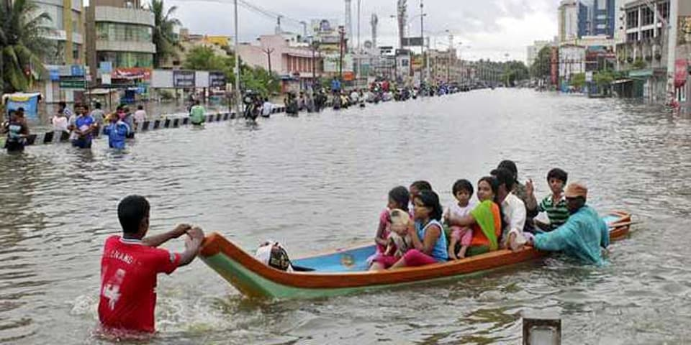
4. Why It Matters
• Saves Time: We cut down sorting time from hours to zero.
• Smart Dispatch: Rescue teams, boats, and ambulances are sent exactly where they are needed most.
• True Automation: The ultimate tool to guarantee no cry for help is ever ignored.

