Slide 1
The Data Science process
GE 3259: Applied geographical data science Gopal Penny

Slide 2
Learning objectives
Understand the key elements of data science:
Import, tidy, explore, communicate
Import tabular data from csv and excel files
Understand the key elements of grammar of graphics:
Apply the grammar of graphics to make visualizations with ggplot2

Slide 3
Key elements of data science
Import: load data into R from CSV or Excel files
Tidy: real-world data is often messy and must be cleaned prior to analysis
Understand
Transform: filter data for subsets, create new variables.
Visualize: essential for understanding the data and developing insights
Model: computational and statistical tools to analyze the data
Communicate: prepare & disseminate reports, blogs, etc.
R for Data Science The data science process (R for Data Science)

Slide 4
Import data to R
Importing data allows us to begin analysis
Data often available in csv or excel format
R has built-in functions for reading data, but these are slightly cumbersome
Instead, we will use functions from the readr (for csv) and readxl (for excel) packages

Slide 5
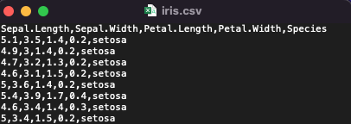
Import csv to R
Let’s say we want to import the following .csv file to R.
stuff

Slide 6
Data in Week 4 data/table_example.csv
Note that the file is in a subdirectory of the working directory:
list.files("Week 4 data")
## [1] "iris.csv" "iris.xlsx"

Slide 7
Import csv to R
We can import the .csv from using the readr and code below. Note that you may need to run install.packages('readr') if you haven’t already.
library(readr)
## Warning: package 'readr' was built under R version 4.0.5
table <- read_csv('Week 4 data/iris.csv') print(table)
## # A tibble: 150 × 5 ## Sepal.Length Sepal.Width Petal.Length Petal.Width Species ## <dbl> <dbl> <dbl> <dbl> <chr> ## 1 5.1 3.5 1.4 0.2 setosa ## 2 4.9 3 1.4 0.2 setosa ## 3 4.7 3.2 1.3 0.2 setosa ## 4 4.6 3.1 1.5 0.2 setosa ## 5 5 3.6 1.4 0.2 setosa ## 6 5.4 3.9 1.7 0.4 setosa ## 7 4.6 3.4 1.4 0.3 setosa ## 8 5 3.4 1.5 0.2 setosa ## 9 4.4 2.9 1.4 0.2 setosa ## 10 4.9 3.1 1.5 0.1 setosa ## # … with 140 more rows

Slide 8
Import excel to R
In excel format. stuff Data in Week 4 data/table_example.xlsx
Again, the file is in a subdirectory of the working directory:
list.files("Week 4 data")
## [1] "iris.csv" "iris.xlsx"

Slide 9
Import excel to R
We can import the .xlsx using the readxl package. You may need to run install.packages('readxl') if you haven’t already.
library(readxl) table_excel <- read_excel('Week 4 data/iris.xlsx') print(table_excel)
## # A tibble: 150 × 5 ## Sepal.Length Sepal.Width Petal.Length Petal.Width Species ## <dbl> <dbl> <dbl> <dbl> <chr> ## 1 5.1 3.5 1.4 0.2 setosa ## 2 4.9 3 1.4 0.2 setosa ## 3 4.7 3.2 1.3 0.2 setosa ## 4 4.6 3.1 1.5 0.2 setosa ## 5 5 3.6 1.4 0.2 setosa ## 6 5.4 3.9 1.7 0.4 setosa ## 7 4.6 3.4 1.4 0.3 setosa ## 8 5 3.4 1.5 0.2 setosa ## 9 4.4 2.9 1.4 0.2 setosa ## 10 4.9 3.1 1.5 0.1 setosa ## # … with 140 more rows

Slide 10
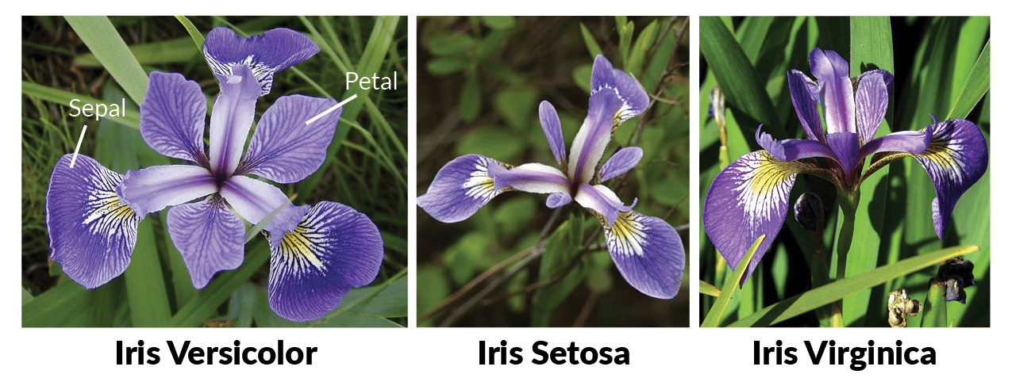
The iris dataset
The iris dataset (from previous slide) is common for code demonstrations. It documents properties of individual flowers from different species

Slide 11
Image from: https://www.datacamp.com/tutorial/machine-learning-in-r

Slide 12
Visualizing the data
Data visualization is an essential component of data science! We use visualization to:
Understand what is in the data set
Develop intuition for relationships in the data before we analyze it
Ensure our analyses are yielding reasonable results
Communicate important findings
When we get a new dataset, we should usually follow two critical steps:
Make sure we can import the data (import the data)
Make sure the data contain the information we expect (use summary() function)
Begin to visualize the data (either with ggplot or GGally, the latter of which we will cover later)

Slide 13
The iris dataset
summary(iris)
## Sepal.Length Sepal.Width Petal.Length Petal.Width ## Min. :4.300 Min. :2.000 Min. :1.000 Min. :0.100 ## 1st Qu.:5.100 1st Qu.:2.800 1st Qu.:1.600 1st Qu.:0.300 ## Median :5.800 Median :3.000 Median :4.350 Median :1.300 ## Mean :5.843 Mean :3.057 Mean :3.758 Mean :1.199 ## 3rd Qu.:6.400 3rd Qu.:3.300 3rd Qu.:5.100 3rd Qu.:1.800 ## Max. :7.900 Max. :4.400 Max. :6.900 Max. :2.500 ## Species ## setosa :50 ## versicolor:50 ## virginica :50 ## ## ##
From the summary output, we see that there are 4 columns of continuous variables and one column for a discrete variable. The dicrete variable has 3 categories each with 50 observations.

Slide 14
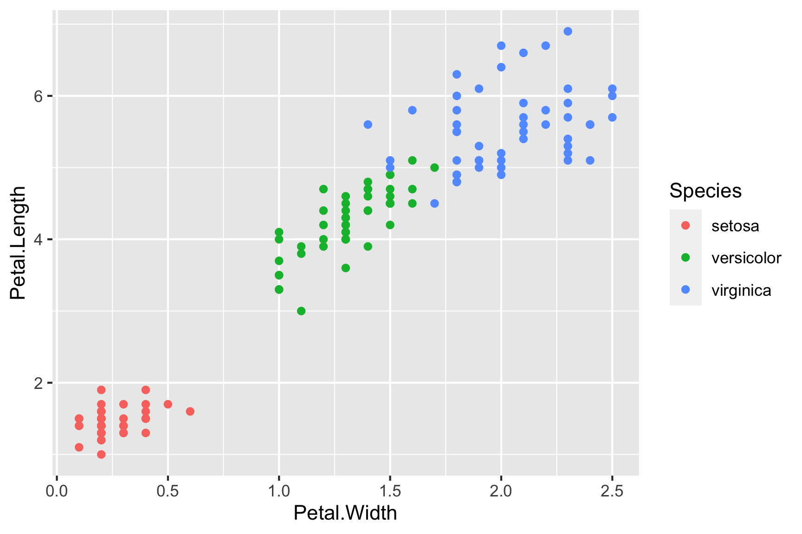
Visualizing the data
Next we want to visualize the data. For now we will consider only 2 variables, Petal.Length vs Petal.Width.
library(ggplot2) iris_plot = ggplot(data = iris) + geom_point(aes(x = Petal.Width, y = Petal.Length, color = Species)) iris_plot

Slide 15
–
Plots in R can be built via the Grammar of Graphics with ggplot
???
My first slide notes

Slide 16
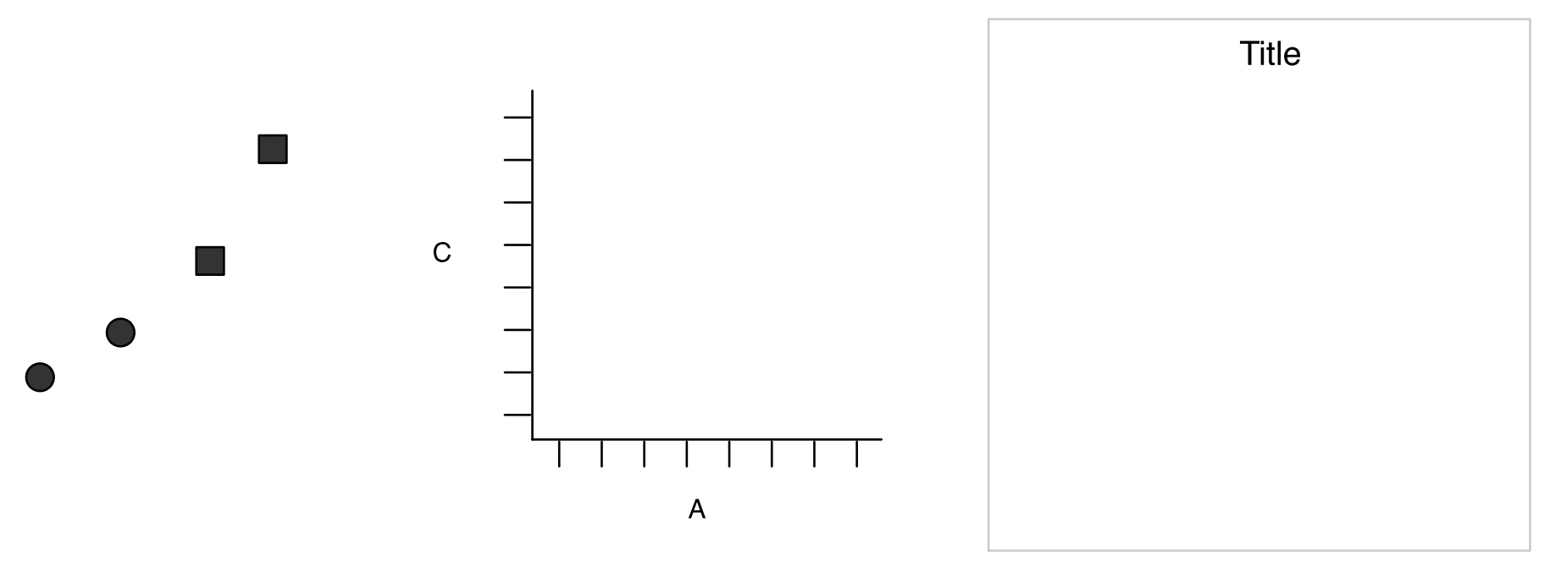
A grammar of graphics
Structured way to think about data visualization:

Slide 17
Graphics objects produced by:
(left) geometric objects - e.g., points, lines, bars
(middle) scales and coordinate system - scales can include shapes, colors, and other aesthetic mappings
(right) plot annotations.1
.footnote[[1] Wickham, 2010. A layered grammar of graphics.]
???
Different from most programming languages – e..g. scatterplot, barplot
Note the shape scale present on left

Slide 18
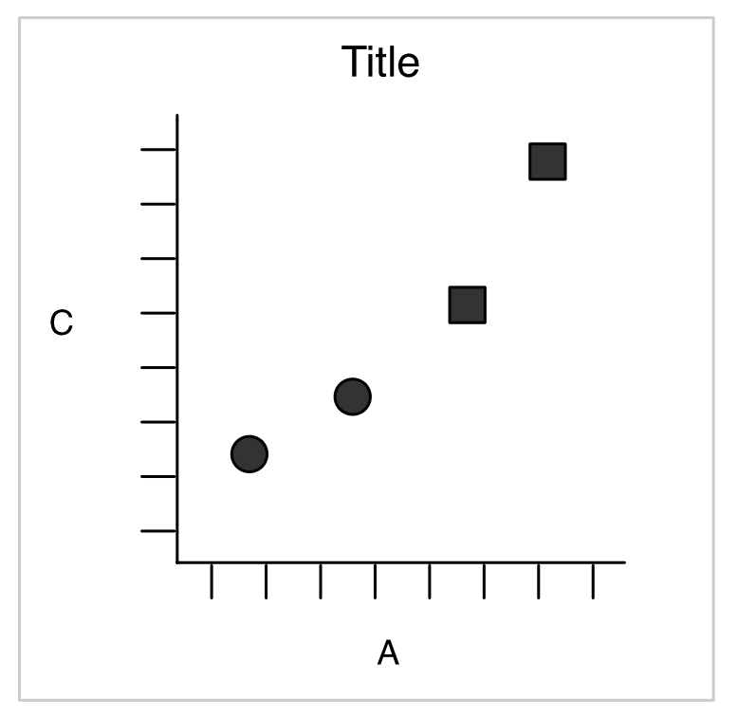
A grammar of graphics
Combining these elements produces the following figure:

Slide 19
The figure is created from the following dataset. Note that the geometric objects are points. The aesthetic mapping includes A and C columns mapped to the x-y coordinate system, and the Shape column mapped to the shape aesthetic.
## A C Shape ## 1 25 11 circle ## 2 0 0 circle ## 3 75 53 square ## 4 200 300 square
[1] Wickham, 2010. A layered grammar of graphics.

Slide 20
Plotting in R: ggplot2
In R, the ggplot2 package implements the Grammar of Graphics. We can see this via the same code as before.
library(ggplot2) iris_plot = ggplot(data = iris) + #<< geom_point(aes(x = Petal.Width, y = Petal.Length, color = Species))
We initialize the ggplot object with a default dataset, in this case iris (see highlighted code). Note that the line ends with a + which means that R will interpret the next line of text as a continuation of this line of code.

Slide 21
Plotting in R: ggplot2
In R, the ggplot2 package implements the Grammar of Graphics. We can see this via the same code as before.
library(ggplot2) iris_plot = ggplot(data = iris) + geom_point(aes(x = Petal.Width, y = Petal.Length, color = Species)) #<<
The next line builds the geometric objects, coordinate system, and aesthetics.
geom_point() means that our geometric objects will be points
The aes() function defines aesthetic mapping of columns to various scales (including the coordinate system):
x = Petal.Width indicates the column that will map to the x-axis
y = Petal.Length indicates the column that will map to the y-axis
color = Species indicates the column that will map to color scale

Slide 22
Another ggplot example
Give example of ggplot with timeseries data using geom_line, geom_point, shape scale, size scale.

Slide 23
Explain code in example
STUFF

Slide 24
Geometric objects in ggplot
(not exhaustive)
geom_point geom_line geom_bar geom_text geom_path geom_polygon geom_segment geom_ribbon
Note that each geometric type has the requirement that aesthetics map to the coordinate system. Usually this includes x-y aesthetics, but may also include, for example, label (geom_text), ymin and ymax (geom_ribbon), etc.

Slide 25
Aesthetic scales in ggplot
All aesthetics include a mapping (e.g. column A to shape) and a scale (which shapes correspond to which values).
The mapping is specified in the aes() function, either as a defult for the figure or within the specific geometric layer.
The scale can be taken as the default for the aesthetic and data type, or specified in a separate function.
x - scale_x_continuous, scale_x_discrete, scale_x_manual y - scale_y_continuous, scale_y_discrete, scale_y_manual color - scale_color_continuous, scale_color_discrete, scale_color_manual fill - scale_fill_continuous, scale_fill_discrete, scale_fill_manual size - scale_size_continuous, scale_size_discrete, scale_size_manual shape - scale_shape_discrete, scale_shape_manual linetype label (text) alpha (transparency)

Slide 26
Syntax of ggplot2
Note that because ggplot2 builds plots in a layered fashion, we can use a variety of syntax styles.
Here, we put the dataset inside the geom_point() object:
ggplot() + geom_point( data = iris, #<< aes(x = Petal.Width, y = Petal.Length, color = Species))
Alternatively, we can put the aes() object inside the ggplot() function to set default aesthetics:
ggplot(data = iris, aes(x = Petal.Width, y = Petal.Length, color = Species)) + #<< geom_point()
Each of these generates the same plot!

Slide 27
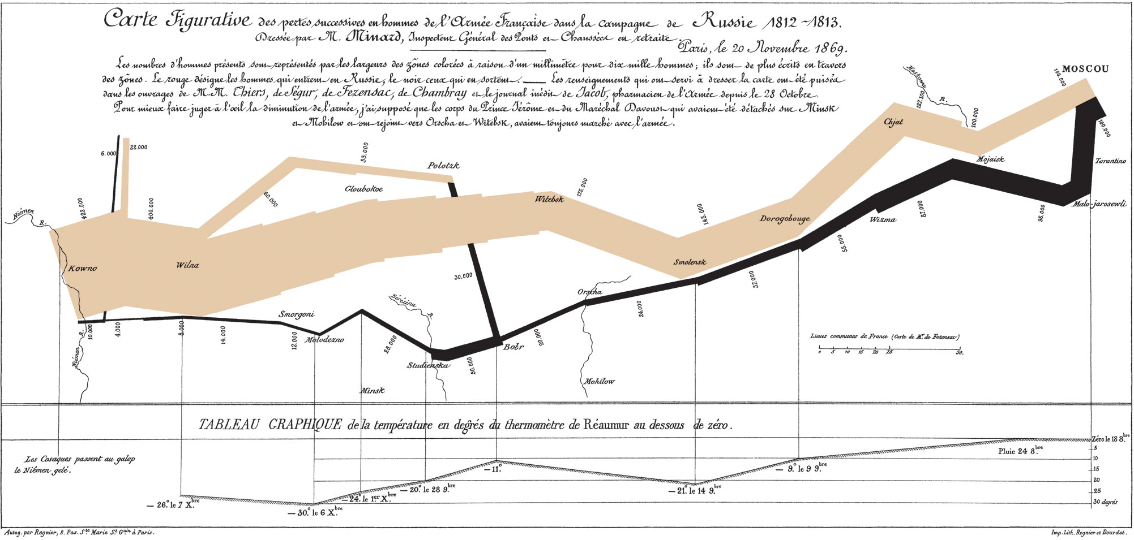
Napoleon’s march on Russia
Famous depiction of the march by Charles Joseph Minard.

Slide 28
???
Begin with 422k, end with 1k Cold temperatures - depictions & stories of men freezing on side of road Elegant and minimal

Slide 29
Napoleon’s march on Russia
We can reproduce a version of Minard’s map using ggplot. First we need the data, which is available online.
cities_url = "https://raw.githubusercontent.com/stdlib-js/datasets-minard-napoleons-march/main/data/cities.csv" cities = read_csv(cities_url) armies_url = "https://raw.githubusercontent.com/stdlib-js/datasets-minard-napoleons-march/main/data/army.csv" armies = read_csv(armies_url)
armies
## # A tibble: 48 × 5 ## lon lat size direction division ## <dbl> <dbl> <dbl> <chr> <dbl> ## 1 24 54.9 340000 A 1 ## 2 24.5 55 340000 A 1 ## 3 25.5 54.5 340000 A 1 ## 4 26 54.7 320000 A 1 ## 5 27 54.8 300000 A 1 ## 6 28 54.9 280000 A 1 ## 7 28.5 55 240000 A 1 ## 8 29 55.1 210000 A 1 ## 9 30 55.2 180000 A 1 ## 10 30.3 55.3 175000 A 1 ## # … with 38 more rows
cities[1:10,]
## # A tibble: 10 × 3 ## lon lat city ## <dbl> <dbl> <chr> ## 1 24 55 Kowno ## 2 25.3 54.7 Wilna ## 3 26.4 54.4 Smorgoni ## 4 26.8 54.3 Molodexno ## 5 27.7 55.2 Gloubokoe ## 6 27.6 53.9 Minsk ## 7 28.5 54.3 Studienska ## 8 28.7 55.5 Polotzk ## 9 29.2 54.4 Bobr ## 10 30.2 55.3 Witebsk

Slide 30
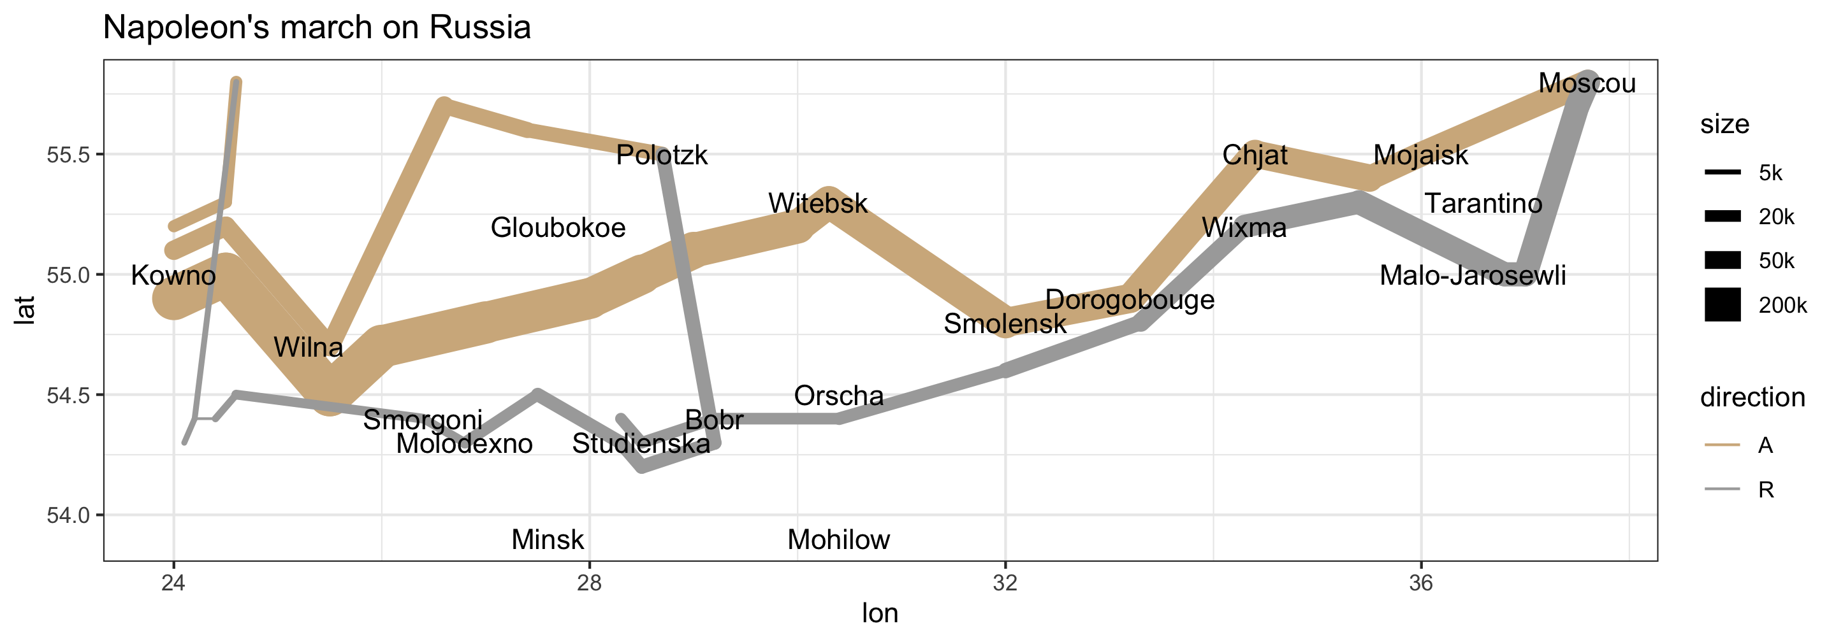
Napoleon’s march on Russia
ggplot(armies) + geom_path(aes(lon, lat, size = size, color = direction, group = division), lineend = 'round') + geom_text(data = cities, aes(x = lon, y = lat, label = city)) + scale_size_continuous(breaks = c(5e3, 2e4, 5e4, 2e5), labels = c("5k", "20k", "50k", "200k"), range = c(0.5, 8)) + scale_color_manual(values = c("tan", 'darkgray')) + ggtitle("Napoleon's march on Russia") + theme_bw()

Slide 31
Specifiying the legend scale for size
scale_size_continuous includes the following key arguments:
breaks indicate which sizes should be shown
labels provide the text for each of the breaks
range controls the actual size of the linewidth

Slide 32
Outline of remaining slides
Additional timeseries dataset
long format data
scale_size_*
scale_color_*, scale_fill_*
scale_linetype_*
scale_x_*, scale_y_*
scale_shape_*
geom_bar
geom_line
geom_text
facet_wrap
theme
In-class activity - plotting data

