Slide 1

Uber Supply Demand Gap CaseStudy

Slide 2
Business Understanding
Problem Statement :
Driver Cancellations and Non-Availability of cabs to and from Airport leading to loss of potential revenue.
Objective :
To identify the Supply-Demand gap in cabs from Airport to City and vice versa.
Goal For Analysis :
•Find out the gap between supply and demand and show the same using plots.
Find the types of requests (city-airport or airport-city) for which the gap is the most severe in the identified time slots.
What might be the reason for this supply-demand gap?
Recommend some ways to improve the supply-demand gap.

Slide 3
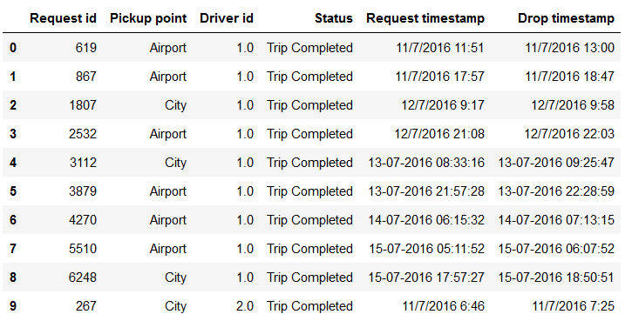
Data Cleaning and Manipulation
Data set contains 6 columns:
Request.id
Pickup.point
Driver.id
Status
Request.timestamp
Drop.timestamp
Other Issues:
Request time stamp is object here. Convert it to date
time format.
2. Dates are separated by “/” and “-”. Make this
consistent for ease of data analysis.
Possible data inconsistencies:
Duplicate values of Request ID
NA values in the columns of interest

Slide 4
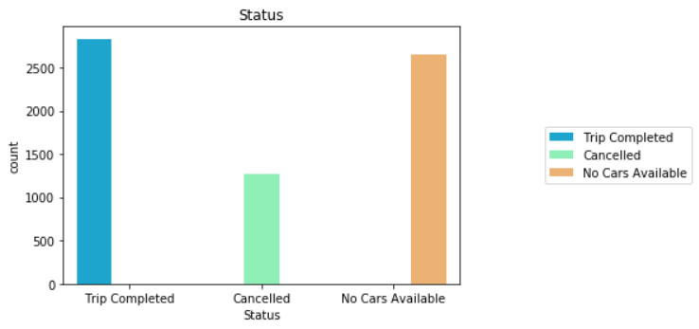
Analysing Trends For Completion of Trips
We can clearly see from this plot that Uber is losing quite a lot of business due to shortage of available Cabs.
Univariate Analysis :
No cars available is more than
the number of trips cancelled.
The question that surfaces now is that what is the Status of Completion for different days in the week ?

Slide 5
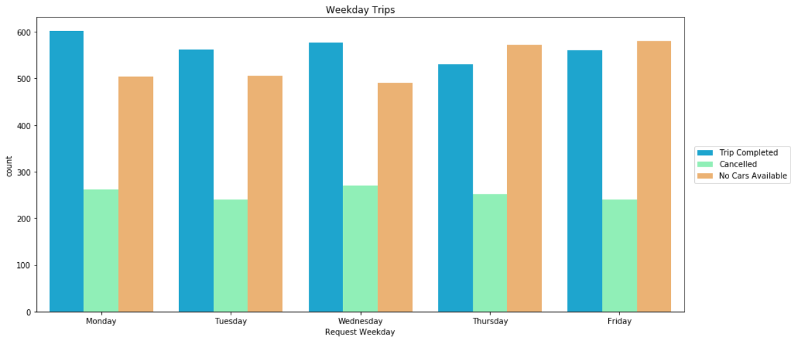
Analysing Trends For Week Days
The Pattern shows highest trips completed on Monday among weekdays.
In the Pattern the Number Of Cars
unavailable is highest on Friday among all days .

Slide 6
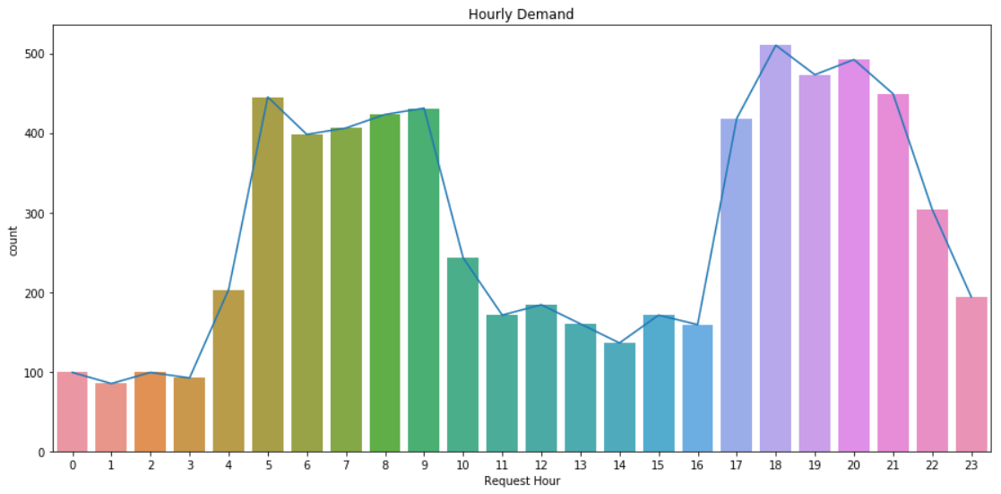
Combining Data For Hour Demand Analysis
Conclusion:
The number of requests can be clubbed together for analysis. Looks like the peak hours for cab requests lie between 5AM to 9AM and between 5PM to 9PM.

Slide 7
Binning Time Into 5 Categories
Requests generated are divided into 5 homogenous categories based on the time of request
Time
Category
12 AM – 5 AM
Pre_Morning
5 AM – 10 AM Morning_Rush
10 AM – 5 PM Day_Time
5 PM – 10 PM Evening_Rush
10 PM – 12 AM Late_Night

Slide 8
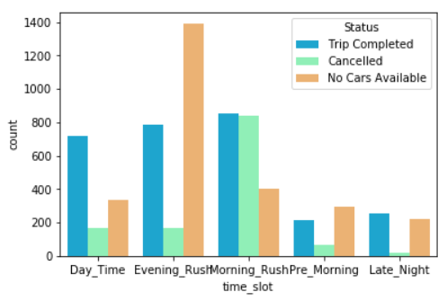
Analysing Trends For Hour Request
Graph clearly shows that the major problems are:
Cancelled trips during the morning rush
Unavailability of cars during evening rush

Slide 9
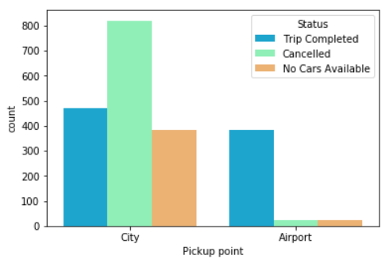
Morning Hour Analysis For Supply Demand Gap
CONCLUSION :
Number of cabs cancelled is high during early morning (3AM-7AM) and morning (7AM-12:00PM)
There is a high demand of cabs from City to Airport in the Early Morning and Morning hours.
95% of cabs Cancelled are from city pickup point .
Reason of high cancellation:
1) The median of duration of the journey is high from city in this time slot.
2) More Outbound flights in the Early Morning and Morning. Hence more customers going to Airport and less customers coming to City.
City Morning Cab Requirement from city to Airport is 1677
City Morning Trip Completed is 472
City Trip Cancelled is 820
Cab Unavailability is 385

Slide 10
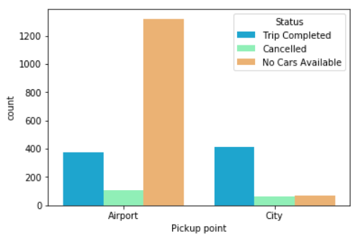
Evening Hour Analysis For Supply Demand Gap
CONCLUSION :
No cars available is high during evening time (4PM-8PM)
There is a high demand of cabs from Airport to City in the
late evening and night hours.
95% of cabs not available are from airport pickup point.
Reason of high cancellation:
More Inbound flights in the Late Evening and Night . Hence more customers coming to City and less customers going to Airport
Since no cabs have reached to the airport earlier from the city ( due to high cancellation) & the supply of the cab is much lower than the demand.
Airport Evening Cab Requirement is 1800
Airport Evening Trip Completed is 373
Airport Trip Cancelled is 106
Cab Unavailability at Airport is 1321

Slide 11
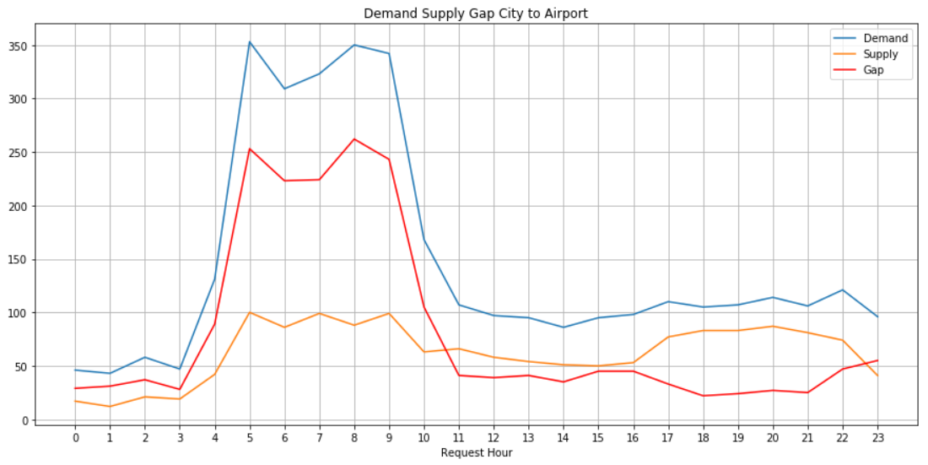
Supply Demand Gap Per Hour for City to Airport
City to Airport (Early Morning & Morning):
High Demand
Low Supply
Cabs denying services as not enough demand from Airport to meet the influx of cabs
Also not enough cabs to meet the demand
City to Airport Supply Demand Gap Curve

Slide 12
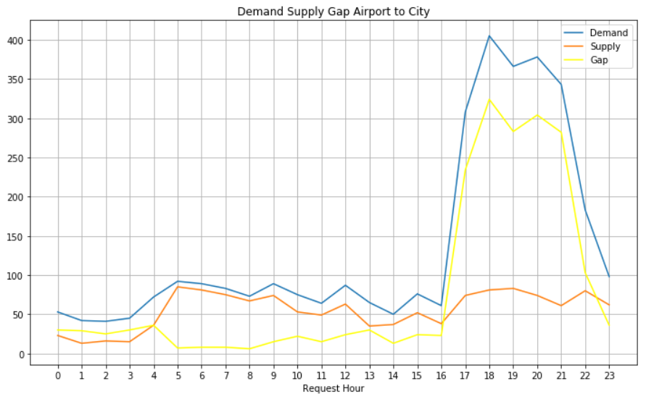
Supply Demand Gap Per Hour from Airport to City
Airport to City (Late Evening and Night) :
High Demand
Low Supply
Not enough cabs go towards Airport to meet the demands
Airport to City Supply Demand Gap Curve

Slide 13
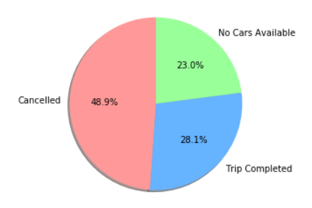
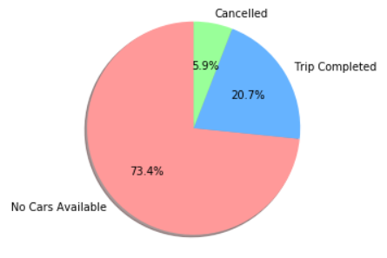
Conclusion :
What is the reason for this supply-demand gap?
The flow of traffic is one-directional due to flight timings.
Early Morning and Morning:
High demand from City, but low demand from Airport. Hence it’s risky/less opportunity for drivers to get return trip to City and the trips are cancelled.
High morning traffic due to office and schools results in high median of travel time to the airport.
Low airport pickup demand results in high wait time at the airport.
Morning Trip
Evening Trip
Late Evening and Night :
High demand from Airport but not enough cars around as less number of cars go towards airport in evening.
Lesser cabs reaching airport by evening results in low supply at increased demand time slot

Slide 14
Recommendations
For the trips in the morning, drivers can be encouraged to make the trips:
They could be given a bonus for each trip they complete from the city to the airport in the morning rush. This will ensure that less number of trips are cancelled.
Uber can pay for the gas mileage of drivers to come back to the city without a ride.
Drivers staying near the airport would have higher incentive to take the trips. More such drivers can be hired.
For the evening, since the number of drivers is less, some of the ways are:
Drivers can again be given a bonus to complete a trip from the airport in the evening. This will ensure that the supply increases at the airport.
Uber can also pay drivers to come without a passenger to the airport
Another innovative way can be to pool the rides of passengers so that lesser number of cars can serve more passengers.

