Slide 1
AI-Enabled Product Recommendation Dashboard using Streamlit
Technical, academic overview of a 4-milestone internship-ready project that builds an interactive recommendation dashboard for e-commerce using Python and Streamlit.

Slide 2

Milestone 1 — Definition s Planning
1 2
3
Project Title
AI-Enabled Product Recommendation Dashboard using Streamlit
Problem Statement
Manual recommendations are time-consuming, inconsistent, and scale poorly for large catalogs.
Objectives
Deliver interactive, scalable recommendations with intuitive UI for evaluators and non- technical users.
4
Real-World Application
E-commerce product discovery and personalized browsing.

Slide 3
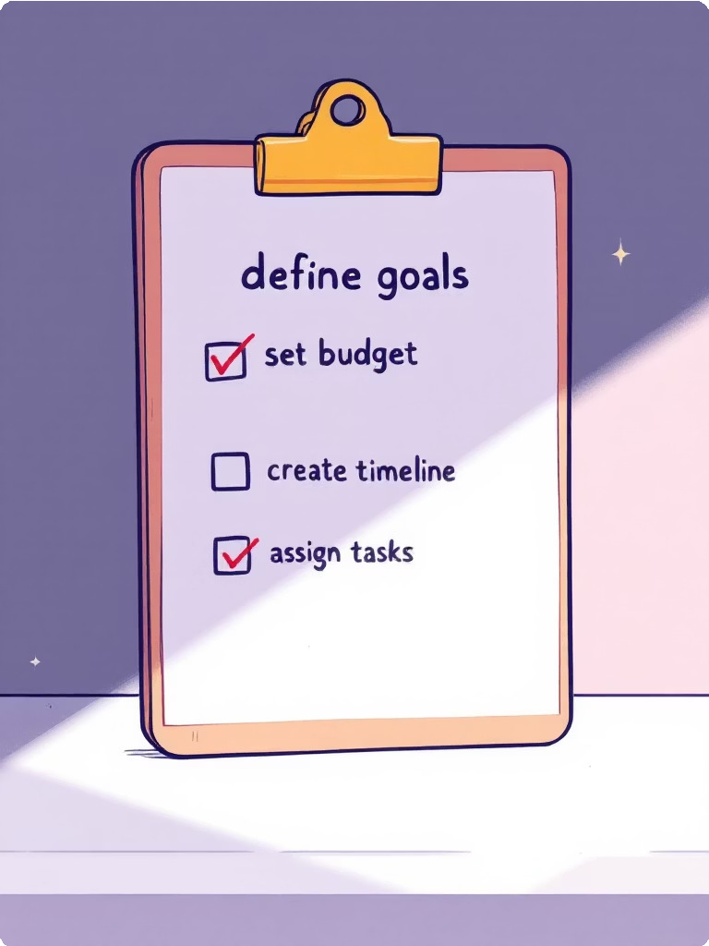
Scops s Rsquirsmsnts
Scope
Interactive dashboard, recommendations, filtering, visual analytics for 1,000 products.
Functional Requirements
Category selection, top recommendations, interactive charts, CSV import.
Non-Functional
Responsive Streamlit UI, fast filtering, reproducible pipeline.
Project Workflow
Define → Prep data → Build modules → Evaluate → Document

Slide 4







Milestone 2 — Dataset Overview
Dataset: 1,000 product records. Source: CSV (sample academic dataset). Key features listed below.
Product ID
Unique identifier for each product.
Product Name s Category
Descriptive name and category label for grouping.
Price
Retail price used for revenue calculations.
Rating s Sales Count
User rating and sales volume — key signals for ranking.
Discount s Revenue
Discount percent and computed revenue per product.
Purchase Date
Transaction date for temporal analysis.

Slide 5
Sample Data s Preprocessing
Produc Product t ID Name |  | Catego ry | Pric Rati e ng
P001 | Wireless Headphones | Electro nics | 79.9 9 | 4.5
P002 P003 | Stainless Water Bottle | Home | 19.9 9 | 4.2 4.6
 | Running Shoes | Sports | 129. 99
Preprocessing Steps
Load CSV with pandas
Handle missing values (impute/drop)
Convert types (dates, numerics) Filter, sort, compute revenue Prepare features for ranking

Slide 6
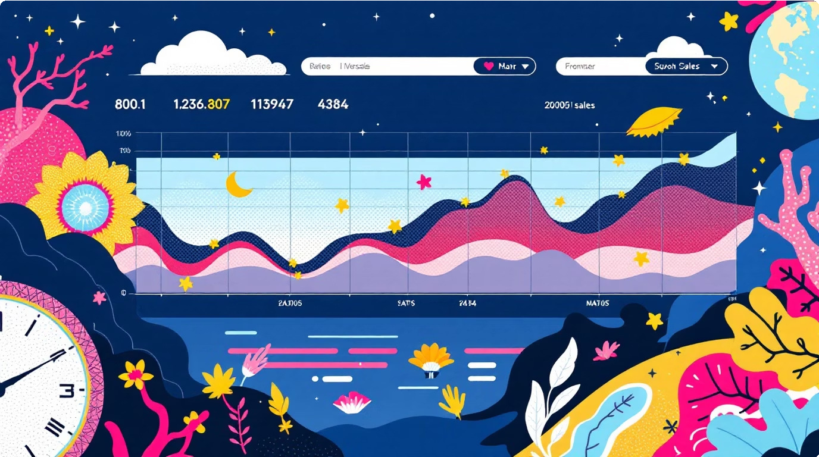
Milestone 2 — Exploratory Data Analysis
Insights: category-wise distribution, rating vs sales trends, and top revenue-generating categories. Use interactive charts (Plotly) to explore patterns and seasonality.
Count
200
150
100
50
Electronics
Home
Sports Category
Fashion
Beauty
0

Slide 7

Milestone 3 — System Design s Implementation
Streamlit Dashboard
UI with charts and filters
CSV Dataset
Raw item and user data
System Architectur e Overview
Recommendatio n Engine
Content-based & category-ranking
Preprocessing
Cleaning, normalization, feature extraction
The architecture connects data ingestion, preprocessing modules, recommendation logic, visualization, and the Streamlit UI for interactive exploration.

Slide 8
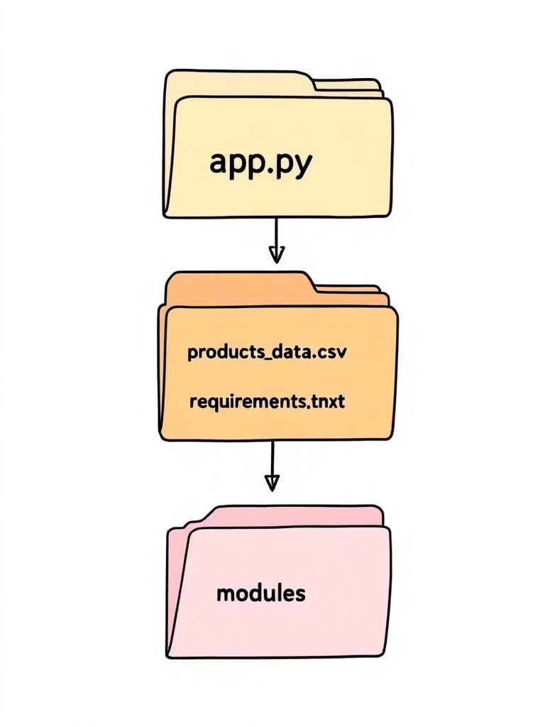
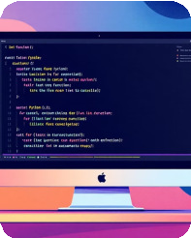

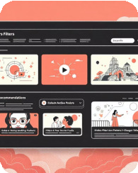
Implementation Details s Recommendation Logic
Modules
Data loading, filtering, recommendatio n logic, visualization.
Recommend ation Logic
Content-based filtering using product attributes; category-based recommendatio ns; ranking by rating and sales.
UI
Category selector, top-N recommendatio ns, interactive charts and tables (Plotly + Streamlit).

Slide 9
Milestone 4 — Results, Evaluation s Next Steps
Dashboard Features
Category selection, top product recommendations, interactive charts, and exportable tables.
Evaluation
Logic-based checks: relevance by category, ranking by rating/sales; qualitative validation via screenshots.
Limitations
No collaborative filtering yet; limited to available product attributes; evaluation is heuristic-based.
Future Enhancements
Integrate collaborative filtering & ML models, user behavior tracking, cloud deployment, A/B testing for recommendations.
Conclusion s References
Streamlit dashboard demonstrates a reproducible, interactive prototype for academic evaluation. References: dataset source, libraries (Pandas, NumPy, Plotly, Streamlit).

Slide 10


